Slide 1
India-California Air Pollution Mitigation Program (ICAMP)
Knowledge Action Plan
Technology
R. Harnish, A. Bandivadekar, A. Aggarwal, M. Waugh,
J. Kubsh, N. Iyer, S. Yeh.

Slide 2
Questions
Which vehicle types contribute most to different pollutants ?
Which technologies are required to reduce emissions of particular pollutants ?
What fuel quality for efficient working of the technologies ?
What I&M systems are required to maintain the performance ?

Slide 3
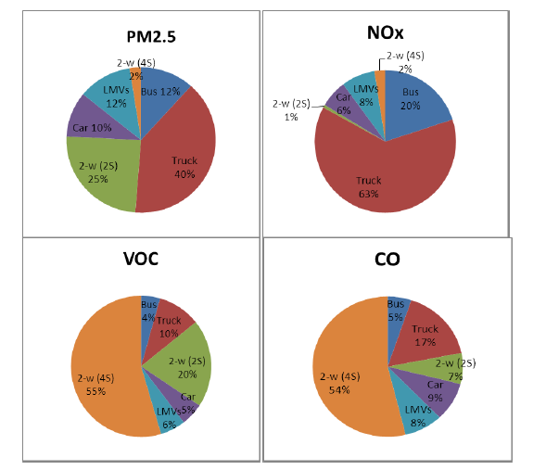
Answer 1
Diesel driven (Trucks, Buses, Cras)
PM, NOx
Gasoline (Cars, 2/3 wheelers)
CO, HC

Slide 4
Answer 2
Engine modifications and combustion process improvements led to reduction of emissions from BS-I to IV
Tail-pipe treatment control will now also be required
Technologies are available : Diesel particulate filters, Selective catalytic reduction, Exhaust gas recirculation etc

Slide 5
Answer 3
Fuel quality needs improvement for efficient working of tail-pipe treatment devices
E.g. at 50 ppm ‘S’ in diesel, the efficiency of DPF could be much lower than at 10 ppm.

Slide 6
Answer 4
Inspection and Maintenance systems to be strengthened
To reduce emissions from in-use vehicles
To check the high emitters
To ensure efficient functioning of tail-pipe devices
To ensure compliance of Type Approval norms

Slide 7
Fuel
Differentiated dual fuel policy – neither good for people nor for vehicles
No road map after 2010
Reach of gaseous fuels is limited
Delay in implementing the supply of ultra-low-sulfur fuels
Significant refinery investments needed to transition to ULSFs in India (a few % of the present fuel price per litre)
Hart Energy and MathPro found the refinery investments needed to transition to ULSFs in India to be around $4.2 billion (~25 k crores)
The California experience is that the cost-per-gallon to meet the lower diesel fuel sulfur requirements is about 2.5 cents per gallon.
Few extra months of on-going diesel price increase will do.

Slide 8
Fuel
Europe, the United States, and Japan implemented low-sulfur fuels years ago
Developing countries like China, South Africa, Mexico, and Brazil have plans to reduce fuel sulfur levels in the near future
Current plan : 50-ppm sulfur fuel to about 60 cities by 2015
Limited benefit: More than 600 Class I-VI cities. Vehicle sales dispersed away from large urban centers.
Trucks—which are the largest emitters of NOx and PM—still on BS-III ?

Slide 9
Vehicles
Several technology options for emission control
combustion research,
fuel systems,
air-handling systems,
controls and after-treatment
DOC, DPF, EGR, lean NOx catalysts, SCR etc
Important to develop the right technology for each application and market served.
Different operating conditions and economic factors can and do influence the technology path which is most appropriate
Involvement of original equipment manufacturers as early as possible in the development and integration process., not only a call for research, but for close collaboration.

Slide 10
2/3 wheelers
Two and three wheeled vehicles produce roughly 40% of PM2.5, 40% of CO and 70% of VOC.
Gradual shift from two-stroke to less polluting four-stroke engines
Share of 2-stroke engines is 6% of the total powered 2-w sales
Shift to four-stroke engines for 3-w not the same as in case of 2-w vehicles.
Application of air-assisted fuel injection can help to reduce PM emissions to the levels of four-stroke engines.
Air Assisted Direct Injection employed on 2-stroke engines can also reduce fuel consumption significantly, say 25 to 30%.
No standards for evaporative emissions. It is now proposed to introduce a limit of 2g/test along with the next set of mass emission standards.

Slide 11
In-use vehicle management
The emission control of inuse vehicles is largely based on periodic vehicle inspection namely pollution under control (PUC )testing.
The periodicity of PUC testing varies form 4 times a year to once a year depending on the State concerned.
PUC is based on idle testing intended to identify heavy polluters is totally ineffective
inadequate compliance,
poor quality of testing due to non-calibrated equipment, and untrained operators
The Type Approval and COP (conformity of production) testing should be backed up by a recall policy.
Significant investments in Inspection and Maintenance (I&M) facilities required

Slide 12
Diesel Stationery Engines
Diesel generators are an important source of diesel emissions in India (as are agricultural tractors).
There are PM standards for diesel generators and currently those are in the process of being tightened.
Standards for diesel generators will be at Euro IIIA or US Tier 3 off-road diesel engine emission norms. This can be achieved with 50 ppm sulfur diesel, but will not require DPFs.
The US and Europe are implementing Tier 4/Stage IV off-road emission standards by another 90%. This requires ultra-low sulfur diesel (10-15ppm).
Shakti Sustainable Energy Foundation’s study reinforced the need to go to low sulfur fuels to enable DPF deployment on the DG sets.

Slide 13
Thanks

