Slide 1
Urban Transport in India: Governance Challenges
Jessica Seddon, Ph.D.
Okapi Research & Advisory
Chennai, Tamil Nadu, India
www.okapia.co

Slide 2
Four Points
Urban Transport is a “constitutional orphan.”
Urban Transport is a heiress.
Urban Transport is a princess.
All is not lost.

Slide 3
First, what are we after?
Planning and siting of urban transport infrastructure to serve existing population and encourage/support intended and expected new development.
Coherent planning of infrastructure and use of infrastructure so that it functions as a network.
Coordination across modes
Traffic management, passenger transit authorities.
Coordinating land use policies and infrastructure development (e.g. FSI, zoning)
Regulation of services and use of infrastructure to ensure internalization of other development goals (e.g. environment, energy efficiency, inclusion)
Notes:
70% of commercial buildings that will exist in India in 2030 do not exist today (Ahluwalia report)

Slide 4
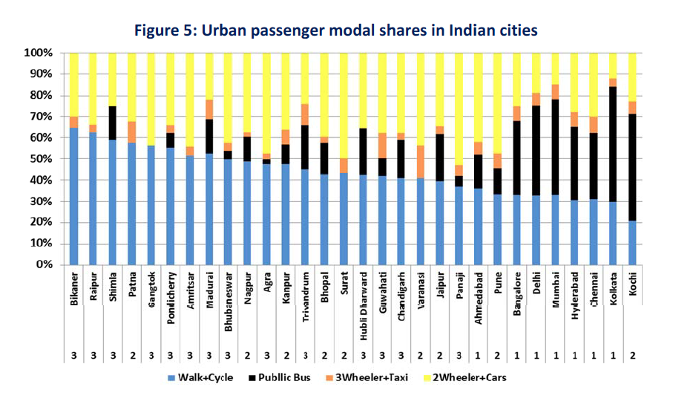
Guttikunda & Jawahar, 2012, from MoUD (2008)

Slide 5
Orphan

Slide 6
Who’s Responsible?

Slide 7
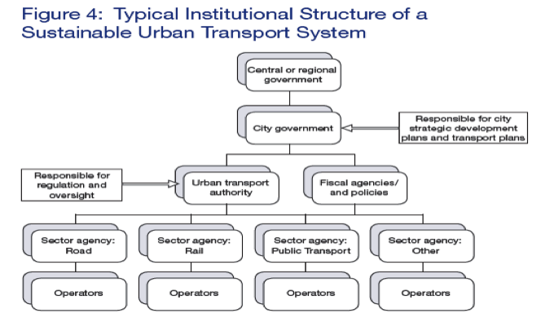
ADB, 2008

Slide 8
heiress

Slide 9
Anticipated Investment
HPEC on Urban Infra:
~Rs.450,000 Cr 2012-2030 for transport (14.5% of all urban infra investment)
~1.7 mn Cr for roads (55% of all urban infra investment)
NTDPC (Prelim)
Rs. 1.5-2.3 million Cr (~15-23 trillion) before 2030
Avg Annual: Rs. 75,000 Cr – 100,000 Cr
Notes:
Roads – 1.7 million crore, 55%

Slide 10
Princess

Slide 11
The Urban Labyrinth
Planning Commission (2011): Impediments to urban strategic planning include:
urban planning without attention to regional development and the urban periphery,
“rigid master planning” that is not integrated with spatial planning including transportation and land use planning,
utopian plans without basis in financial and operational realities,
“inadequate institutional clarity,” and
lack of capacity and enabling tools such as GIS and GIS-enabled management information systems. (p.7-8).
Metropolitan Planning Commissions: constitutionally mandatory, BUT new, nascent, weak by all accounts, even to the point of some confusion in official documents about how many exist.
De facto urban Planning, investment coordination takes place at the state level.
Notes:
Four of the eighteen states with urban areas that should, according to the Constitution, have Metropolitan Planning Commissions to integrate land use planning, regional development, and infrastructure among other tasks, do not have enabling legislation. Most of the enabled MPCs have not actually been set up. (Sivaramakrishnan and Maiti, 2009, updated via web search by MJ Vishnu). “Metropolitan area means an area having a population of ten lakhs or more, comprised in one or more districts and consisting of two or more Municipalities or Panchayats or other contiguous area, specified by the Governor by public notification to be Metropolitan area for the purposes of this Part”

Slide 12
All is Not Lost

Slide 13
A Push
NUTP: All cities of at least a million should have a Unified Metropolitan Transport Authority
53 urban agglomerations
~8-10 UMTAs exist, in varying states of development.
JNNURM: Comprehensive Mobility Plan Required.
Reviews of JNNURM CMPS are mixed – intentions, but still project focus, limited links to other plans (master plan, zoning, slum rehabilitation) and extend of implementation unclear.
Notes:
National Mission on Sustainable Habitat of the National Action Plan on Climate Change (NAPCC)
The National Urban Transport Policy (2006) recommended that each city of more than a million residents form an Urban Metropolitan Transport Authority (UMTA). As of the 2011 Census, there are 53 cities of that size. There were five UMTAs/UMTA-like entities as of 2011 according to Agarwal and Chauahan (2011):
The Greater Guwahati Transport Coordination Committee, set up in 1999 under the Chief Secretary.
Delhi Transport Planning Group set up in 2001 under the Chief Minister. Agarwal and Chauhan (2011) report that a statutory UMTA was under consideration as of 2011, but it does not seem to have been approved.
Hyderabad UMTA set up in 2008 as part of the HMDA act. Includes the Chief Secretary as chairman, 2 transport experts, and heads of all transport agencies.
Bangalore Metro Land Transport Authority, set up in 2007, discussed below
Unified Mumbai Metropolitan Transport Authority set up in 2008.
This list may be incomplete, as the paper misses the Chennai UMTA notified by the government in December 2010. There are conflicting public reports about the institutional status of the CUMTA, but it appears to function as a sub-entity of the CMDA. It published a Comprehensive Transportation Study (CCTS) in 2010, and some of the projects recommended in that proposal are underway.
Available information suggests that the UMTAs are in the early stages of institutional development. According to Agarwal and Chauhan (2011), the Guwahati initiative held one meeting and the Delhi transport planning group never met. Both were established by executive order, but did not gain traction once their political champions were moved. Mumbai’s MTA was also created by Executive Order, but meets more regularly. The Hyderabad UMTA is reportedly the strongest: it has the power to approve projects and the Chief Secretary plays an active role in convening the various stakeholders.
Agarwal, O.P., and Ishita Chauhan (2011). “Toward Coordinated Urban Transport Planning in India,” Transportation Research Record: Journal of the Transportation Research Board, No. 2239, Transportation Research Board of the National Academies, Washington, D.C., 2011, pp. 112–116.
The Act is available at http://www.thehindu.com/multimedia/archive/00287/Chennai_Unified_Met_287799a.pdf
Shivakumar, C. (2012). “CUMTA Approves CCTS As Chennai Transportation Plan,” The New Indian Express. May 2, 2012.
UMTAs – Mumbai’ MTA/MMRDA’s additional chief was quite frank. Bangalore and Chennai seem to be on the move, but very much driven by the state government.
JNNURM – not a bad sign, can’t expect instant strategic foresight, especially with a limited budget. Worth looking at more closely to see the extent to which cities have implemented their CMS in the projects. Not something done in Hidalgo paper, which was more focused on expert interviews (28). Lack of connection to other plans is ok too, if other plans aren’t actually really being used as guides.

Slide 14
But Need to Build a Foundation
UMTAs (or whatever one calls them) need to have independent finances, human capacity, data.
Concerted investment in capacity: university centres of excellence, research funding, professional courses.
Frameworks for evaluating options: e.g. Life Cycle Analysis

Slide 15
And Small Things (May) Add Up
Passenger amenities:
Route maps
Integrated ticketing
Station facilities & safety
Filling the gaps: paratransit, cycle and foot paths, urban design
Data Collection and Research

