Slide 1

Regional and Local Nature of Air Pollution: Observations and Monitoring Needs
S. N. Tripathi
Dept. of Civil Engineering & Center for Environmental Science and Engineering
Indian Institute of Technology Kanpur, India

Slide 2
India measurements scarcity & implications
Indian subcontinent diversity
Topography
Increasing population
Distinct anthropogenic (man-made) activities and living habits
Dense fog in North India
Movement of ITCZ over Indian subcontinent and associated weather patterns
Strong seasonality in climatic conditions
Diverse pollution sources
Monitoring needs
Regional
Local
Vehicular emission

Slide 3
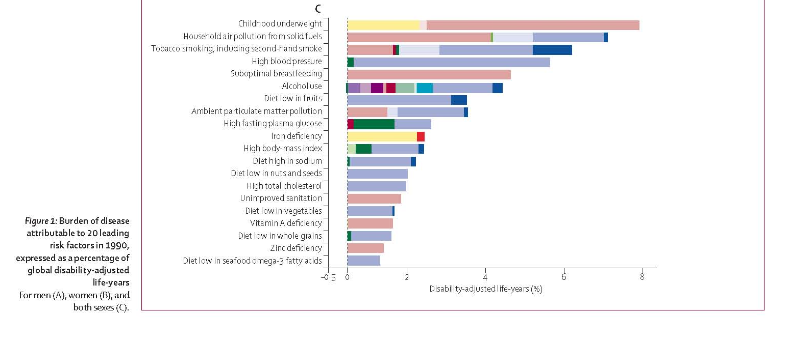
A comparative risk assessment of burden of disease and injury attributable to 67 risk factors and risk factor clusters in 21 regions, 1990–2010: a systematic analysis for the Global Burden of Disease Study 2010
Lim et al., 2012, Lancet Courtsey: Ted Russell
    http://www.healthmetricsandevaluation.org/gbd/visualizations/
Childhood
underweight
Indoor PM
Smoking
Ambient PM
High body mass index
Unimproved sanitation
Ozone exposure is ~0.2%
8%, ~2x10⁸
Disability Adjusted Life Years Lost by Risk Factor
Colors indicate related health disorder (e.g., cancer, cardiovascular disease)
(AP ~7 million related deaths/yr)

Slide 4
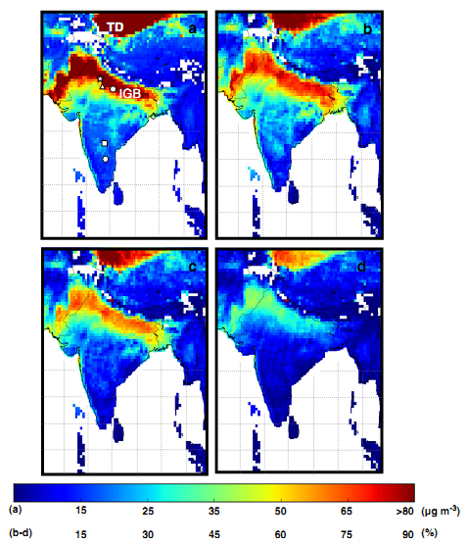
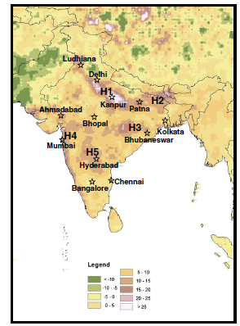
Particulate matter from Satellite AOD: Health and Climate implications
Delhi is hotspot
Spatial distributions of (a) mean annual concentration (in μ gm⁻ ³) and percentage of clear days per year with mean daily exceeding (b) 37.5 μg m⁻³ (WHO IT-3), (c) 50 μ gm⁻³ (WHO IT-2) and (d) 75 μg m⁻³ (WHO IT-1) during Mar 2000 – Feb 2010 over the Indian Subcontinent. ‘IGB’ and ‘TD ’ are acronyms of Indo-Gangetic Basin and Taklamakan Desert. 'White' regions represent ‘water’ or ‘no data’. Note different scales for Figs. 3a and b-d. Locations of Delhi, Kanpur, Agra, Hyderabad, Anantpur and Sunderban are shown by ‘star’, ‘circle’, ‘triangle’, ‘square’, ‘hexagon’ and ‘diamond’ respectively. (For interpretation of the references to color in this ﬁgure legend, the reader is re-ferred to the web version of this article).
Spatial distribution of total changes in PM2:5 concentration (in μg m−3) during Mar 2000-Feb 2010 over the Indian subcontinent. Increase ofPM2:5 by >15 μg m−3 are characterized as hotspots. Five hotspots (marked as H1 to H5) are identified across India and Bangladesh. Locations of some of the large urban centers are also shown (by open star) for a better reference
Dey, Tripathi et al., Remote sensing of Env., (2012)

Slide 5
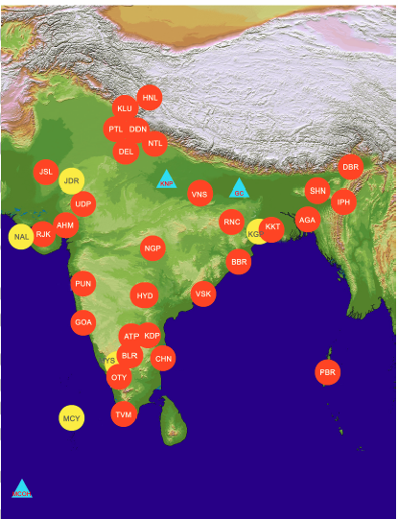
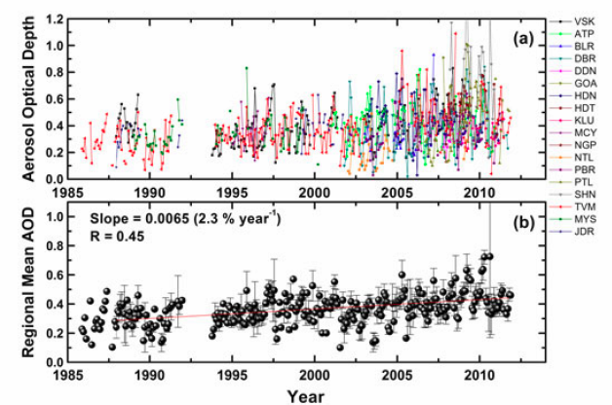
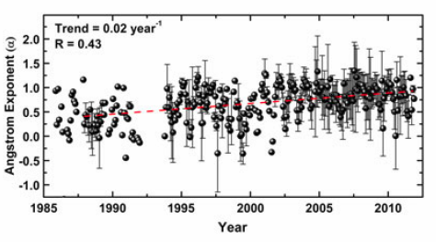
Decadal trend in Aerosols: AFRINET Network
AFRINET is a network of 35 aerosol observatories over the Indian region to generate the first time regional synthesis using primary data and estimate the aerosol trends.
AOD was found increasing at a rate of 2.3% (of its value pre-industrial value in 1985) per year and more rapidly (~4%) during the last decade.
Moorthy et al., GRL, (2013)
Moorthy et al., GRL, (2013)

Slide 6
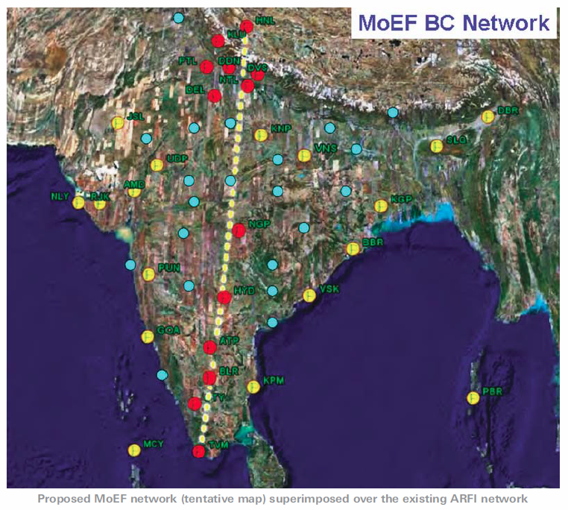
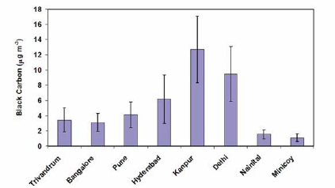
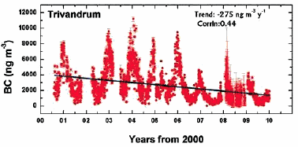
National Carbonaceous Aerosol Programme
NCAP: Black Carbon Research Initiative
Inter-Ministry Initiative: Proposed programme
Babu et al., 2002; Satheesh et al., 2010; Safai et al., 2007; Singh et al., 2010; Badrinath and Latha, 2006; Dey et al., 2008, Dumka et al., 2010
BC is decreasing. Why?
Ministry of Earth Science (MoES)
Ministry of Environment and Forest (MoEF)
Indian Space Research Organization (ISRO)

Slide 7
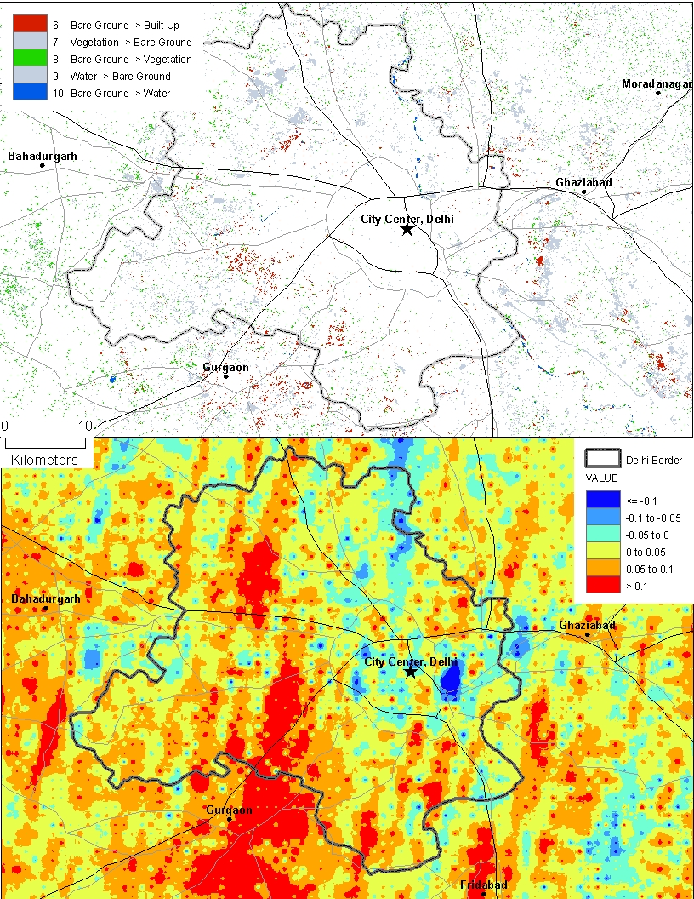
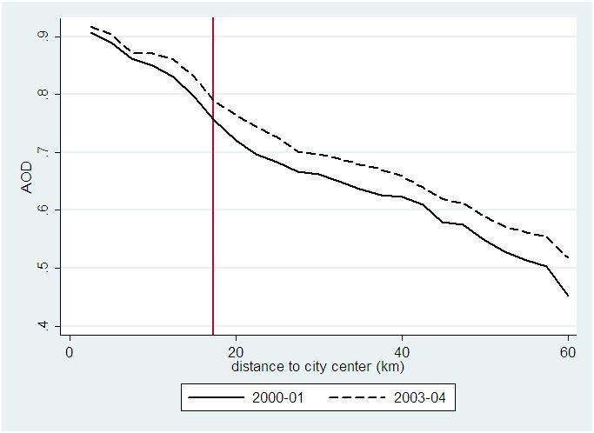
Impact of policy
Measures on aerosol redistribution
Change in AOD with respect to distance to the city center (Connaught Place, i.e. central business district of Delhi)
Change in AOD from 2000-01 to 2003-04

Slide 8
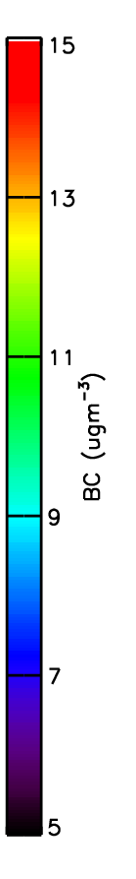
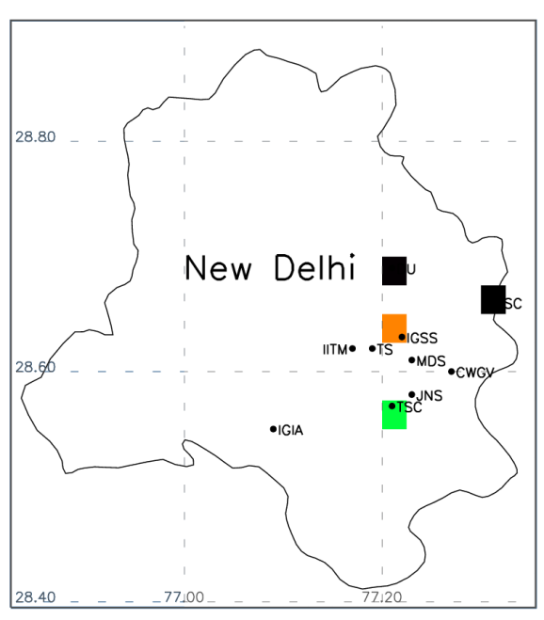
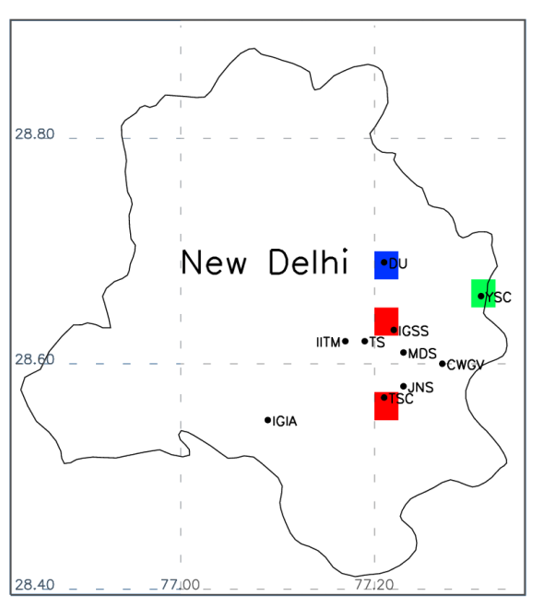
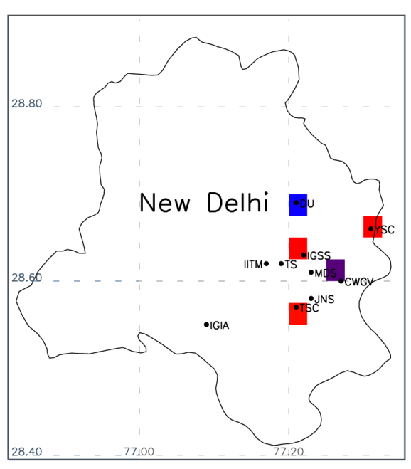
BC variability during Commonwealth games, 2010
Before (24/9-2/10)
During (3/10-14/10)
After (15/10-21/10)
BC
DU: University of Delhi
IITM: Indian Institute of Tropical Meteorology, Delhi
IGIA: Indira Gandhi International Airport
IGSS: Indira Gandhi Sport Complex
YSC: Yamuna Sport Complex
TS: Talkatora Stadium
MDS: Major Dhyan Chand National Stadium
CWGV: Common Wealth Game Village
JNS: Jawaharlal Nehru Sports Complex
TSC: Thyagaraj Sport Complex
Growing concentrations at few sites related to increased traffic–related emissions
Strong variability
Modified after Beig et al., 2013

Slide 9
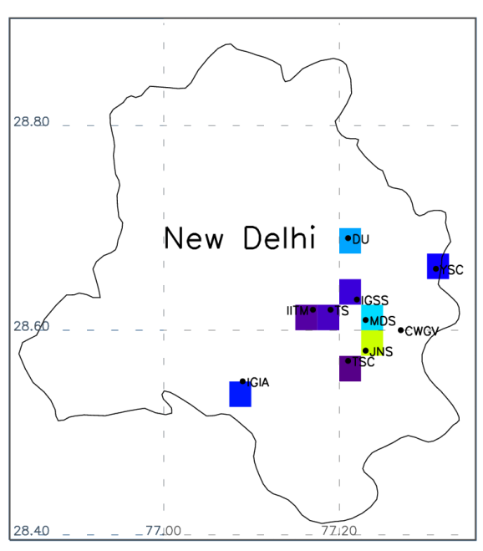
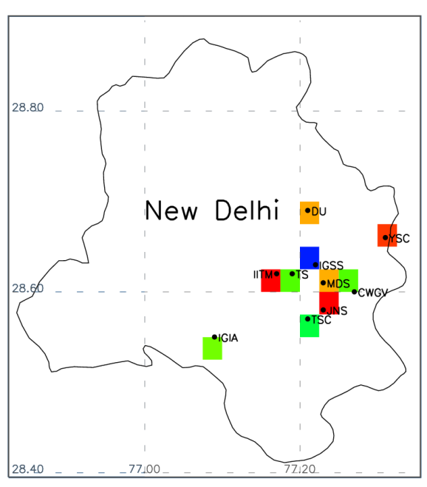
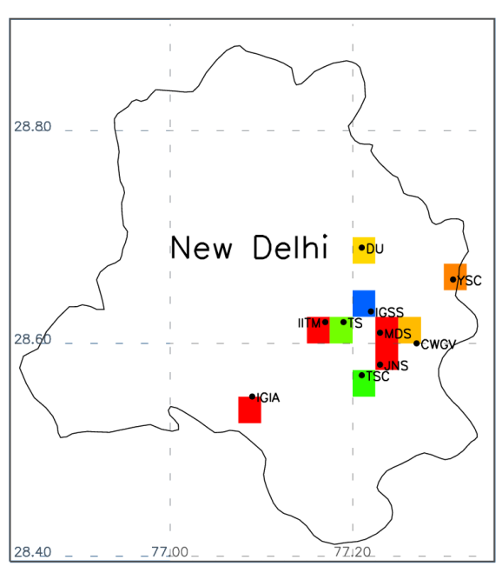
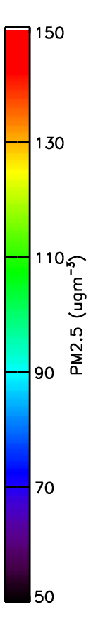
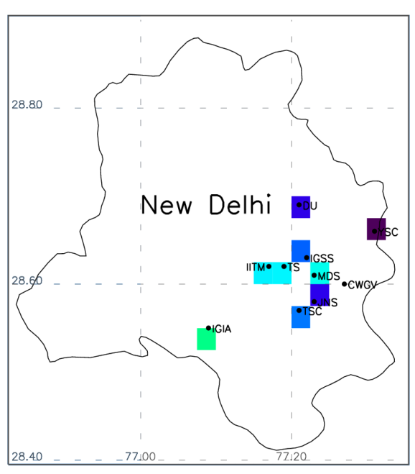
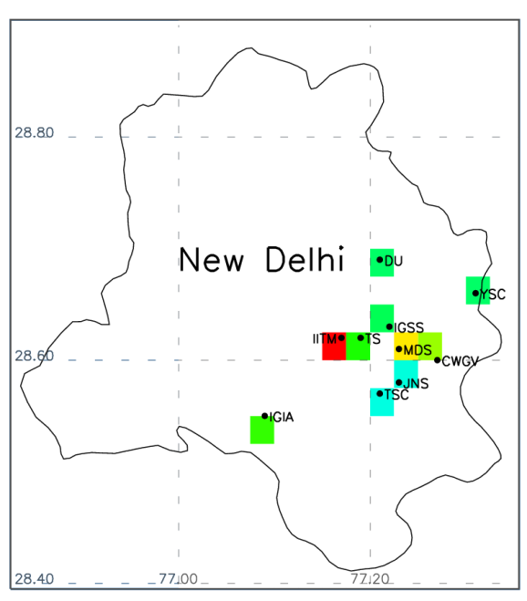
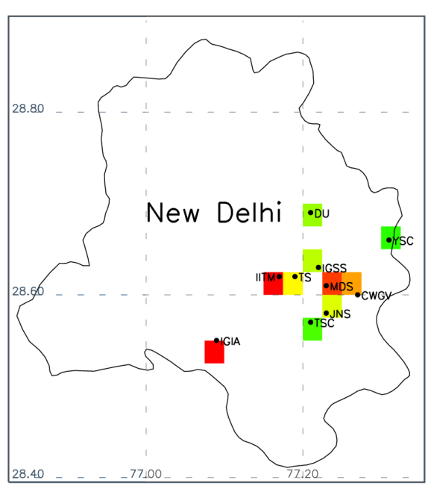
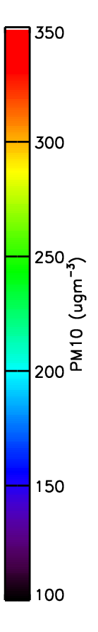
Aerosol variability during Commonwealth games
Before (24/9-2/10)
During (3/10-14/10)
After (15/10-21/10)
PM2.5
PM10
Modified after Beig et al., 2013

Slide 10
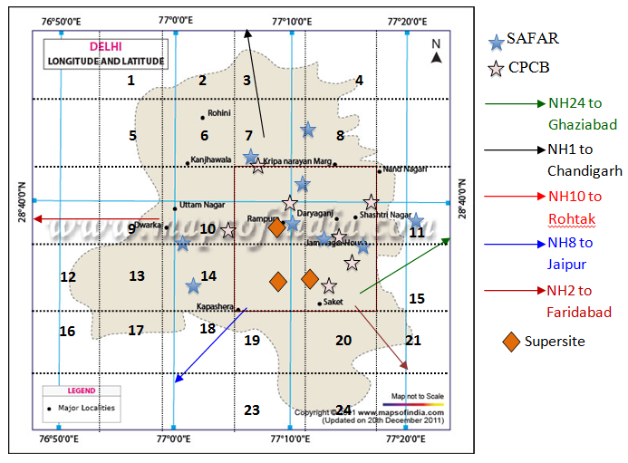
Proposed Monitoring Networks (Delhi)
Map of Delhi National Capital Region (NCR) and the proposed observations overlain with existing air quality measurements networks (some well-known places are marked for reference).
Vehicular emission
BC, CO,CO₂, vehicle and model
Propose to monitor PM_{2.5}, (O₃), BC, chemical composition for ambient air quality.
Cell phone based, Aethalometer (AE 42), Gas-analyzer, EBAM PM sampler
Bulk filter sampler, EC-OC analyzer, 7-wavelength Aethalometer

Slide 11
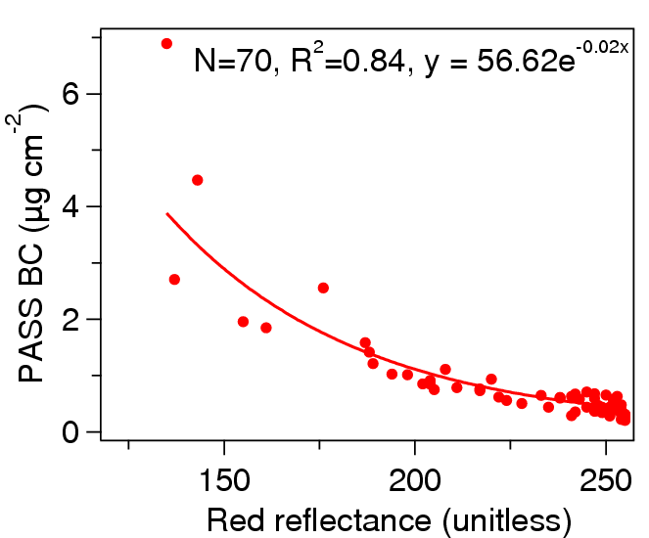
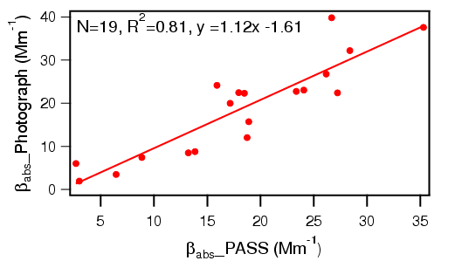

Cell Phone based Network for BC monitoring
For all 41 sites, a cell phone monitoring network will be set up at each site in order to collect immediate measurements of BC from filters (Ramanathan et al, 2011)
With increasing BC loading on the filter, the red reflectance of the image is decreasing.
Enhanced black carbon on the filter makes it darker due to increased absorbance of light
Fig. Correlation of PASS derived BC surface loading with red reflectance.
Fig. Comparison of β_{abs} derived from photographs of the filter samples with β_{abs} derived from PASS.
Lachandani, Ramanathan, Tripathi et al., under pre. (2013)
Developed by Nithya Ramanathan, Nexleaf

Slide 12
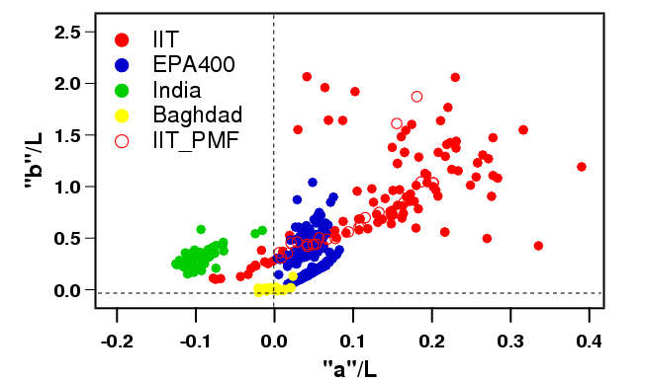
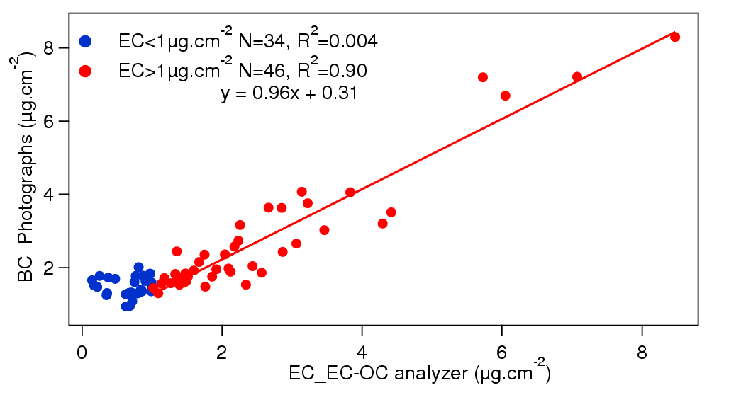
L, a and b are three dimensionsof Lab colour space. L represents brightness and ranges from 0 (black) to 100 (white) whereas “a” and “b” represent colour of an image. “a” spans from negative (green) to positive (red) whereas “b” spans from negative (blue) to positive (yellow).
Almost all data lie on the positive side of “b”/L axis which shows that OC in all the samples has yellow colour signal.
Samples from different locations having different OC sources lie in different regions of the plot.
Fig. Plot of a/L and b/L for samples collected in IITK, USEPA, India and Baghdad.
Fig. Comparison of BC derived from photographic method with the EC derived from EC-OC analyzer from samples collected at IITK.
Resolve in various factors
Aim to have PM from cell phone
Lachandani, Ramanathan, Tripathi et al., under pre. (2013)

Slide 13
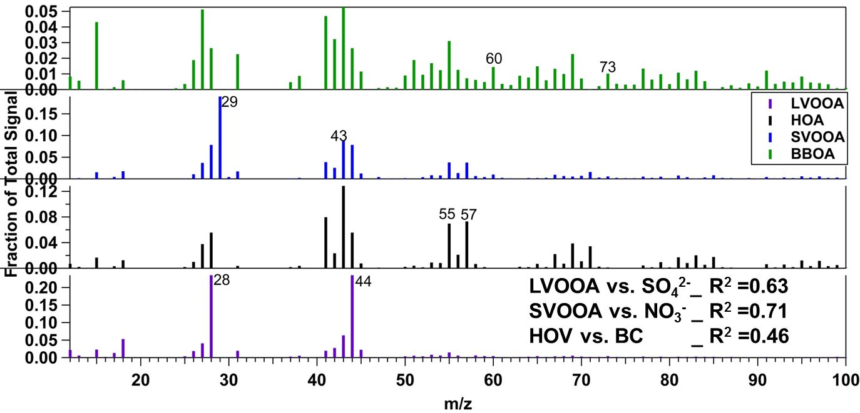
Contribution of various Factors to Organics
Organics measured from HR-ToF-AMS is analyzed along with absorption data to quantify the effect of organic aerosols on absorption
Positive Matrix Analysis (PMF) analysis of HR-ToF-AMS data is used to identify different sources of organic aerosols
No big biomass burning event other than site specific diurnal variation is observed during this period
LVOA-+SVOO:-Oxygenated Organic Aerosols: SOA
HOA-HydroCarbon Like Organic Aerosols: Traffic
BBOA-Biomass Burning Organic Aerosols

Slide 14
Summary
City-level, dense monitoring networks for ambient air quality and vehicular emissions are required
Cell phone based sensors can provide high accuracy, high frequency data on BC (and PM)
Source profiling are also needed
Can be (semi) automated to have least human intervention

Slide 15
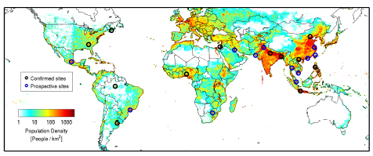
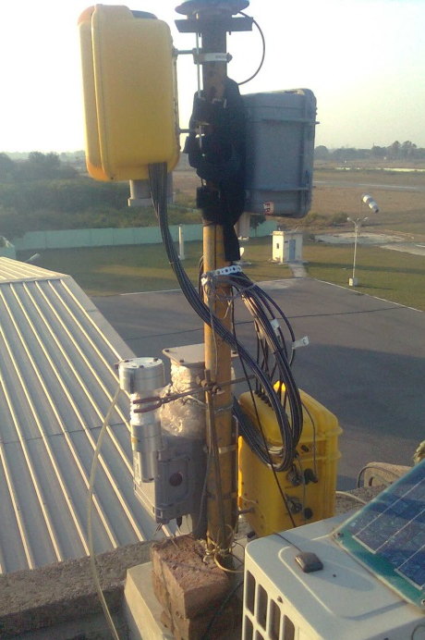
Surface PARTiculate mAtter Network (SPARTAN)
A global network of ground-based measurements of fine particle concentrations to evaluate and enhance satellite remote sensing estimates that can be applied in health effects research and risk assessment.
8 active and 11 proposed sites
Kanpur
Since Nov. 2013
Snider, Tripathi et al., under pre. (2014)

Slide 16
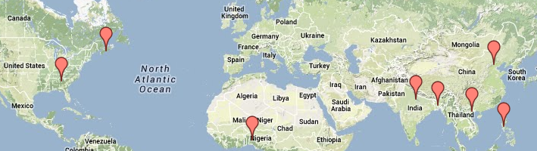
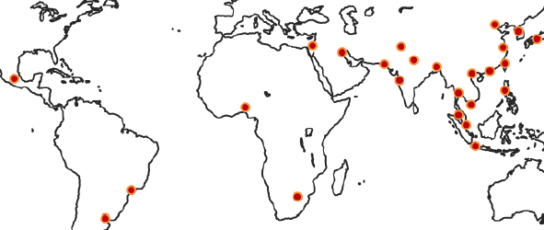
Surface PARTiculate mAtter Network (SPARTAN) PM_{2.5} Network
A global network of ground-based measurements of fine particle concentrations to evaluate and enhance satellite remote sensing estimates that can be applied in health effects research and risk assessment.
8 active sites
Kanpur
Proposed sites
Since Nov. 2013
http://fizz.phys.dal.ca/~atmos/martin/?page_id=464

Slide 17
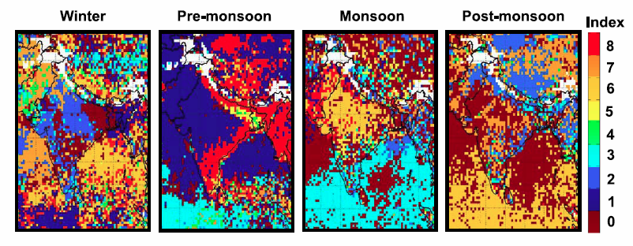
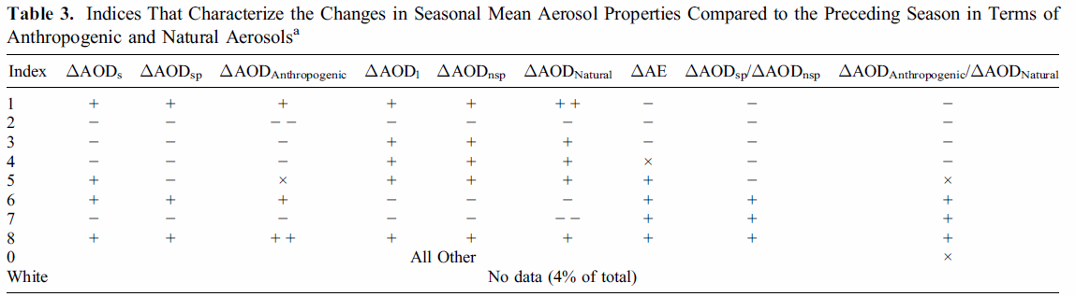
India Aerosol Climatology (Relative to Previous Season)
Increasing Anthropogenic
Spatial distribution of the index characterizing the changes in seasonal mean aerosol properties compared to the preceding season. Index is based on non-sphericity and effective radius.
For example, Indices 6 and 7 in winter and Index 6 in postmonsoon represent increasing anthropogenic particle fraction over the ocean because of transport of aerosols from the mainland; in premonsoon, Index 1 represents increasing natural particle fraction because of transport of dust, and Index 8 over the land represents increasing anthropogenic particle fraction because of seasonal peak in biomass burning; and in monsoon, Index 3 represents increasing natural particle fraction over the ocean because of persisting influence of dust transport and enhanced production of maritime aerosols. White represents no data
Dey and Di Girolamo, JGR, (2010)

Slide 18
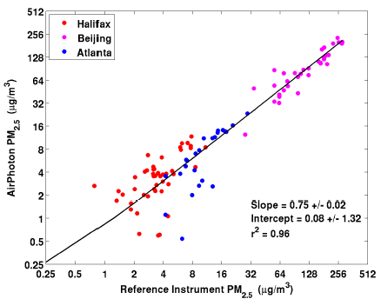
Assembled PM2.5 filter results: Calibration sites
The nephelometer readings were in good agreement with reference instruments at all three sites (R²>0.80).
The slope of filter masses was 0.75 compared with federal reference method (FRM) instruments with coefficient of variation of R²=0.96.
Overall, instrument calibrations results are very encouraging and motivating.
Scatter plot shows reduced major axis (RMA) regression for Beijing, Atlanta and Halifax PM2.5 conc., respect. AirPhoton filter samplers in Halifax, Atlanta and Beijing are referenced using a Partisol, personal environmental monitor (PEM) and Laoying air sampler instruments, respectively.

Slide 19
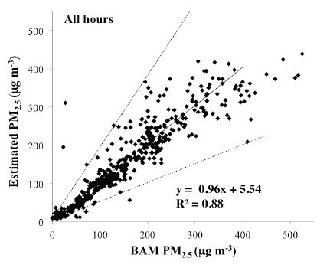
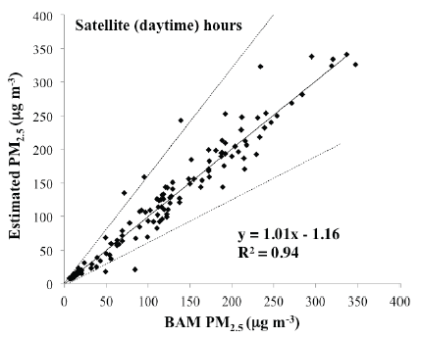
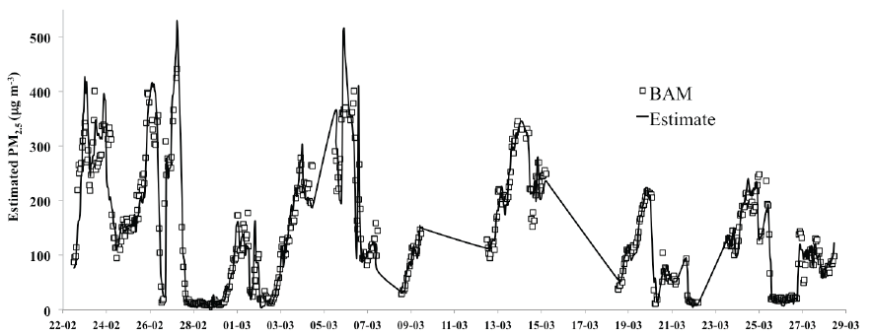
Evaluation of hourly PM2.5 in Beijing
Evaluation of hourly PM2.5 in Beijing from February 24 to March 29, 2013 reconstructed from
the AirPhoton nephelometer, and compared to the reference instrument (BAM) located 15 km away. The 1-σ percent error with respect to the lines of best fit for BAM is 1 μg m-3 + 24% (all hours) and 1 μg m-3 + 19% (satellite overpass hours). Dashed lines show the 2-σ confidence intervals.
Promising correlations are found with 24-hour BAM fine mass (R²=0.88) and noontime averages (R²= 0.94) despite the 15 kms of separation between the BAM and nephelomter.

Slide 20
Proposed plan
A total of 24 sites is proposed to measure BC, O₃, CO and PM2.5, with more concentrated measurements sites (about 12) in the central part of Delhi
Five additional sites will be chosen (Grid 9, Grid 3, Grid 15, Grid 21 and Grid 18 or 19) to monitor vehicular emission, as these are the major entry points for the heavy-duty vehicles via National Highways.
Highly time resolved (e.g., 1 Hz) measurements of CO₂, BC, and NO_{x} conc. would be ideal at these locations to enable quantification of emission factors for the heavy-duty vehicles that pass the sampling locations.
Using a carbon balance method, the measured CO₂ is related to the amount of fuel burned to compute fuel-normalized emission factors: g pollutant emitted per kg fuel burned. Further additional measurement of NO or NO₂ would be of interest
Additional information about the passing heavy-duty trucks, such as engine model year and installed emission control equipment (e.g., if the truck was retrofitted with a diesel particle filter), would add value to the study.
Total proposed sites = 24 (to maximize the coverage of Delhi NCR) + 12 (within the core zone) + 5 (outlet points) = 41

Slide 21
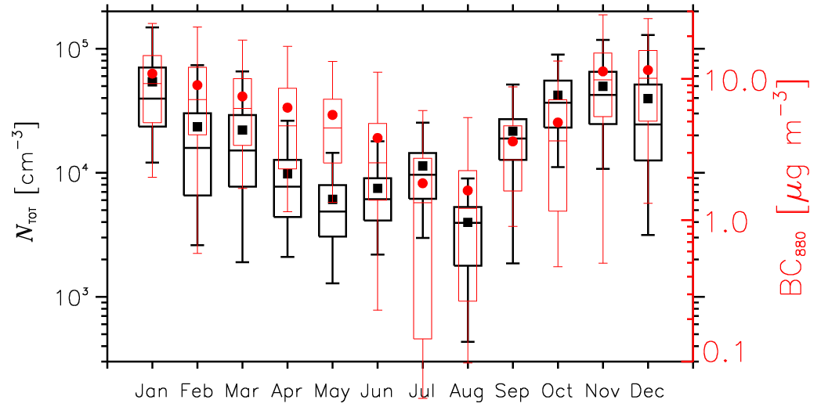
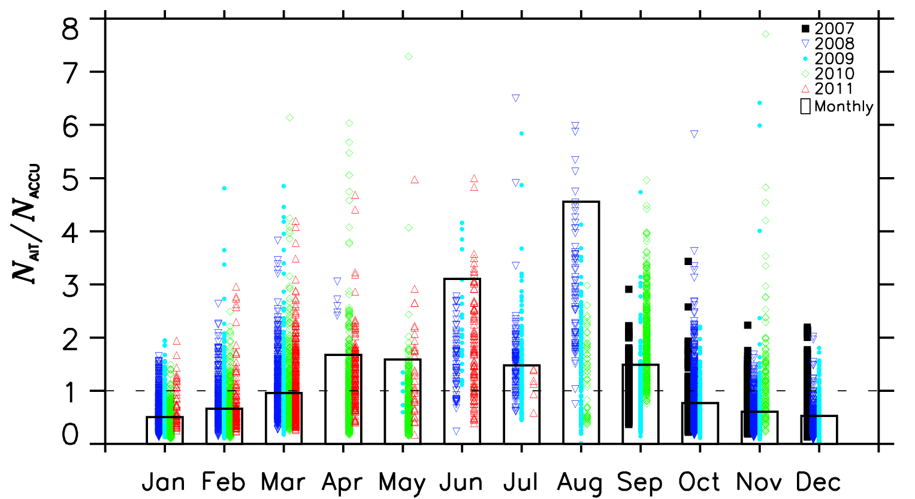
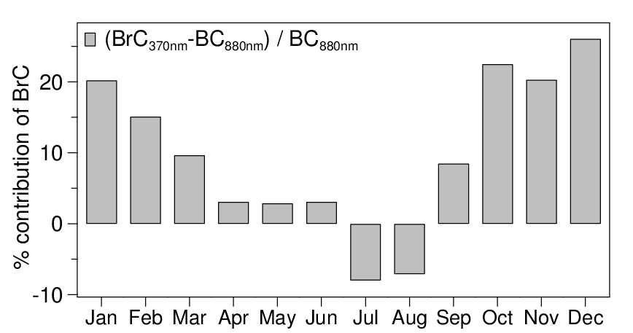
Sub-micron particle size distributions: Kanpur long-term study
Measurements of sub-micron particle size distribution in the size range of 14-680 nm were conducted at IIT, Kanpur from Sept. 2007 to July 2011.
A distinct seasonal pattern, with the total particle number and BC mass conc. peaking in winter and lower during the monsoon season.
The high ratio (Aitken/Accumulation) values could arise due to NPF events whereas the low value indicates that the air mass was aged and/or contains larger particles as a primary aerosol.
The +ve value indicates the significant BrC contribution came from wood/trash burning emissions (mainly winter months) and the –ve value suggests that fossil-fuel combustion largely contributed to BrC
Kanawade, Tripathi et al., under review, (2014)

Slide 22
Contribution of various Factors to Organics
Organics measured from HR-ToF-AMS is analyzed along with absorption data to quantify the effect of organic aerosols on absorption
Positive Matrix Analysis (PMF) analysis of HR-ToF-AMS data is used to identify different sources of organic aerosols
Data is analyzed for 9 clear days (1 to 9 March 2013)
No big biomass burning event other than site specific diurnal variation is observed during this period

Slide 23
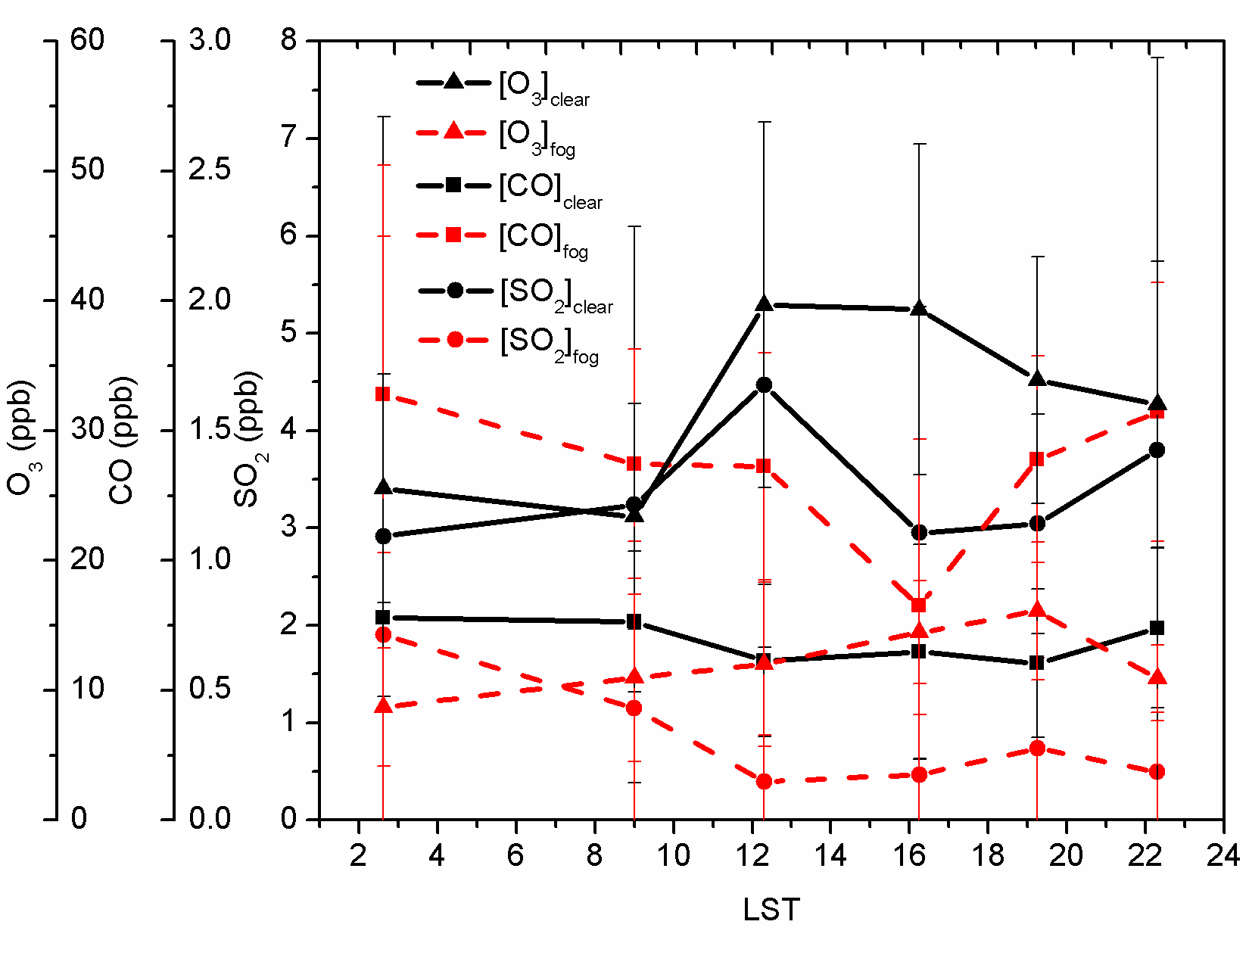
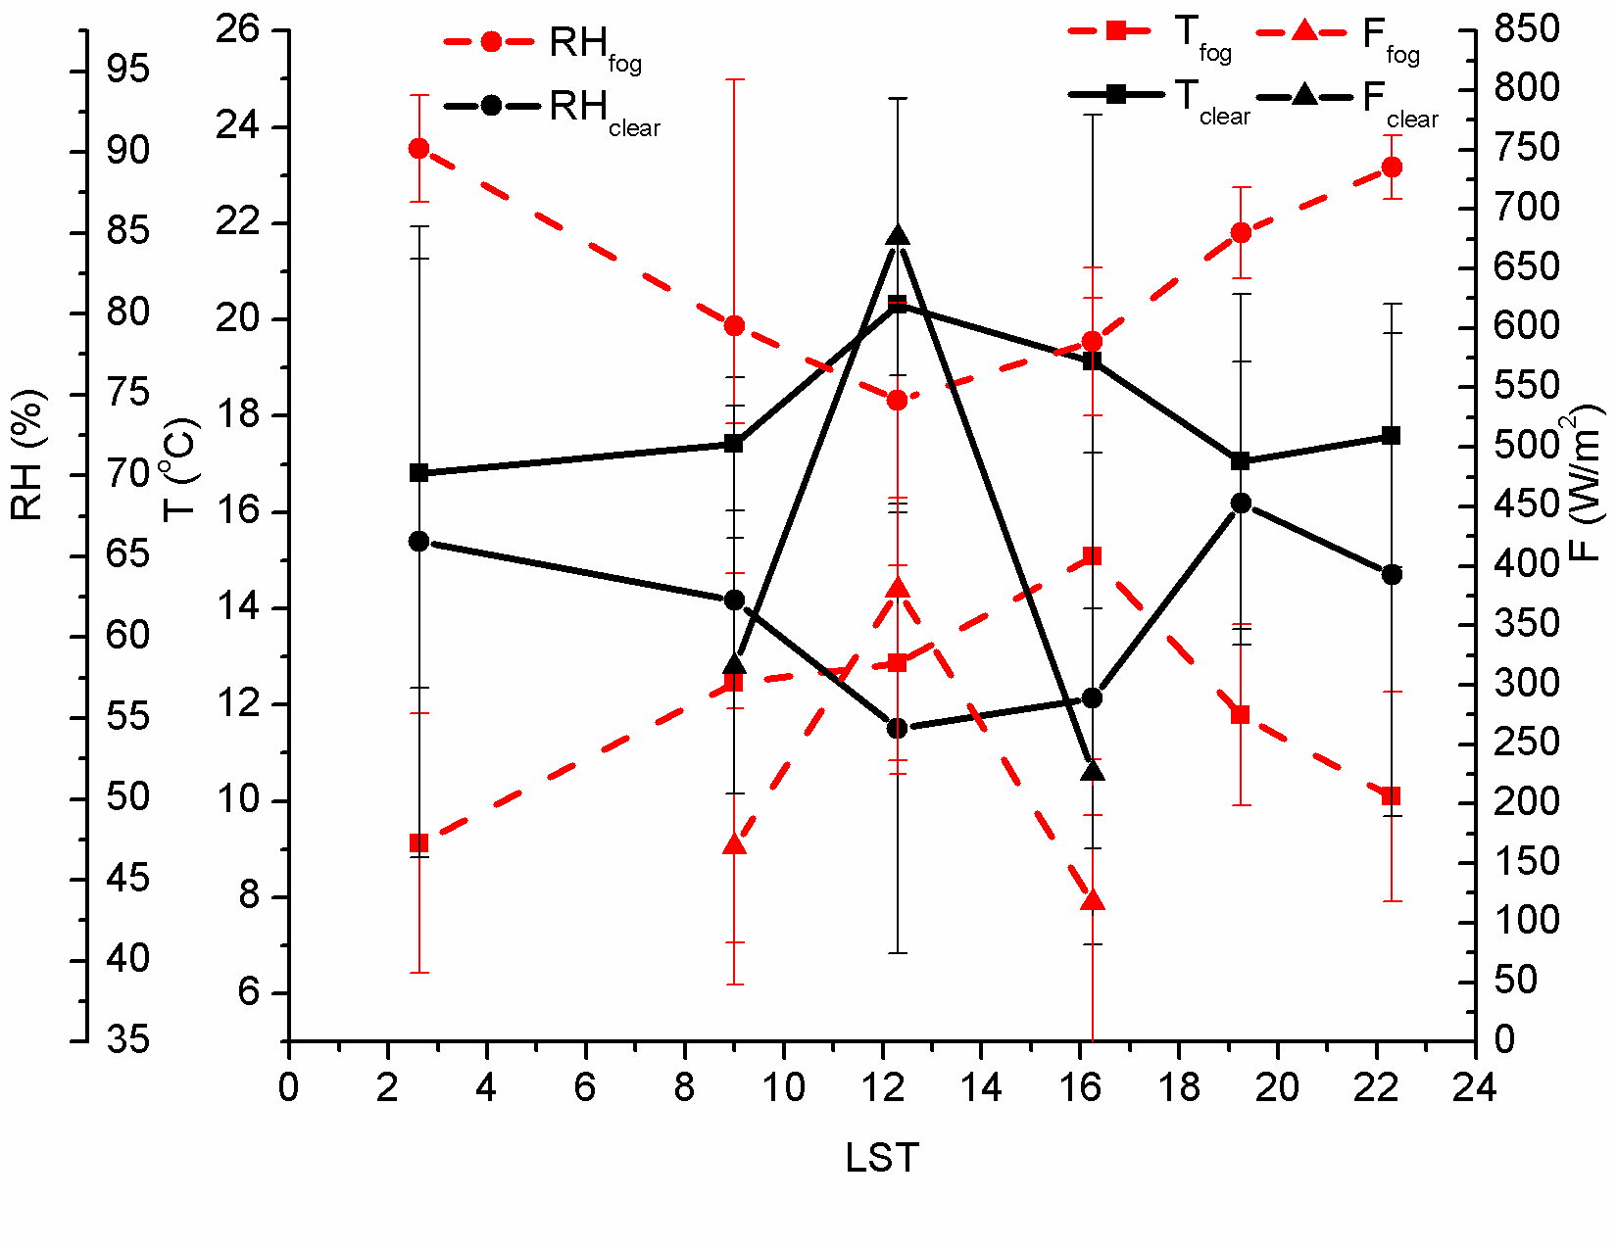
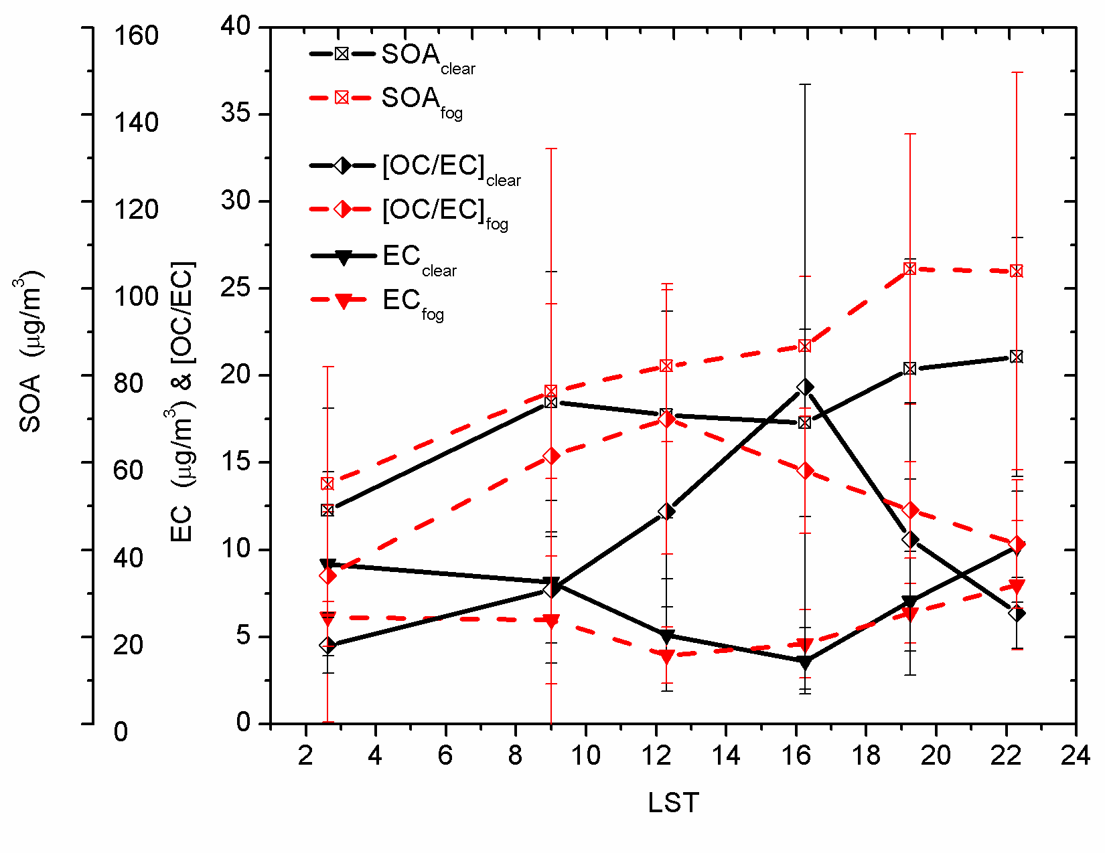
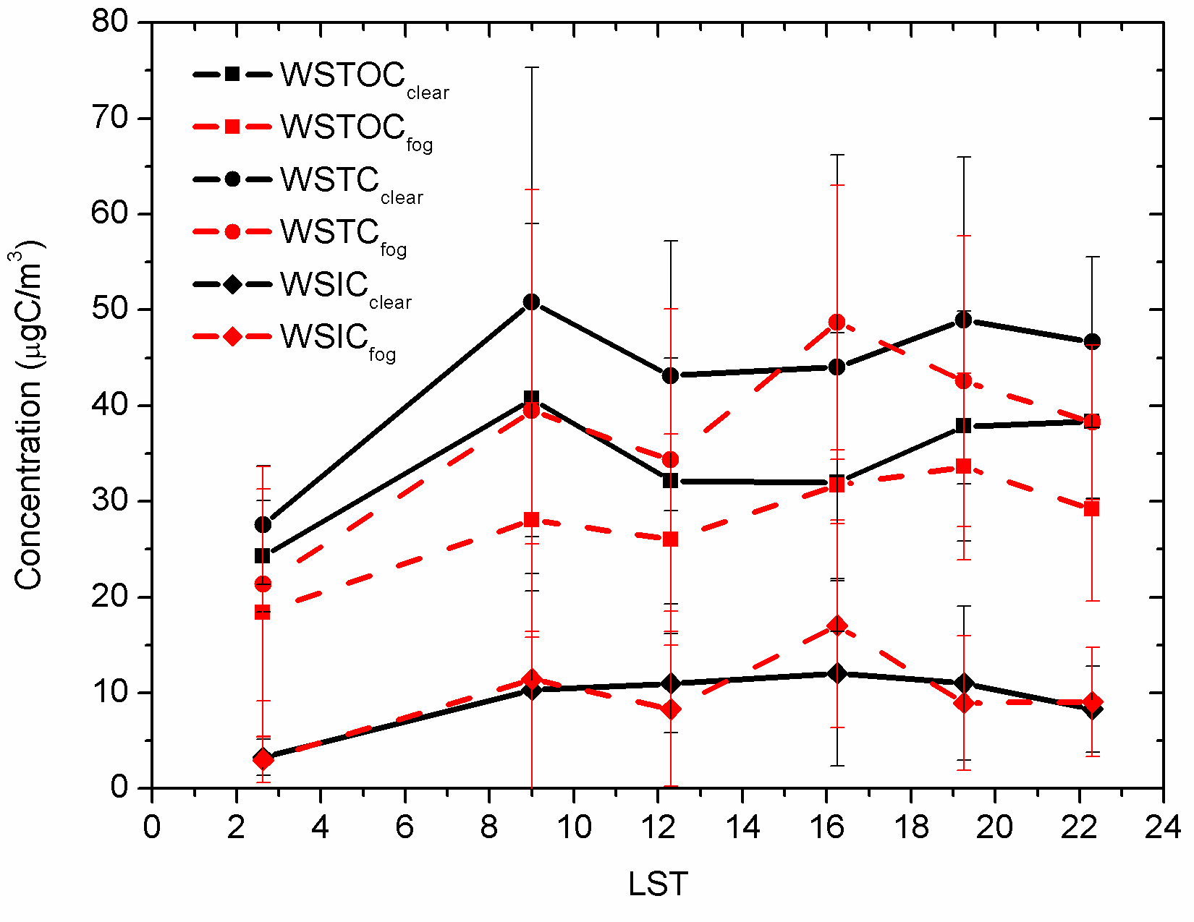
Secondary Organic Aerosol: Winter Fog (Kanpur)
Ozone (ppb)
CO (ppb)
Sulphur Dioxide (ppb)
Low EC but High SOA during Fog
WSTOC Water Soluble Total Organic Carbon
WSTC Water Soluble Total Carbon
WSTIC Water Soluble Total Inorganic Carbon
Secondary Organic Aerosol (μg/m³)
EC (μg/m³) and (OC/EC)
Kaul, Tripathi, et al., ES&T, (2011)

Slide 24
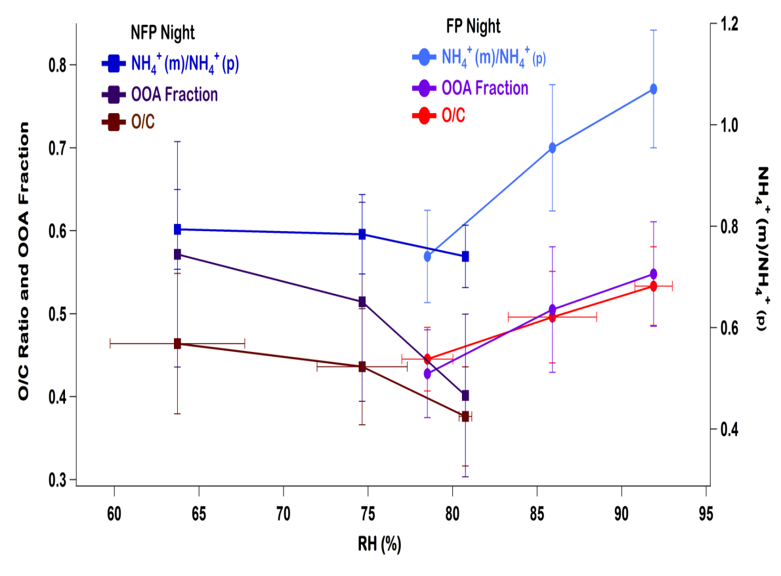
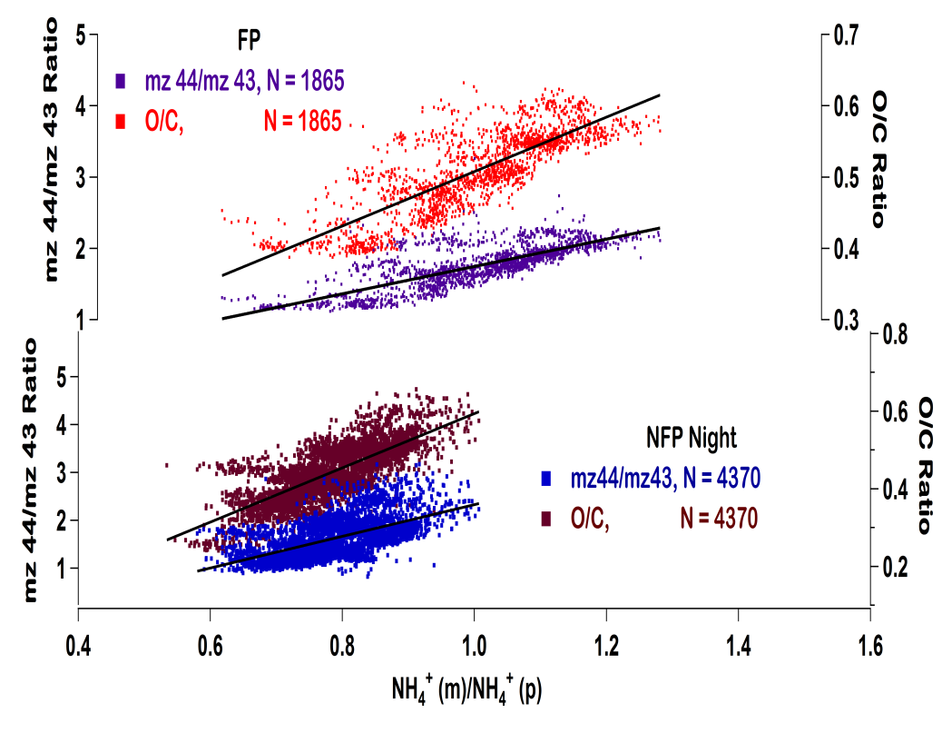
Processing of aerosols and aq. Chemistry: Fog
How aerosol acidity affects the ambient SOA formation and by what mechanism?
mz 44/mz 43
O/C ratio
O/C ratio and OOA fraction
NH₄⁺(m)/NH₄⁺(p)
mz 44/mz 43
O/C ratio
RH (%)
During both foggy (FP) and non-foggy periods (NFP), O/C ratio and OOA fractions are +vely correlated
However, during NFP, RH and O/C are negatively correlated while during FP, its positively correlated indicating possible role of aqueous chemistry
Increasing trend of mz 44/ mz 43 ratio with neutralization may be an indication of dominance of fragmentation pathway over functionalization
Ambient aerosols were more oxidized and less acidic during FP compared to NFP.

Slide 25
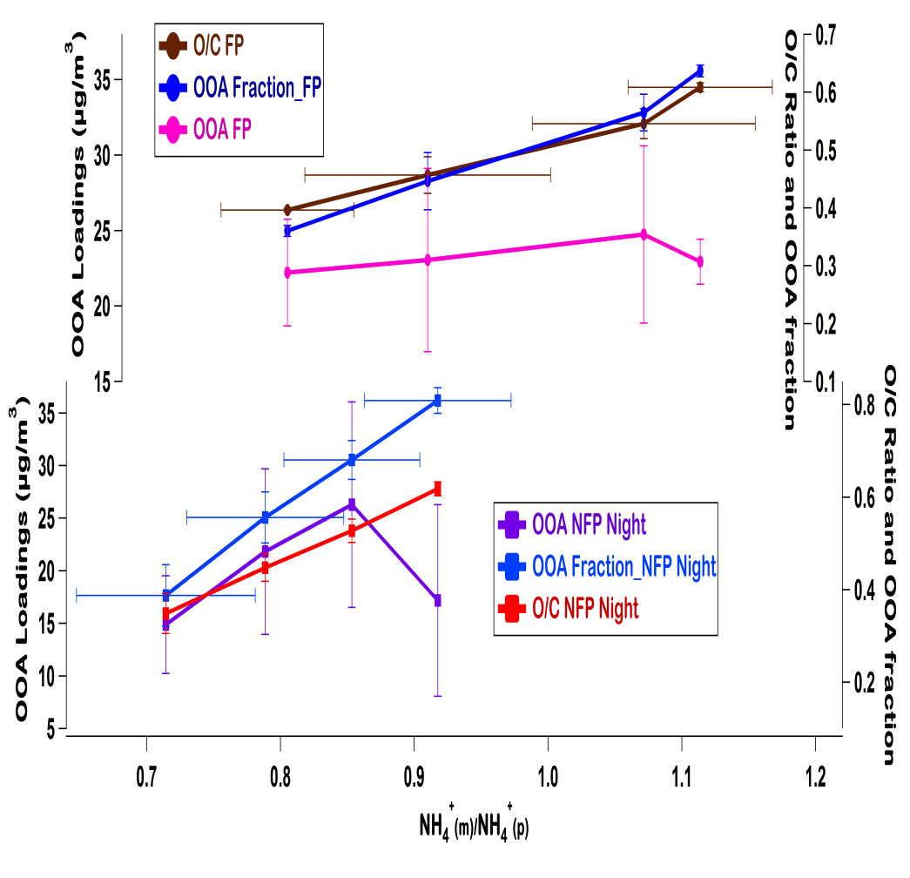
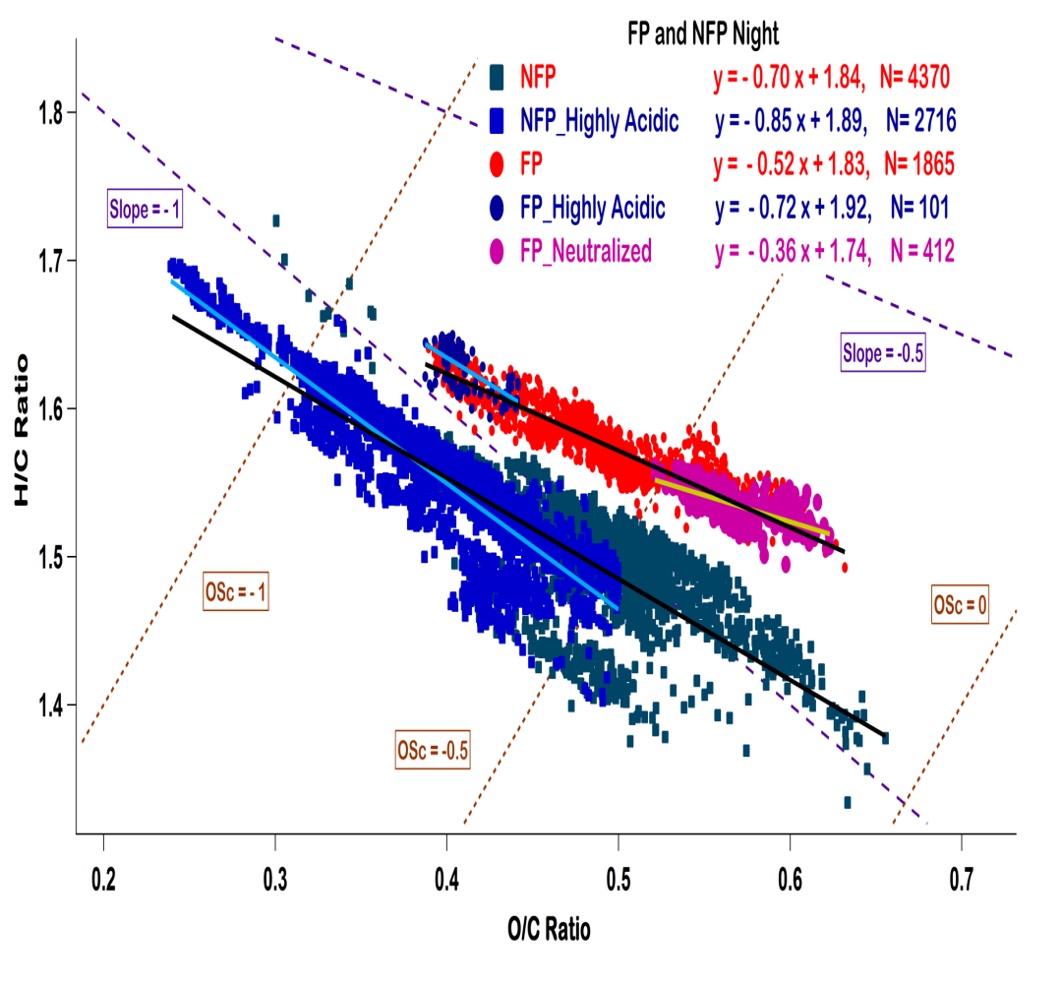
SOA formation mechanism
Shallow slope in Foggy periods: More carbon loss
OOA loadings (µg m⁻³)
O/C ratio; OOA fraction
H/C ratio
OOA loadings (µg m⁻³)
O/C ratio; OOA fraction
NH₄⁺(m)NH₄⁺(p)
O/C ratio
Loss of oxidized organic mass indicates fragmentation
Steeper slope in Non-Foggy Periods: More oxygen addition
AA also seems to influence the oxidation mechanism, neutralized aerosols favors fragmentation while acidic ones favors functionalization.
Mechanism of aerosol oxidation is different in both the periods, aqueous processing during FP favors more fragmentation than NFP.
Chakraborty, Tripathi, et al., under pre. (2014)

Slide 26

PMF Factors/organics & B abs at 405 nm
Diurnal variation
B abs follows the trend of SVOOA/Organics and BBOA/Organics
LVOOA fraction of organic aerosols have negative effect on absorption coefficient.
Shamjad, Tripathi, et al., under pre., (2013)

Slide 27
Thank you!

Slide 28

Courtesy: Dr. Antti Arola, Finnish Meteorological Institute
Forcing [BrC] = Forcing [all-species] – Forcing [without BrC]
Courtesy: Dr. Greg Schuster: Retrieval of volume fractions (work in progress)

Slide 29




SO₂, NO_{x}, CO and O₃: Kanpur (06/2009-05/2013)
Monthly mean time series of trace gases; (a) SO₂, (b) NO_{x}, (c) CO, and (d) O₃. The horizontal line indicates the median, filled square indicates the mean, top and bottom of the box indicate the 75th and 25th percentile, respectively, top and bottom whiskers indicate the 95th and 5th percentile, respectively, and top and bottom plus sign indicate the minimum and maximum value, respectively.
SO₂, NO_{x} and CO concentrations were highest during the winter season, whereas O₃ concentration peaked during summer.
The lowest concentration of all trace gases were observed during monsoon season, due to efficient wet scavenging by precipitation.
Gaur, Tripathi, et al., communicated, (2013)

Slide 30
Sub-micron particle size distributions: Kanpur long-term study
Measurements of sub-micron particle size distribution in the size range of 14-680 nm were conducted at IIT, Kanpur from Sept. 2007 to July 2011.
A distinct seasonal pattern, with the total particle number and BC mass conc. peaking in winter and lower during the monsoon season.
The high ratio (Aitken/Accumulation) values could arise due to NPF events whereas the low value indicates that the air mass was aged and/or contains larger particles as a primary aerosol.
The +ve value indicates the significant BrC contribution came from wood/trash burning emissions (mainly winter months) and the –ve value suggests that fossil-fuel combustion largely contributed to BrC
Kanawade, Tripathi et al., under review, (2014)

Slide 31


Interannual increase in SO₂ over India
Due to the rapid growth of electricity demand and the absence of regulations, SO₂ emissions from coal-fired power plants in India have increased notably in the past decade
Interannual trend of SO₂ emissions from selected Indian coal-fired power plant regions, the OMI-observed SO₂ burden (the sum of fitted α and the corresponding 95% confidence intervals), national mean SO₂ concentrations reported by the CPCB of Government of India, and annual average SO₂ concentrations at selected coal-fired power plant regions. R values shown are the correlation coefficients with the OMI-observed SO₂ burden
Fig. Spatial distribution of yearly OMI SO2 columns over India
Based on a unit-based inventory for the coal-fired power sector, SO₂ emissions increased dramatically by 71% during 2005−2012.
Annual average SO₂ in coal-fired power plant regions increased by >60% during 2005−2012, implying the air quality monitoring network needs to be optimized to reflect the true SO₂ situation in India
Lu et al., ES&T, (2013)

Slide 32



Trends in O₃, CO, NO_{x}
Spatial distribution of (a) increasing trend (% / decade) of tropospheric ozone.
Spatial distribution on of absolute increase in (a) CO and (b) NOx emissions in year 2000 with respective to corresponding emission in 1979 over the India.
Increasing trends in tropospheric ozone are observed over most of the regions of India, consistent with the observed trends in coal (9.2%/year) and petroleum (8.3%/year) consumption, and NOx and CO emissions in India.
The regressed tropospheric ozone pattern during monsoon season shows large trend over the entire Indo-Gangetic region and is largest, 6–7.2% per decade.
Lal, Ghude et al., AR, (2012)

Slide 33
Summary
Increasing trend in aerosol burden over sub continent
Increased anthropogenic sources
Decrease in dust
Fog processing of Secondary Organic Aerosol
Implications to Cloud Condensation Nuclei
Enhancement in aerosol absorption
Mixing state
Brown Carbon
Aqueous processing

Slide 34

Climate Change Mitigation in India
Bond et al., (2013)

Slide 35


(a)
(b)
Climate forcing by (a) BC-rich sources and (b) their sub set. The bottom color key should be used for three sets of bars with black dots as the best estimate with uncertainties
Bond et al., (2013)

Slide 36
Aerosol Climatology at Kanpur
Eck, Tripathi et al., JGR, (2010)

Slide 37




Hygroscopicity, mixing state & absorption
Linear regression between PASS-1 measured β_{abs} and Aethalometer measured BC mass for four consecutive winter seasons at Kanpur
Hygroscopic growth from Two SMPS System
Absorption amplification (𝜸)
Comparison of measured and modeled β_{abs}
Shamjad, Tripathi, et al., ES&T, (2013)

Slide 38


Inferring absorbing organic (brown) carbon
AERONET observations
Mean absorbing OC concentration (mg/m² ) inferred from AERONET-retrieved imaginary indices for September.
Arola, Tripathi et al., ACP (2011)

Slide 39



Enhancement in absorption (E abs)
E abs quantifies the enhancement in total absorption due to lensing and absorption due to organic carbon
$E_{abs}$=$\frac{ B abs from atmospheric aerosols}{B abs from denuded aerosols}$ = $\frac{\left(\text{B} \text{abs}\text{_}\text{BC}\right)\text{+}\left(\text{B} \text{abs}\text{_ }\text{Lens}\right)\text{+}\left(\text{B} \text{abs}\text{_}\text{OC}\right)}{\left(\text{B} \text{abs}\text{_}\text{BC}\right)}$
E abs for Clear Days
Wavelength | Peak E abs Bin
405 nm | 1.3 to 1.4
532 nm | 1.6 to 1.7
781 nm | 1.1 to 1.2
E abs for Biomass Burning Days
Wavelength | Peak E abs Bin
405 nm | 1.5 to 1.6
532 nm | Multiple Peaks
781 nm | 1.2 to 1.3
For biomass burning days E abs shows shift towards higher values as compared to clear days.
E abs at 781 nm shows small shift in peak value indicating increase in absorption from lensing only

Slide 40



Health and Climatic effects
Annual visibility trend over Delhi (1980-2009)
Visibility does not respond strongly to reduction of mass concentration of insoluble, accumulation mode and coarse mode dust particles.
Reduction of mass concentration of soot and water-soluble particles in the range of 10%-50% will lead to an increase in visibility by 2.4-11.3% and 4.9-29%, respectively.
Reduction of the last two anthropogenic components has co-benefits, as it may reduce fog formation
Singh and Dey, AE, (2012)

Slide 41
Particle size distributions: Kanpur (09/2007-07/2011)
Measurements of sub-micron particle size distribution in the size range of 14-680 nm were conducted at IIT, Kanpur from Sept. 2007 to July 2011.
A distinct seasonal pattern, with the total particle number and BC mass conc. peaking in winter and lower during the monsoon season.
The high ratio values could arise due to NPF events whereas the low value indicates that the air mass was aged and/or contains larger particles as a primary aerosol.
The +ve value indicates the significant BrC contribution came from wood/trash burning emissions (mainly winter months) and the –ve value suggests that fossil-fuel combustion largely contributed to BrC
Kanawade, Tripathi et al., under review, (2014)

Slide 42
Thank you!

