Slide 1
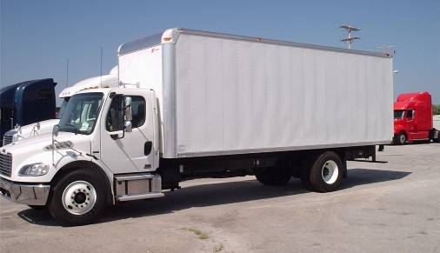
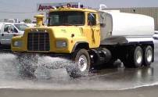
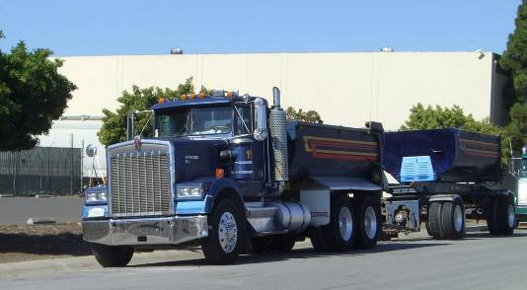

Reducing Emissions from Existing Trucks and Buses
Tony Brasil, Chief
Heavy Duty Diesel Implementation Branch
India – California Air-Pollution Mitigation Program
Oakland, California
October 21-23, 2013
Notes:
Thank you, Chairman Nichols, and good afternoon members of the Board.
Today, staff is presenting for your consideration a comprehensive strategy to reduce emissions from the nearly one million trucks that travel California’s highways each year. This strategy is comprised of two parts: a regulation to significantly reduce criteria pollutants from existing trucks and buses, and a companion measure that would improve the fuel efficiency of many of the long-haul trucks operating throughout the state and would reduce green house gas emissions.

Slide 2
Main Topics
Need for emissions reductions
Heavy duty emission control strategies
Heavy duty truck emissions
Diesel engine emission reduction strategies

Slide 3
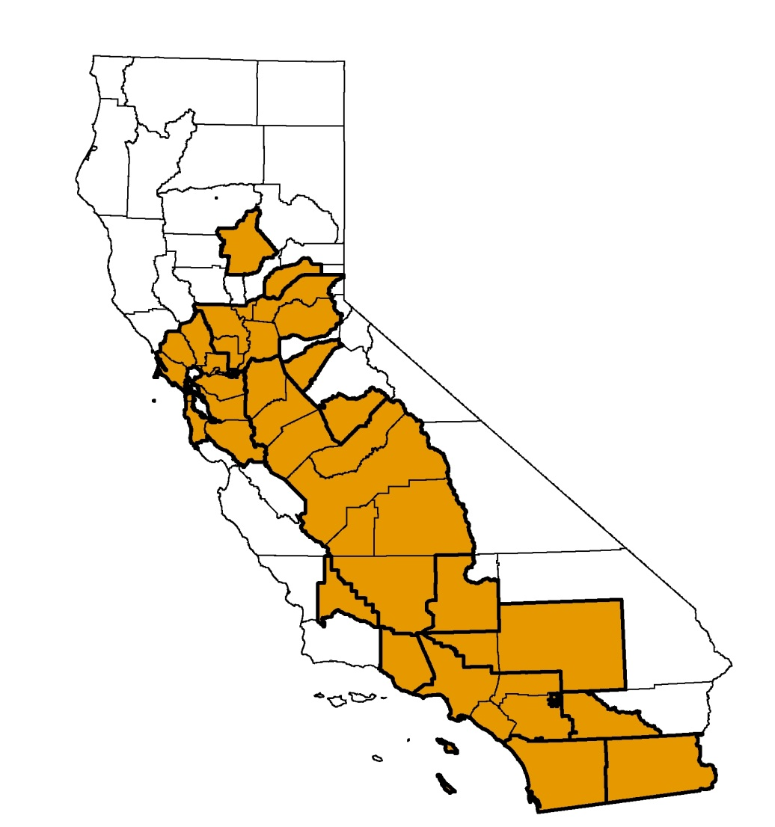
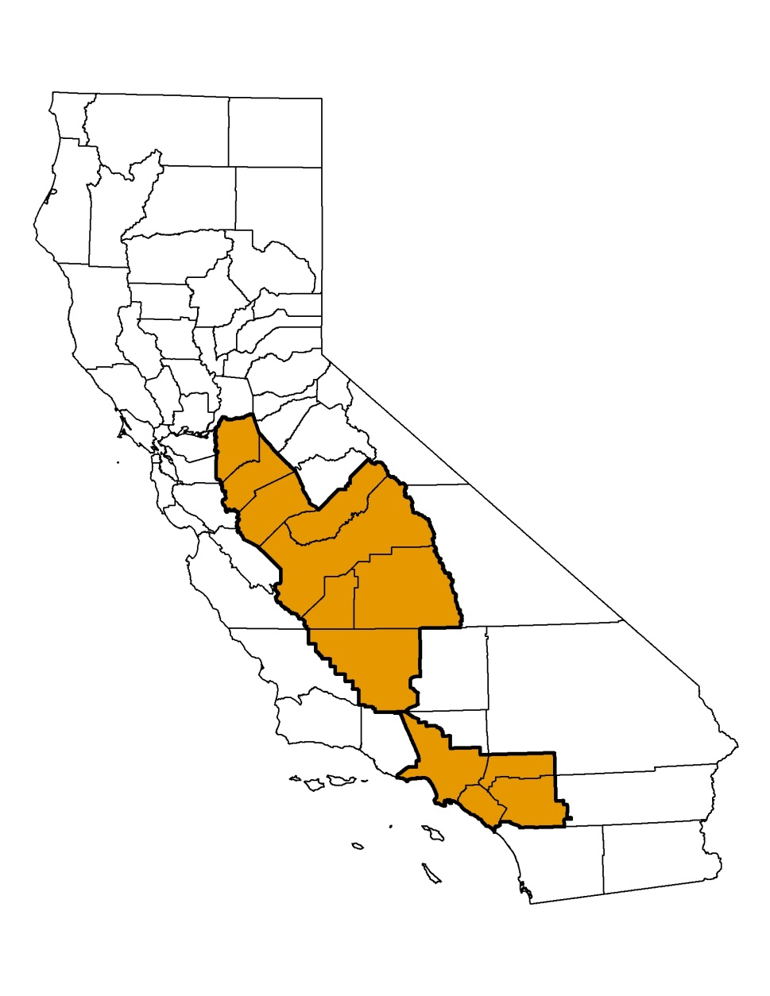
Many Areas of State Do Not Meet Federal Air Quality Standards
Federal 8hr Ozone
Federal PM2.5
Non-attainment

Slide 4
Control Strategies
Cleaner fuels
Cleaner engines
Operational controls
Retrofit
Retire
Replace

Slide 5
Cleaner Burning Diesel
Diesel
  1993 Phase I
    Reduced statewide sulfur levels to 500 ppm
      Lower SO₂ and sulfate emissions
    Reduced aromatic hydrocarbon to 10 percent
      Lower PM and NOx emissions
  2006 Phase II
    Sulfur levels reduced to 15 ppm
    Enables effective aftertreatment (PM, NOx)
      Heavy- and light-duty diesel vehicles

Slide 6
Heavy-Duty Diesel Engine Emission Standards
* Reflects Manufacturer Average
Note: Emissions are average in-use emissions by engine model year

Slide 7
Trucks Significant Source of Emissions
Notes:
Diesel trucks are the largest source of vehicular emissions. They contribute to 40% of PM emission and 32% of NOx emissions.
The Truck and Bus regulation (by itself) is expected to reduce soot, also called diesel particulate matter (PM), emissions by 50 percent in 2014 and by 85 percent by 2016.
The Regulation will achieve emission reductions by requiring the installation of a soot filter on an existing older vehicle, an engine upgrade or vehicle upgrade to meet 2010 emission standards.
PM is a powerful short-lived climate pollutant

Slide 8










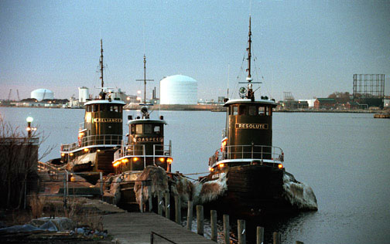
In-Use Diesel Fleet Regulations
Urban Buses (2000) Garbage Trucks (2003) Stationary Engines (2004) Transport Refrigeration Units (2004) Portable Engines (2004) Transit Fleet Vehicles (2005) Public Fleets & Utilities (2005) | Cargo Handling Equipment (2005) Drayage Trucks (2007) Off-Road Vehicles (2007) Tractor-Trailer GHG (2008) Trucks and Buses (2008) Agricultural Tractors and Equipment

Slide 9
Emission Reductions Needed from Existing Trucks
Existing trucks last 20 years or more
Needed to meet federal deadlines
State plan identifies commitments
  Strategy for PM2.5 and Ozone
  Largest share of reductions expected from trucks
70% of known cancer risk from all air toxics
No equivalent federal programs
California leadership is critical

Slide 10
Diesel Emission Control Verification
Verified for PM or NOx reduction
Quantifies system performance to determine if emission reductions are real and durable
  Based on engine model year/tier and engine family
  Unique for on-road, off-road, stationary, etc
Provides a warranty for the device and installation
  Up to 5 years/150,000 miles for filter
  Depends on service class

Slide 11

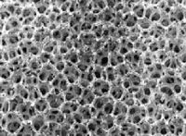
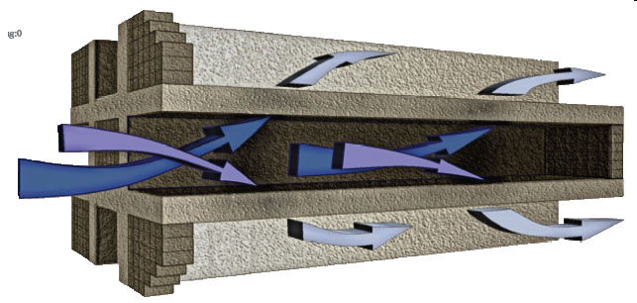
Types of Particulate Controls
Level I Devices
  Diesel Oxidation Catalysts (DOC)
  Monolith (25 – 49%)
Level II Devices
  Diesel Flow-Through Filters
  Wire Mesh (50 – 84%)
Level III Devices
  Diesel Wall-flow Filters
  Wall-Flow (≥ 85%)

Slide 12
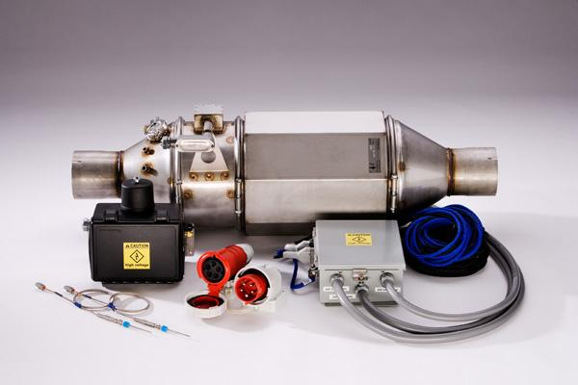
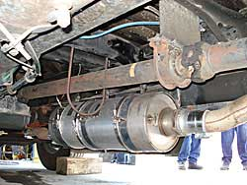
Verified Diesel PM Exhaust Filters

Slide 13
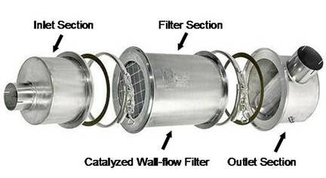
PM Retrofit Filter Costs
PM Retrofits | Installed Cost
Passive | $15,000*
Active | $18,000
* $11,000 for medium heavy-duty vehicles
Wall Flow Filter
Add retrofit picture xxx

Slide 14
Financial Incentive Programs
Grant programs and vouchers
  Funding solely for surplus (early) actions
Loan assistance programs
Funding is available for the following:
  Vehicle replacements
  Exhaust retrofits
  Hybrid trucks
  Engine repowers

Slide 15
Truck and Bus Regulation

Slide 16

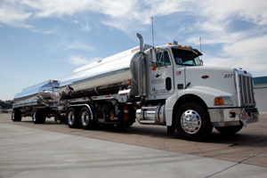
Truck and Bus Regulation Reduces Emissions
Basic Requirements
  Lighter Vehicles
    Upgrade to 2010+ Engine 2015-2023
  Heavier Vehicles
    PM Filters 2012 – 2014, then
    Upgrade to 2010+ Engine 2020-2023
Small fleet options
Phase-in for large fleets
Light
Heavy

Slide 17

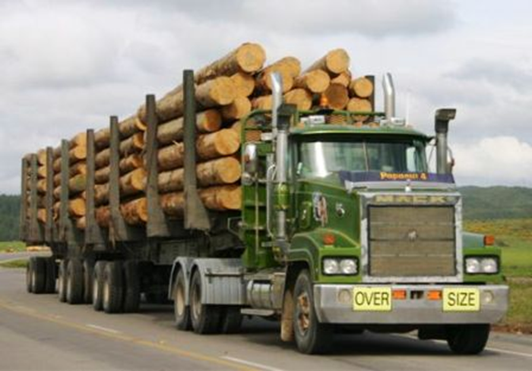

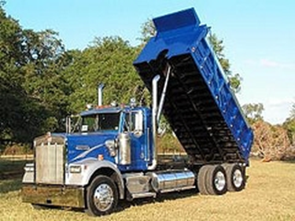
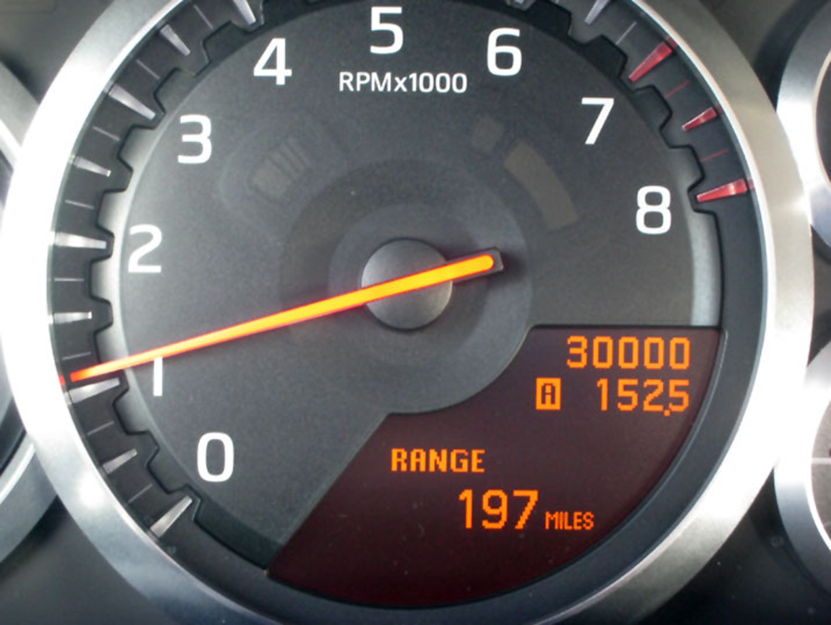
Significant Flexibility in Regulation
Log Truck Phase-In
Low-Mileage Construction
Low-Use Exemption
Compliance 2017 or 2023
Upgrade to 2010 engines 2014-2023
Phase-in 2014 to 2016
1,000 miles per year
100 hours per year if stationary work
NOx Exempt Areas
Filter only phase-in 2014-2016
Low-Use Agriculture

Slide 18
PM Benefits Already Realized

Slide 19
Significant NOx Benefits Expected
Expect 100 tons/day reduction by 2023

Slide 20
Reducing Diesel PM Provides Climate Benefits
Climate impacts
  Increases climate warming
  Accelerates ice and snow melt
  Disrupts precipitation patterns
Immediate reduction benefits
  Air Quality
  Slowing rate of climate change
  Improve public health
Diesel PM contains Black Carbon
Diesel fuel/engine regulations
70% decrease from 1990-2010

Slide 21
Localized Benefits Confirmed
July 2007 and July 2010 L.A./Long Beach study
  Measurements at busy intersections
  Black carbon and NOx levels reduced 50%
November 2009 to June 2010 Oakland study
  Black carbon emissions reduced 54%
  NOx emissions reduced 41%
  Black carbon reduction of 40% at Caldecott Tunnel took 9 years
Notes:
An ARB study focused on the port truck clean up in Los Angeles and Long Beach, measuring pollutant levels at busy intersections in July 2007 and July 2010. The study found that levels of both black carbon and NOx – primarily from diesel vehicles – were reduced by 50% over the three-year period.
A study in West Oakland performed by UC Berkeley researchers measured port truck emissions from November 2009 to June 2010 and found that diesel PM emissions went down 54% percent and NOx emissions went down 41 percent. It is also notable that this port truck clean-up occurred rapidly, in less than a year. Similar reductions for heavy duty trucks at another Bay Area location took 9 years to achieve.
While these near term successes are important, California must continue its progress towards reducing emissions from diesel engines so that we can meet our long-term emission reduction goals.
[Advance]

Slide 22
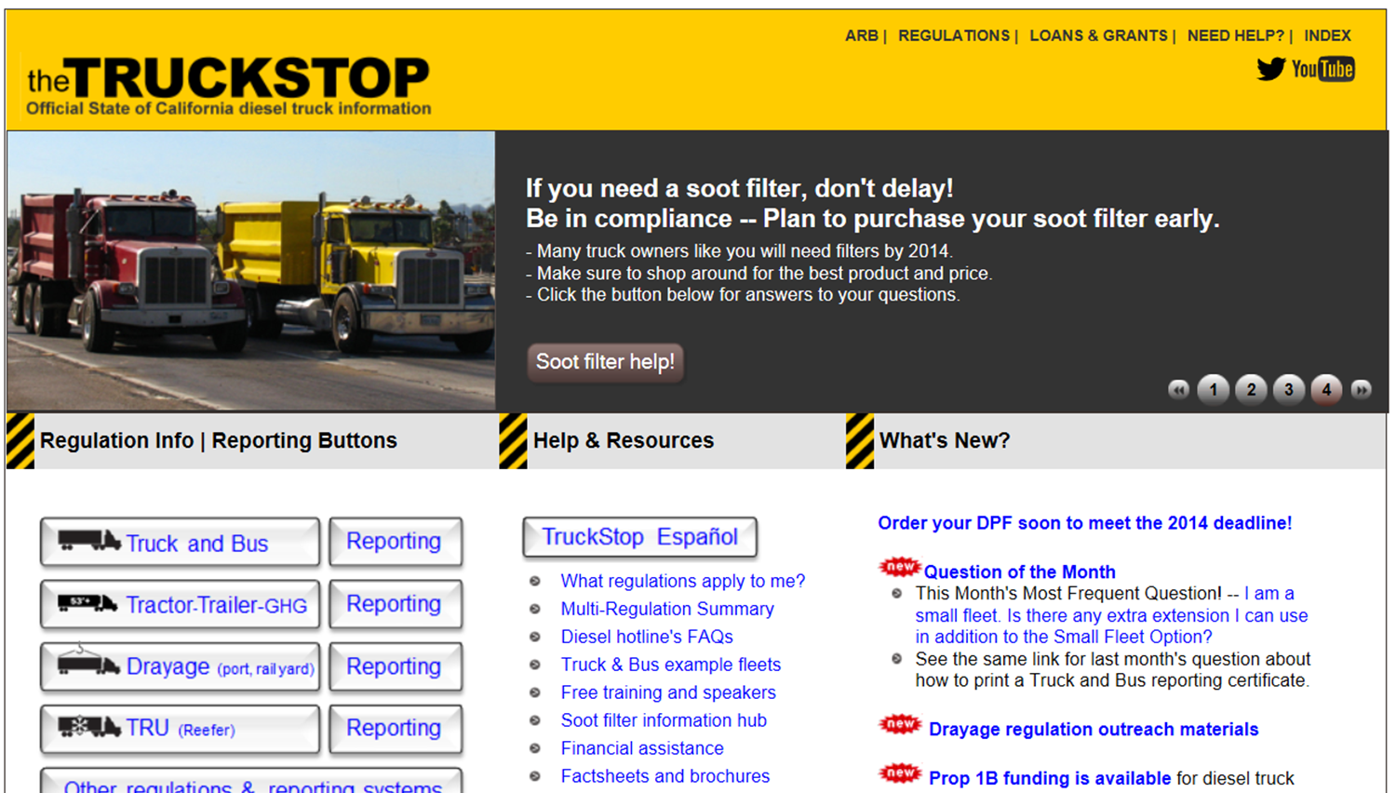
the Truck Stop

