Slide 1
Auto industry preparedness for advancement of vehicular technologies & Fuel efficiency in India
Policy Conclave on reducing vehicular emissions
To improve Air quality
4th– 5th Feb 2014
Presented by :
I V Rao, Executive Advisor, Maruti Suzuki India
Co-Chairman, SIAM National and International Regulation Council

Slide 2
Auto industry preparedness for Advancement of vehicular technologies & Fuel efficiency in India
Policy Conclave on reducing vehicular emissions
To improve air quality
4th– 5th Feb 2014
Presented by :
I V Rao, Executive Advisor, Maruti Suzuki India
Co-Chairman, SIAM National and International Regulation Council

Slide 3
Contents
1. The Journey so far – Emissions and Fuel Update
2. Emission Reduction and Technology Requirements
3. Moving Forward : Basic Requirements
4. Fuel Efficiency Regulation
5. Cost Impact of regulation and its potential impact on Growth
6. Judging Preparedness

Slide 4
Contents
1. The Journey so far – Emissions and Fuel Update
2. Emission Reduction and Technology Requirements
3. Moving Forward : Basic Requirements
4. Fuel Efficiency Regulation
5. Cost Impact of regulation and its potential impact on Growth
6. Judging Preparedness

Slide 5


Emissions/Safety Regulations Progression in India
1992
1996
2000
2005
2010
2014
2017
2020
2022
2024
2026
Emission
EURO1
EURO2
EURO3
EURO4
EURO5
EURO6
Major cities
BS1
BS2
BS3
2013
BS4
BS4 OBDII
Nationwide
BS1
BS2
BS3
BS4 OBDII
BS5
Fuel Consumption
Nationwide for M1 Vehicles
FE Regulation 1
FE Regulation 2
Safety
Full Frontal
Offset Crash
Side Impact

Slide 6
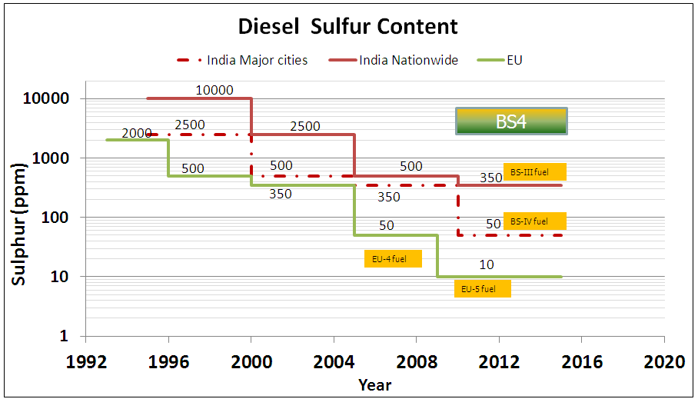
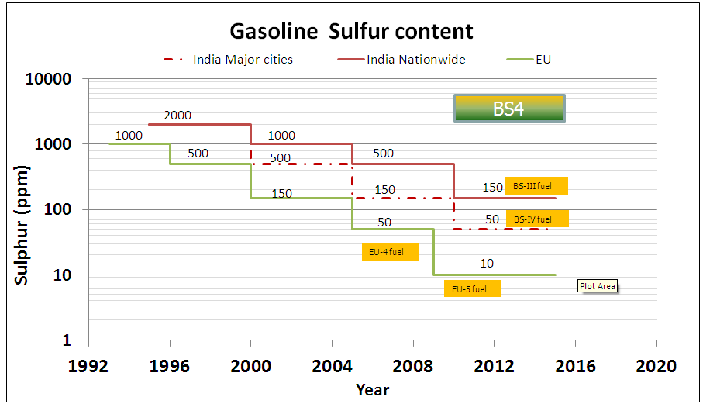
Fuel Specifications Improvement
Fuel and Emission improvement have gone hand in hand thru series of Emission legislations in India

Slide 7
Contents
1. The Journey so far – Emissions and Fuel Update
2. Emission Reduction and Technology Requirements
3. Moving Forward : Basic Requirements
4. Fuel Efficiency Regulation
5. Cost Impact of regulation and its potential impact on Growth
6. Judging Preparedness

Slide 8
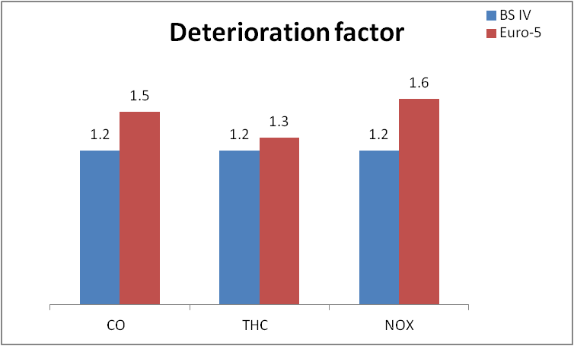
  Future Emission Regulation – Spark Ignition
Emission norms current & Future
NOx: -47%
-44%
CO: -57%
-20%
THC: -50%
-8%
Deterioration factor
Up to 33 %
20% Effective reduction in CO & 44%reduction in Nox, additional limits for NMHC
Longer durability requirement for emission control.
Enhanced OBD requirements for fault in-service (e.g. IUPR).

Slide 9
  Regulatory requirements – Compression Ignition
CO: -22%
PM: -50%
-10%
-26%
NOx+THC: -46%
-80%
NOx: -50%
-23%
-28%
-56%
BS4 → BS5
PM reduction by 80%, NOx reduction by 28% and NOx+THC reduction of 23%.
Additional requirement of measuring and limiting PN to 6.0×10¹¹
With Change to EU6, additional reduction of NOx by 56%, PM by 10% and NOx+THC reduction by 26%

Slide 10
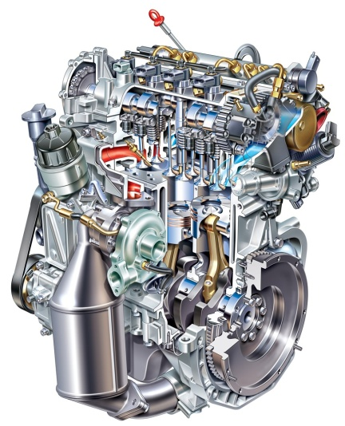


  Meeting the EU5 Regulation
Engine Optimization:
Combustion Process Refinement
Change of Emission Tradeoff
, Oil Consumption reduction, Friction Reduction
Engine out emission Reduction, Fuel Consumption Reduction & Durability Improvement
Vehicle level Improvements:
Weight reduction
Running Loss Reduction,
Improved Air flow – cooling requirements
Emission reduction, Fuel Consumption Reduction
Exhaust After-treatment:
Exhaust Treatment to Reduce Tailpipe Emissions
A three prong improvement for meeting Emissions and Durability needs

Slide 11
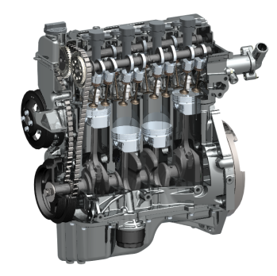
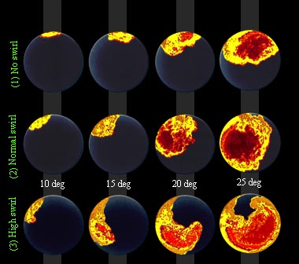
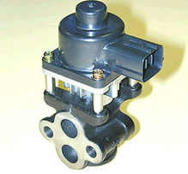
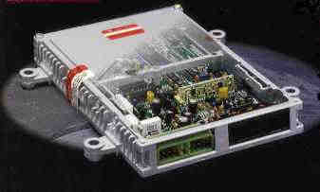
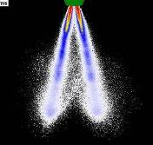
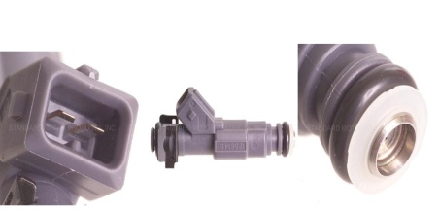
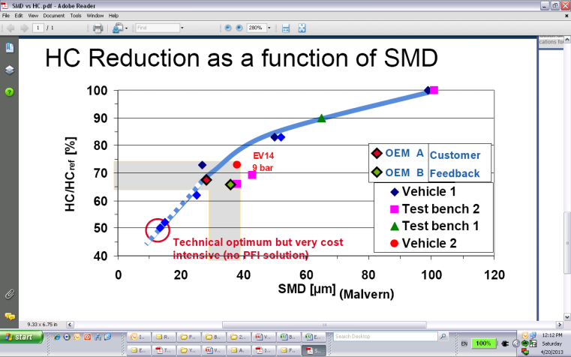
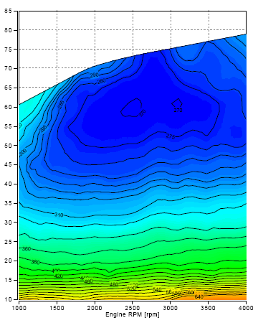
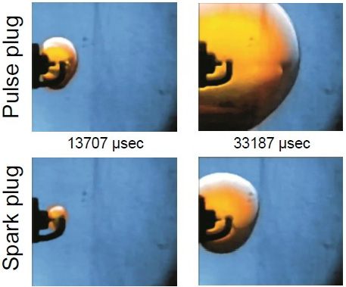
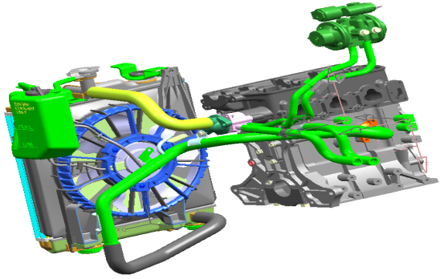
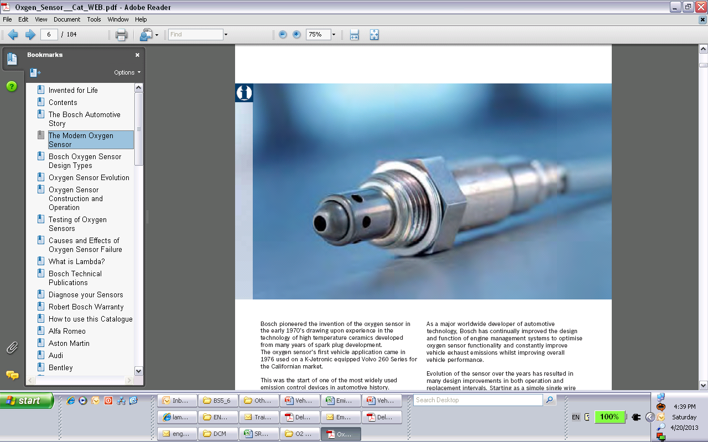
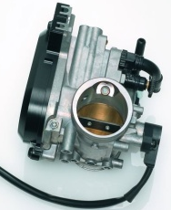
  Meeting the EU5 Regulation – SI Engines
Engine Optimization:
Advanced PFI, Improved Air Fuel Control (VVT, LAF, ETC)
EGR, High Pressure injection with lower SMD, High Energy Ignition Control, High CR
Engine out emission Reduction, Fuel Consumption Reduction & Durability Improvement
High CR & Engine Mod.
EGR & High Energy Ig.
Advanced PFI
Major Engine Modifications for Durability and lower Engine out emissions. Need lower Sulfur levels to ensure durability of the parts/sensors

Slide 12
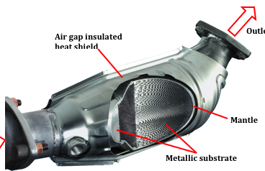
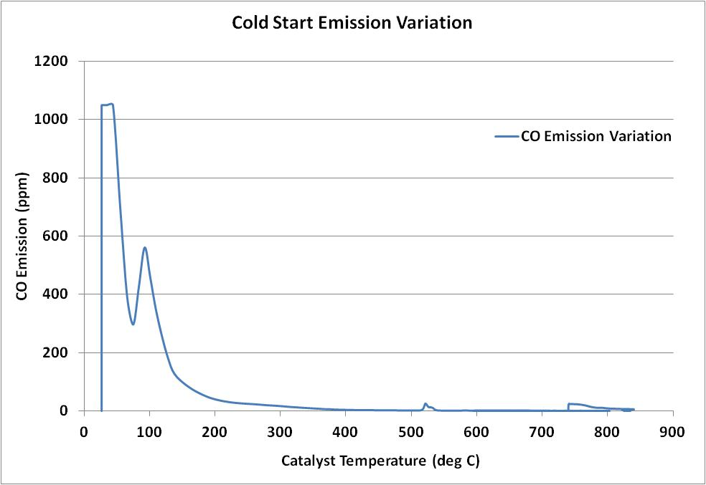
  Meeting the EU5 Regulation – SI Engines
Exhaust After-treatment:
Higher Catalyst Loading with improved durability
Higher Cell Density
Exhaust Treatment to Reduce Tailpipe Emissions
Increase in Cell Density and Precious metal
Catalyst Light off improvements to improve Cold Start Emissions
More Durable emission After Treatment System will be the requirement. Low Sulfur required for durability requirements

Slide 13
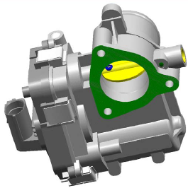
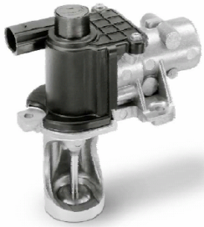
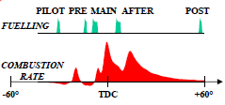

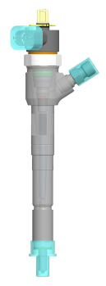
  Meeting the EU5 Regulation – CI Engines
Engine Optimization:
Combustion Process Refinement
Change of Emission Tradeoff
, Oil Consumption reduction, Friction reduction
Engine out emission Reduction, Fuel Consumption Reduction & Durability Improvement
Higher EGR
PM
Higher EGR at Low Loads
NOx
Lower Comp. ratio
Injection Rate Shaping
Engine Re-design and Optimization will be the key to achieve low and durable emissions
Sensitivity to higher sulfur levels increases

Slide 14
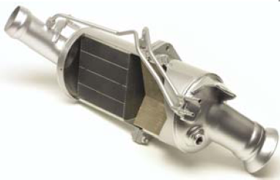
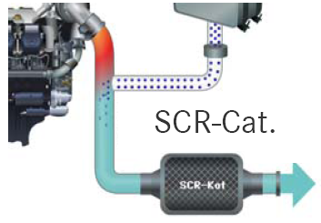
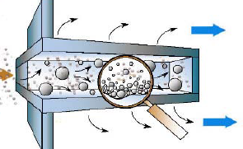
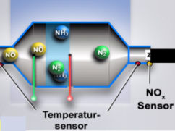
  Meeting the EU5 Regulation – CI Engines
Exhaust After-treatment:
Diesel Particulate filter/
SCR Alternative Routes
Exhaust Treatment to Reduce Tailpipe Emissions
PM Control by Engine Optimization with NOx control by an after Treatment device
PM
NOx
SCR - Alternative
Particulate Filter will be a must for PM control. Passive Regeneration will be the key. Low sulfur will be required for durability requirements

Slide 15
Contents
1. The Journey so far – Emissions and Fuel Update
2. Emission Reduction and Technology Requirements
3. Moving Forward : Basic Requirements
4. Fuel Efficiency Regulation
5. Cost Impact of regulation and its potential impact on Growth
6. Judging Preparedness

Slide 16
Contents
1. The Journey so far – Emissions and Fuel Update
2. Emission Reduction and Technology Requirements
3. Moving Forward : Basic Requirements
a) One Nation One Fuel One Norm
b) Fuel requirements for Next stage of Emissions
c) Adopting Next level of emissions – Not a Plug & Play

Slide 17
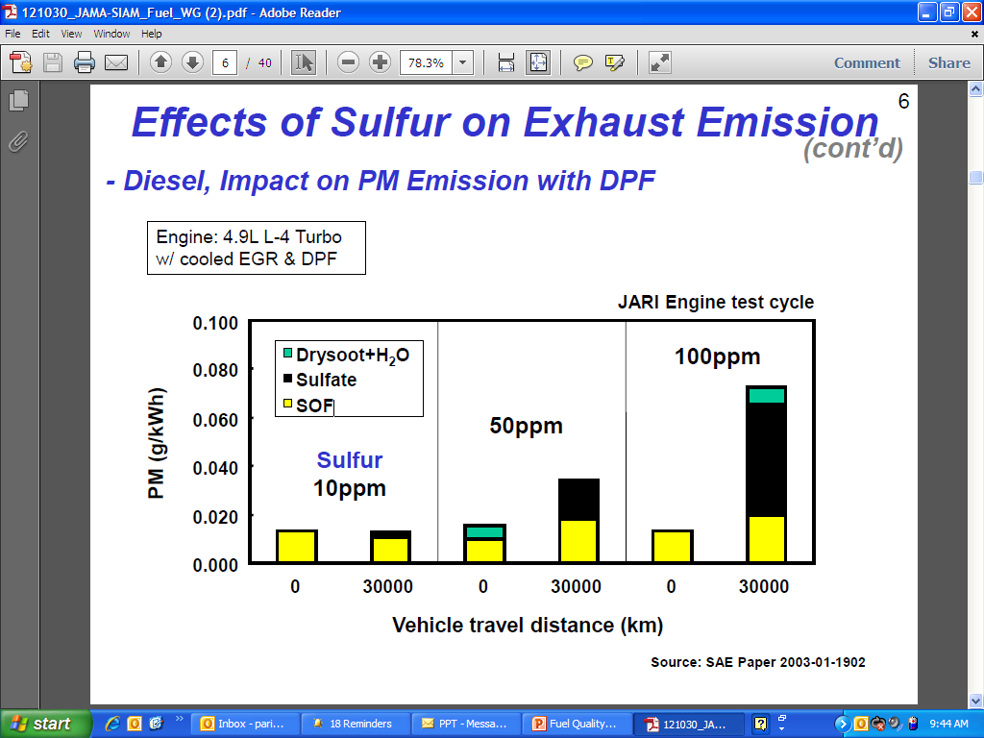
“One nation One fuel” Requirement
Non-availability of BSIV spec fuel in the areas beyond the 13 cities does not allow spreading higher emission regime to more areas
Migration of Vehicles from BSIII regions impact Emissions in BSIV areas
Migration of BSIV Vehicles to BSIII areas result in Deterioration of Emissions and durability of parts when running with BSIII Fuel
Deterioration of Emissions
A need rather than a wish for Improving Ambient Air Quality

Slide 18
“One nation One Fuel” Requirement
Higher Sulfur in Fuel results in Deterioration of Emissions
This phenomenon is not a “temporary phenomenon” in Indian conditions
Recovery of catalyst efficiency happens only when the vehicle is run at high speed and catalyst temperature is high.
Vehicles running with high sulfur result in Deterioration of emissions while in service

Slide 19
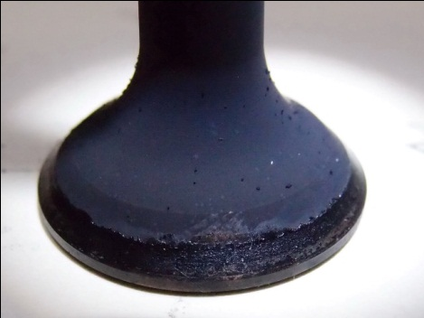
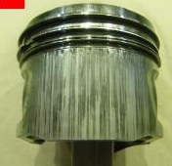
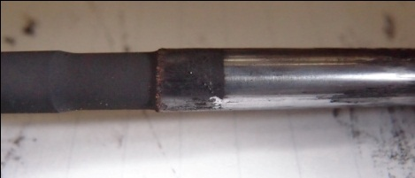
Fuel Requirements for Next Stage Emission norms –
Impact of Fuel Quality and Specifications
Emissions from Vehicles are impacted by Durability of the engine Parts
Engine parts get impacted by running with Higher Sulfur fuel
Lower Emission Vehicles have become more and more intolerant to higher sulfur
BS5 requires higher Emission Durability from Vehicles
Fig: Impact of BSIII Fuel on BSIV Vehicles
Engine Hardware on BSIV Vehicles - intolerant to lower fuel specifications
BS5 Engines will not be able to tolerate higher than 10PPM fuel

Slide 20
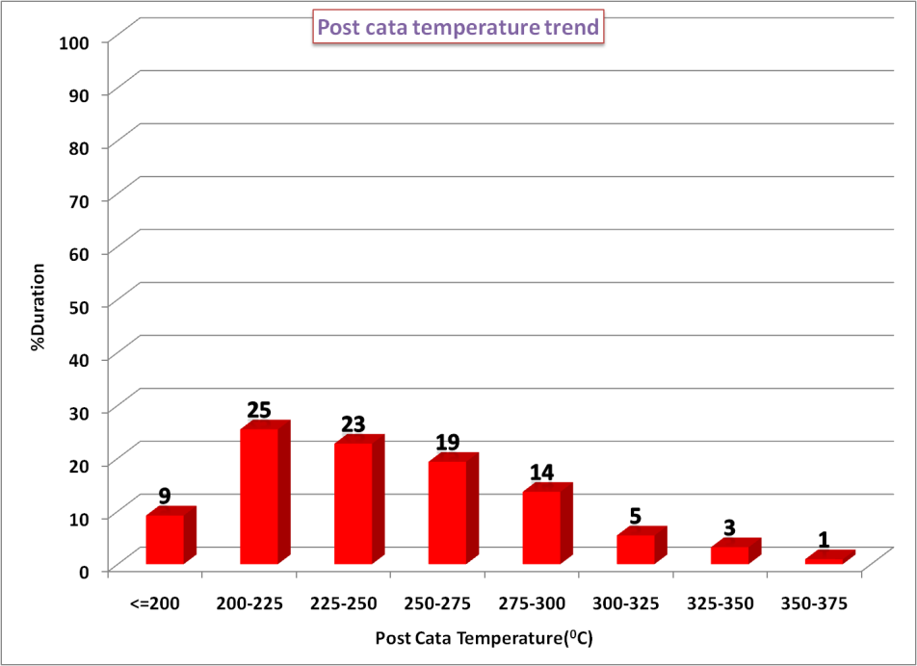
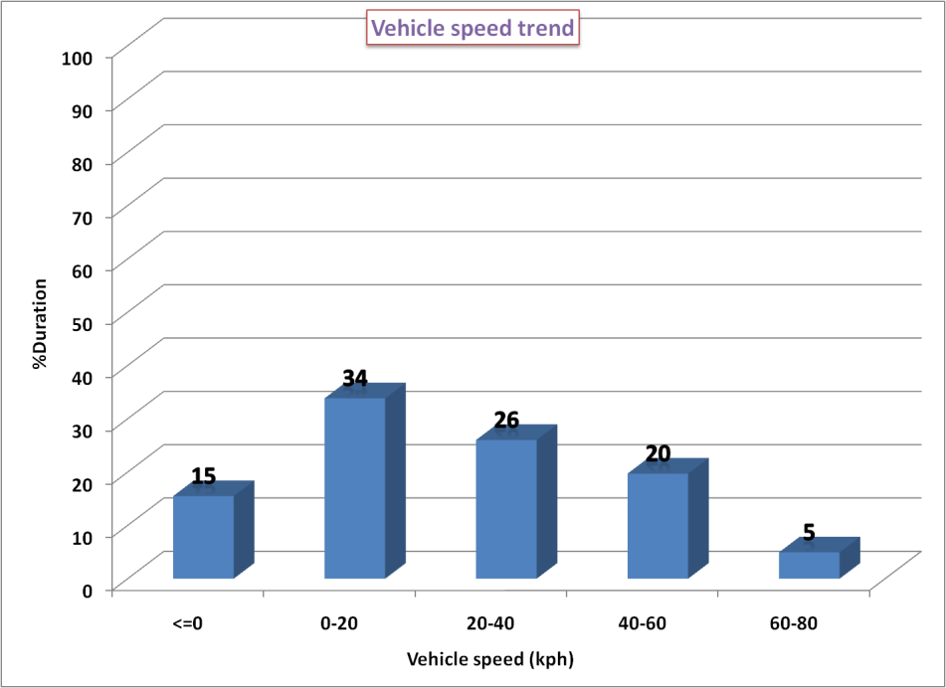
Fuel Requirements for Next Stage Emission norms –
Impact of Fuel Quality and Specifications
Indian Driving conditions – Challenge for Durability
90% Time, exhaust temperature is lower than 300^{O}C
75% time running lower than 40kph
Lower Temperatures => Lower chances of Passive Regeneration
Temperature in the range 250ºC to 300ºC range → Opportunity of passive regeneration only provided if low S diesel is available
Passive Regeneration
NO + O2 = NO2
Regeneration of NO2 depends on Sulfur
NO2 + C = CO/CO2 + NO
10PPM sulfur fuel a must for improving passive regeneration

Slide 21


Impact of fuel Sulfur on engine durability of BS5 Vehicles
Delhi city driving : Impact on Fuel Dilution
Delhi city Running
Fuel: BS4
Oil dipstick level
0
500
Source: Bosch
Vehicle mileage [km]
Higher Soot loading on DPF observed as expected with 50PPM fuel.
Higher Instances of Active Regeneration (Post injection of Fuel to increase Exh. temp. > 550^{O}C
Higher Oil Dilution observed due to higher Active Regenerations – a critical Engine Durability Concern
Fuel Sulfur of 10PPM required to ensure Engine durability in BS5 Vehicles

Slide 22
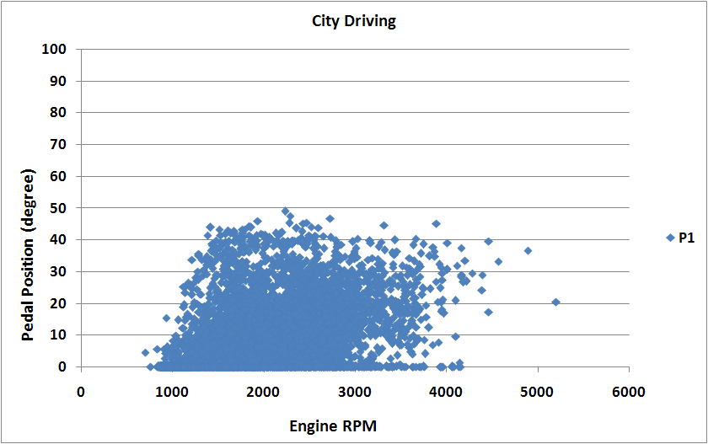
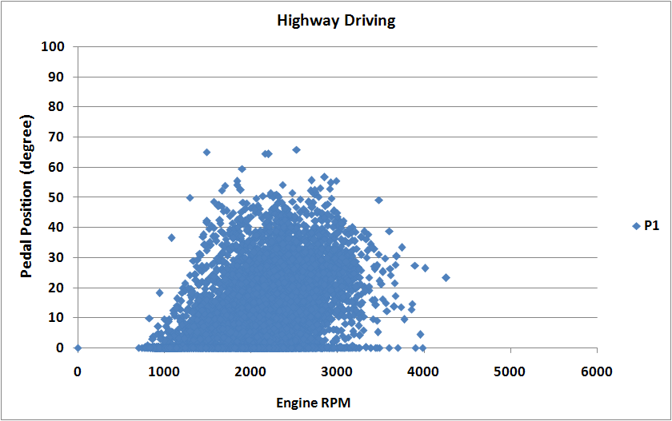
Adopting Future Emission Regulations: Not a Plug and Play solution
Indian Driving conditions and Driver behavior is not same as European driving style
BS5 Development in India is not going to be a Plug and Play solution

Slide 23
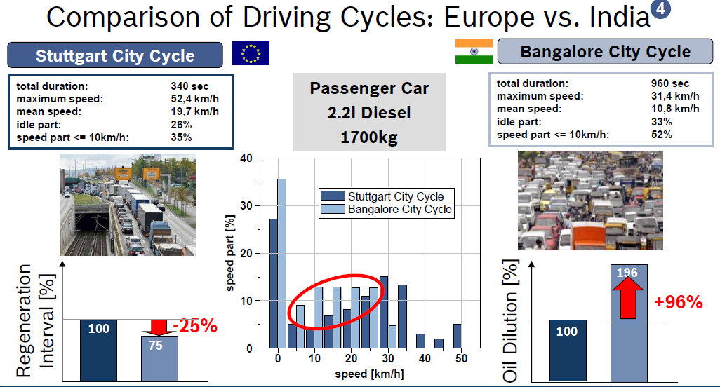
Adopting Future Emission Regulations: Not a Plug and Play solution
Developing a BS5 vehicle is not just about meeting emissions on the test cycle
It is about making sure the solution runs in Indian conditions
Source: Bosch
European solution will need to be re-developed for Indian condition

Slide 24
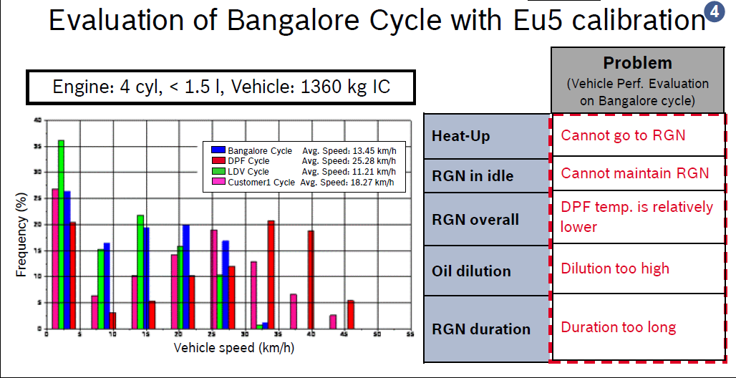
Adopting Future Emission Regulations: Not a Plug and Play solution
Source: Bosch
European Solution/Experience will be useful but will need re-development for India
EU6 to be implemented in Europe from 2014. India will need to learn from European experience

Slide 25
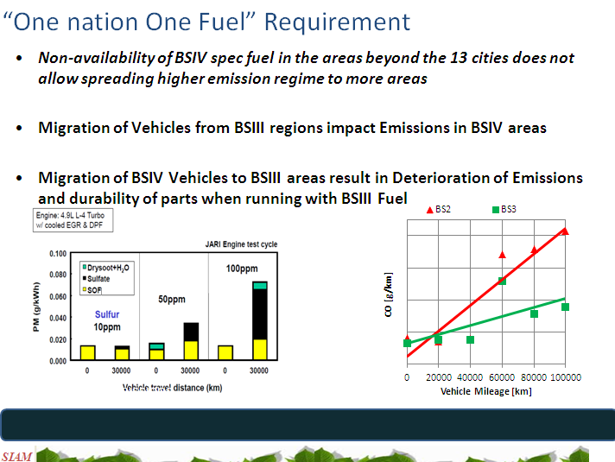
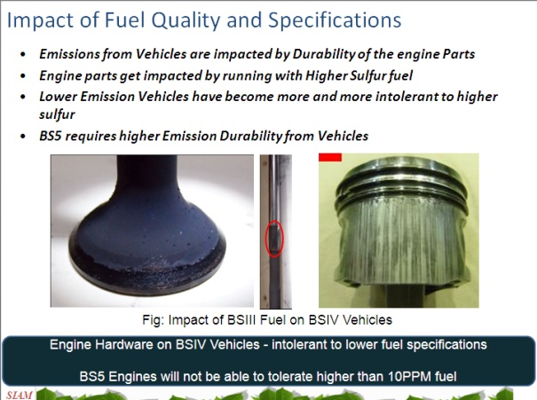
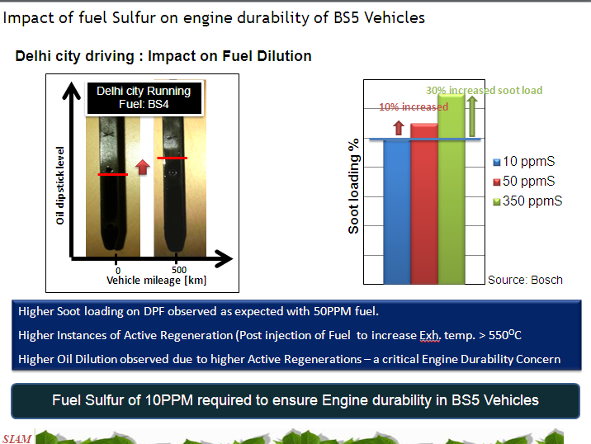
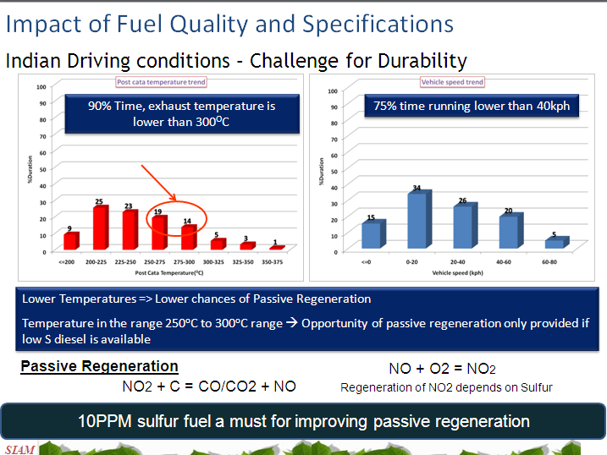
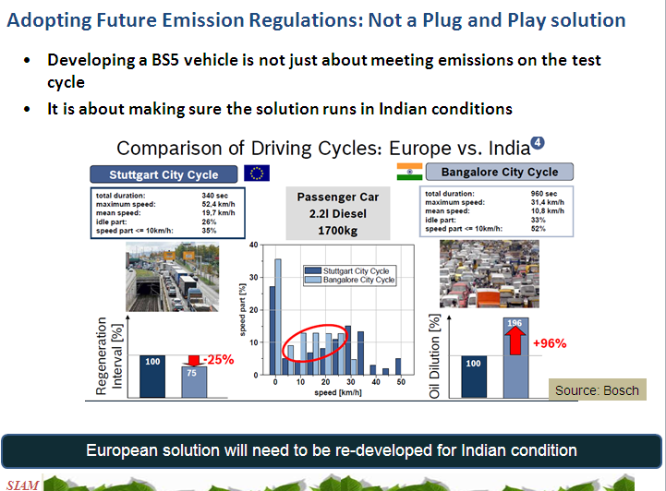
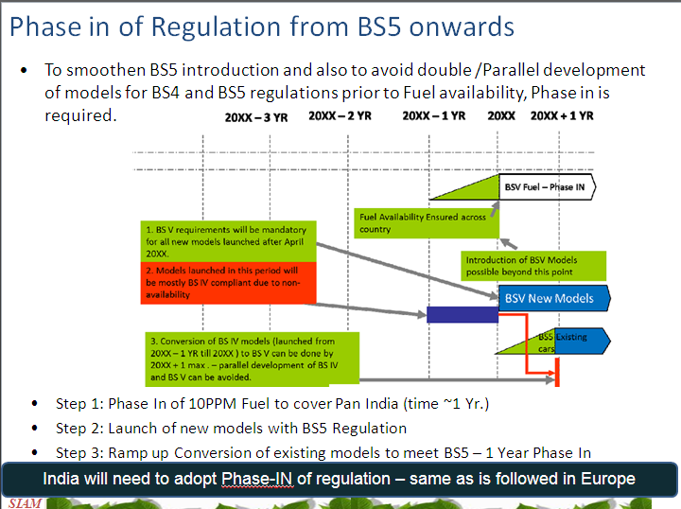
Going Forward – Basic Requirements Summary
Single Fuel
Sulfur: Impact on BSIV Engine
Sulfur : Impact on BSV Engine
BS5 : 10 PPM Fuel
BS5: Need Lead time
Phase-In Need
Policy needs to facilitate a smooth transition and trouble free aftermarket experience

Slide 26
Contents
1. The Journey so far – Emissions and Fuel Update
2. Emission Reduction and Technology Requirements
3. Moving Forward : Basic Requirements
4. Fuel Efficiency Regulation
5. Cost Impact of regulation and its potential impact on Growth
6. Judging Preparedness

Slide 27







New Car Fuel Efficiency Standards
CO2 Reduction
Improved Fuel Economy
Europe
2.08 % per yr
Main Driver: Expected Co2 Legislation
160 g/km 130 g/km (2012~2015)
Outlook: 95~105 g/km (2020)
North America
3 %
per yr
Local CO2- Incentives (California)
Café 220 g/km 146 g/km (2020)
Japan
JAMA self- commitment
160 g/km 140 g/km (2009)
Outlook: 113 g/km (2020)
Mexico
Comprehensive regulation in 3-5 years
India
FE regulation
Under Discussion
Australia
Proposed Regulation
2020 – 195 g/km
Japan and Europe to improve at a rate of 2% for 2015 Regulations

Slide 28
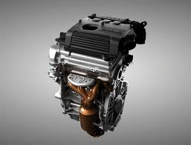
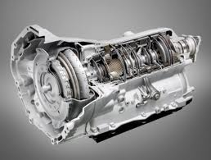
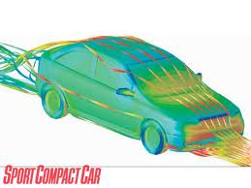
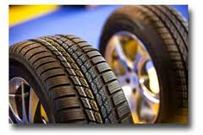
Technologies for Improvement of Fuel Efficiency
Engine efficiency
Transmission Efficiency
Vehicle Weight & Shape
Rolling Resistance of Tires
Fuel Shift can also contribute to Efficiency of Fleet
Limitations of Usage of FC Improvement ideas in India
Comparison with other countries usually not justified

Slide 29
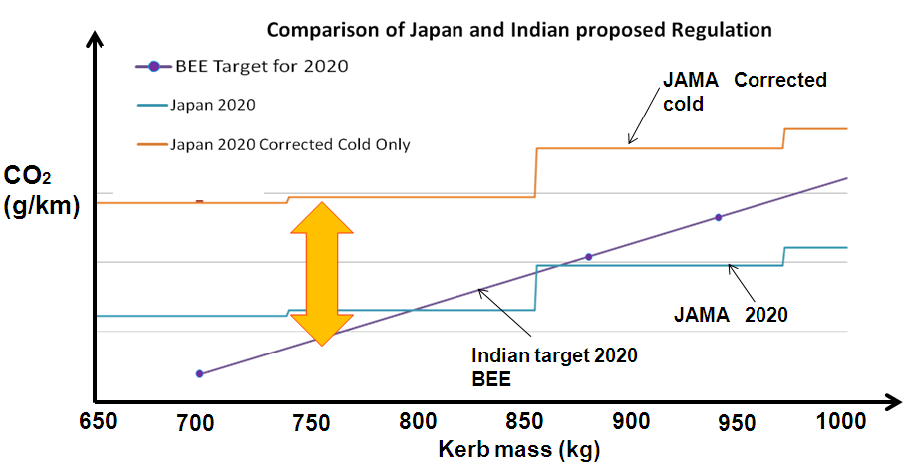
Regulation comparison
Japan has set 2020 Target (Declaration : 25% of cold start + 75% of hot start)
Japan also is targeting around 20% Hybrid Fleet by 2020 (Source : JAMA/MLIT)
Indian regulation in similar category cannot be more stringent than Japanese regulation
  Indian Proposed Standard is more stringent than the Japanese Regulation for 2020 for small vehicles

Slide 30
Contents
1. The Journey so far – Emissions and Fuel Update
2. Emission Reduction and Technology Requirements
3. Moving Forward : Basic Requirements
4. Fuel Efficiency Regulation
5. Cost Impact of regulation and its potential impact on Growth
6. Judging Preparedness

Slide 31
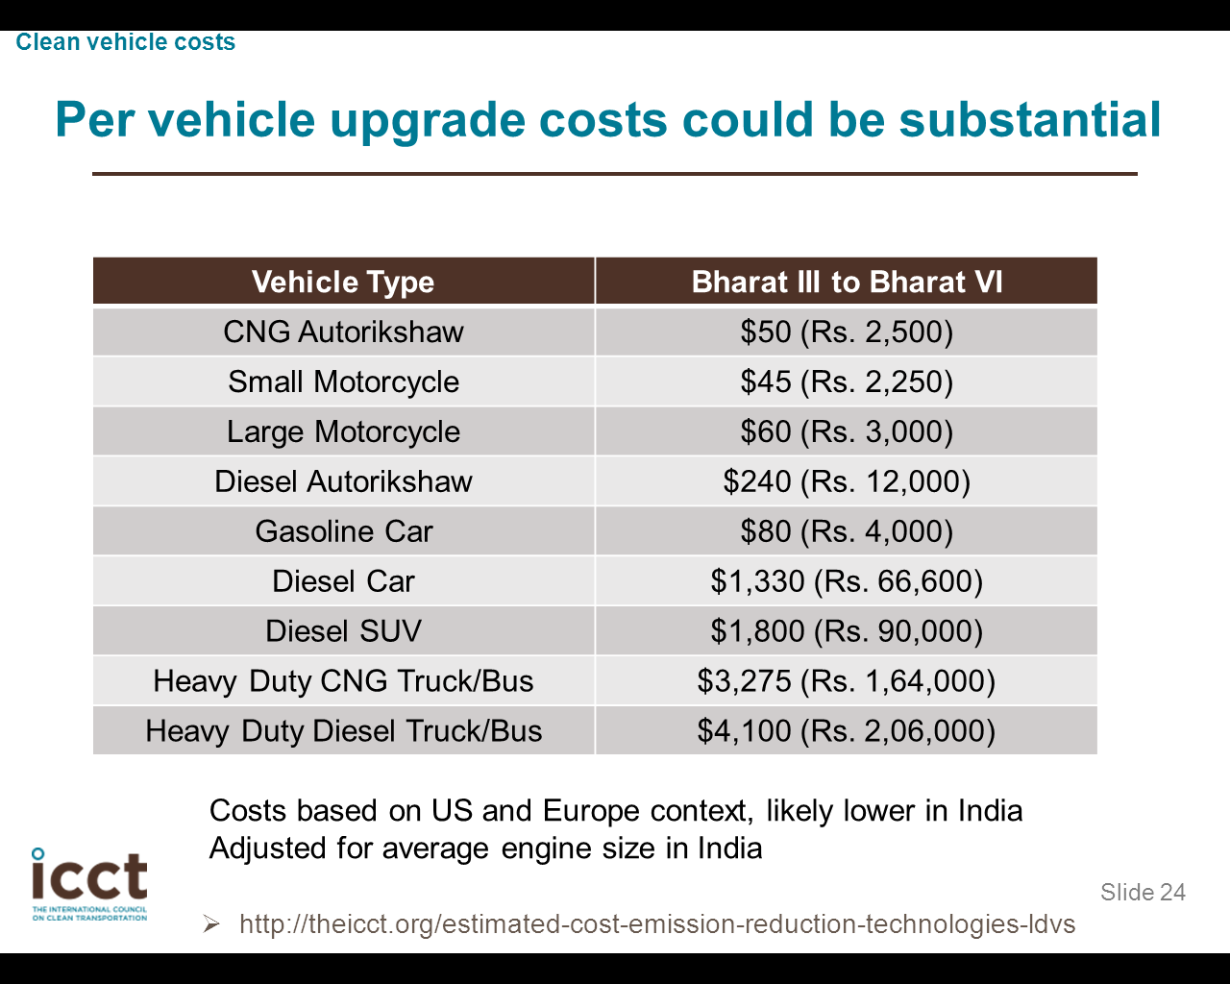
Cost Impact of Regulation
ICCT Estimates
Industry Estimates
Regulation | Gasoline, Cost Increase*, Rs | Diesel, Cost Increase*, Rs
BSIV to BSV | 3,000 | 40,000
BSV to BSVI | 6,000 | 60,000
* Vehicle Price increase could be 30% to 45% higher depending on Excise duty etc
The cost estimates are similar and very high for adoption of BSV regulation for Diesels

Slide 32
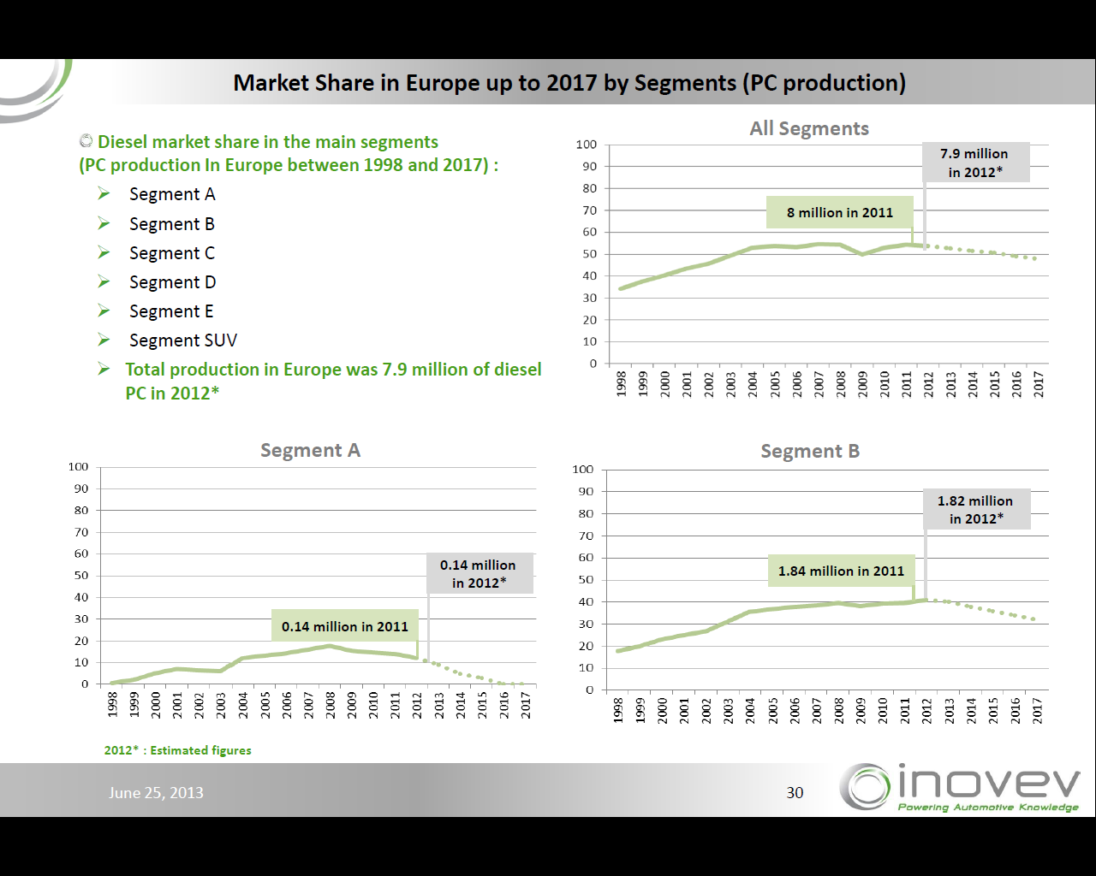
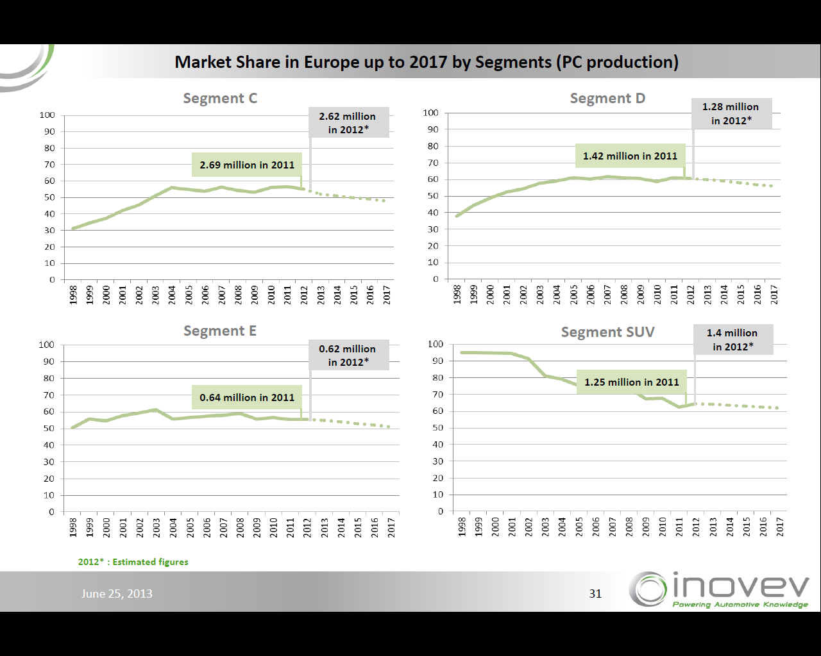
Impact of Cost increase due to EU5 Regulation
In Europe, the impact of Cost increase almost wiped put the small diesel vehicles
India is a predominantly Small Car market and Price sensitivity is higher for an Indian customer.
Impact of cost increase in In India is going to be very high for Diesel vehicles

Slide 33

Impact of Fuel Price Differential on share of Diesel
Source: Society of Indian Automobile Manufacturers
Impact of Fuel price differential/Payback period seen clearly on Diesel sales
Reduction of Diesel Share will make the FE target even more stringent
High cost of Diesel BS 5 Cars will further impact Diesel Car sales
33

Slide 34
Impact of Diesel Penetration decrease
The penetration of Diesel vehicles is bound to decrease with such high cost of implementation of BS5
Penetration change will increase the Fleet Average CO2 of a Manufacturer by around 3%
To meet the regulation, the Manufacturer will have to implement more Fuel Efficiency improvement ideas on Gasoline vehicles (Beyond Plan).
Will increase cost of Gasoline vehicles and hence total growth of Industry
The Diesel Penetration could go down to around 20~30% with higher Vehicle Price

Slide 35

Impact of FE Regulation
High Cost Impact of Vehicles based on New suggested targets of GOI especially smaller vehicles
Payback period will deter buyers to purchase such vehicles
Vehicle sales price increase
~Rs 52000
( ~17% )
Source: Cost Curve based on BEE Document: Car Fuel Efficiency assessment 2011-11-10
  Need to have a Rational Fuel Efficiency Regulation considering Indian fleet

Slide 36

Small Car Contribution
India is Largest producer of small cars
India has the potential to become the largest exporter of Small cars in the world

Slide 37



Small Car - Contribution to CO2 reduction
Source: MSIL Calculation based on 2009~10 SIAM Data
Policies should be conducive to the Growth of Small Cars as per AMP 2016

Slide 38
Contents
1. The Journey so far – Emissions and Fuel Update
2. Emission Reduction and Technology Requirements
3. Moving Forward : Basic Requirements
4. Fuel Efficiency Regulation
5. Cost Impact of regulation and its potential impact on Growth
6. Judging Preparedness

Slide 39
Impact Assessment
Fuel
Improvements
Infra
Improvements
Impact of Regulation
Tech Upgrades
Infra
Improvements
Tech Upgrades
Impact on Ambient Air
Cost of Improvement
Driver
Behavior
Fuel
Improvements
Cost of Improvement
Socio Economic Impact is a must before enacting any regulation

Slide 40
Complimentary Measures – Air Quality/Fuel Consumption
Mainstream Interventions
Complimentary Measures
Fuel Specification Improvement
Fuel Quality Audit at Retail Outlets
Vehicle Emission improvement
Inspection and Maintenance
Develop CNG/LPG as a mainstream fuel
Fleet Renewal
Emission Source Monitoring
Existing Vehicles emit/consume less
Cleaner Emissions from New Vehicles
Emission Load increase is eased off
Better Energy Security
Durable Emissions during service life
Consumer Awareness
Removing highly polluting fuel guzzling vehicles from vehicle Parc.
Emission Improvement from un-related areas
Mainstream and Complimentary measures have to be taken together to improve Ambient Air quality

Slide 41



Judging Preparedness
100 %
Road Infrastructure
Driver Education
Multi Modal transport
Source Apportionment
Socio/Economic Impact assessments
Fuel Infrastructure
Auto Industry / Vehicle Technology
0 %
Auto and Fuel Industry have gotten their act together
Need to focus on Complimentary measures to improve Ambient Air

Slide 42
Thank You for Your Attention

