Slide 1

Role of Low Carbon Fuel Standard in Reducing Transportation Emissions
Sonia Yeh
Researcher
Institute of Transportation Studies
University of California, Davis
Policy Conclave on Reducing Vehicular Emissions to Improve Air Quality
4th– 5th Feb 2014
New Delhi, India

Slide 2

California Greenhouse Gas Emissions (GHG)
Total emissions = 450 MMTCO2e/year, 2010
Total emissions = 500 MMTCO2e/year, 2010 including domestic and international aviation and international marine bunker fuel use are included.
To meet our climate goal and air quality targets in 2050 (~86 MMTCO2e), transportation will need to achieve the largest GHG reductions of any sector from 2010 to 2050, while at the same time remaining the highest contributor to overall emissions of any sector in 2050.
Source: EIA State Profiles and Energy Estimates (2013)

Slide 3
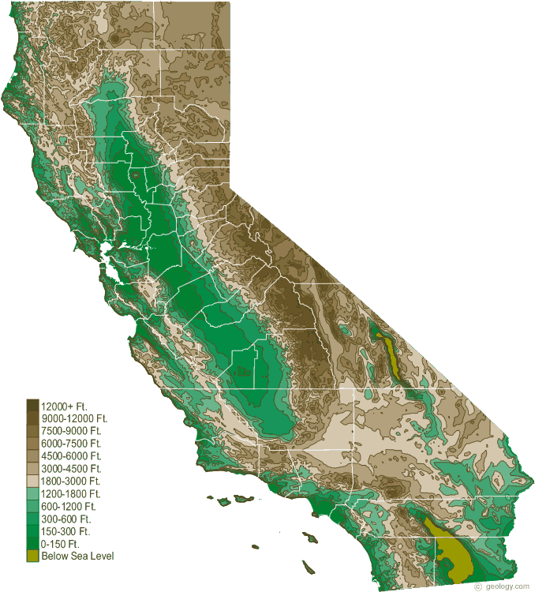
California Energy – By the Numbers
GSP ~$1.93 Trillion (2010)
Electricity Consumption
~260,000 GWh (2010)
Peak Demand
~64,000 MW (2006)
Energy Expenditures (2010)
~$33.4B Electricity
~$15B Natural Gas
~$72B Petroleum
Total ~ $320Million/day (2010)
References: US DOE Energy Information Agency and California Energy Commission
Notes:
Transportation is the largest component of our State energy bill by far and the sector is dependent on a single commodity (petroleum) where price is inextricably tied to global markets (regardless of the source of production).

Slide 4

Costs of Dependence of Fossil Fuels (partial)
Estimates for greenhouse gas emission damage costs vary widely. A comprehensive interagency study¹ estimates average costs = $13-69/MTCO2e in 2020:
200 MMTCO2 = $2.6 - $13.8 B/yr
Other external cost factors (e.g. health and environmental costs from criteria air and water pollution, etc.) ~ $10B’s/yr
Estimates of the economic cost of petroleum dependence ~$10-30/barrel²
~450M barrels/year = $4.5-$13.5B/yr
Ref/notes: Numbers applied for California emissions
¹http://www.epa.gov/climatechange/EPAactivities/economics/scc.html
Graphic: “Our Changing Climate”, www.energy.ca.gov/2012publications/
CEC-500-2012-007/CEC-500-2012-007.pdf
²EPA/NHTSA, table 4-13, siting ORNL/Leiby (2009)
Notes:
The costs of oil dependence to the United States are caused by a combination of:
1. The exercise of monopoly power by certain oil-producing states,
2. The importance of petroleum to the U.S. economy, and
3. The lack of ready, economical substitutes for petroleum.
Costs exceed those that would prevail in a competitive market due to the use of market power chiefly by nationalized oil exporters. The direct economic costs of oil dependence can be partitioned into the following three, mutually exclusive components (Greene and Leiby, 1993):
1. Disruption costs, reductions in gross domestic (GDP) due to price shocks,
2. Long-run GDP losses due to higher than competitive market oil prices,
3. Transfer of wealth from U.S. oil consumers to non-US oil producers via monopoly rents.

Slide 5
Need Massive Shift Away From Petroleum in Cars and Trucks To Meet 2ºC Goal (450 ppm)
(2/3 of cars and urban trucks and 1/3 of long-haul trucks in this scenario)
IEA, 2012
More CNG/LNG in some new projections in both the BAU (without climate policy) and with climate policies

Slide 6
Projections of India’s Future Transportation Fuel Use Varies Dramatically Among Major Global Models
GCAM’s Projection of Energy Intensity in 2050

Slide 7
Future Transportation Fuel Demand and GHG Emissions will be Dominated by Developing Countries
Mishra et al. (2014) Global Transportation Demand and Fuel Use Assessment in the New IPCC Shared Socioeconomic Pathways (SSPs)

Slide 8
Future Transportation Fuel Demand and GHG Emissions will be Dominated by Developing Countries
Mishra et al. (2014) Global Transportation Demand and Fuel Use Assessment in the New IPCC Shared Socioeconomic Pathways (SSPs)

Slide 9
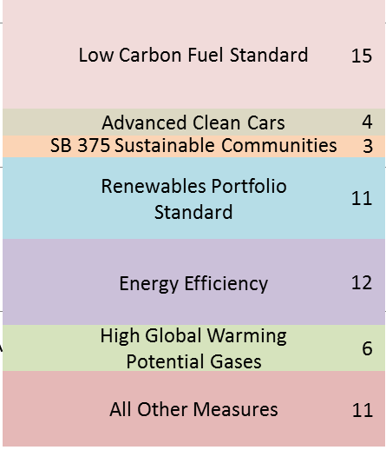

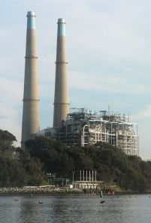
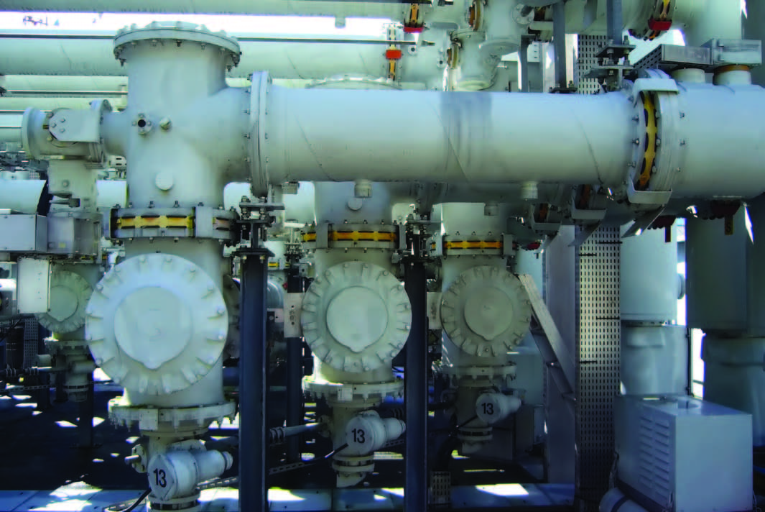

California Climate Goals in 2020
Business as Usual
Estimated reductions from: “Regulatory measures”
2015 Expanded Scope
Cap and Trade “Closes the Gap”
GHG MT/Year
AB32 2020 Limit
2020 Uncapped Emission
Emissions from capped sectors
Cap and Trade
+
2015
Year
2020
Notes:
2015 cap = 394.5 MMT + 8% offset limit
2020 cap = 334.2 MMT + 8% offset limit

Slide 10

Transportation GHG Reduction strategies
Primary Energy Carbon Intensity
Total
Demand
Efficiency
GHG Emission
(MTCO2e per Year)
GHG (MTCO2e)
Energy
Energy
Mile
Miles year
=
x
x
Vehicle
Efficiency
Land Use, Transportation Planning
Low carbon fuels
IMPROVE
AVOID and SHIFT

Slide 11
FCV
Hybrid
Hydrogen
Plug-in’s
Biofuels

Slide 12
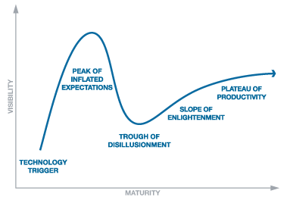
Fuel du jour Phenomenon
Disruptive and wasteful
Fuel du jour Phenomenon
Disruptive and wasteful
35 years ago – Synfuels (oil shale, coal)
25 years ago – Methanol
20 years ago – Electricity (Battery EVs)
10 years ago – Hydrogen (Fuel cells)
7 years ago – Biofuels
Today – Electricity (PEVs)
What’s next?
Without policy intervention, we’d start all over with unconventional oil
Hype Cycle

Slide 13




India’s Biofuel Policy – mandatory countrywide 30% blending of Jatropha biodiesel by 2020
2000
2003
2011
2013

Slide 14


Many Policy Approaches
Volumetric mandates
  e.g. US Renewable Fuel Standard
  Government picking winners?!
Fuel subsidies
  eg, corn ethanol and biodiesel
  Can be effective when done selectively and initially
  Expensive for taxpayers (and budget)
Market instruments
  Carbon taxes or cap and trade
  Ineffective at overcoming large barriers to entry (at politically palatable prices)
Low carbon fuel standard (LCFS)
  Hybrid of performance-based and market-based policy instrument
+

Slide 15
Key Features of California’s Low Carbon Fuel Standard
Key Features of California’s Low Carbon Fuel Standard
Administered by California Air Resources Board
  University of California, Berkeley and Davis provided policy blueprints by the request of the Gov.
Regulated parties are transport energy suppliers
  Oil providers, plus others who want to earn credits, such as biofuel, electricity, NG and H₂ providers
Requires 10% reduction in carbon intensity (gCO₂-eq/MJ)
Carbon intensity measured as life cycle emissions
Includes all fuels (oil, biofuels, electricity, natural gas, hydrogen, etc)
Allows trading of credits
Notes:
15

Slide 16
Legal Status Becoming More Secure
(California Mostly Won Lawsuits)
Federal Court: Oil and corn ethanol companies alleged California was unconstitutionally regulating beyond its borders (“extraterritorially”) and was discriminating against interstate commerce (ie, ethanol and oil producers outside California)
  In Sept 2013, appeals court reversed lower court and unanimously upheld the LCFS as constitutional. It required some additional fact finding and a freezing of the LCFS target for one year.
California State Court: Ethanol company (POET) alleged that CARB violated the California Environmental Quality Act by not preparing an adequate environmental analysis when it adopted the LCFS (dealing with higher NOx emissions from biodiesel), and also claiming that they were unfairly penalized by having to include indirect (land use) emissions
  In June 2013, an appeals court ruled that CARB did not conduct a full environmental review before adopting LCFS and needed to fix its review, but that the LCFS "will continue to operate”.
In both state and federal cases, the judges spent considerable time and effort discussing CARB’s mandate to implement AB 32 and the complexity and importance of California’s LCFS.

Slide 17
LCFS Is Modestly Successful, So Far
Excess credits generated (and increasing) every quarter
  46% extra credits generated (relative to LCFS requirements) in first half of 2013 (and 61%extra credits total since 2011)
Biofuels are being decarbonized
  Carbon intensity declined for all biofuels except sugarcane etoh
  Higher-carbon ethanol (90+ g/MJ) dropped from >1/2 of ethanol mix in 2011 to <1/4 in first half of 2013
  Some of this “decarbonization” likely due to shuffling
Increasing quantities of very low-carbon, waste-based fuels
Credit prices, volumes, and trades trending up
  $16/MT in 2012 to $80/MT in November 2013 (and drop to $50-60 at end of December)

Slide 18
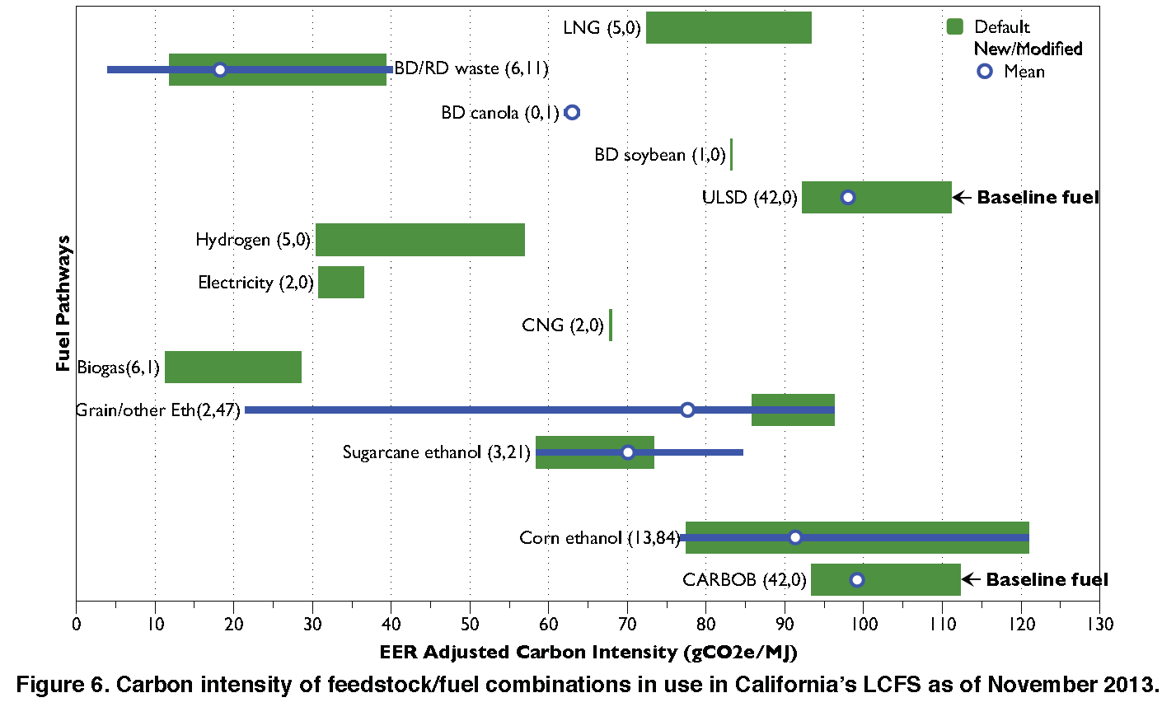
Innovations in Carbon Intensity of LCFS Pathways
Yeh and Witcover, 2014)
Notes:
Notes

Slide 19
Excess Credits Being Generated
(Targets Exceeded for 2011-2013)
Yeh and Witcover, 2014)

Slide 20
Biofuels Are “Decarbonizing”(2011-13)
Volumes
Credits

Slide 21
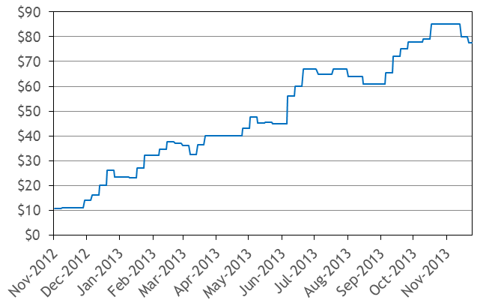
LCFS Credit Prices Increasing
Argus white paper, Dec 2013
Caution in interpreting LCFS credit prices
Because stringency of the LCFS increases over time and credit price is spread over entire fuel pool….
$80/tonne CO2 translates to:
  2 cents per gallon in 2015
  8 cents per gallon in 2020

Slide 22
LCFS Impact
Industry behavior changing—inspiring a storm of innovation, from lower-carbon oil sands production to more efficient oilfields to greater use of corn wastes

Slide 23

















NextSTEPS Sponsors
California
Air Resources Board
Notes:
23

