Slide 1

Aerosol measurements: India perspective
India-California Air-Pollution Mitigation Program
Initiative for Mitigating Air Pollution from the Transportation Sector
Sachi Tripathi
Dept. of Civil Engineering & Centre for Environmental Science & Engineering
Indian Institute of Technology, Kanpur, India

Slide 2
India measurements scarcity & implications
Indian subcontinent diversity
Topography
Large population density
Distinct anthropogenic (man-made) activities and living habits
Movement of ITCZ over Indian subcontinent and associated weather patterns
Seasonal patterns with a long, dry, winter season
Long-range transport of pollutants
Europe, middle-east countries, northwest-southeast Asia
Potential climate and human health implications

Slide 3
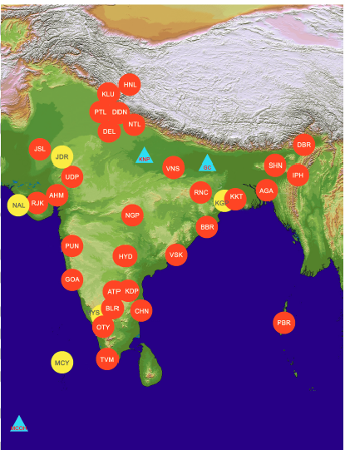
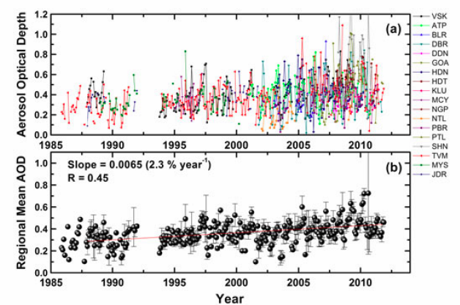
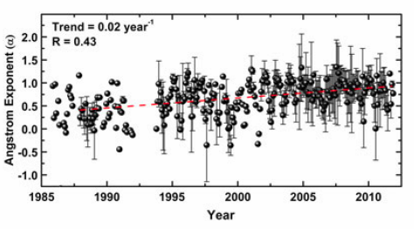
Decadal Trend in Aerosols: ARFINET Network
AFRINET is a network of 35 aerosol observatories over the Indian region to generate the first time regional synthesis using primary data and estimate the aerosol trends.
AOD was found to be increasing at a rate of 2.3% (of its value in 1985) per year and more rapidly (~4%) during the last decade.
Moorthy et al., GRL, (2013)

Slide 4
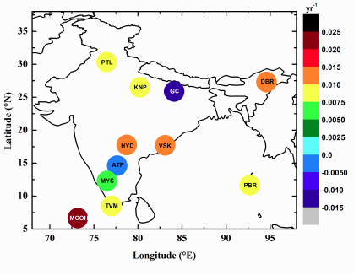
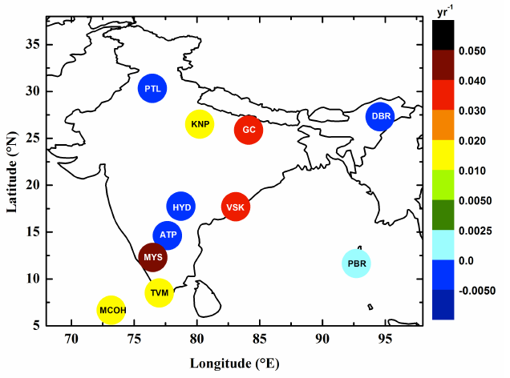
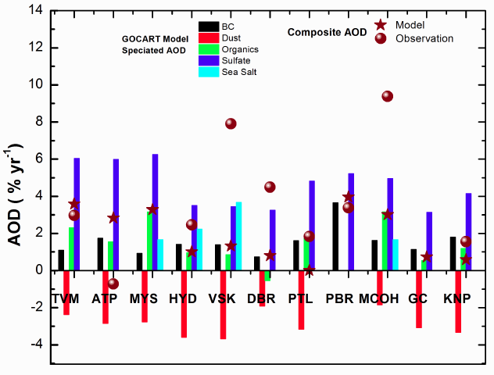
Decadal Trend in aerosols: ARFINET Network
Annual trend (yr⁻¹) in AOD
Annual trend (yr⁻¹) in Angstrom Exponent (α)
The trends in the spectral variation of AOD reveal the significance of anthropogenic activities on the increasing trend in AOD.
AERONET: KNP and GC
GOCART model: Jan. 2000 to Dec. 2007
GOCART simulation over the ARFINET stations, showed an increasing trend for all the anthropogenic components and a decreasing trend for dust AOD
Babu et al., JGR, (2013)
Notes:
The sulphate and BC AODs depicted strong increasing trend over all the stations. Modeling study by Streets et al (2006) have indicated that the trends in surface radiation are correlated with the trends in the emissions of sulfur dioxide, BC and AODs. Based on the analysis of emission inventories (EMEP, REAS and IPCC inventories) and AODs derived from satellites (MODIS and MISR) and AERONET, de Meij et al (2012) reported that the AOD trends are generally dominated by changing anthropogenic SO2 emissions, especially over Europe and Asia. Lu et al (2011) also reported upward trends in fine anthropogenic aerosols over China and India using emissions inventories for sulfate and carbonaceous aerosols.
However, a decreasing trend in dust AOD is observed over all the stations in the GOCART simulation. The negative trend in AOD over these stations during certain period (AM and JJAS months) is appears to be strongly associated with the significant contribution of dust AOD to the total.

Slide 5
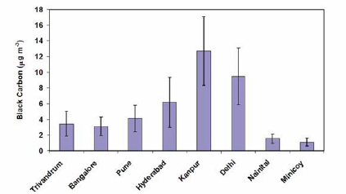
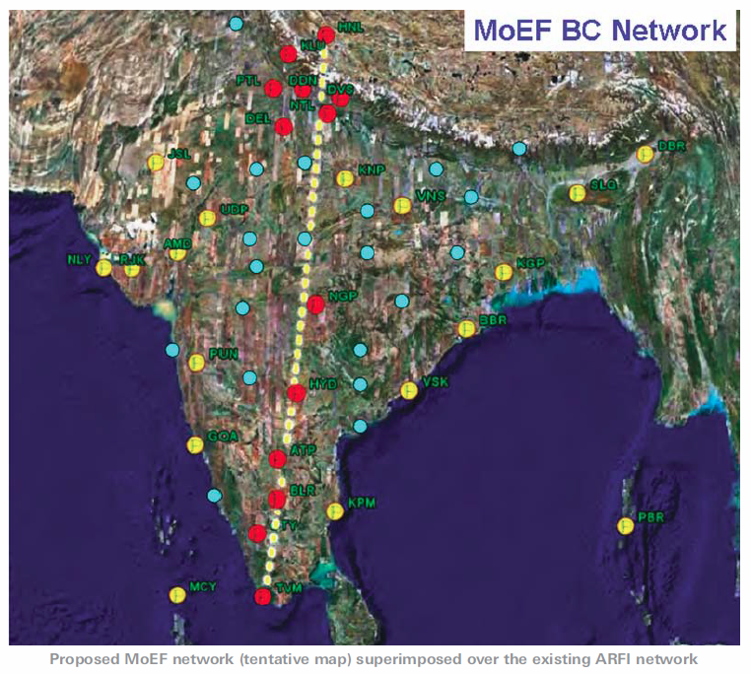
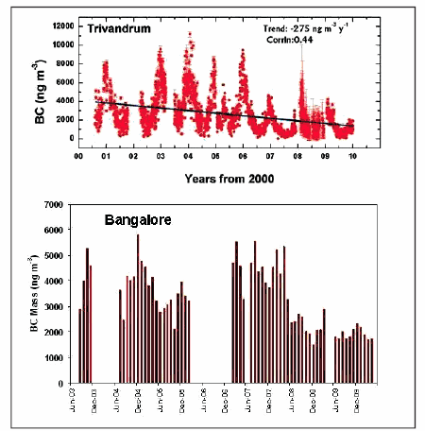
National Carbonaceous Aerosol Programme (NCAP)
Black Carbon Research Initiative
Ministry of Environment and Forests BC Network
BC mass concentration over different locations
Babu et al., 2002; Satheesh et al., 2010; Safai et al., 2007; Singh et al., 2010; Badrinath and Latha, 2006; Dey et al., 2008, Dumka et al., 2010
INCCA reports: Ministry of Science ad Technology, MoEF, MoES, ISRO

Slide 6
AERONET Decadal Climatology at Kanpur
Eck, Tripathi et al., JGR, (2010)

Slide 7
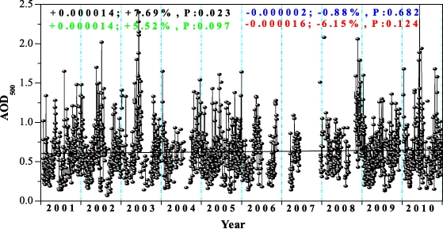
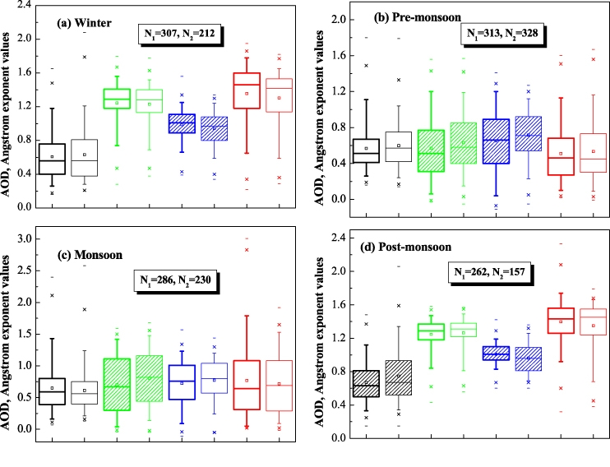
Variability and trends of aerosol properties over Kanpur, using AERONET data (2001-10)
Black-AOD
Green-Angstrom
Thick-2001-2005
Thin- 2006-2010
Kaskaoutis, Tripathi et al., Environ. Res. Lett., (2012)

Slide 8
SW Aerosol Radiative Forcing (2001-2005)
Clear-sky
Annual: -4.1±6,-31.8±10.9, +27.7±10.4
Cloudy-sky
Annual: -1.4±6.1,-23.3±9.3, +24.8±9.7
Columnar Cloud Parameters
Dey and Tripathi, JGR, (2007, 2008)

Slide 9
Secondary organic aerosols: Role of Acidity
Processing of Ambient Aerosols during Fog (F) Events: Comparison with Non Foggy (NF) Periods
and Role of Acidity

Slide 10
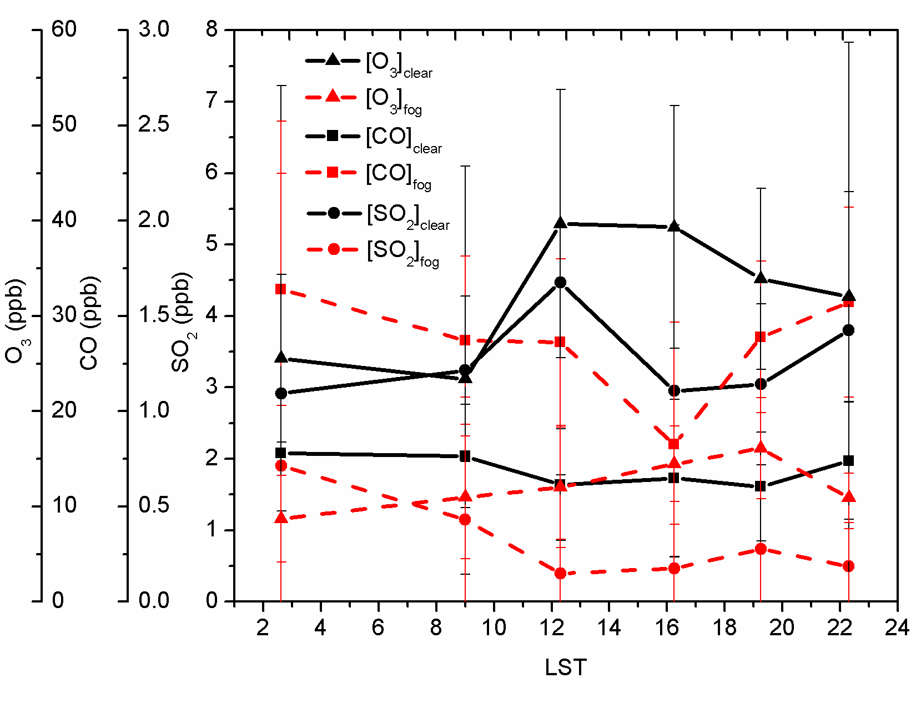
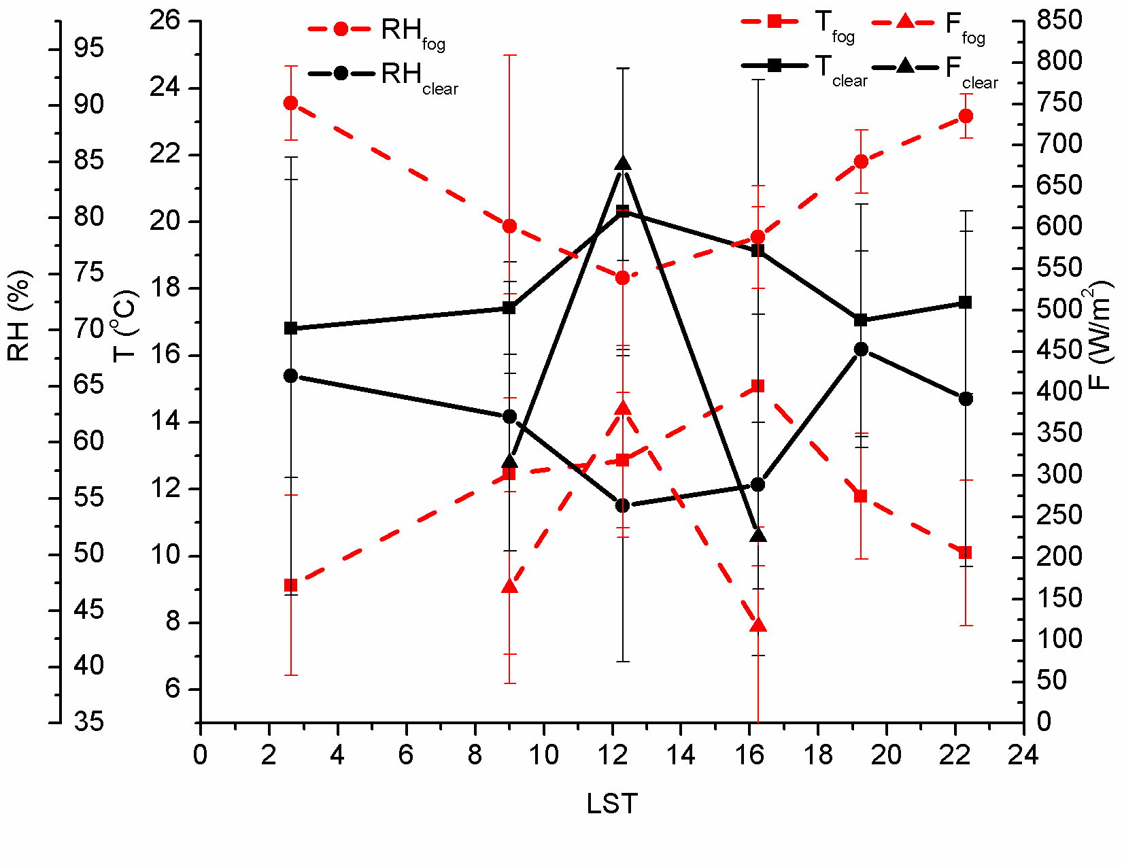
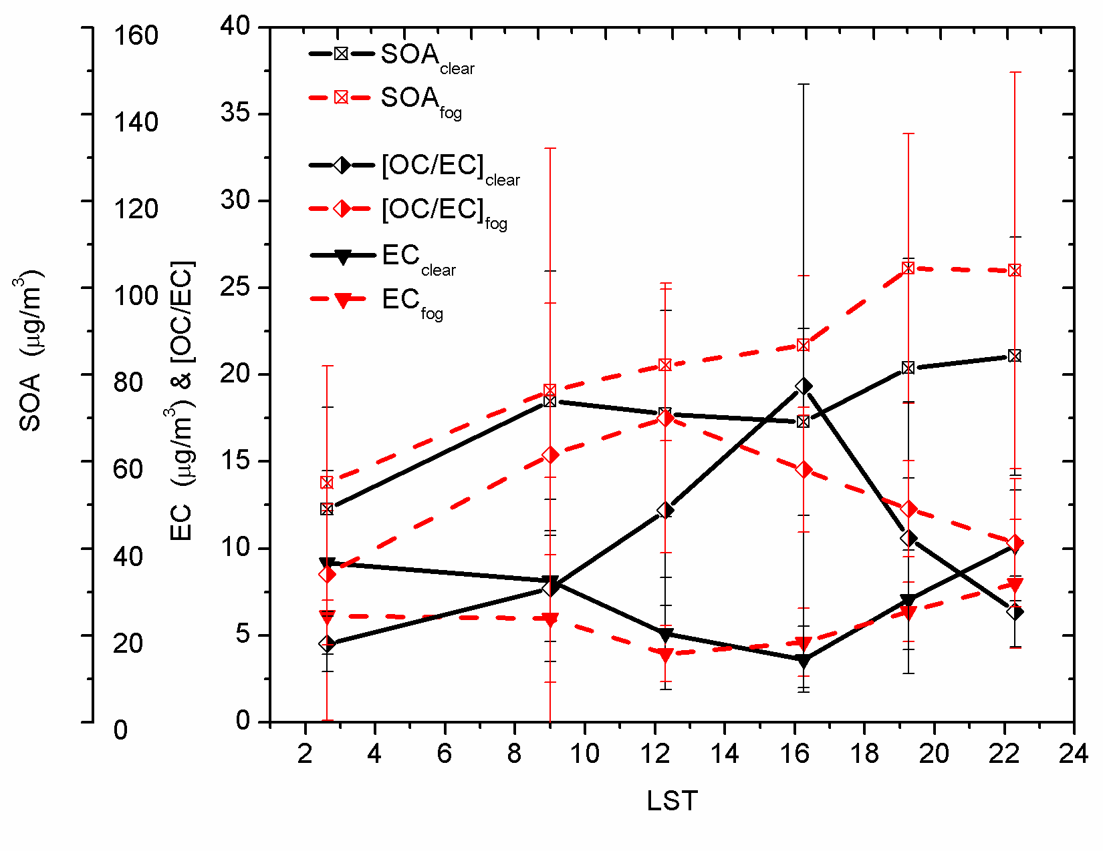
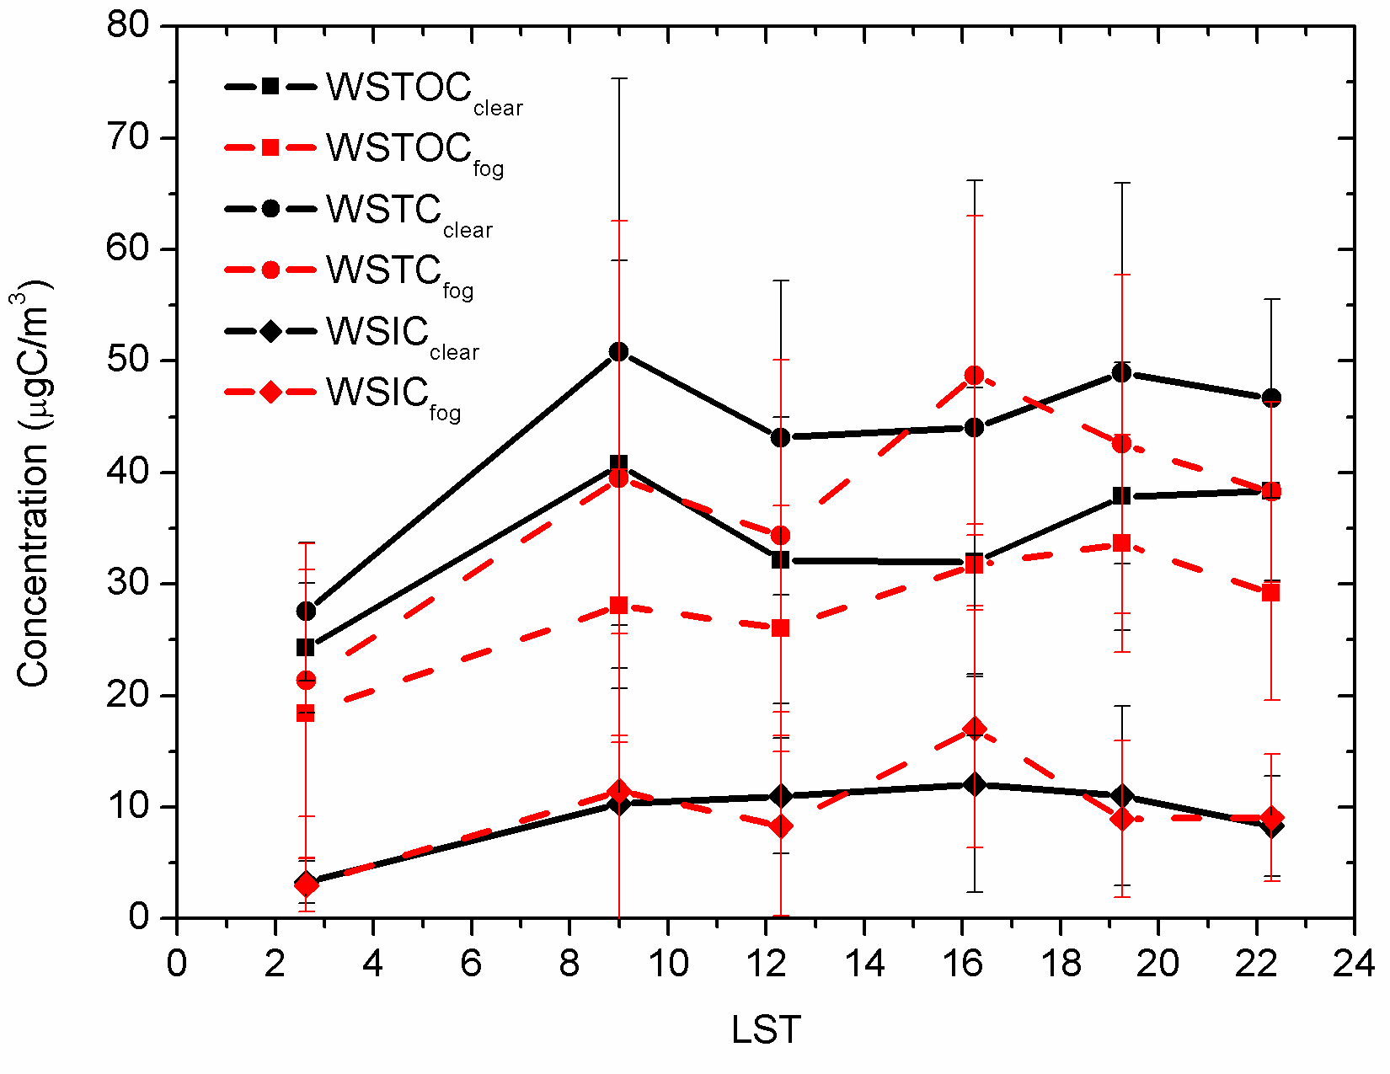
Secondary organic aerosols during Fog: Winter
Ozone (ppb)
Carbon Monoxide (ppb)
Sulphur Dioxide (ppb)
Kaul, Tripathi et al., Env. Sci. &Tech. (2011)
Low EC but High SOA during Fog
WSTOC Water Soluble Total Organic Carbon
WSTC Water Soluble Total Carbon
WSTIC Water Soluble Total Inorganic Carbon
Elemental Carbon (μg/m³) and (Organic Carbon)/(Elem Carbon)
Secondary Organic Aerosol (μg/m³)

Slide 11
Secondary organic aerosols: Role of Acidity
Processing of Ambient Aerosols during Fog (F) Events: Comparison with Non Foggy (NF) Periods
and Role of Acidity

Slide 12
Secondary organic aerosols during Fog: Winter
Ozone (ppb)
Carbon Monoxide (ppb)
Sulphur Dioxide (ppb)
Low EC but High SOA during Fog
Kaul, Tripathi, et al., ES&T (2011)
WSTOC Water Soluble Total Organic Carbon
WSTC Water Soluble Total Carbon
WSTIC Water Soluble Total Inorganic Carbon
Elemental Carbon (μg/m³) and (Organic Carbon)/(Elem Carbon)
Secondary Organic Aerosol (μg/m³)

Slide 13
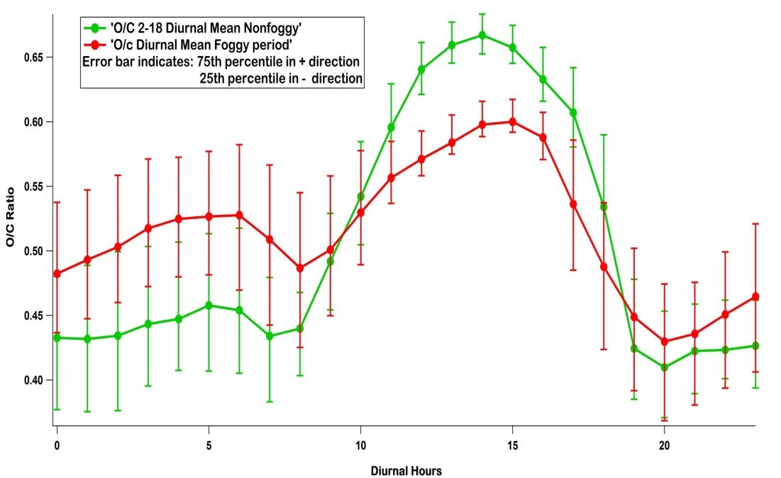
Aerosol Acidity vs Oxidation Mechanism: Foggy
vs Non Foggy based on HR-ToF-MS
During foggy night time aerosol oxidation level was higher than that of non foggy period, indicating enhanced oxidation, may be due to aqueous processing.

Slide 14
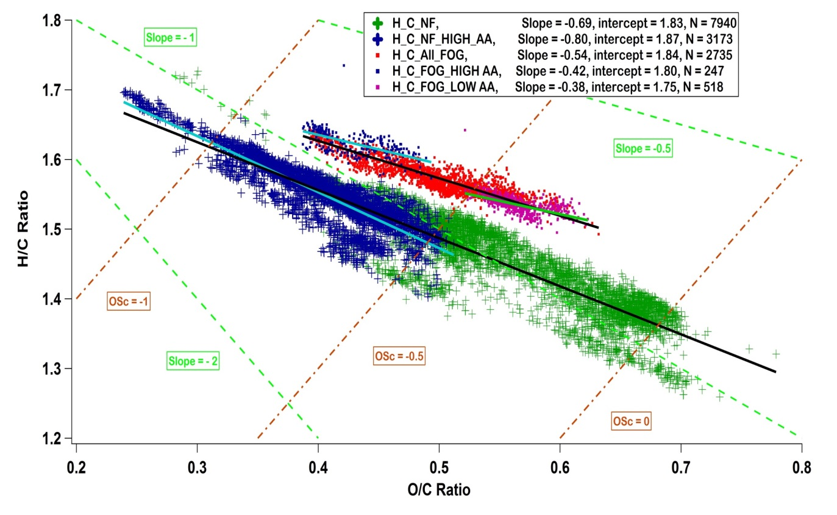
AA vs Oxidation Mechanism: F vs NF
Van krevelen diagram
Overall shallow slope during foggy period indicates that fragmentation is the dominant process, while for non foggy period its functionalization.
Aerosol Acidity (AA) calculated by stoichiometric neutralization ratio of AMS measured NH4+ to predicted amount of NH4+ which is required to neutralize SO4²⁻,NO3⁻, Cl⁻ , Higher the ratio lower the acidity.
Also in neutralized aerosol the slope is flatter indicating that alkalinity favors fragmentation and production of highly oxidized organic aerosol
Chakraborty, Tripathi et al., Under Preparation, (2013)

Slide 15
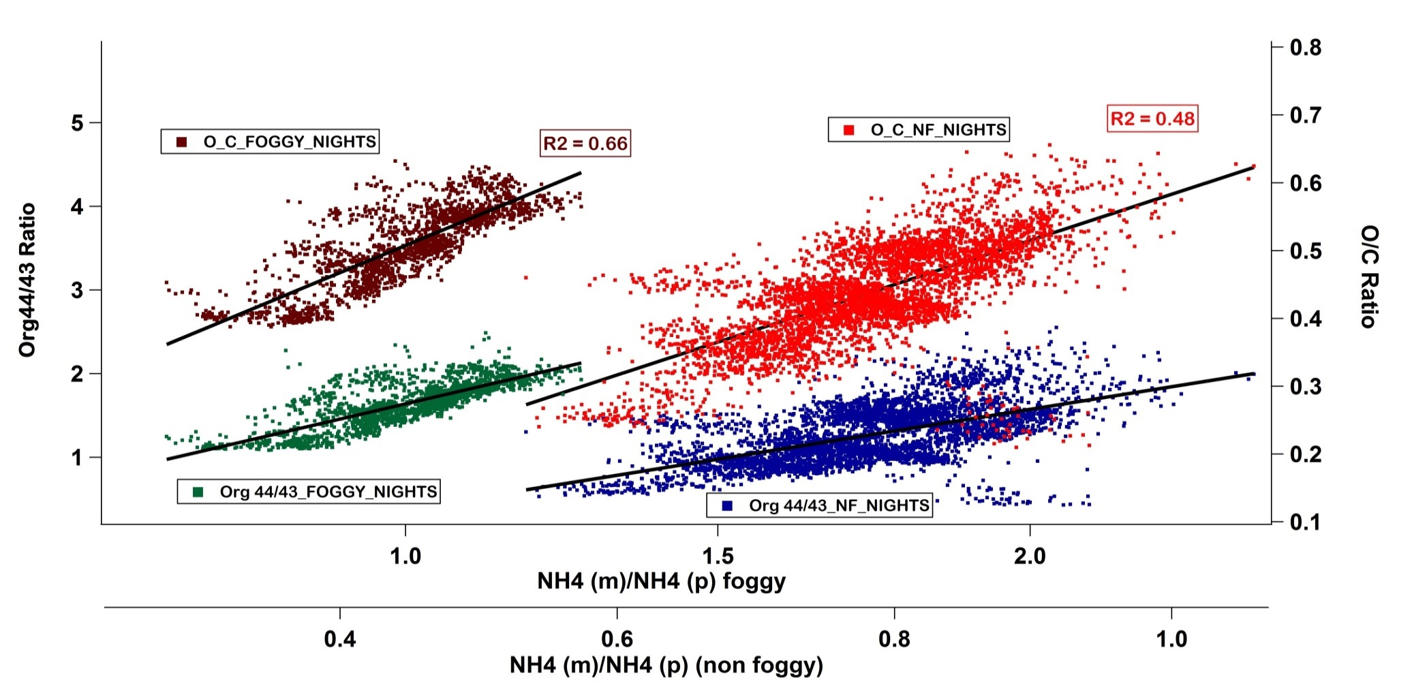
Aerosol acidity vs Oxidation level: F vs NF
Increasing O/C ratio with decreasing acidity
R^2 = 0.6
R^2 = 0.35
Org44: Fragmentation
Org43: Functionalization
Aerosol Acidity (AA) calculated by stoichiometric neutralization ratio of AMS measured NH4+ to predicted amount of NH4+ which is required to neutralize SO4²⁻,NO3⁻, Cl⁻ , Higher the ratio lower the acidity.
Acidity influences aerosol oxidation level and mechanisms of oxidation particularly when photochemistry is weak.
Chakraborty, Tripathi et al., under preparation, (2013)

Slide 16
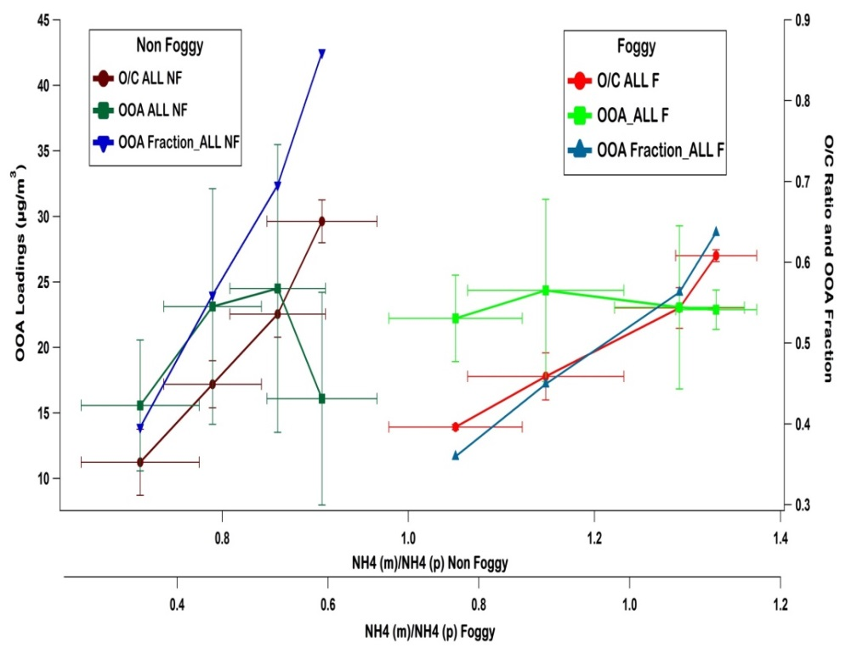
Effect of mixing on oxidation mech. and O/C
PMF was used to identify various fractions of organic aerosol (OA): Oxidized OA (OOA) or Primary OA (POA)
In both periods with increase of OOA fraction the slope gets flatter, which indicates that more oxidized aerosols are more likely to go through fragmentation
During non foggy day time the slope becomes steeper at highest OOA fraction indicating that photochemistry might be playing a different role
OOA fraction dictates the evolution of O/C ratio not the absolute OOA mass

Slide 17
Spectral absorption and mixing state: BC
Effect of mixing and aging on black (brown) carbon optical properties: Biomass Burning vs Clear Event

Slide 18
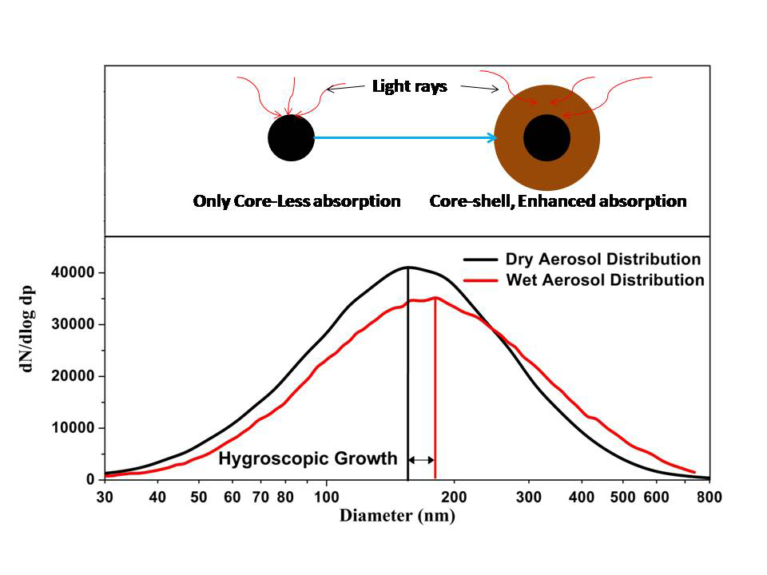
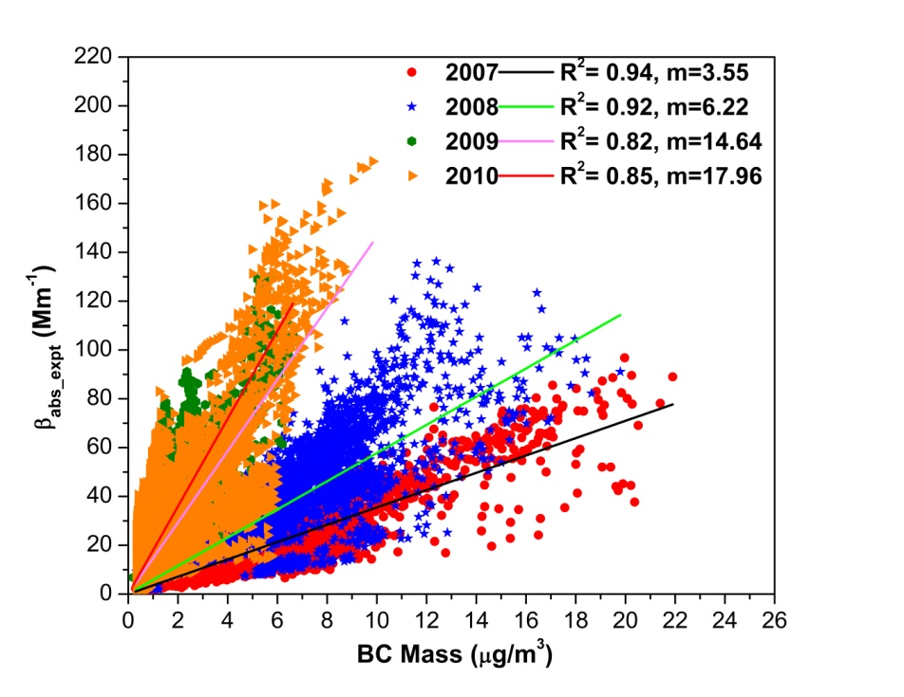
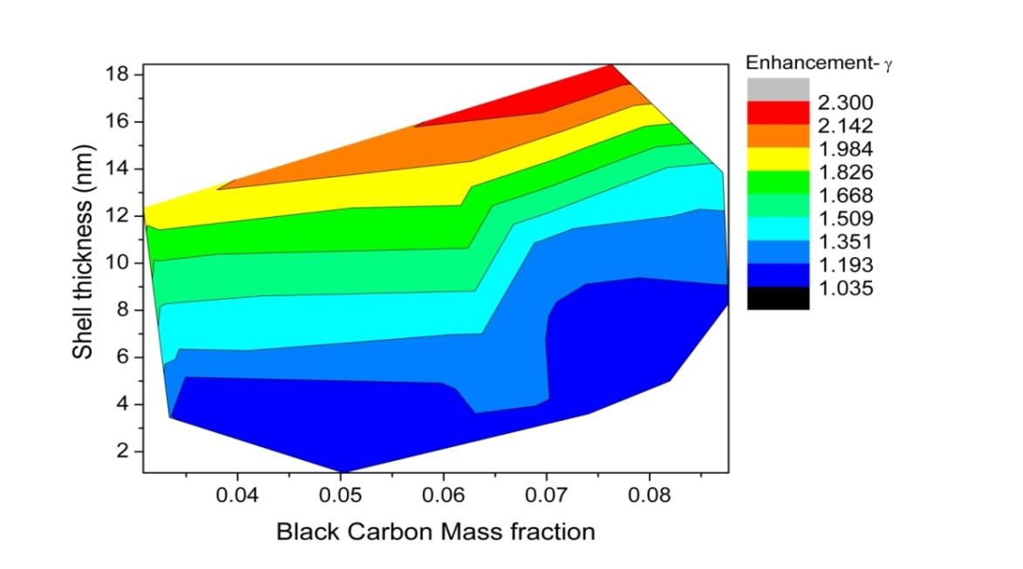
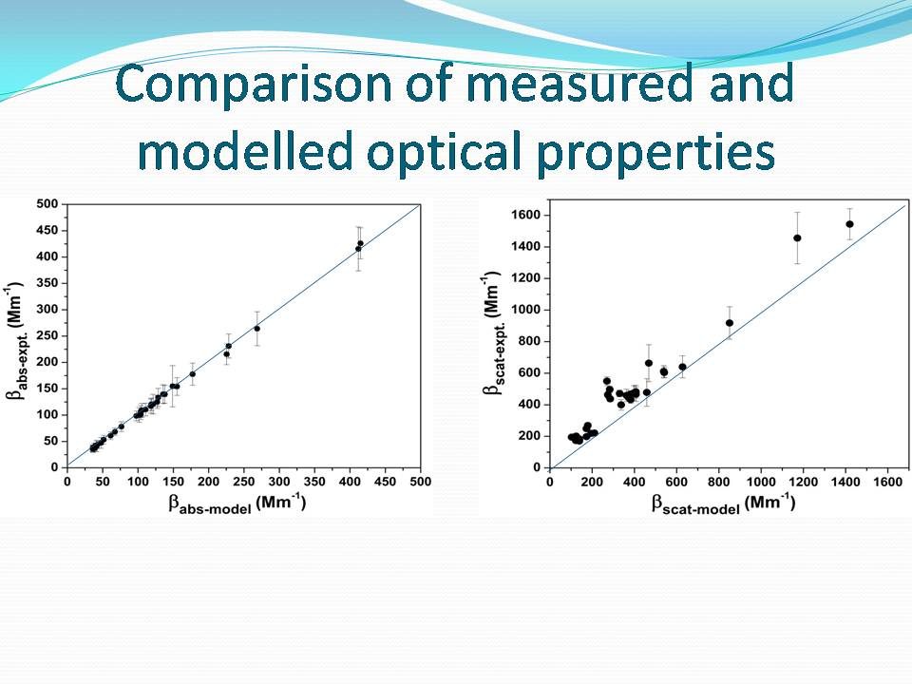
Hygroscopicity, mixing state and enhanced absorption of Aerosols
Linear regression between PASS-1 measured β_{abs} and Aethalometer measured BC mass for four consecutive winter seasons at Kanpur
Hygroscopic growth from Two SMPS System
Absorption amplification (𝜸)
Comparison of measured and modeled β_{abs}
Shamjad, Tripathi et al., ES&T, (2013)

Slide 19
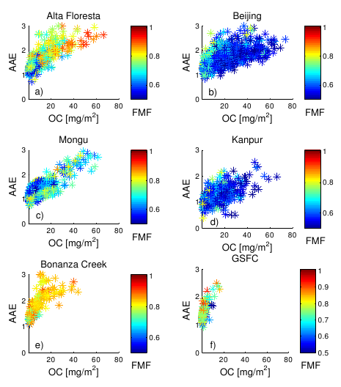
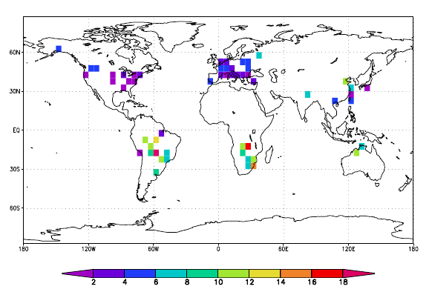
Inferring absorbing organic (brown) carbon content from AERONET data
Mean absorbing OC concentration (mg/m² ) inferred from AERONET-retrieved imaginary indices for September.
Arola, Tripathi. et al, Atmos. Chem. Phys., (2011)

Slide 20
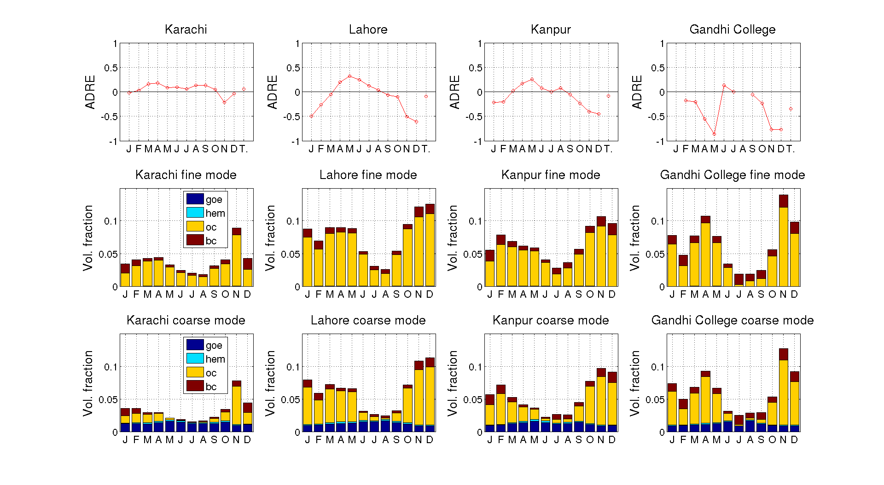
Courtesy: Dr. Antti Arola, Finnish Meteorological Institute
Forcing [BrC] = Forcing [all-species] – Forcing [without BrC]
Retrieval of volume fractions, Courtesy: Dr. Greg Schuster,
Work in progress…..

Slide 21
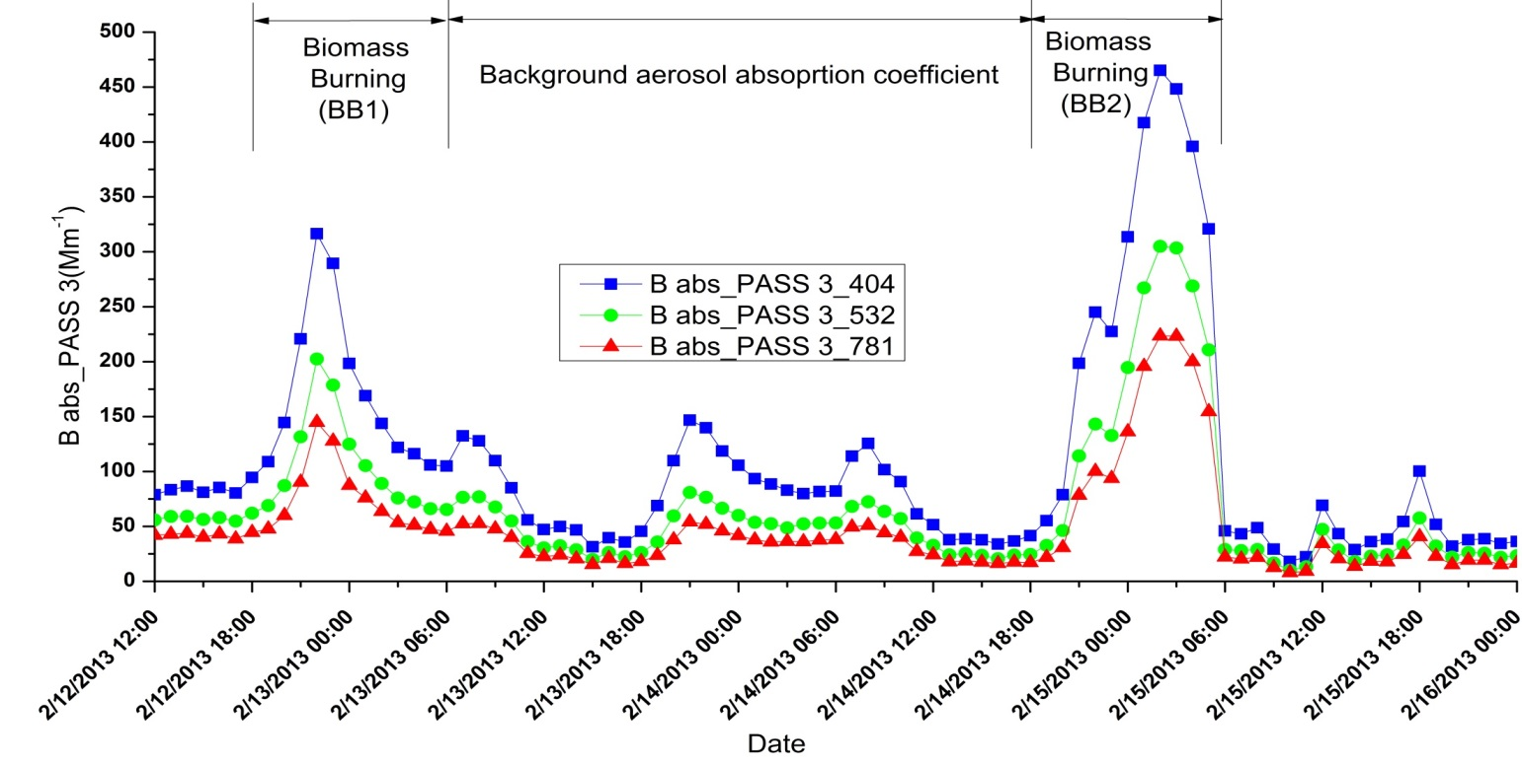
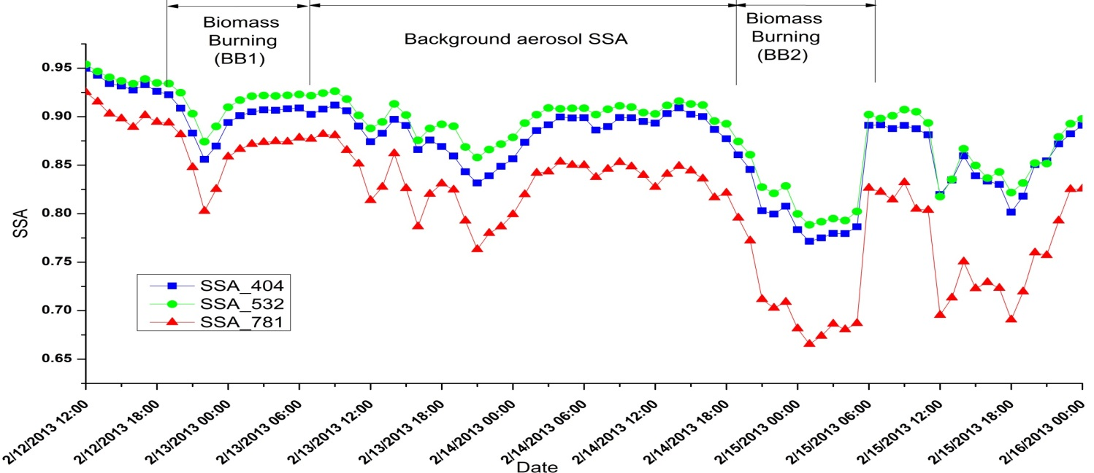
Aerosol optical properties: Clear vs Biomass Burning
Absorption coefficient
Single Scattering Albedo (SSA)

Slide 22
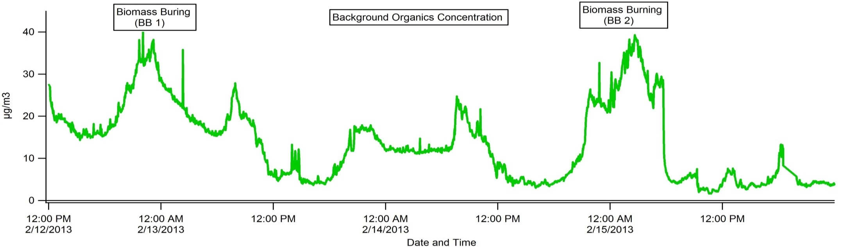
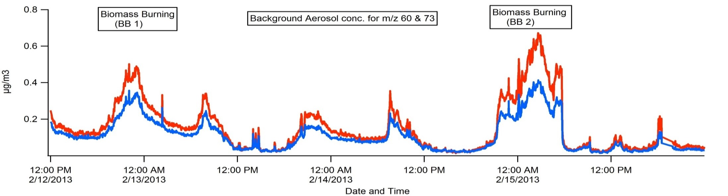
Total organics mass from HR-ToF-AMS
Biomass burning indicator species (m/z 60 and m/z 73) from HR-ToF-AMS
Levoglucosan (m/z=60) and less oxygenated fraction of Levoglucosan (m/z=73) has been considered as an indicator for biomass burning.

Slide 23
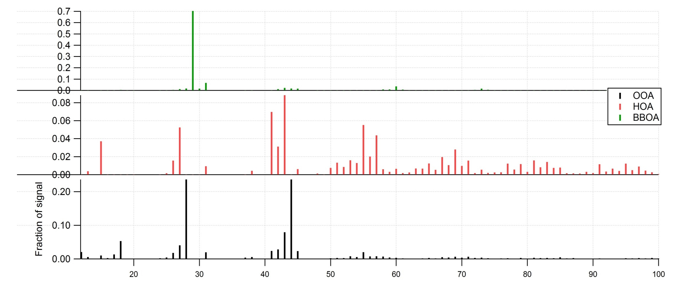
Positive Matrix Factorization (PMF) analysis of HR-ToF-AMS data: Clear-event
OOA - Oxygenated Organic Aerosols
HOA – Hydro-Carbon like Organic Aerosols
BBOA - Biomass Burning Organic Aerosols

Slide 24
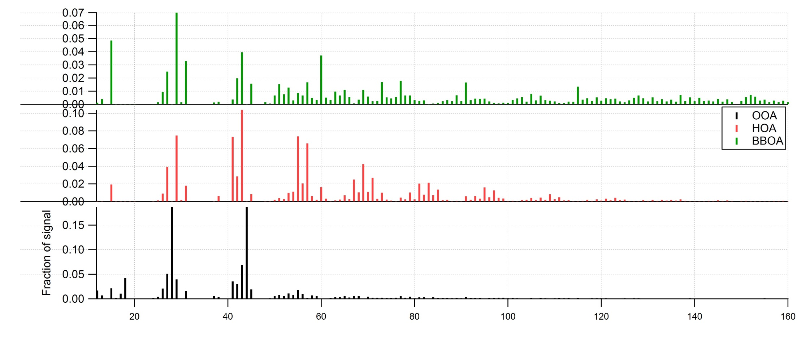
Factors Identified
PMF analysis of HR-ToF-AMS data: BB-event
m/z 60 - Indicator for BB-event
OOA - Oxygenated Organic Aerosols
HOA – Hydro-Carbon like Organic Aerosols
BBOA - Biomass Burning Organic Aerosols

Slide 25
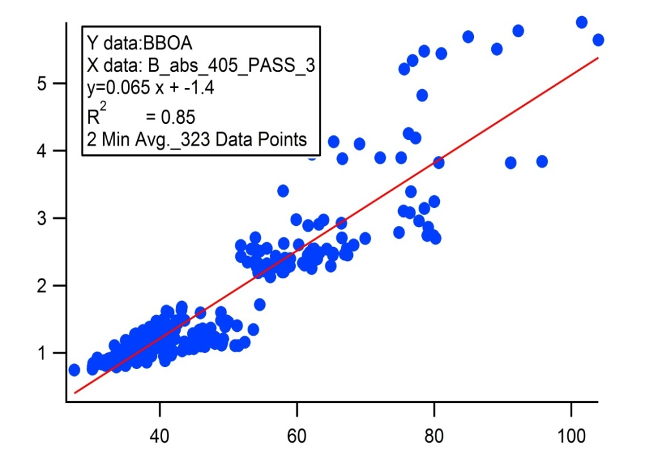
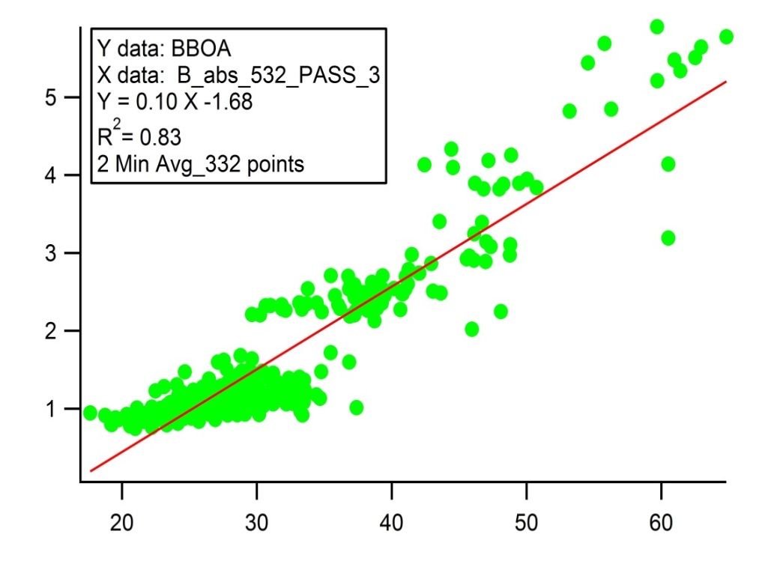
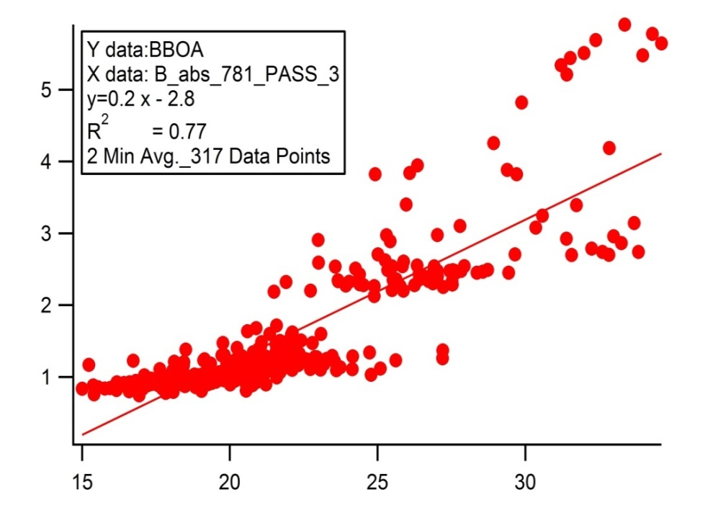
B abs (PASS-3) vs BBOA: Clear-event
BBOA
BBOA
B abs
B abs
Good correlation is observed at all 3 wavelengths.
BBOA
B abs

Slide 26
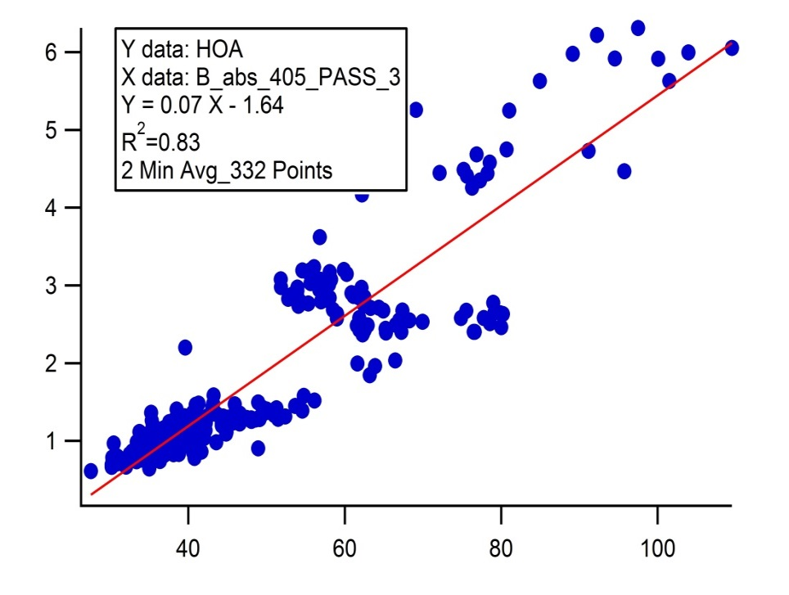
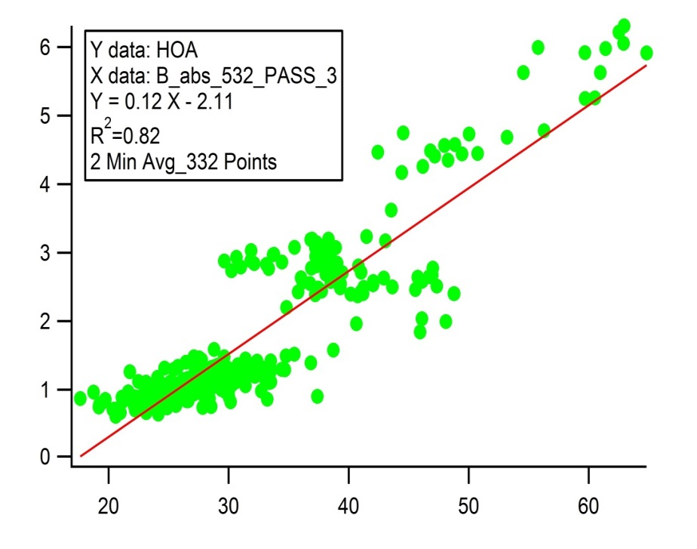
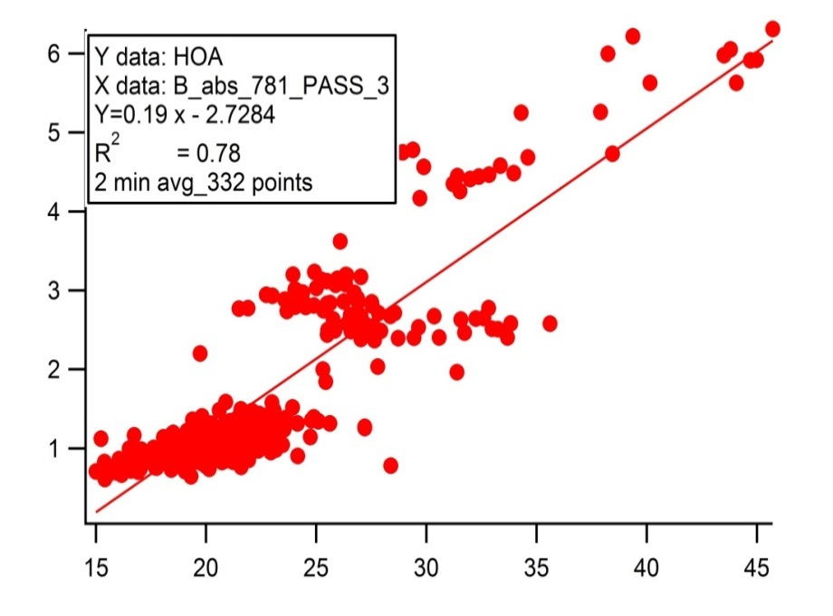
B abs (PASS-3) vs HOA: Clear-event
HOA
HOA
B abs
B abs
Good correlation is observed at all 3 wavelengths.
HOA
B abs

Slide 27
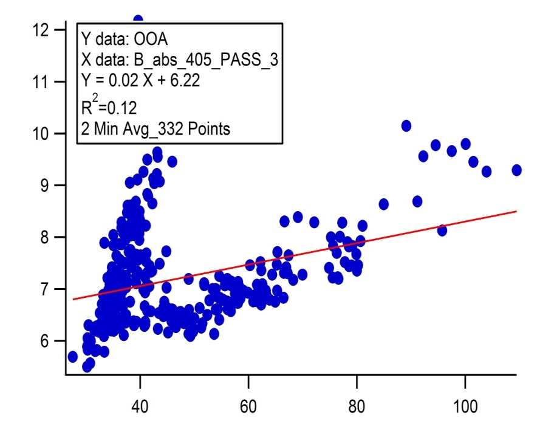
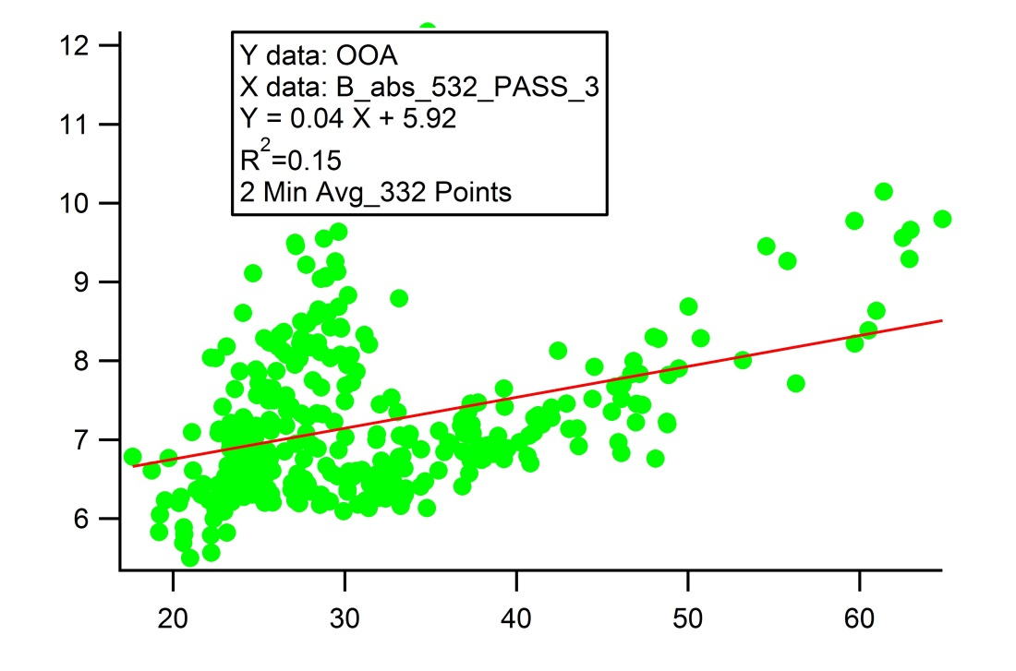
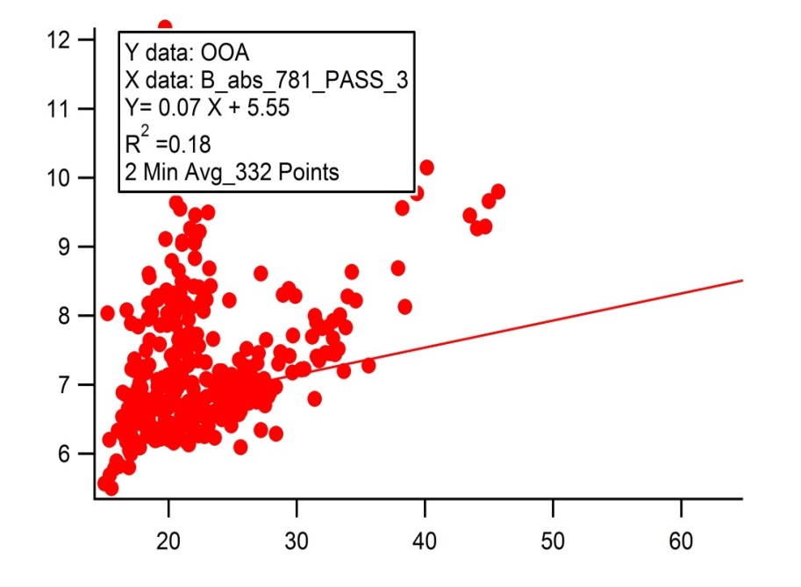
B abs (PASS-3) vs OOA: Clear-event
OOA
OOA
B abs
B abs
Bad correlation is observed due to branching of data points.
Branching of data is due to presence of sunlight. Day time photochemically- produced OOA absorbs less light as compared to night time OOA
OOA
B abs

Slide 28
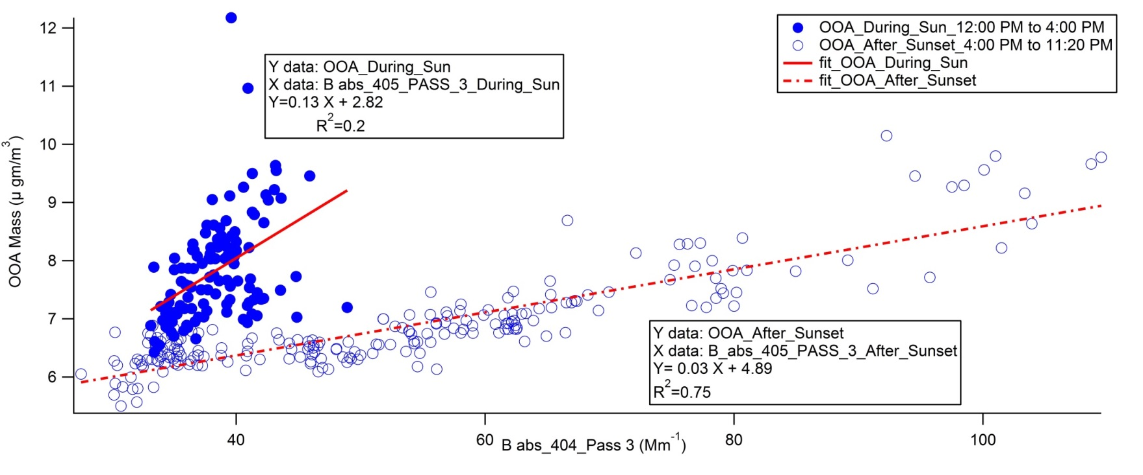
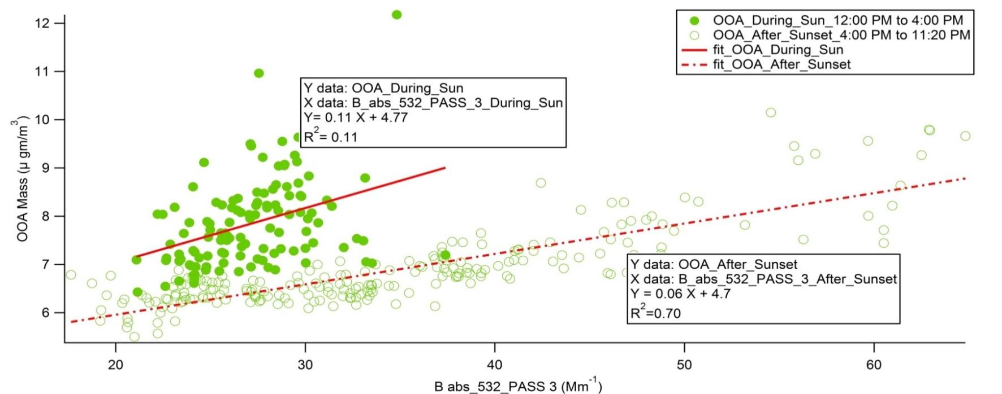
B abs (PASS-3) vs OOA: Day vs Night

Slide 29
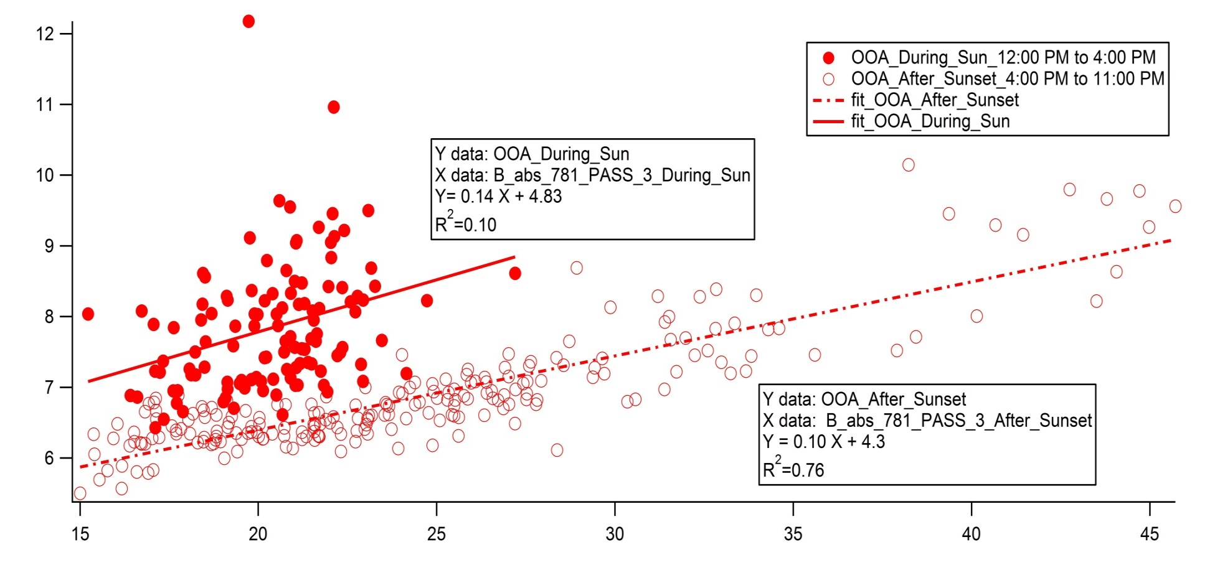
OOA
B abs
The branching in the data points indicates the difference in OOA’s optical properties in the presence and absence of sunlight.
OOA produced in the sunlight absorbs less light as compared to OOA in the absence of sunlight.

Slide 30
Summary
Increasing trend in aerosol burden over sub continent
Increased anthropogenic sources
Decrease in dust
Fog processing of Secondary Organic Aerosol
Implications to Cloud Condensation Nuclei
Enhancement in aerosol absorption
Mixing state
Brown Carbon
Aqueous processing

Slide 31
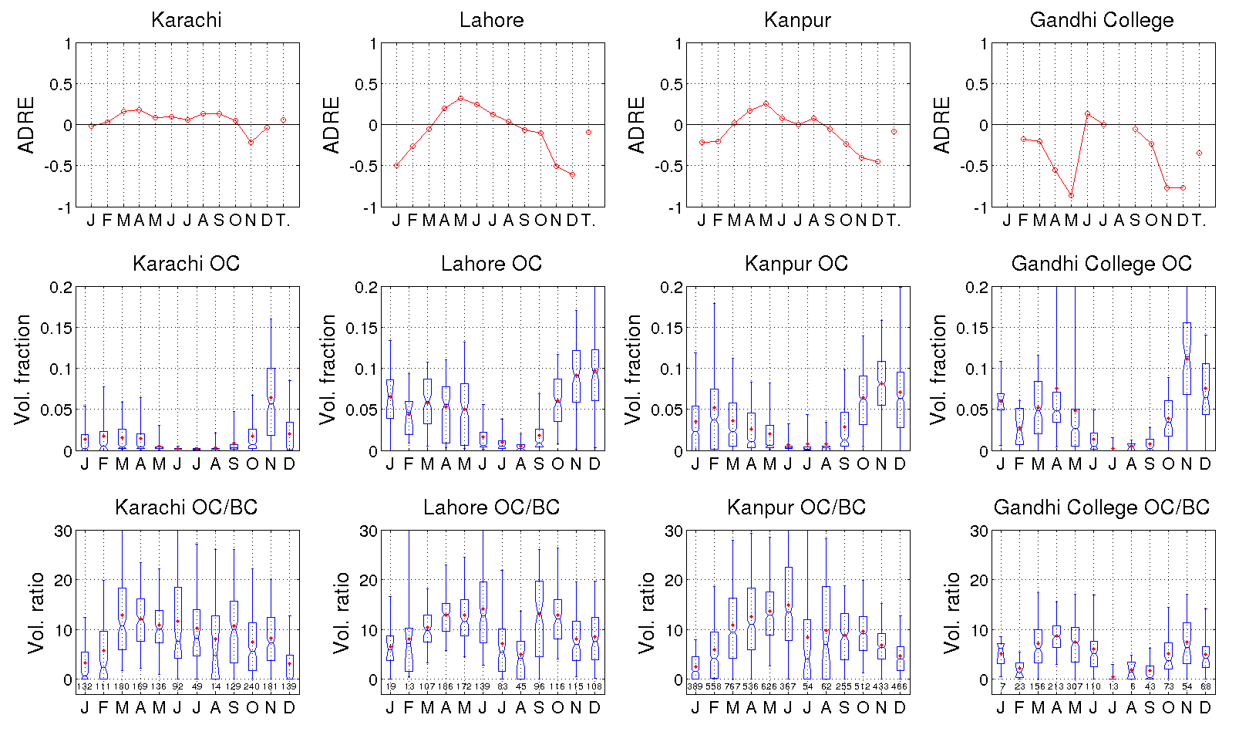
Fig. OC volume fraction and OC/BC volume ratio for sum of fine and coarse modes, numbers below OC/BC ratio boxes denote number of measurements per month, Whiskers: 5th and 95th percentiles, box edges: 25th and 75th percentiles, box center notch: median, red dots: average

Slide 35
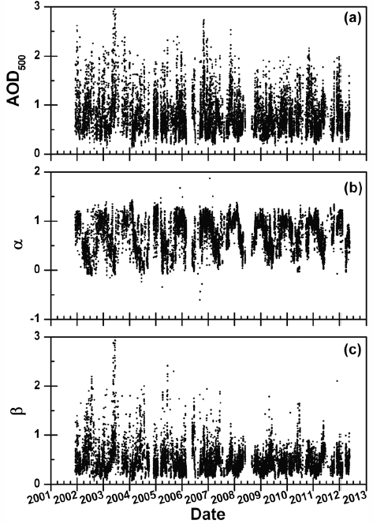
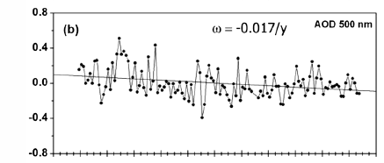
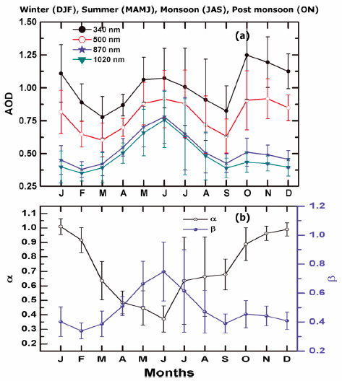
Aerosol Climatology at New Delhi
The AODs show a weak but statistically significant (in 95% confidence level) decreasing trend ~0.02/year at 500 nm.
Fig. The monthly mean climatology of (a) spectral AODs and (b) Angstrom parameters.
Fig. The temporal variations of (a) AOD at 500 nm, (b) Angstrom exponent α, and (c) turbidity coefficient β during Dec. 2001- May 2012 at Delhi
The climatological monthly mean AOD at shorter wavelengths peaks twice, during June and November, while at longer wavelengths it shows only one peak in June.
Lodhi et al., JGR, (2013)

Slide 36
Kanpur in Indo-Gangetic plain – at glance
Physical, chemical, optical, and morphological properties of atmospheric aerosols.
Radiative forcing due to Carbonaceous aerosols (e.g. BC)
Laboratory experiments of aerosols
Spectral absorption and Mixing state
Hygroscopicity and aging, and their influence on CCN properties
SOA formation
Microphysical properties of aerosols (e.g. new atmospheric aerosol formation)
Development of modeling tools to improve process-level understanding
Local- to regional-scale modeling in conjunction with ground-based and space-borne instruments
To accurately represent aerosol effects in the regional climate-chemistry models that are used to estimate the climate and health impacts of aerosols over the Indo-Gangetic Basin.

Slide 37
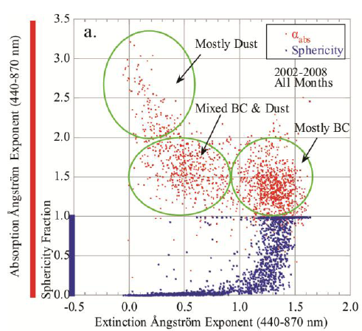
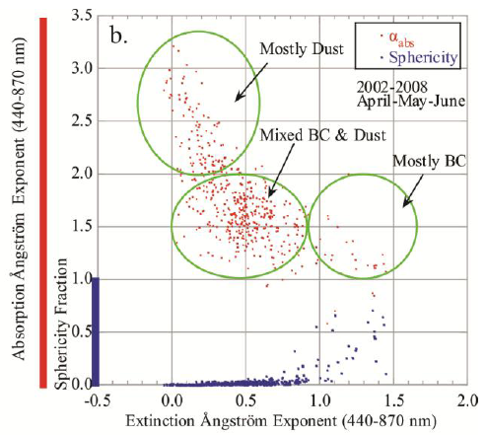


Absorption Ångström exponent (αabs) and sphericity fraction as a function of extinction Ångström exponent (αext) and fine mode fraction of AOD at 675 nm (η675nm; from the almucantar inversions) from the Kanpur AERONET record (2002-2008) in all seasons (a,c) and April-May-June (b,d).
α ≥ 0.8-2.0: BC
α ≤ 0.8: Dust
Ellipses ~ Mixed BC & Dust
Sphericity fraction:
1. 0= 100% spherical particle
Giles, Tripathi et al., JGR, (2011)

Slide 38




Optical properties of Mixture
Fine mode fraction (< 1 μm, peak at 0.3-0.4) decreases with wavelength because most effective scattering at 440
SSA as a function of FMF shows little variation at 440 nm but large range at larger wavelengths
Eck , Tripathi et al., JGR, (2010)

Slide 39
Transmission Electron Microscopy (TEM) images of atmospheric aerosols

Slide 40



Enhancement in absorption: Clear vs BB
Clear-event
$E_{abs}$=$\frac{ B abs from atmospheric aerosols}{B abs from denuded aerosols}$
BB-event
For biomass burning days E abs shows shift in range towards higher values as compared to clear days.

Slide 41

PMF factor mass: Clear-event
During clear day OOA fraction dominates the organic aerosol species
OOA - Oxygenated Organic Aerosols
HOA – Hydro-Carbon like Organic Aerosols
BBOA - Biomass Burning Organic Aerosols

