Slide 1
Nature of Air Pollution in India
Dr. Sarath Guttikunda

Slide 2
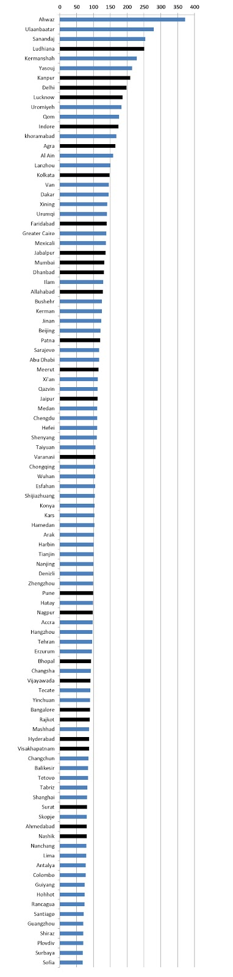
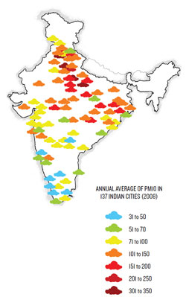
Air Pollution in Indian Cities
27
Cities in Top 100 with the worst air quality
WHO (2011, 2013)
Notes:
2

Slide 3
Air Pollution in Indian Cities
Ludhiana
Kanpur
Delhi
Lucknow
Indore
Agra
Kolkata
Faridabad
Jabalpur
Mumbai
Dhanbad
Allahabad
Patna
Meerut
Jaipur
Varanasi
Pune
Nagpur
Bhopal
Vijayawada
Bangalore
Rajkot
Hyderabad
Vizag
Surat
Ahmedabad
Nashik
WHO, 2011
27
PM₁₀
WHO guideline = 20μg/m³
Notes:
3

Slide 4
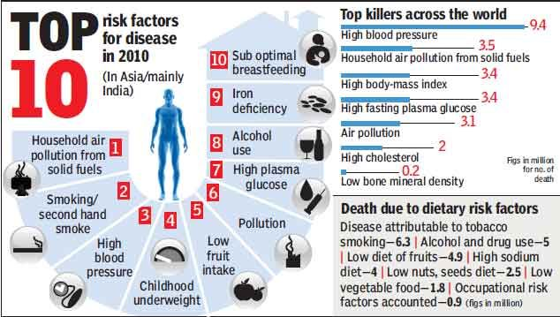
Air Pollution in Indian Cities
6th
GBD 2010 (IHME, 2013)
~695,000 premature deaths
~100,000 from household combustion
Notes:
4

Slide 5
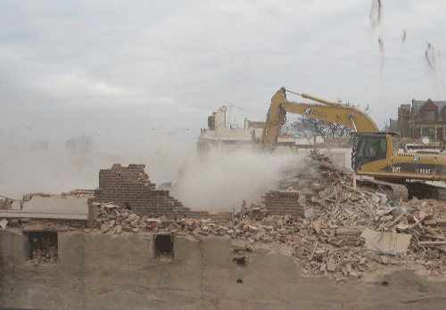
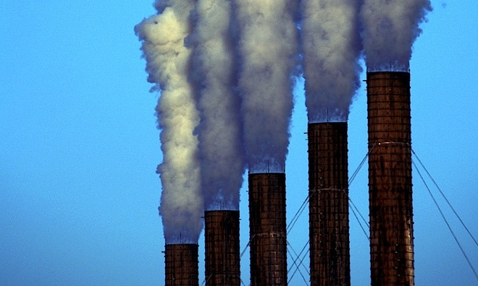
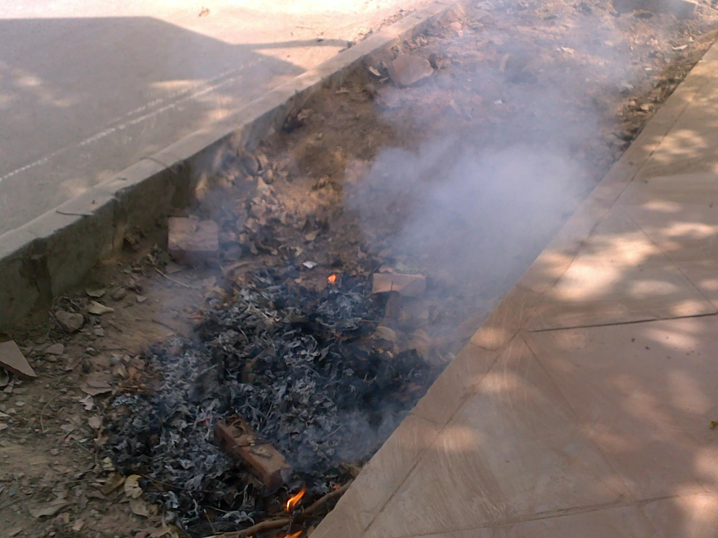

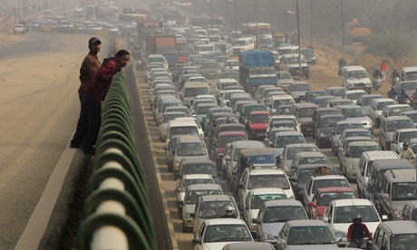
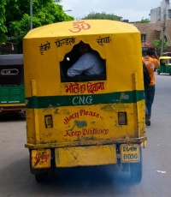
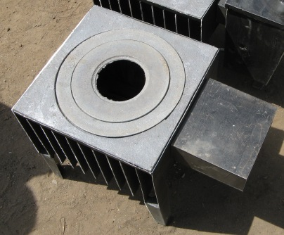
Long List of Anthropogenic and Natural Sources
power plants
construction
garbage burning
industries
road dust
vehicle exhaust
domestic fuels

Slide 6
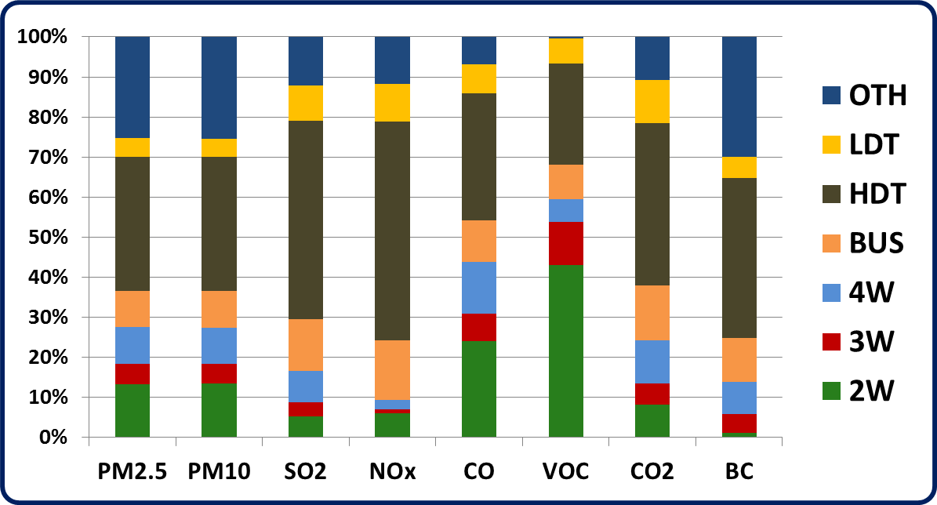
National Transport Emissions
2011-12
120 million registered vehicles
More @ http://www.urbanemissions.info
Notes:
6

Slide 7
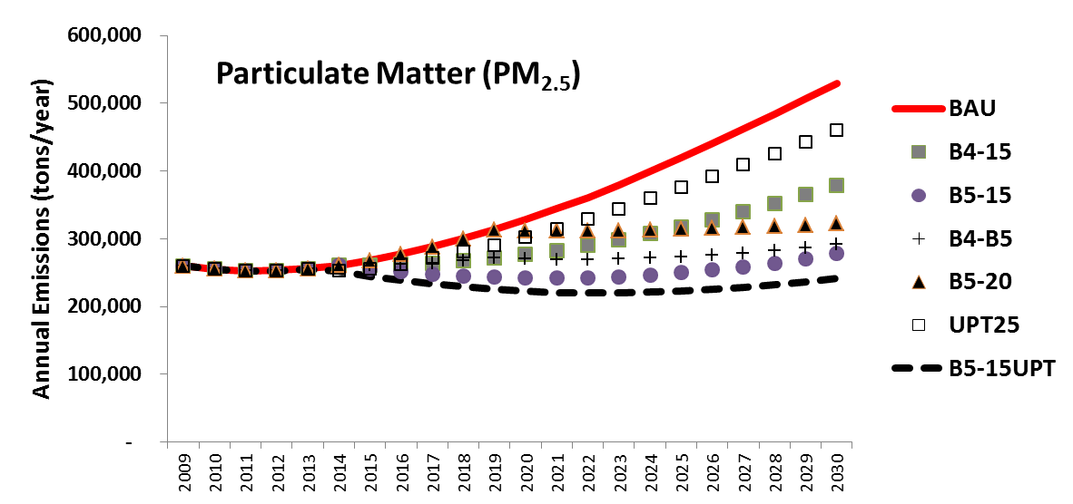
National Transport Emissions
2010-30
More @ http://www.urbanemissions.info
Notes:
7

Slide 8
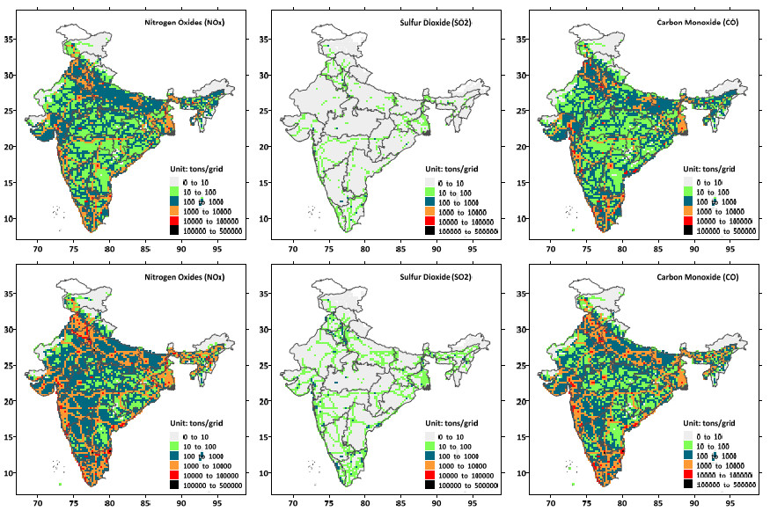
National Transport Emissions
2010 & 2030
2010
2030

Slide 9
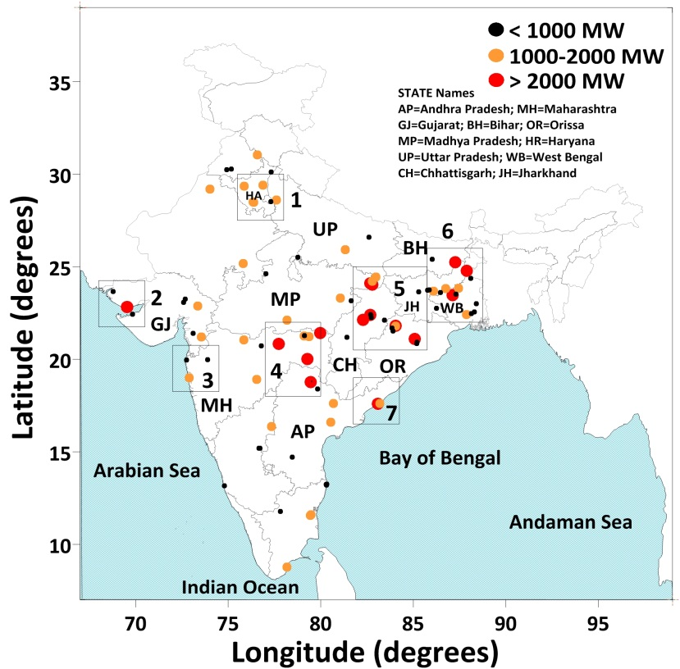
Sectoral Linkages – Power Plants
112 coal-fired power plants
More @ http://www.urbanemissions.info

Slide 10
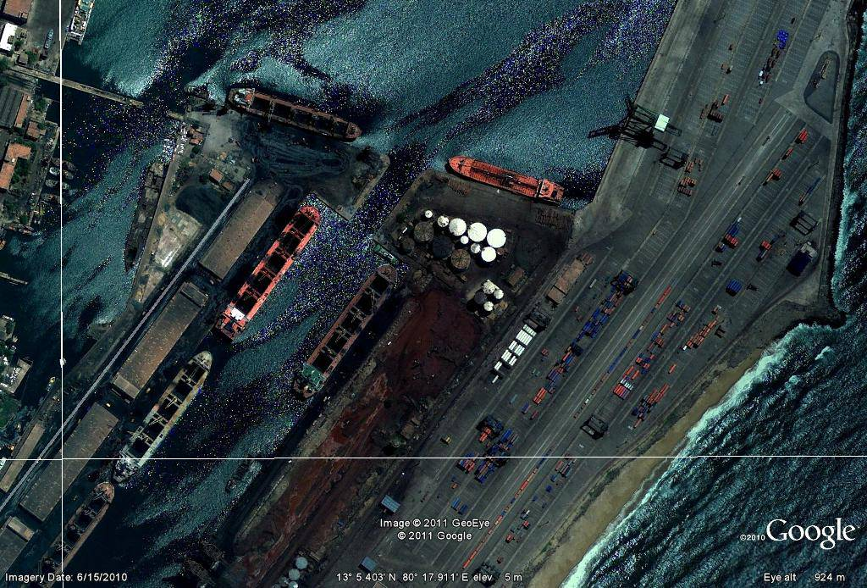

Slide 11
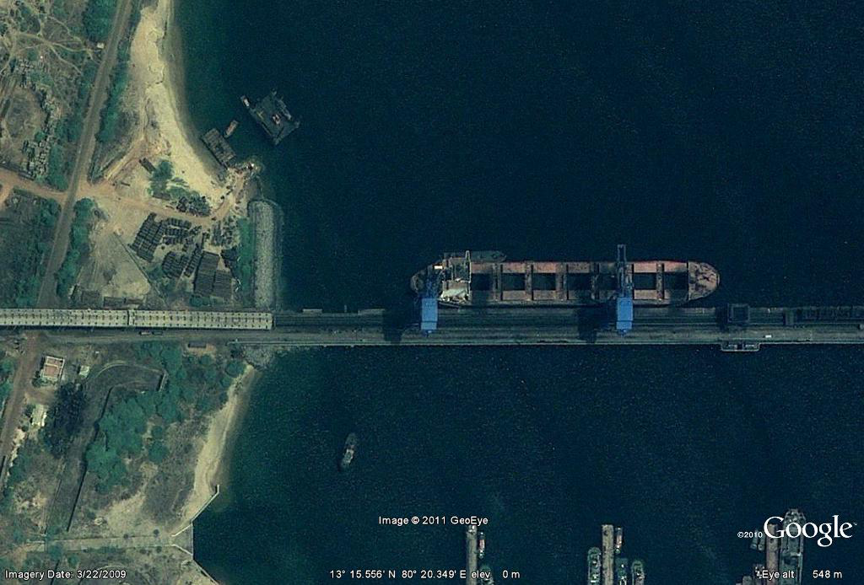
Coal unloading on to the conveyor belt at
North Chennai PP

Slide 12
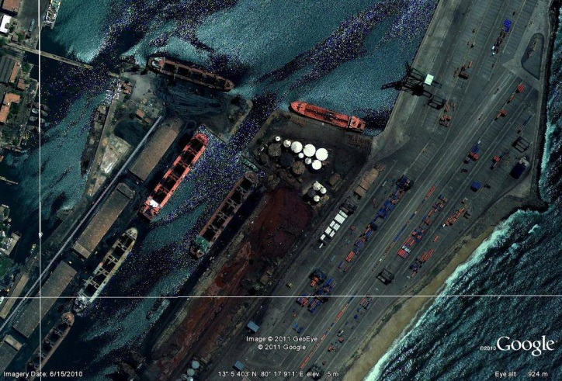
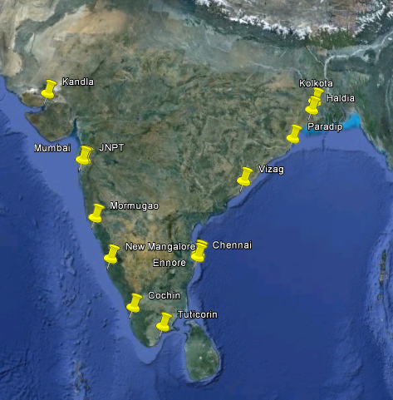
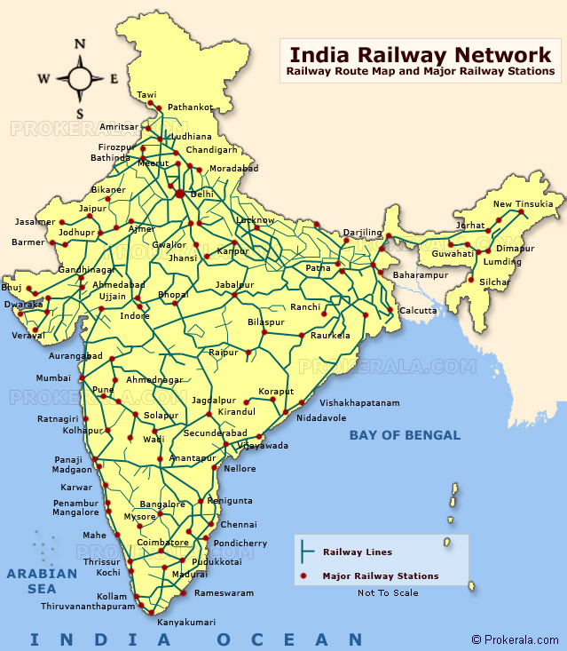
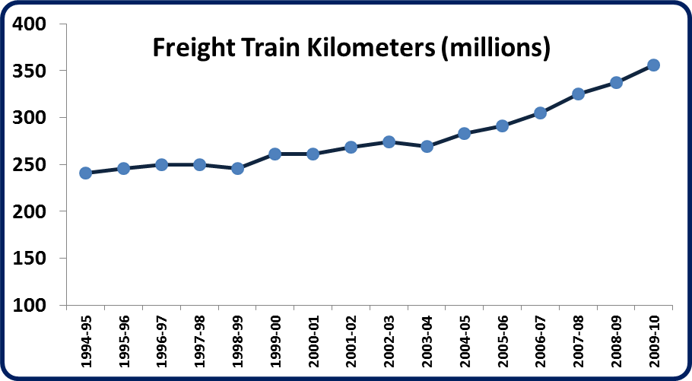
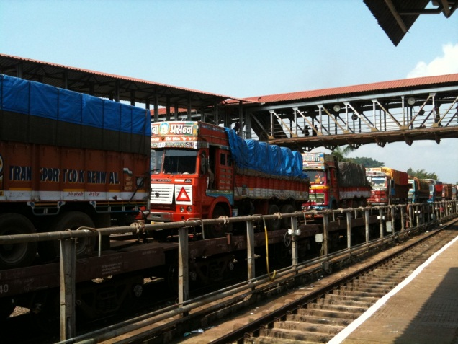
Coal, Ore, Cement, Fertilizers, Salt, Sugar
Road vs. Rail Freight Movement??

Slide 13
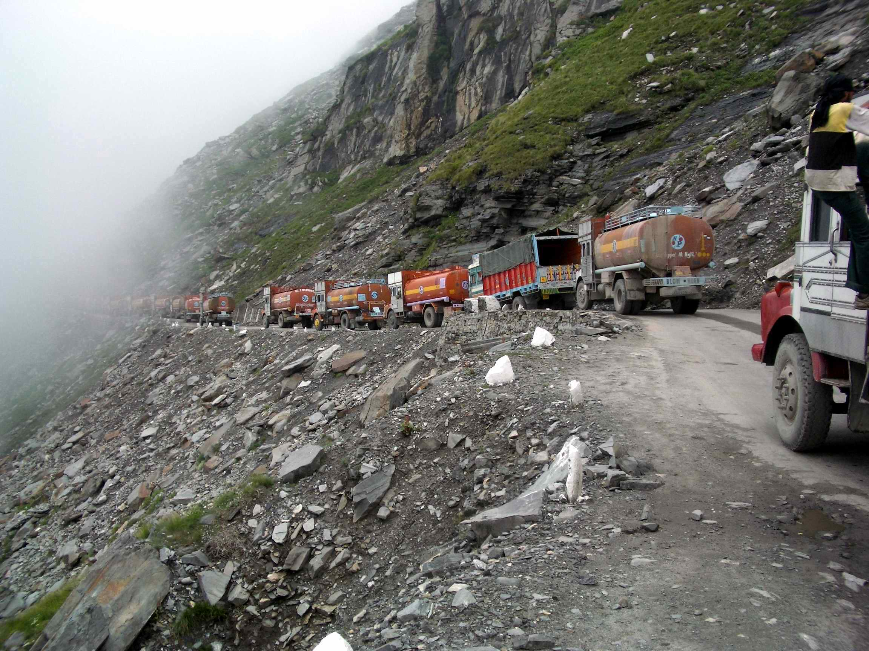
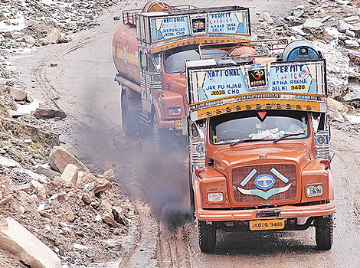
Sectoral Linkages – Freight
Rohtang pass, Himachal Pradesh

Slide 14
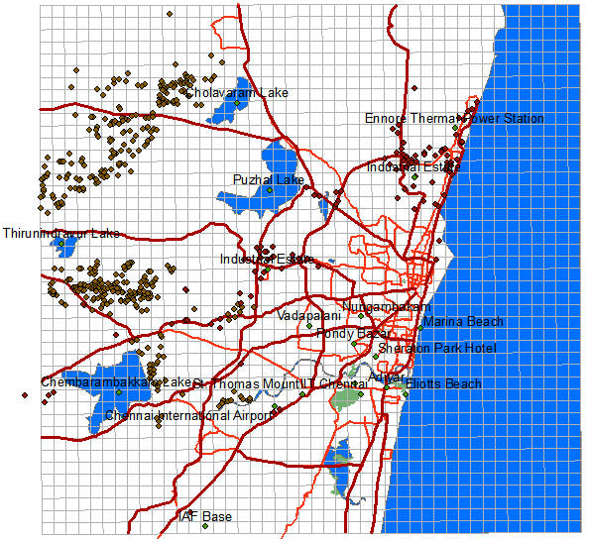
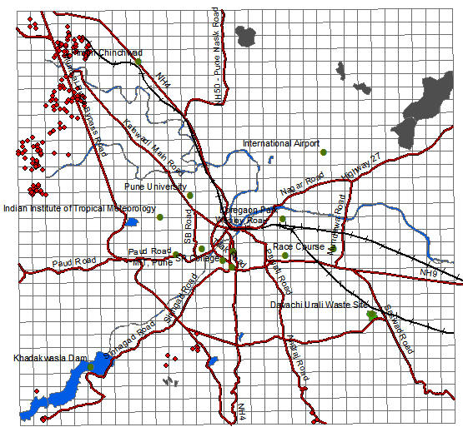
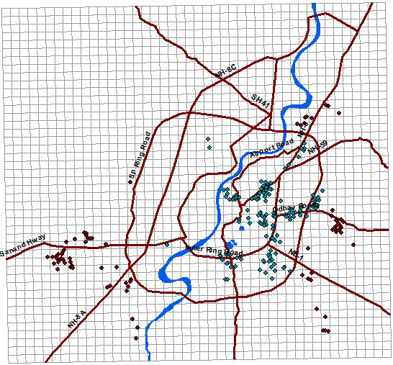
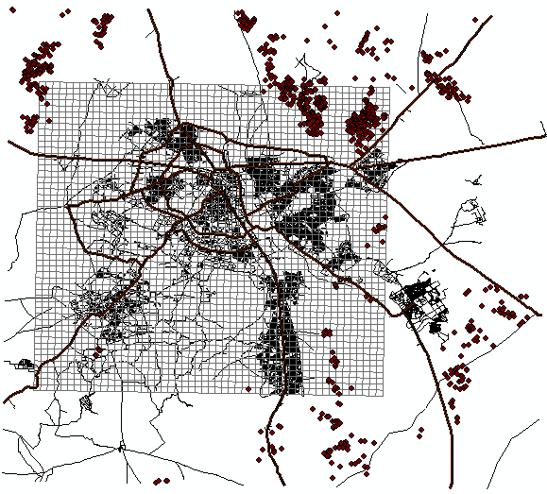
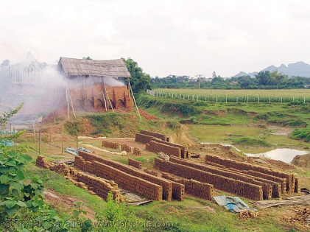
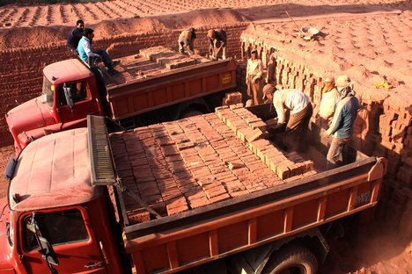
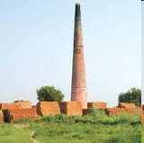
Sectoral Linkages – Brick Kilns
Chennai, ~550
Pune, ~400
Ahmedabad, ~400
Delhi, ~800

Slide 15
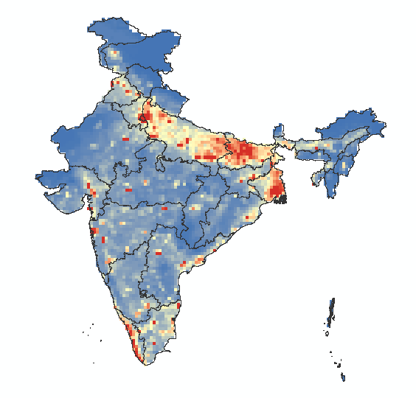
Sectoral Linkages – Brick Kilns
Indo-Gangetic Region
Transport
Rural biomass cooking
Agricultural
Industries
Brick kilns
PM₁₀

Slide 16
Sectoral Linkages – Urban
MoUD, 2008

Slide 17
Sectoral Linkages – Urban
MoUD, 2008

Slide 18
Sectoral Linkages – Urban
MoUD, 2008

Slide 19
Sectoral Linkages – Urban
MoUD, 2008

Slide 20
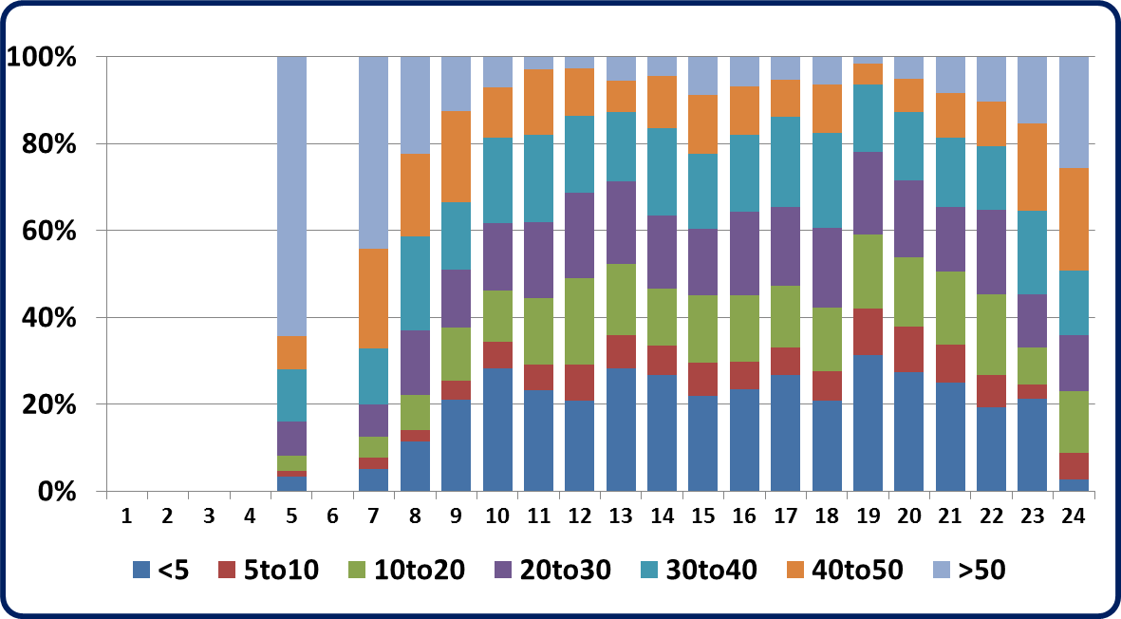
On-road Idling Pollution
Ludhiana
Delhi
Vizag
20%
Driving time is spent idling for passenger cars
Car moving speeds in Delhi – km/hr
20 min of idling for cars = Rs. 1 crores in fuel losses (~$200,000) per day
Goel & Guttikunda, 2013

Slide 21
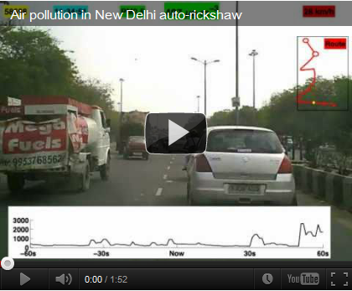
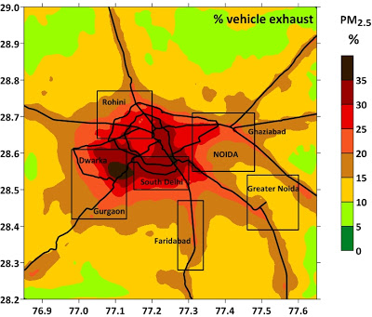
On-road Moving Pollution
25%
On road BC to PM2.5 ratio (in 2010)
Apte et al., 2011
On road measurements from 2010
% vehicle pollution to PM2.5 in Delhi
More @ http://www.urbanemissions.info
Notes:
21

Slide 22
National Transport Emissions
2010-30
?
More @ http://www.urbanemissions.info
Notes:
22

Slide 23
Thank you
More @

