Slide 1
ICAMP: POLICY CONCLAVE ON REDUCING VEHICULAR EMISSIONS TO IMPROVE AIR QUALITY
DELHI, FEBRUARY 04, 2014
COMBATING VEHICULAR POLLUTION: GETTING BEYOND RECITATION
Dr. Prashant Gargava and Ms Meetu Puri
Central Pollution Control Board
Delhi
(Email: eepg.cpcb@nic.in)
(Web: http://www.cpcb.nic.in)

Slide 2
PRESENTATION OUTLINE
VEHICULAR POLLUTION CONTROL
What have been done? – Actions
What have been achieved? – Status
Are we on the right track? – Action Dilemma
What can be done? – Way Forward

Slide 3
VEHICULAR POLLUTION CONTROL
TECHNOLOGY INTERVENTIONS
Improved fuel quality – S content in Diesel: 0.5% (1996) – 0.005% (mega cities) and 0.035% (rest of the country) (2010); Gasoline: 0.015% – 0.005%
Progressive emission norms for vehicles – BS I (1999) – BS IV in major cities and BS III in rest of the country (2010)
Alternate cleaner fuel (CNG/LPG) – 1.1 million vehicles (8% of total fleet), 0.55 million in Delhi
Improvement in public transport system (Metro) – 2.5 million passengers; 2500 trips covering 69,000 km
RESOURCE INTENSIVE

Slide 4
EMISSION REDUCTIONS IN PASSENGER CARS ( DIESEL)
CO
HC+NOx
NOx
PM
BS-III
0.64
0.56
0.50
0.05
21.8%
46.4%
50%
50%
BS-IV
0.50
0.30
0.25
0.025
0%
23.3%
28%
80%
BS-V
0.50
0.23
0.18
0.005
0%
26%
55.5%
0%
BS-VI
0.50
0.17
0.08
0.005

Slide 5
EMISSION REDUCTIONS IN PASSENGER CARS (GASOLINE)
CO
HC
NOx
BS-III
2.3
0.20
0.15
21.8%
50.0%
47%
BS-IV
1.0
0.10
0.08
0%
0%
25%
BS-V
1.0
0.10
0.06
0%
0%
0%
BS-VI
1.0
0.10
0.06

Slide 6
VEHICULAR POLLUTION CONTROL
MANAGEMENT INTERVENTIONS
Phasing out of old commercial vehicles
PUC Scheme
Restriction on goods vehicles during day time
Installation of time clocks at important crossings
Construction of more flyovers and subways
IMPLEMENTATION DIFFICULTIES

Slide 7
VEHICLE GROWTH IN DELHI AND INDIA
Source : MoRTH & Delhi Transport Department

Slide 8
AIR QUALITY AT ITO, DELHI

Slide 9
SIX CITY STUDY: PM₁₀ SOURCE CONTRIBUTIONS
City | Bangalore | Chennai | Delhi | Kanpur | Mumbai | Pune
Sources
Roadside Dust | 45 – 55 | 6 – 27 | 14 – 29 | 7 – 9 | 29 – 47 | 49 – 64
Vehicles | 10 – 22 | 35 – 48 | 9 – 20 | 15 – 17 | 8 – 26 | 2 – 10
Industries | 27 | - | 6 – 9 | 2 – 19 | 1 – 7 | -
Construction | - | - | 23 | - | 28 – 46 | 6 – 28
Secondary Particulates | 2 – 11 | - | - | 16 – 19 | 10 – 21 | -
Domestic | - | 4 – 20 | 3 – 9 | 15 – 26 | 3 – 18 | -
DG Sets | 7 – 18 | 14 – 16 | 7 – 12 | 5 – 8 | - | 3 – 4
Roadside dust and vehicles are prominent sources in all the six cities

Slide 10
EMISSION INVENTORY FOR SIX CITIES
PM₁₀:
Major Source – Road dust re-suspension
Significant contribution of industries in Kanpur, Mumbai and Delhi
NO_{x}:
Vehicles are major source
Contribution of industries (power plants) high in Delhi, Mumbai and Kanpur
Important observation: A few prominent sources in a city can mask the contribution of the other sources.
HEAVY DUTY DIESEL VEHICLE: 40 – 59%

Slide 11
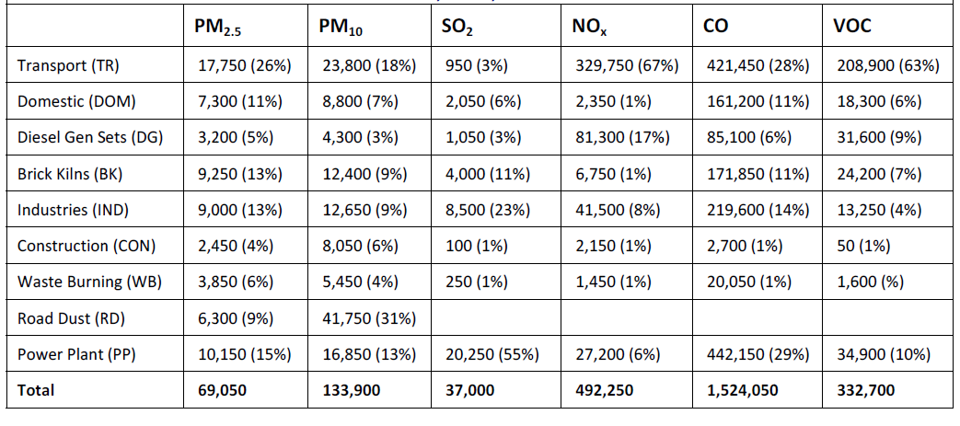
EMISSION INVENTORY (TONS/YEAR): DELHI, 2010
Source: International Council on Clean Transportation

Slide 12
CARBON AND TOXIC METAL FRACTION IN PM₁₀ EMISSIONS IN DELHI, 2007: CONTRIBUTION OF DIFFERENT SOURCES

Slide 13
CARBON AND TOXIC METAL FRACTION IN PM₁₀ EMISSIONS IN DELHI, 2007: CONTRIBUTION OF DIFFERENT FUELS

Slide 14
CONTRIBUTION OF DIESEL, GASOLINE AND CNG FUELED VEHICLES TO PM₁₀, CARBON AND TOXIC METAL EMISSIONS IN DELHI, 2007

Slide 15
CONCLUSION
Action Dilemma – Technology v/s Management based options?
No direct visible impact/correlation of the measures taken – many influencing factors
Many contributing sources – vehicle share not most prominent, but road dust could be attributed to vehicle movement
Higher contribution of vehicles and diesel in toxic carbon component of PM

Slide 16
WAY FORWARD
Efficient, affordable, convenient public transport
Next generation norms – sooner the better
Get the dirty vehicles off the roads as quickly as possible
Address pollution from heavy duty diesel vehicles – effective freight management
Policies to translate in micro level actions
Minimize activities in hotspots
Experiment with ideas
Aggressive public awareness
HOW AND HOW FAST??

Slide 17
THANK YOU

