Slide 1
Governance interventions to mitigate air pollution Opportunities for Action !! in Uttarakhand state (Dr UK Panwar, Secretary of Transportation)

Slide 2
The state of Uttarakhand
New state (2000)
Small state (11 million)
Small capital city of Dehradun (700,000)
Most ecologically fragile and important state
13 National parks, and bioshphere reserves, 2 world heritage sites
67% land mass covered with forest
Fragile Himalayan ecosystem (recent floods)

Slide 3
Uttarakhand
High environmental consciousness
High literacy (> 70%)
Economy based on tourism
High influx of vehicular traffic
Most beautiful state
simply heaven

Slide 4
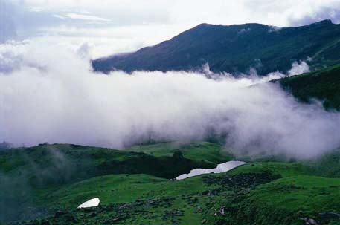
Unparalleled natural beauty
Bedini tal

Slide 5
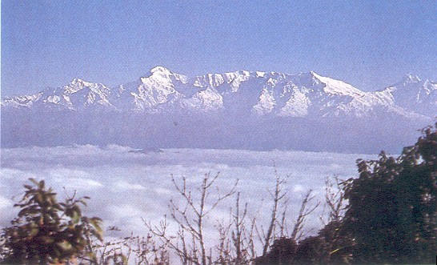
Unparalleled natural beauty
View from Binsar

Slide 6
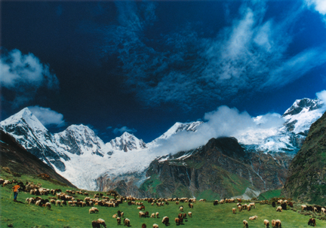
Unparalleled natural beauty
Panchachuli peak

Slide 7
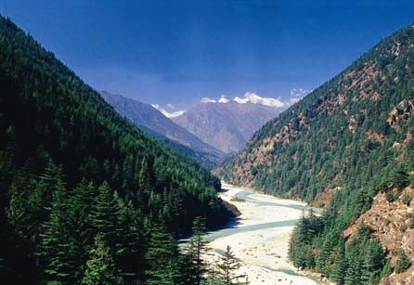
Unparalleled natural beauty
Harsil

Slide 8
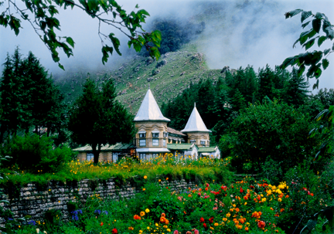
Unparalleled natural beauty
Narayan Ashram

Slide 9
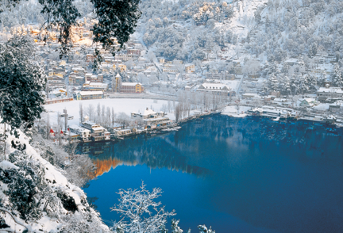
Unparalleled natural beauty
Nainital during winter

Slide 10
Unparalleled natural beauty
Valley of flowers

Slide 11
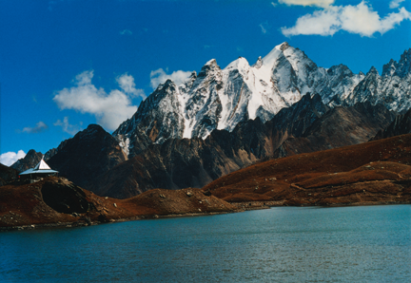
Cradled in the Himalayas
Pandav parwat

Slide 12
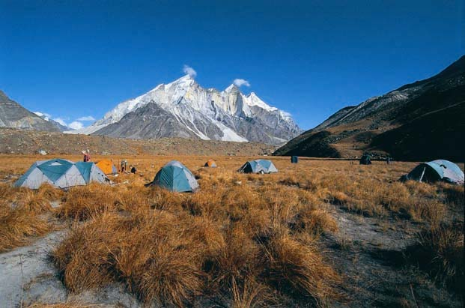
Cradled in the Himalayas
High altitude camping

Slide 13
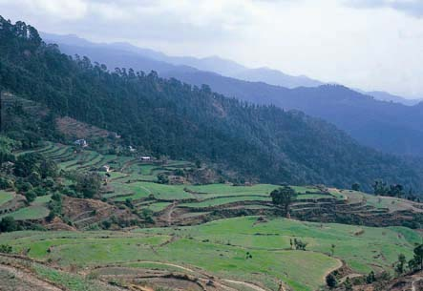
Cradled in the Himalayas
Terraced fields

Slide 14
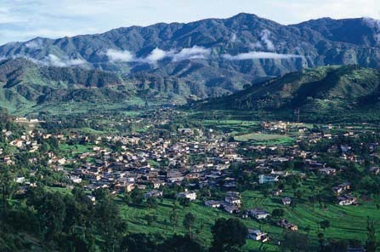
Cradled in the Himalayas
…a village

Slide 15
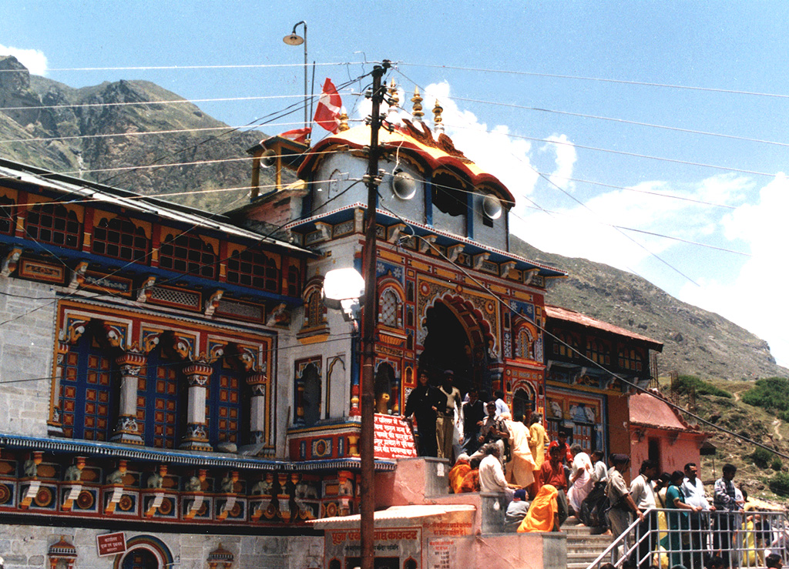
Abode of Gods
Badrinath temple

Slide 16
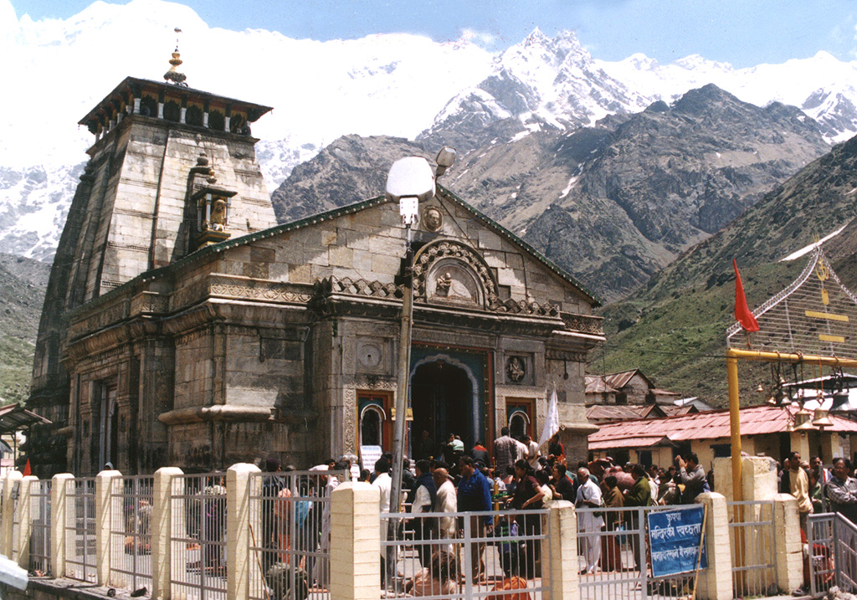
Abode of Gods
Kedarnath temple

Slide 17
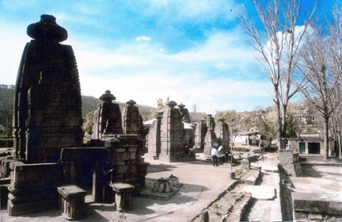
Abode of Gods
Baijnath temple

Slide 18
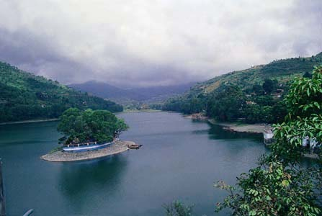
Land of Lakes
Bhim tal

Slide 19
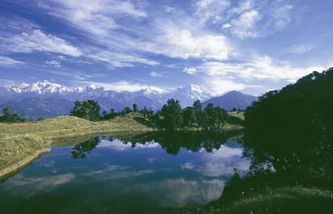
Land of hundreds of Lakes
Deoria tal

Slide 20
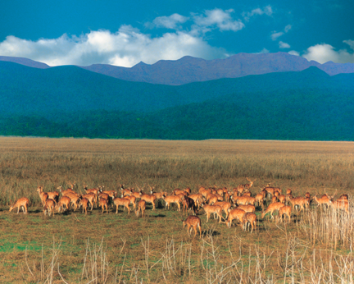
Exotic wildlife
Corbett National park

Slide 21
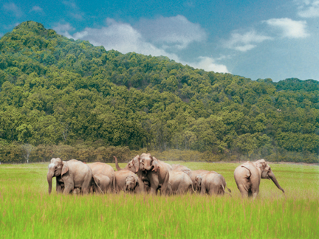
Exotic wildlife
Rajaji National Park

Slide 22
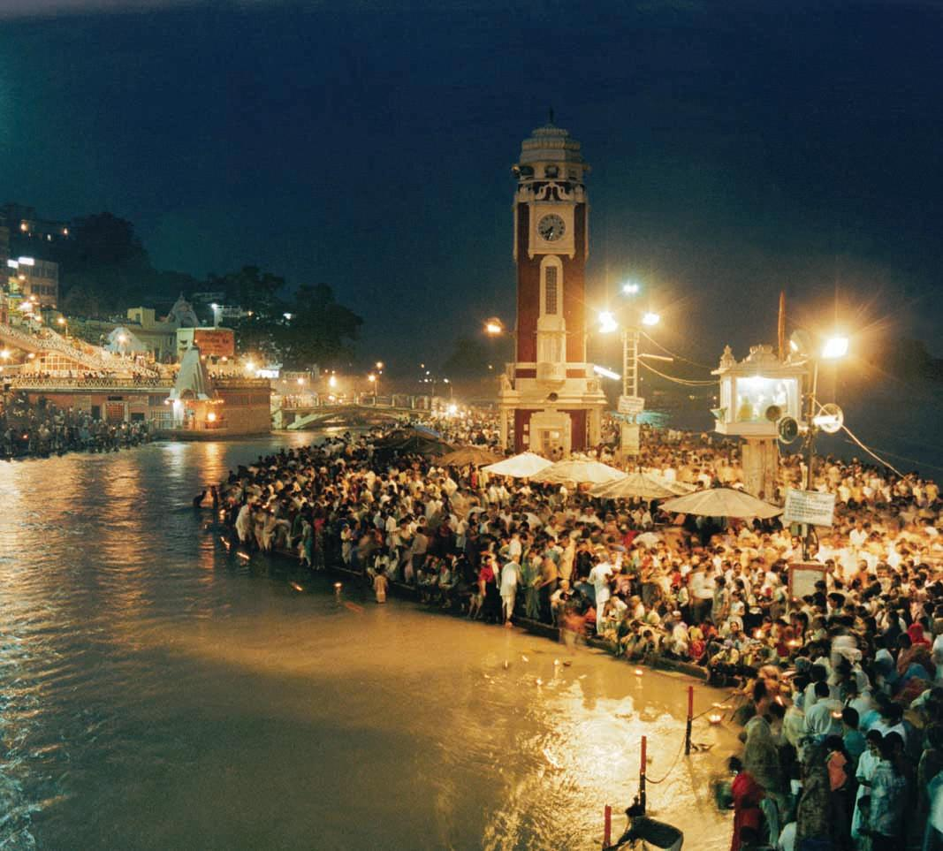
Source of the mighty Ganga & Yamuna
Holy Ganga at Haridwar

Slide 23
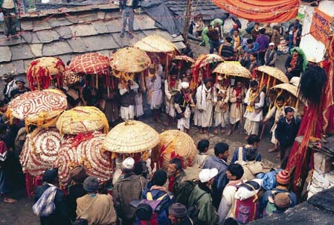
Cultural Tourism
Gods own people

Slide 24
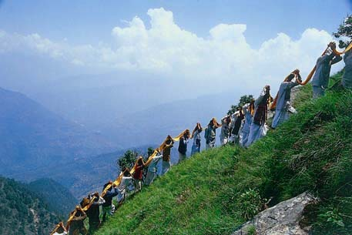
Cultural Tourism
Gods own people

Slide 25
The Natural disaster of June 2013
Massive floods
caused by sudden excessive rain
“cloud burst”

Slide 26
Kedarnath
Before
After

Slide 27
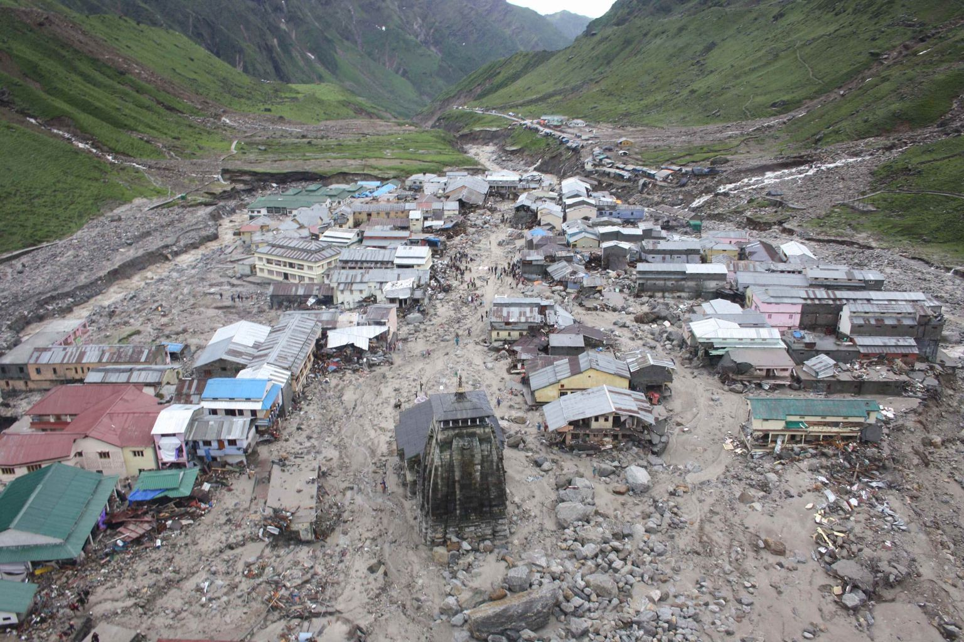

Slide 29
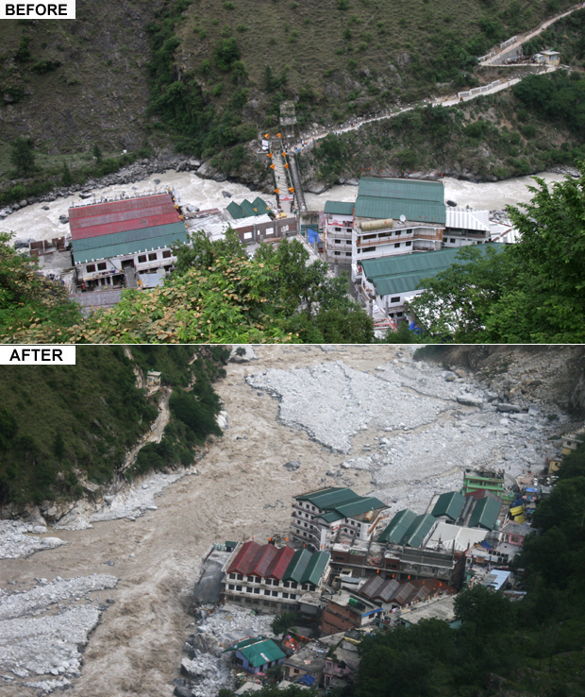
GOVINDGHAT IN ALAKNANDA VALLEY SEVERELY DAMAGED
Before
After

Slide 30
DAMAGE TO SSB ACADEMY in SRINAGAR BY ALAKNANDA

Slide 31
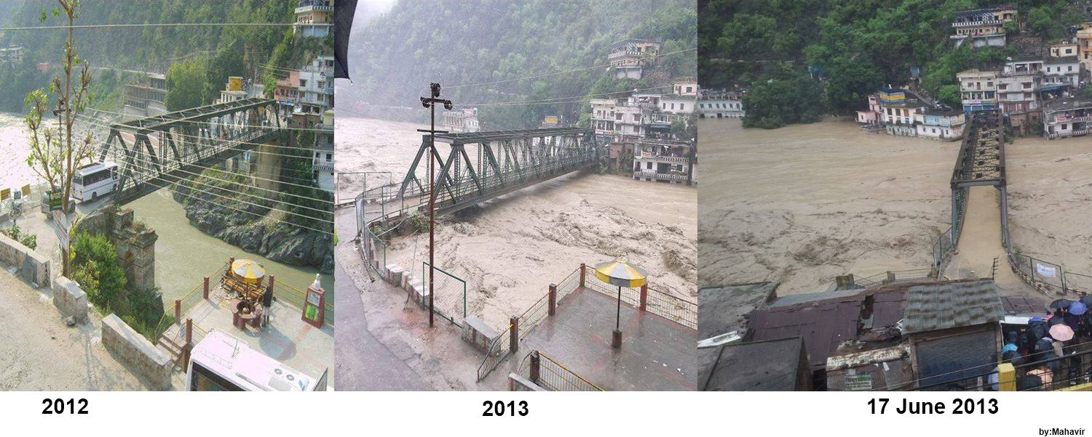
Bridge at Rudra Prayag
(Unprecedented Flow of Water)
16th June 2013
2012
16 June
17th June 2013

Slide 32
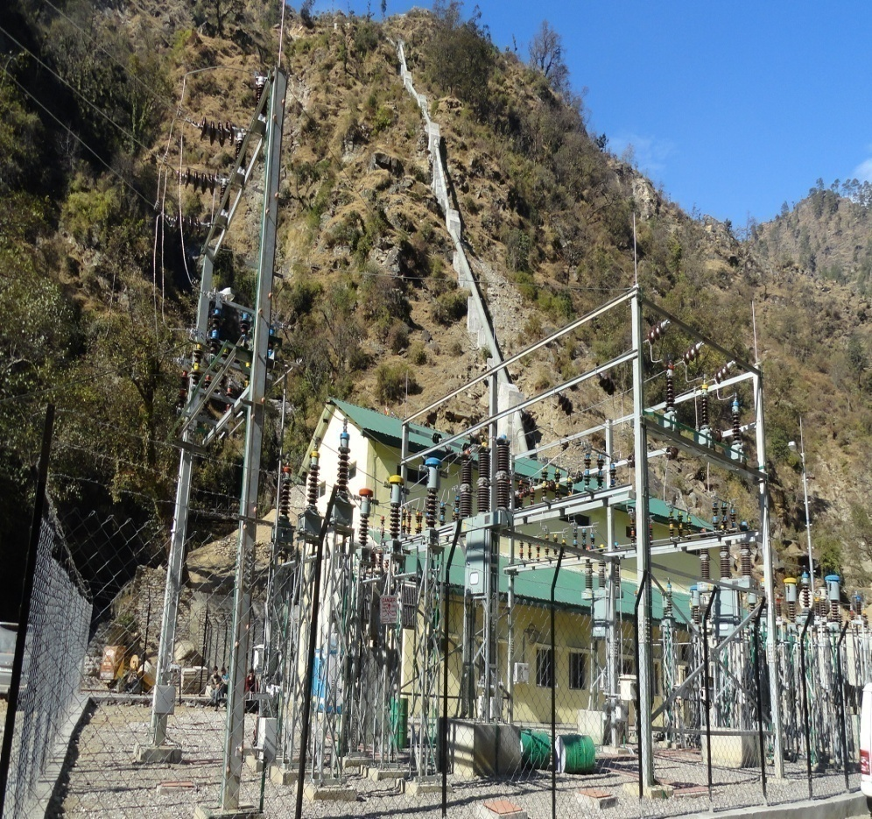
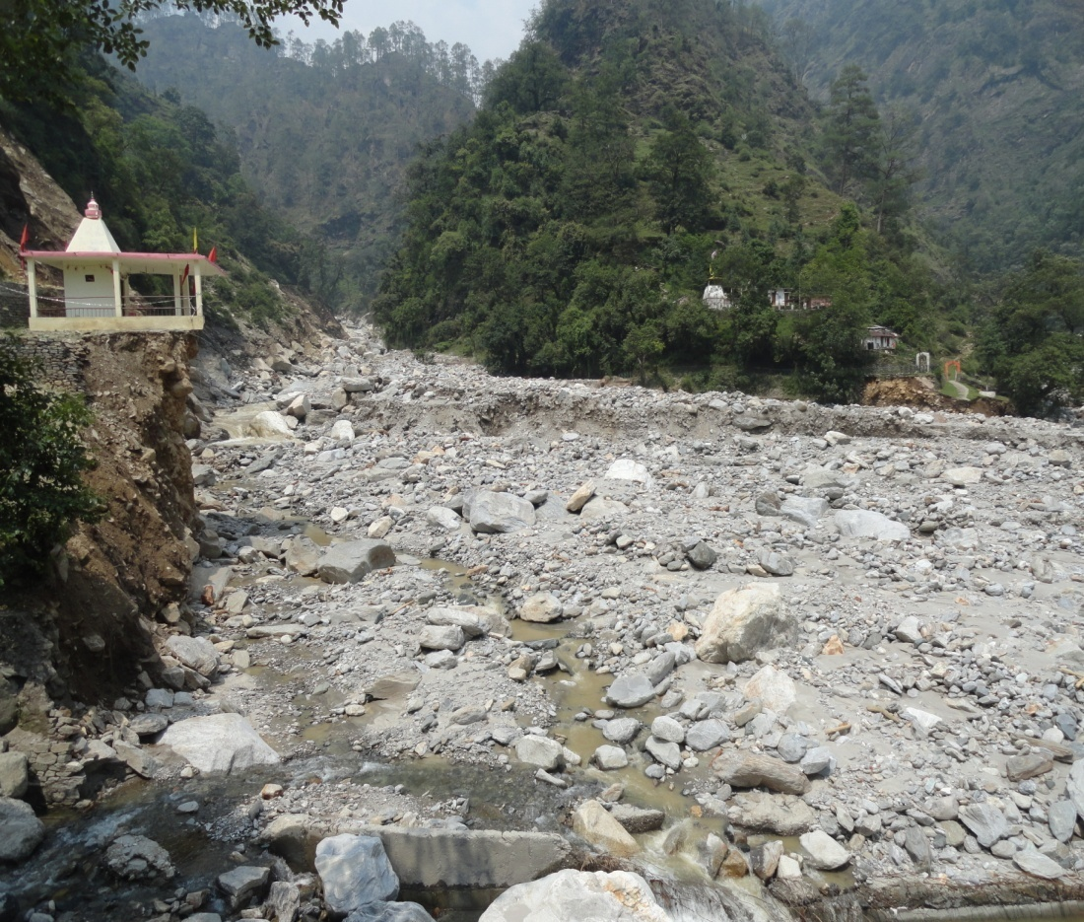
ADB assisted Kaliganga Small Hydro Project (SWITCHYARD)
BEFORE AFTER
TEMPLE BEHIND POWER HOUSE
TEMPLE

Slide 33
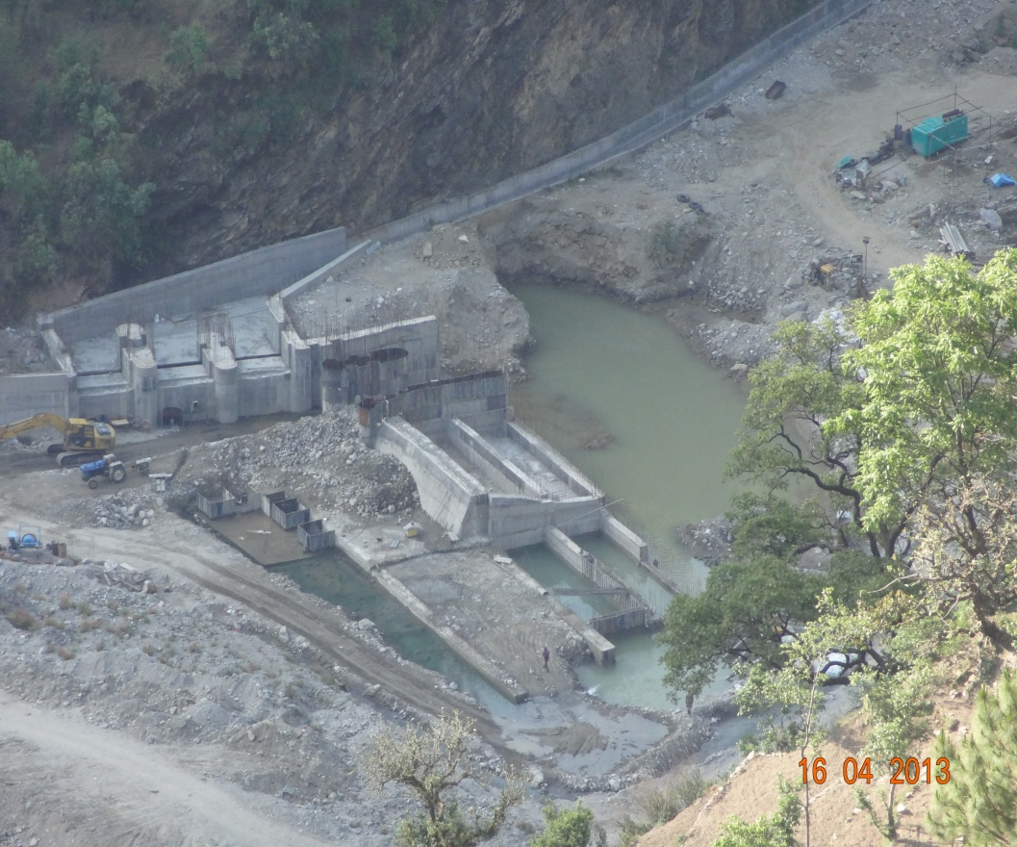
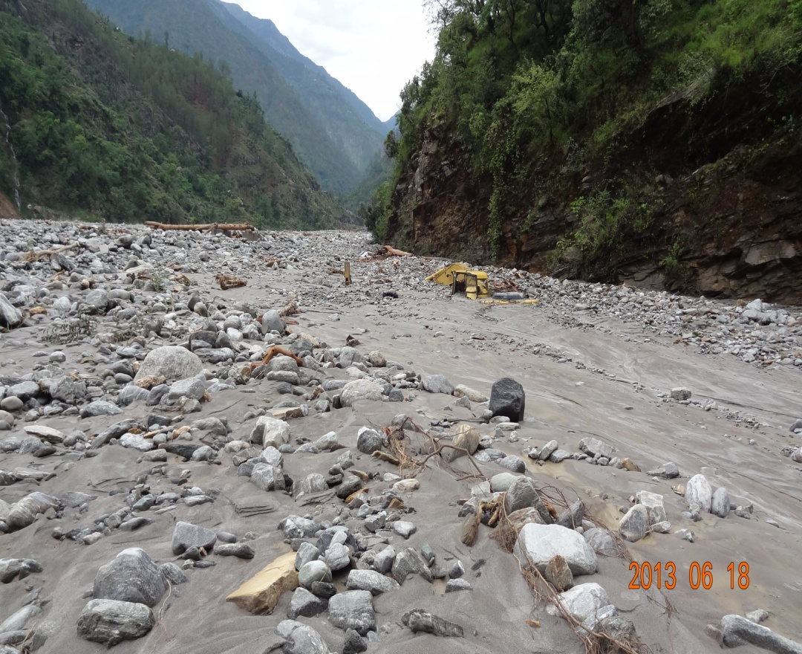
ADB assisted Small Hydro Project ,Madhyamaheshwar
(DIVERSION STRUCTURE)
BEFORE AFTER

Slide 34
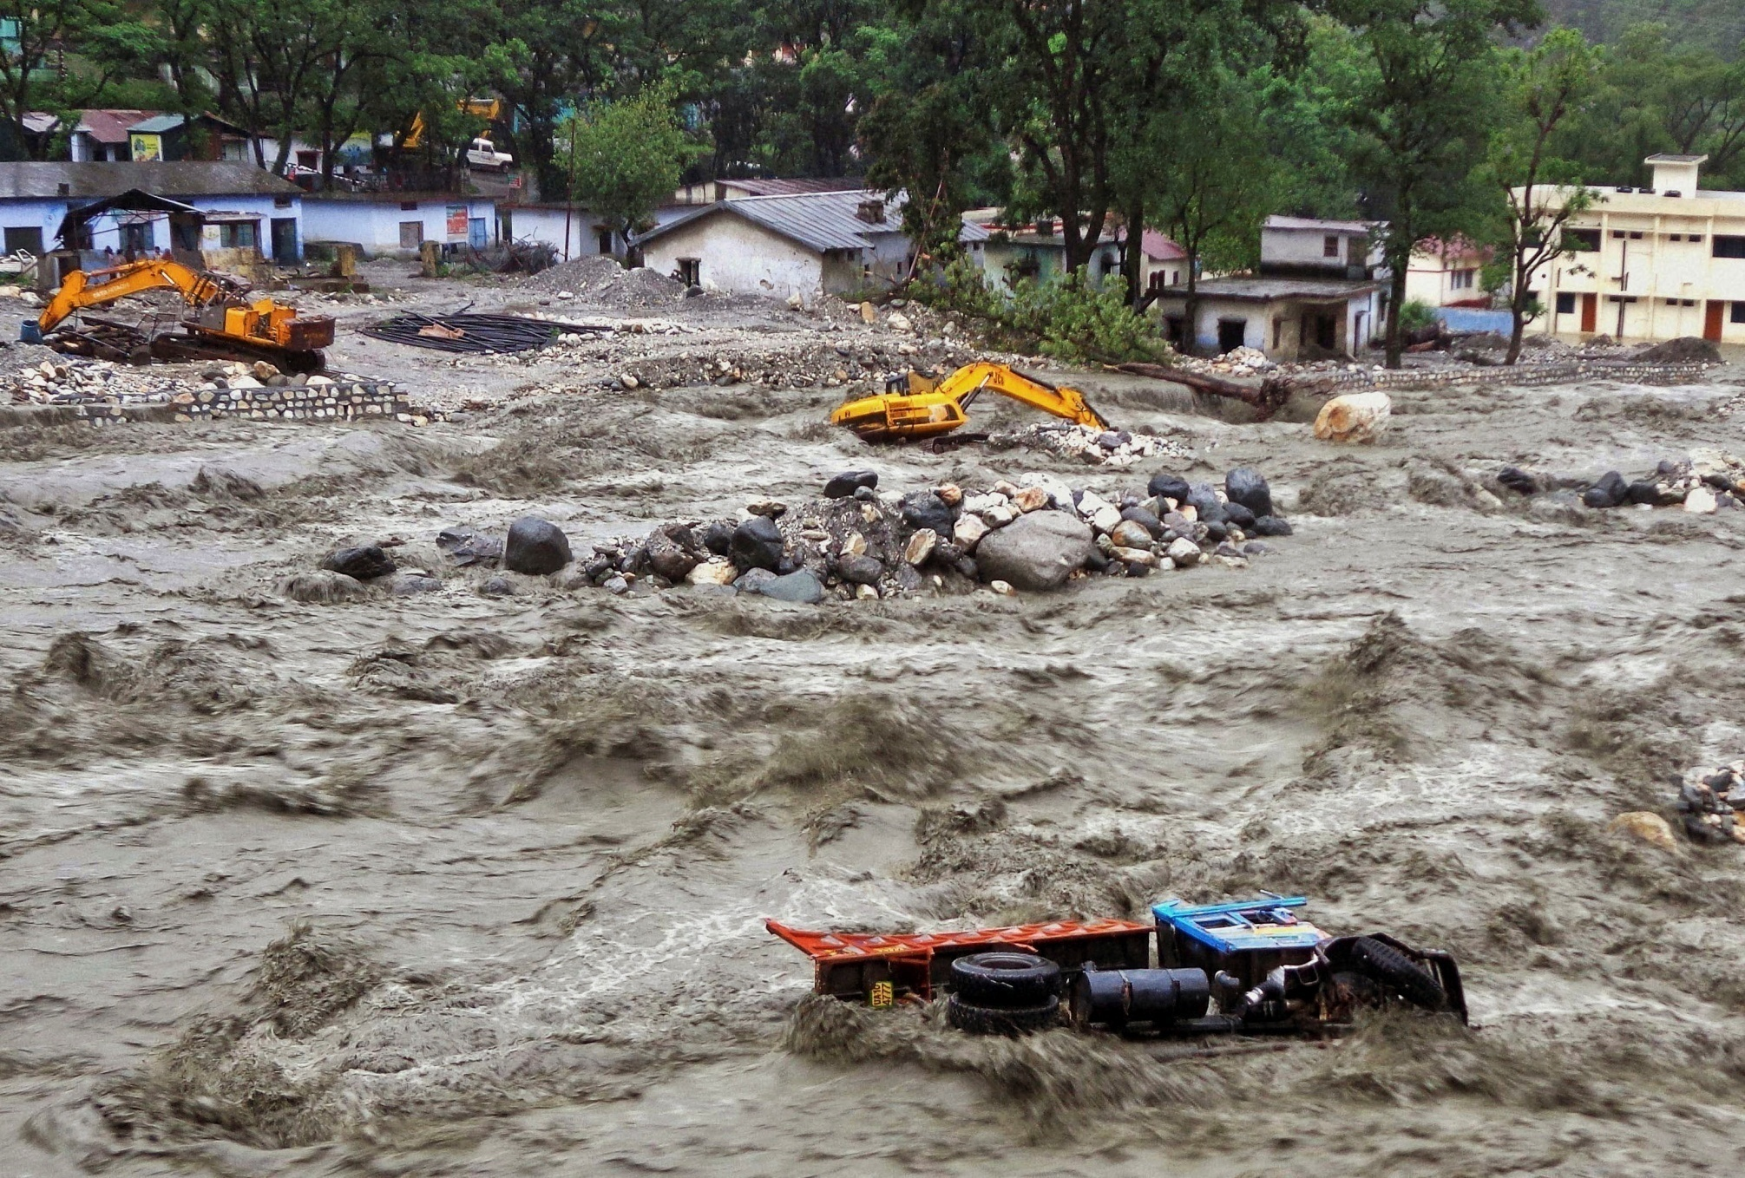
JCBs and Trucks being washed away in the Asiganga torrent-Uttarkashi

Slide 35
An ICAMP/WB Pilot Project in Uttarakhand state (capital city of Dehradun)

Slide 36
Why Dehradun (Uttarakhand)?
Newly created state
closer focus on governance
Small state
easy to effect change and see results
Pilot will cost less
Tourist state
High influx of tourist vehicles
Himalayan state
Ecologically fragile (recent disaster)
High environmental consciousness among public
We can save the beautiful valley

Slide 37
Avoid
(avoid the need for transit)
Shift
(Shift to public transport)
Improve
(standards, technology, governance)

Slide 38
Avoid
New capital infrastructure in under development
The new state assembly complex
The new secretariat complex
State government offices
Opportunity to in-build TOD
(transit oriented development)

Slide 39
The Uttarakhand Pilot Project..1
Avoid
ICAMP/ WB can support :
TOD
Intervene now to help design better layout of new urban infrastructure
Bus shelters, lay by areas, parking spaces, inter-modal transit exchange terminals
Residential facilities for workers
Ancillary services will develop around the capital complex. Make it TOD

Slide 40
Shift
Pubic transport is underdeveloped
Retrofitting the old cities with modern public transport is difficult
Geo-morphology of old towns is a challenge
Government resource crunch- constrains Investment in public transport

Slide 41
Shift …2
Solutions/ Opportunities:
Replace auto rickshaws with mini buses (Euro – IV compliant), electric vehicles
Replace Vikrams (the most polluting vehichle on roads) with mini vans/buses (Euro – IV compliant)
City buses are being funded by JNNRUM but not suitable for cities with narrow streets- use them as inter-city/ suburban transport

Slide 42
The Uttarakhand Pilot Project..2
Shift
ICMP/ WB can support:
One time replacement of existing Vikrams and Auto rickshaws
We can ban registration of new vehicle in the state
Build/ facilitate shifting by providing waiting areas, parking spaces, bus shelters, bus stops
Subsidized fares in the begining

Slide 43
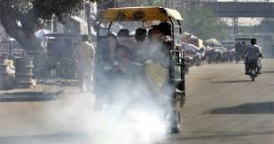
Vikaram ( a type of autorickshow)

Slide 44
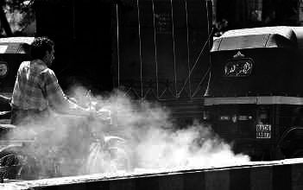
Auto rickshaw

Slide 45
Improve
Euro-4, 5 standards to be regulated by GoI
Fuel supply – not controlled by state govt.
Monitoring/ checks
We can upgrade monitoring and testing
Stricter enforcement

Slide 46
Summary of Pilot Project
Start a 3 year pilot (GoUK + CARB +TERI + WB)
With a small cost ($ < 5 m)
Intervention
Measurements (monitoring facilities)
Vehicle replacement (intra-city service)
Supporting infrastrucutre (shelters, parking etc.)
Urban design technical support
Technical support for enforcement (testing/ checking)
Technology support

Slide 47
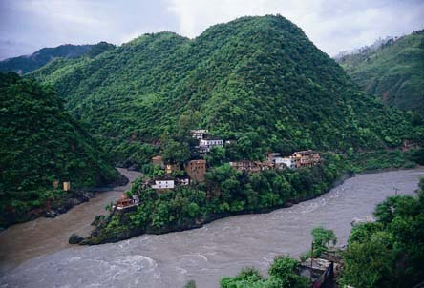
Thank you
Devprayag

