Slide 1

California’s Light-Duty Vehicle Control Program
India-California Air Pollution Mitigation Program
October 21, 2013
Oakland, California
Paul Hughes
Retired Annuitant
Mobile Source Control Division
Air Resources Board

Slide 2
Transportation’s Contribution to California Emissions

Slide 3
Vehicle Emissions Depend On
How clean is the fuel
  Reduces engine out emissions
  Maximizes efficiency of aftertreatment
How well the fuel is combusted
  Combustion chamber design, fuel control, etc.
How effectively the exhaust is treated

Slide 4
Cleaner Burning Gasoline
Gasoline
  1992 Phase I Cleaner Burning Gasoline
    Eliminated lead in gasoline.
    RVP reduced from 9.0 to 7.8 psi.
      Applies during warmer weather months
      Evaporative emissions benefit
    Required the addition of 10% oxygenates.
  1996 Phase II Cleaner Burning Gasoline
    Sulfur levels reduced from 151 ppmw to 30 ppmw
    RVP reduced to 7.0 psi
      Evaporative emissions benefit
    Reduced ozone precursors by 300 tons/day.
    Equivalent to taking 3.5 million cars off the road.
  2002 Phase III Cleaner Burning Gasoline
    Prohibited use of MTBE as oxygenate - replaced by ethanol
    Sulfur levels reduced to 15 ppmw

Slide 5
Alternative Fuels
CNG
  Low reactivity for ozone
  Primarily used by centrally fueled fleets
    Buses, medium-duty trucks and delivery vans, taxis
    Limited light-duty vehicle models
Ethanol
  Used as an oxygenate in gasoline (E10)
  Flex-fuel vehicles (E0-E85)
Propane
  Limited light-duty vehicle models
Electricity
  Electric vehicles, Plug-in HEVs
  Upstream emissions dependent on power source
Hydrogen
  Fuel Cell Vehicles
  Upstream emissions dependent on fuel source

Slide 6
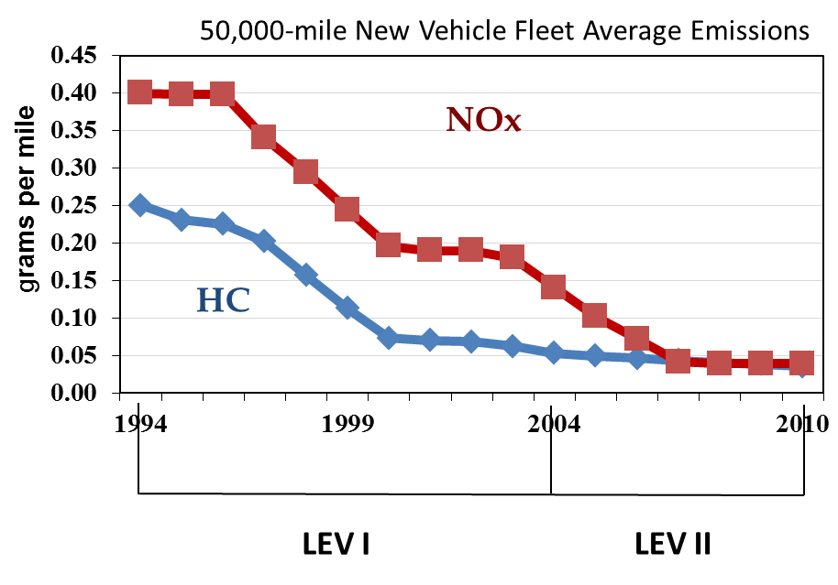
LEV Program 1994-2010
LEV I
  Adopted 1990
  Implemented 1994-2003
  First program to provide multiple emission standards (bins) and fleet average requirement
    Provides flexibility
    Assures continued emission reductions
  First program to take fuel contribution to exhaust emissions into account
    Reactivity factors
LEV II
  Adopted 1998
  Implemented 2004-2010
  Light trucks meet passenger car standards
  NOx focused
Long-term programs provide certainty and lead time for manufacturers

Slide 7
Advanced Clean Cars
Multi-pronged approach to meeting mid- and long-term emission reductions from light duty vehicles
ZEV
Future
Technology advancement
Infrastructure development
LEV
Conventional
Vehicle
Advancement

Slide 8
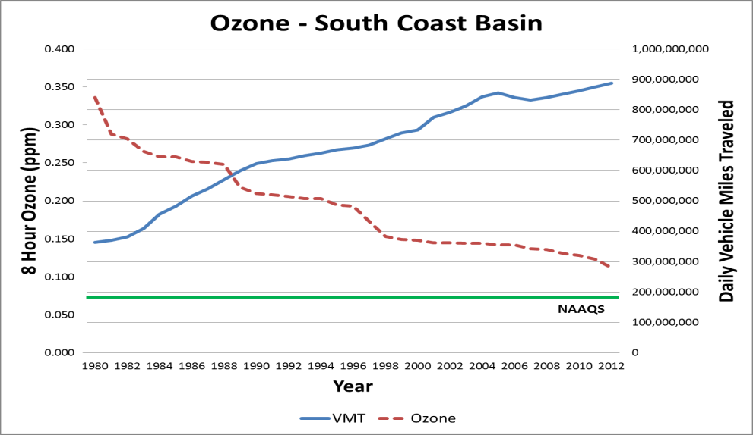
Advanced Clean Cars Program Goals
Continued progress towards ozone attainment
Reduce localized exposure
  PM, toxics
Ensure commercialization of ultra-clean vehicles
Reduce GHG emissions
  80% by 2050
Transp. Sector 38%; LDV 28%

Slide 9
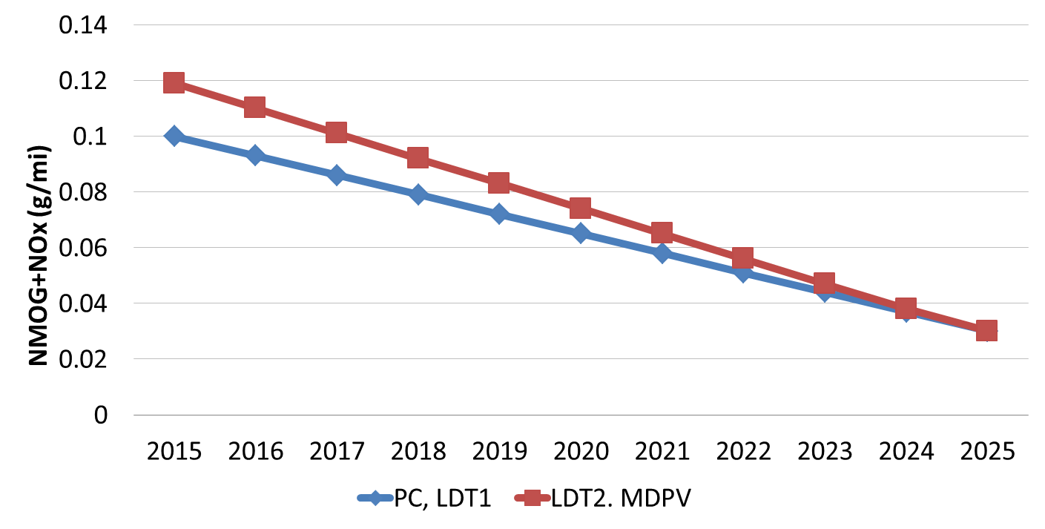
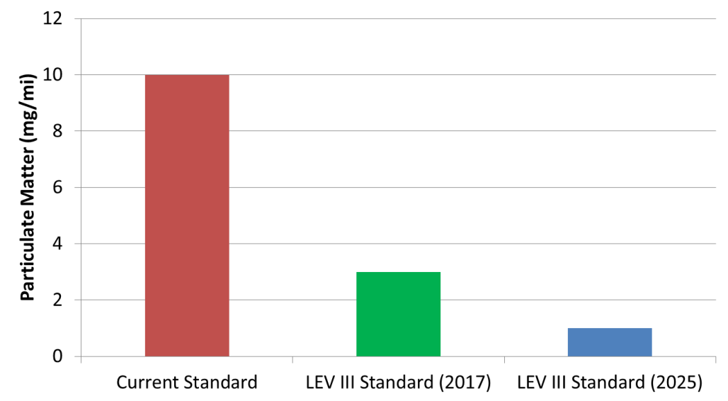
LEV III: Reducing Criteria Emissions
150,000-mile New Vehicle Fleet Average Emissions
75% Reduction in fleet average emissions 2015-2025
LEV III Particulate Matter Standards
1 mg/mi PM standard in 2025 maintains current PM emission level of well controlled PFI engines

Slide 10
Technology and Costs
(Gasoline)
 | Technology Component | From ULEV to SULEV
 |  | PC/LDT1 |  |  | LDT2
 |  | 4-cyl | 6-cyl | 8-cyl | 4-cyl | 6-cyl | 8-cyl
Systems with additional technology costs | Greater catalyst loading | $23 | $31 | $39 | $23 | $31 | $39
 | Optimized close-coupled catalyst(s) | $0 | $0 | $0 | $0 | $0 | $0
 | Secondary air | $0 | $19 | $58 | $0 | $19 | $58
 | HC adsorber (active) | $0 | $0 | $17 | $0 | $0 | $17
 | Optimized thermal management | $6 | $6 | $6 | $6 | $6 | $6
 | Low thermal mass turbocharger | $0 | $0 | $0 | $0 | $0 | $0
 | Evaporative equipment | $13 | $13 | $13 | $13 | $13 | $13
Total incremental cost |  | $42 | $69 | $134 | $42 | $69 | $134
Total incremental price |  | $50 | $83 | $161 | $50 | $83 | $161

Slide 11
Vehicle Cost
(Gasoline)
Vehicle Category | Initial baseline certification level | Engine size |  |  | Average incremental priceª ($/vehicle) | Average incremental price^{b} ($/vehicle)
 |  | 4-cyl | 6-cyl | 8-cyl
PC/LDT1 | LEV | $87 | $142 | $248 | $130 | $55
 | ULEV | $50 | $83 | $161 | $68
 | SULEV | $0 | $0 | $0 | $0
LDT2 | LEV | $87 | $142 | $248 | $159 | $117
 | ULEV | $50 | $83 | $161 | $111
 | SULEV | $0 | $0 | $0 | $0
ª Sales-weighted average for each initial certification level
^{b} Sales-weighted average for vehicle category

Slide 12
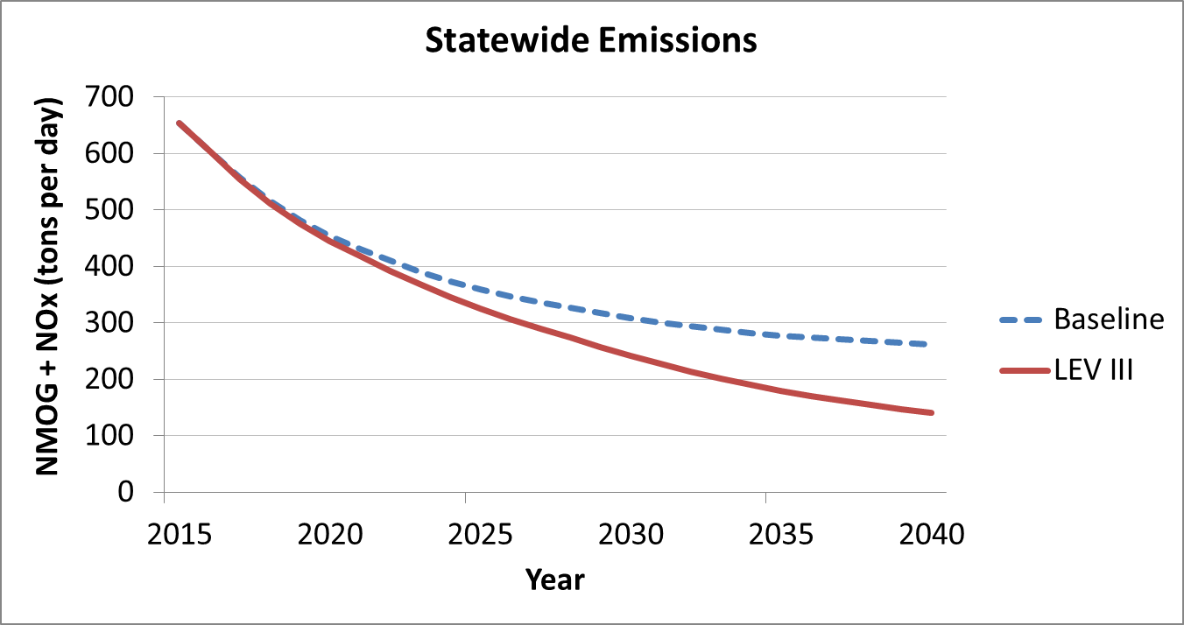
LEV III Smog-Related Emission Benefits

Slide 13
Keeping Cars Clean
Extended emission standard durability requirement
  LEV I 100,000 miles, LEV II 120,000 miles, LEV III 150,000 miles
Manufacturer in-use verification
  Test low and high mileage vehicles
Agency in-use verification program
  Test low and high mileage vehicles
On-Board Diagnostics
  Provides rapid diagnostics of complex emission control systems
  Enables cost-effective repair
  Ensures component robustness
Smog Check Program
  Biennial check of in-use vehicle emissions
  Will incorporate OBD only check for 2000+ vehicles into program

Slide 14
California Greenhouse Goals
AB 1493 (2002) - “Pavley”
  Achieve maximum feasible and cost effective reduction of GHG emissions from motor vehicles
AB 32 (2006) – California Global Warming Solutions Act
  Reduce GHG emissions to 1990 levels by 2020
Governors Executive Order S-03-05 (2005)
  Reduce GHG emissions to 80% below 1990 levels

Slide 15
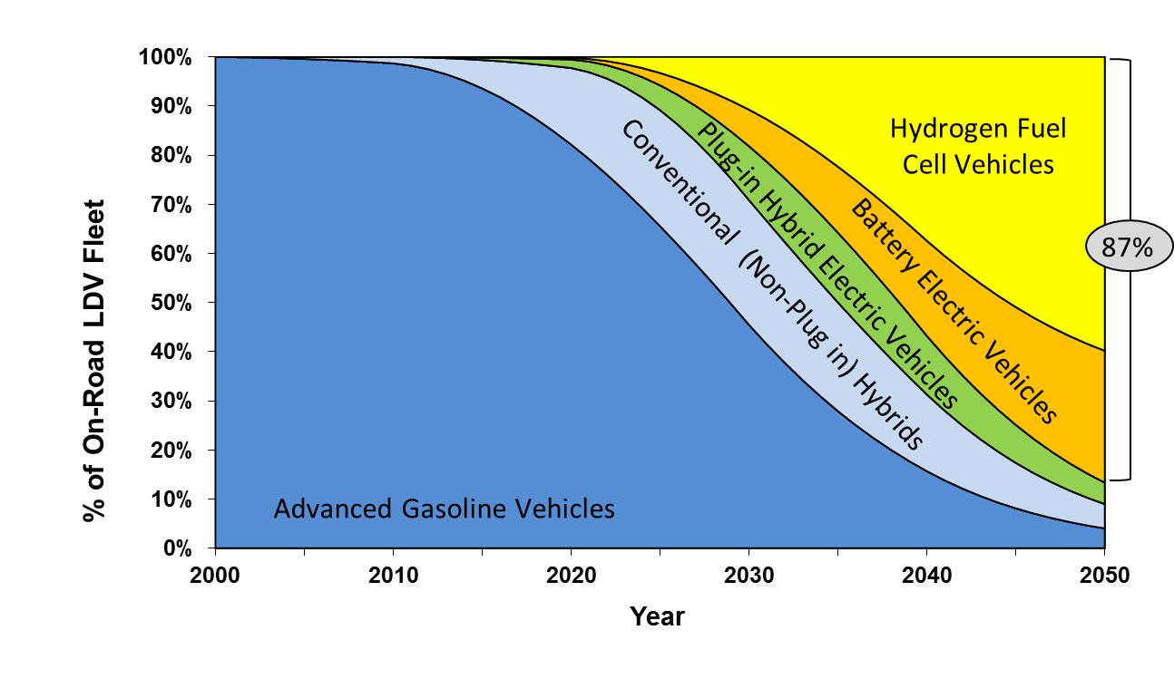
Meeting Greenhouse Gas Goals
(80% reduction from 1990 levels by 2050)

Slide 16
LEV III: Reducing Greenhouse Gas Emissions
Follows Pavley requirements (2009-2016)
  First light-duty GHG program in US
  Template for federal 2012-2016 requirements
LEV III regulations continue emission reductions for all new vehicles
  - Greenhouse gas (GHG) standards reduce climate emissions by 34%

Slide 17
Federal Coordination
ARB rulemaking paralleled federal regulation timing
“Deemed to comply” provision
  ARB has deemed compliance with US EPA GHG regulation as sufficient for ARB GHG regulation compliance
Mid-Term Review
  ARB intends to participate in the federal agencies’ “Mid-Term Review” to review standards for model years 2022-2025 (to be completed by April 2018).

Slide 18
Emerging GHG Technology Solutions
Off-the-shelf low-GHG technology becomes commonplace
Variable valve control
Direct injection
Turbocharging
Cylinder deactivation
Cooled exhaust gas recirculation
Optimized controls
8-speed transmission
Continuously variable
Dual clutch transmission
Engine stop-start
Hybrid power assist
Aerodynamics
Low rolling resistance tires
Advanced lightweight materials
Low-GWP refrigerant
Electric accessories
Engine
Driveline
Vehicle

Slide 19
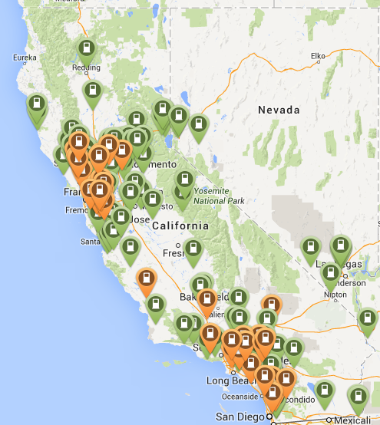
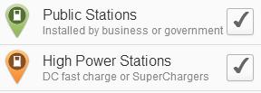
Public Charging Infrastructure
Existing Public Infrastructure
  Close to 1000 Level 2 stations with over 2800 connectors
  67 quick chargers
Future Activities
  CEC recent awards – $2.5M
  for 39 quick chargers in So Cal
  NRG settlement: $100 million
    200 combo fast charge/Level 2 station (“Freedom Stations”)
    Infrastructure for 10,000 level 2 EVSEs for multi-family housing, workplace, schools and hospitals.
Map courtesy of plugshare.com

Slide 20
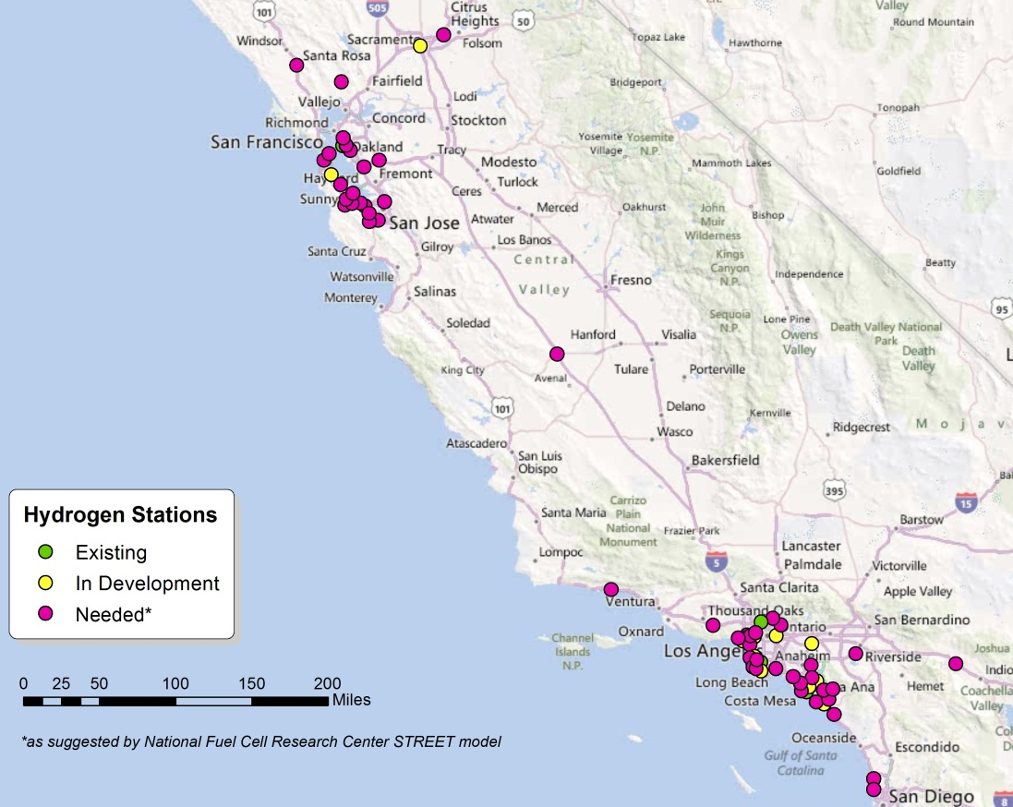
AB8/AB118 Hydrogen Infrastructure
Annual requirements:
CEC allocates $20
million/year of AB 118
funds toward hydrogen
infrastructure until there
are 100 public stations
ARB collects data on
FCEV numbers
ARB assesses need for
additional stations and
reports findings to CEC
CaFCP: “A California Road Map.” July 2012

Slide 21
Substantial GHG Reduction
Major impact as low-GHG vehicles replace older vehicles
  GHG reduction in California: 27% in 2035 and 33% by 2050
  Cumulative: 870 million metric tons through 2050
Baseline
33%
27%
With Regulation
Passenger Vehicle GHG Emissions
(million metric ton CO₂e)

Slide 22
Flexibility Preserves Vehicle Choice
Fleet average requirement for criteria emissions
Company sales-weighted averaging for GHG emissions
Footprint-indexed targets
Separate car and truck standards
Credit banking (5-year carryforward, 3-year carryback)
Technology-specific credit opportunities
  Off-cycle emission reductions
    Recognizes reductions achieved outside of test cycles
  Truck hybridization
  A/C efficiency improvements and low GWP refrigerants

Slide 23
ACC Program: Vehicle Technology Cost
Regulations impose increasing costs from 2015 to 2025
  Incremental 2025 price increase to consumers: $1,900/vehicle
  At $1,900/vehicle , vehicle prices would increase by about 8%
  Fuel savings are 3 times greater than cost; payback period is within 3 years
Average 2025 vehicle price

Slide 24
Consumer Savings Exceed Technology Cost

Slide 25
Summary
State vehicle standards main reason air quality has improved in CA
Regulations have been effective
  95+% criteria emission reduction
  Significant GHG emission reductions
  Full model availability
Costs have been reasonable - no diminishing returns

Slide 26
Contacts and References
Advanced Clean Cars
  Staff
    Michael McCarthy - mmccarth@arb.ca.gov
    Paul Hughes – phughes@arb.ca.gov
  Program
    http://www.arb.ca.gov/msprog/levprog/test_proc.htm
Fuels
  Staff
    Michael Waugh - mwaugh@arb.ca.gov
  Program
    http://www.arb.ca.gov/fuels/fuels.htm

