Slide 1
India-California Air Pollution Mitigation Program (ICAMP)
Knowledge Action Plan
Science
S. Sharma, S. Tripathi, S. Guttikunda, N. Ramanathan, R. Bahadur, T. Kirchstetter, T.K. Joshi, W. Al-Delaimy, A. Dutta, M. Panwar, J.Burney, G. Beig, V. Ramanathan.

Slide 3
Key issues addressed
Health impacts
Emission Scenarios
Impacts on agriculture
Monitoring
Mitigation

Slide 4
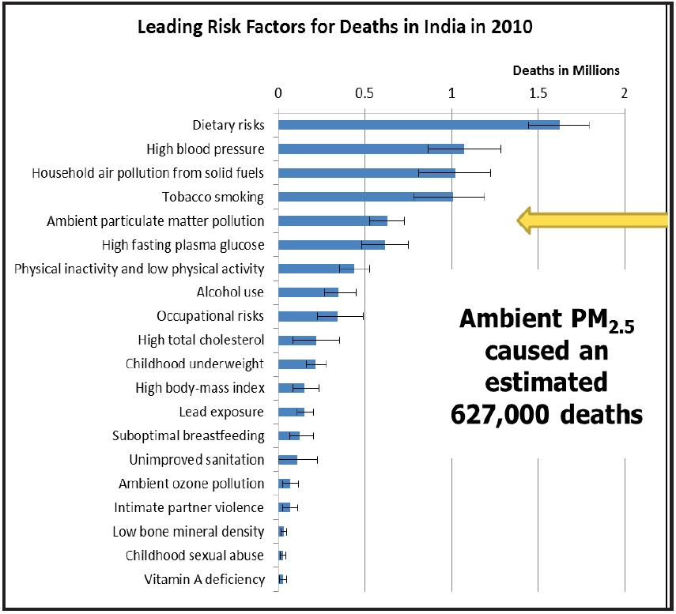
Health impacts of air pollutants
Particulate Matter (PM) and ozone are the culprits.
However PM 10 times more adversely impacts than ozone

Slide 5
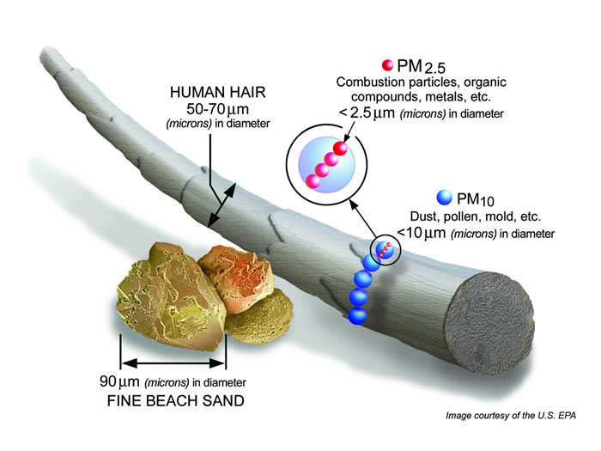
PM size

Slide 6
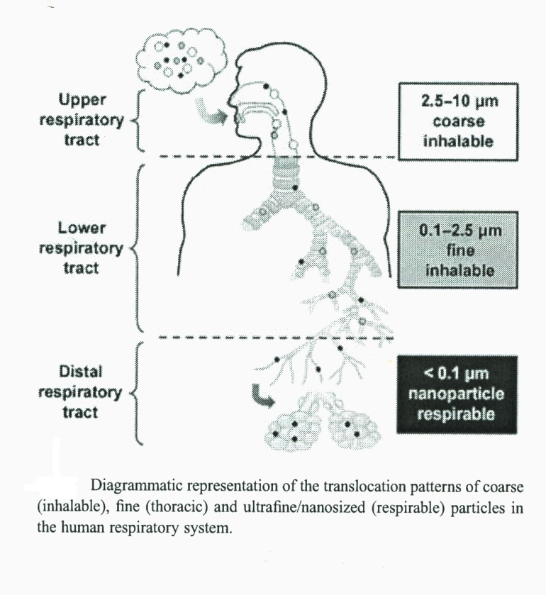
How PM enters in human body

Slide 7
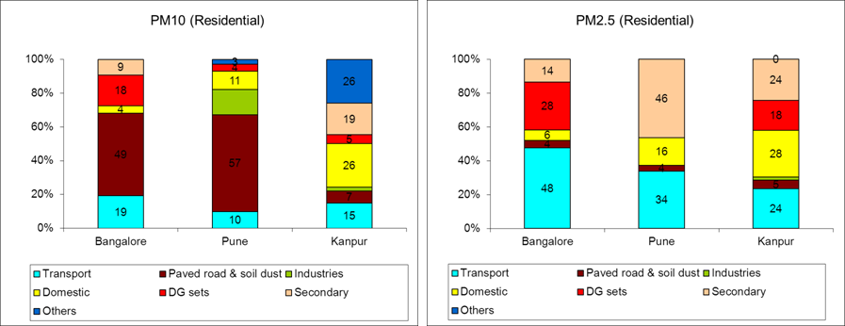
PM emission from various sectors
Note PM2.5 is more harmful to health

Slide 8
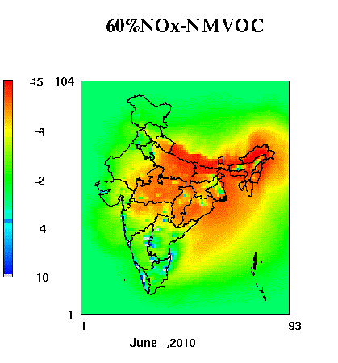
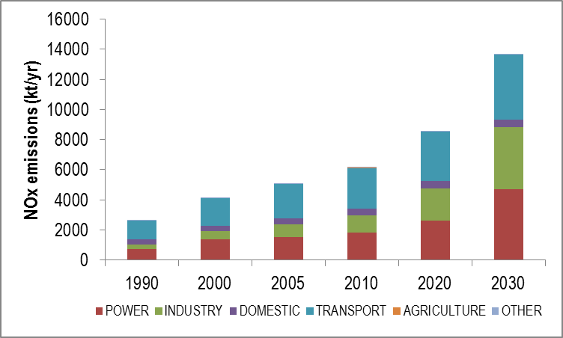
NO_{x} emission from various sectors
O₃ reduction due to 40% reduction in NO_{x}

Slide 9
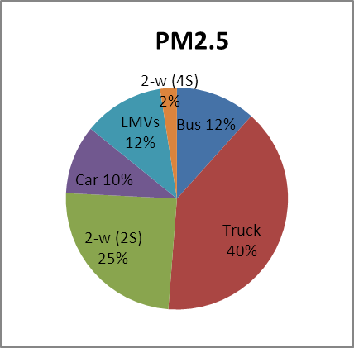
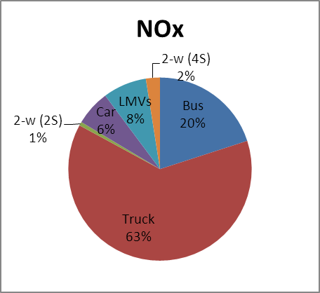
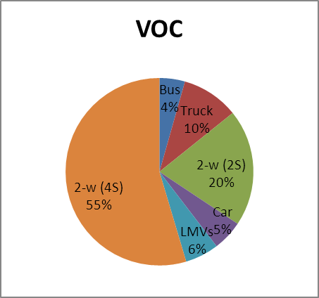
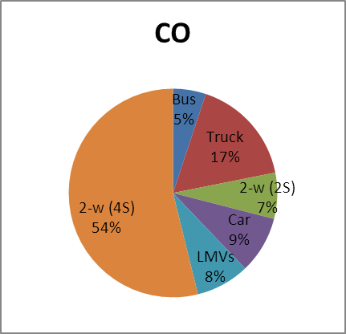
Vehicle wise distribution of PM and NO_{x}

Slide 10
Agriculture and air pollutants
India plays a key role in Global Food Security.
O₃ is toxic to plants damaging through stomatal exchange. Significant loss to cotton, soybean, rice and bean due to O₃ exposure in India. Total loss of 5.5 million tons of wheat and rice in 2005 sufficient to feed 94 million people.
Black Carbon aerosols can impact plants by shielding the sun light reaching to them.

Slide 11
Climate Change Mitigation
Within transport sector trucks are largest emitters of PM (therefore BC) and NO_{x.}
The climate forcing from on- and off-road diesel is positive (with high confidence) leading to climate warming with largest contribution from heavy-duty trucks. The control of BC from on-road diesel engine (truck and buses) thus offers an effective means of mitigating near-term climate change. Next target is 2-wheeler.
This will have co-benefits in terms of health.

Slide 12
Major Recommendations
Overall, drastic reduction of PM (and hence BC) and NOx from trucks and buses, would have the largest beneficial impact on human health, food availability, and regional climate change. Next in priority is the reduction of PM and NOx emissions from two wheelers.
The California example demonstrates that technologies are available to accomplish such massive reductions (>90%) in air pollution.
A coordinated (between academia and government) observational and modeling effort is required to develop Science Based Policy directives. Observations should include field measurements to improve emission inventories and tail pipe emission factors; Cell-phone based soot monitors can revolutionize data collections at massive scales~ few hundreds or more per city.

Slide 13
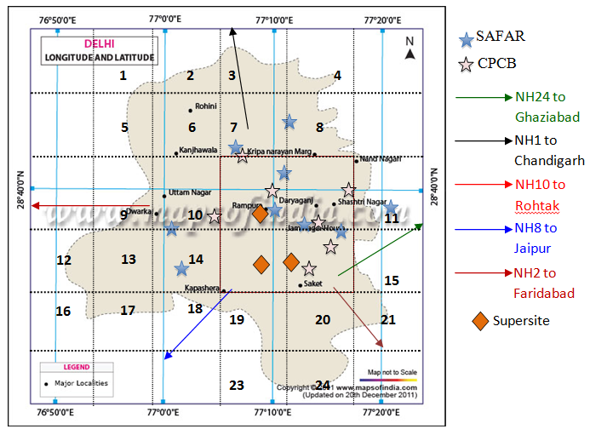
Proposed Monitoring Networks (Delhi)
Map of Delhi National Capital Region (NCR) and the proposed observations overlain with existing air quality measurements networks (some well-known places are marked for reference).
Vehicular emission
BC, CO,CO₂, vehicle and model
Propose to monitor PM_{2.5}, (O₃), BC, chemical composition for ambient air quality.
Cell phone based, Aethalometer (AE 42), Gas-analyzer, EBAM PM sampler
Bulk filter sampler, EC-OC analyzer, 7-wavelength Aethalometer

