Slide 1
Role of State Governments in India
Manisha Panwar
Uttarakhand, India

Slide 2
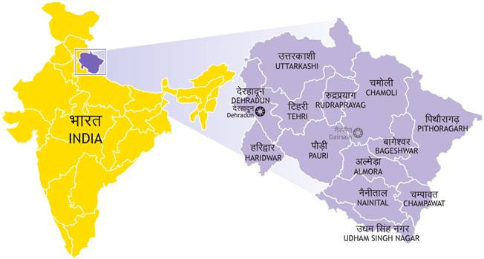
Uttarakhand

Slide 3
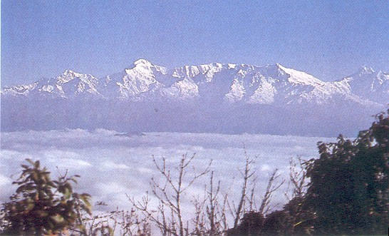
View from Binsar

Slide 4
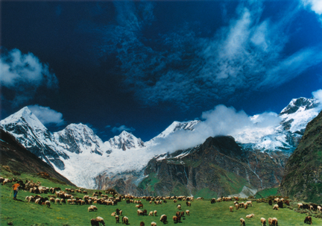
Panchachuli peak

Slide 5
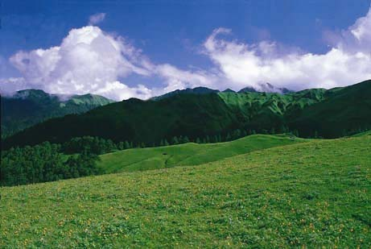
Bedini Bugyal

Slide 6
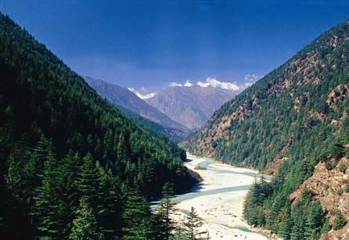
Harsil

Slide 7
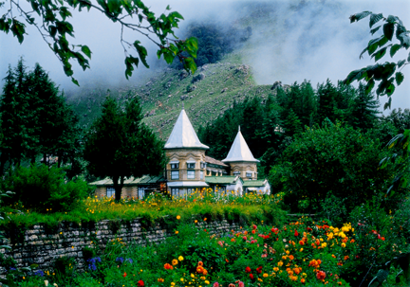
Narayan Ashram

Slide 8
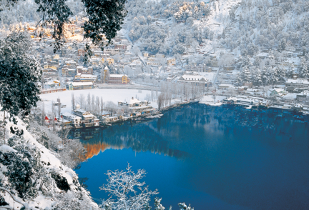
Nainital during winter

Slide 9
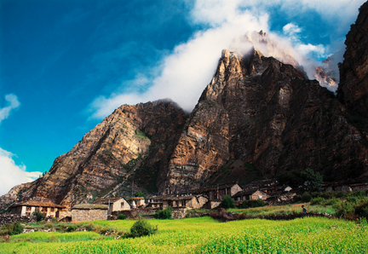
Nabi village

Slide 10
Valley of flowers

Slide 11
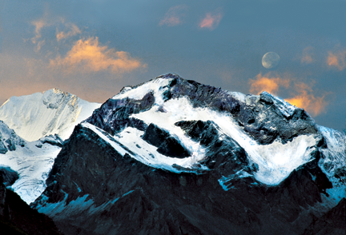
Om parwat

Slide 12
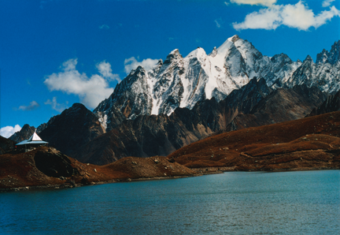
Pandav parwat

Slide 13
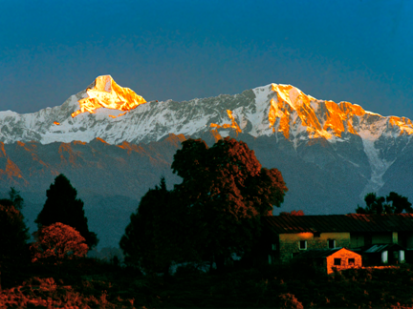
Nandakot parwat

Slide 14
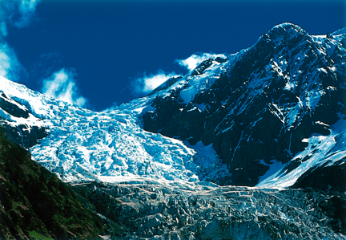
Pindar Glacier

Slide 15
About The State
Small Mountain state in Himalayas
1000 meters to 4000 meters above MSL
10 million people
70% land area under forest cover
Economy dependent of tourism
Limited financial resources
Ecologically sensitive
Development hampered by environment laws
Long standing demand for Green bonus

Slide 16
…Air pollution in the state
Tourist influx 20-25 million…
Local population 10 million
Adverse geography, traps pollution
High Vehicular emission
Tourist Vehicles
Supply vehicles
Traffic far exceeds carrying capacity
All major towns pollution levels 2-3 times of permissible limits

Slide 17
Role of state Government
Emission standards set by federal government
Fuel standard set by federal government
State Govt should have authority to lay down standards
(we want stricter standards)
My state not even in the 2015, Euro 4 cities list

Slide 18
Enforcement issues
Enforcement done by States
Weak enforcement
Lack of resources
Lack of sensitivity
Failed initiative
Battery operated public transport
Lack of funding / support from government

Slide 19
State’s public transport
Inefficient state public transport
State Bus transport corporation
Losses
Survives on subsidy
No funds for modernization
No planning for MRTS for smaller states
Tier 2 and tier 3 towns/ cities

Slide 20
Governance issues
Urban planning and Governance
Local self government is a state subject
Municipal bodies
Lack of capacity
Starved of funds
Need structural and governance reforms
Tax collection
Urban planning
Waste disposal
Civic facilities
Urban transport
JNN Urban Renewal Mission

Slide 21
Public health perspective
Public health
State subject
Air pollution, Environmental Health, not a priority
Still struggling with infectious diseases, mal nutrition
Forthcoming National Urban Health Mission
Should also focus on environmental health

Slide 22
Pollution Control Machinery
State pollution control board
Not independent of the government
Needs autonomy
Needs empowerment
Focused on industrial pollution, passive surveys
Transport emissions/ pollution not a priority
Need re-orientation

Slide 23
Thank you

