Slide 1

Solutions to the Pollution and Climate Problems in India and California
Mark Z. Jacobson ICAMP
Atmosphere/Energy Program Oakland, California
Stanford University October 21, 2013
J. G. Swanepoel/Dreamstime.com
Wind farm near Middelgrunden, Denmark

Slide 2
What’s the Problem? Why act Quickly?
Air pollution kills 2.5-4 million people worldwide prematurely each year, including 700,000/yr in South Asia and 16,000/yr in California.
Arctic sea ice may disappear in 10-30 years. Global temperatures are rising at a faster rate than any time in recorded history.
Increasing energy demand is increasing pollution, global warming, and energy prices.
Higher energy prices lead to economic, social, political instability
→ Drastic problems require immediate and definite solutions

Slide 3
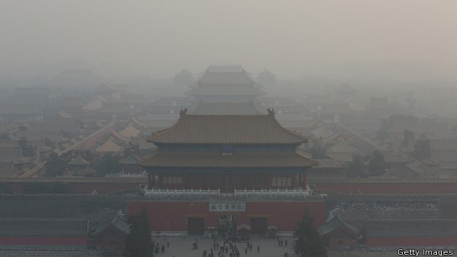
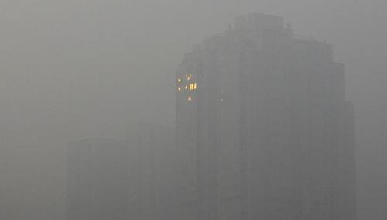
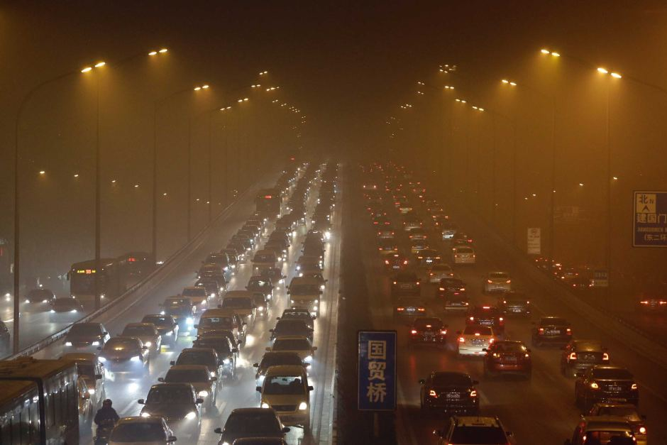
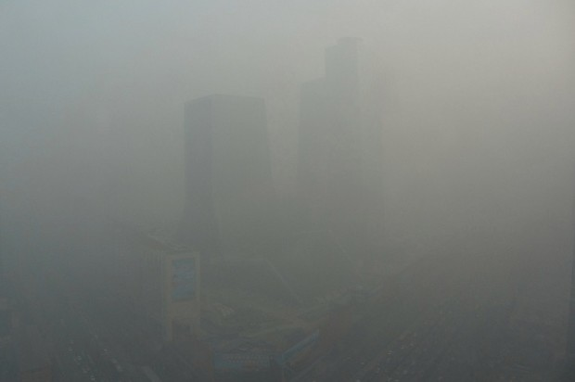
Beijing, China, Jan 11-14, 2013
Notes:
http://www.spxdaily.com/images-lg/smog-january-2013-beijing-afp-lg.jpg
http://www.straitstimes.com/sites/straitstimes.com/files/imagecache/story-gallery-featured/26664112e.jpg
http://img.rasset.ie/0006e761-642.jpg
http://www.abc.net.au/news/2013-01-13/beijing-shrouded-in-dense-smog/4462834
http://www.theworld.org/wp-content/uploads/Beijing-CCTV-2-e1358195681873.jpg

Slide 4
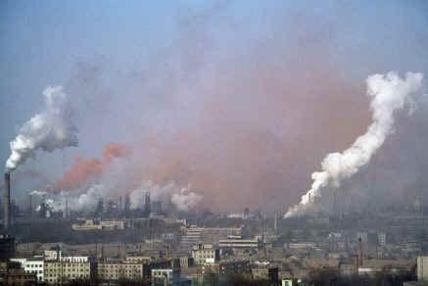
Sukinda, India
http://www.worldinterestingfacts.com/infrastructure/top-10-most-polluted-cities-in-the-world.html

Slide 5
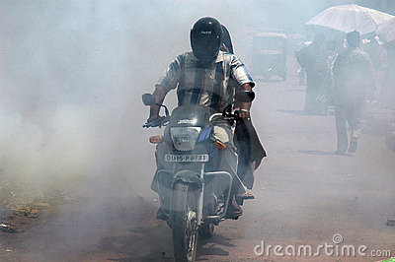

Calcutta and New Delhi
Samrat35/Digitalfestival/Dreamstime.com

Slide 6
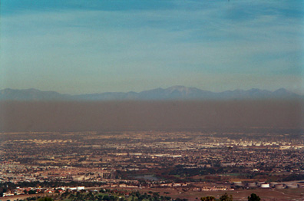
Brown and Black Carbon Particles in Los Angeles Smog (Dec. 2000)
Mark Z. Jacobson

Slide 7
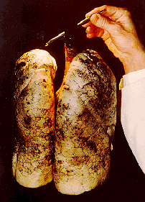
Lung of LA Teenage Nonsmoker in 1970s;
SCAQMD/CARB

Slide 8
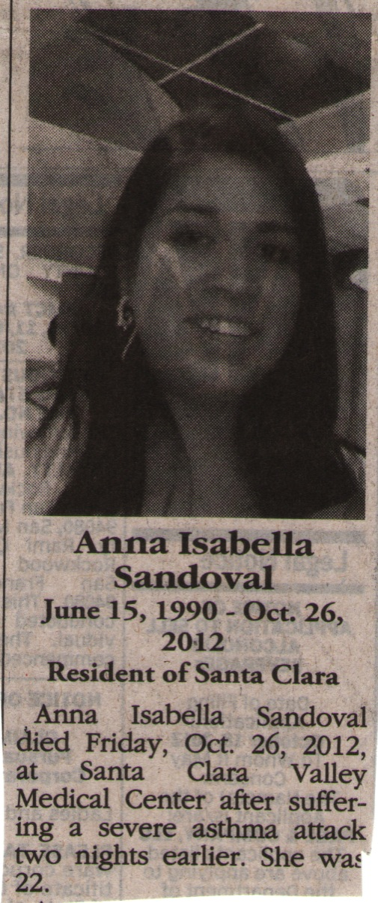
A Young Air Pollution Victim

Slide 9
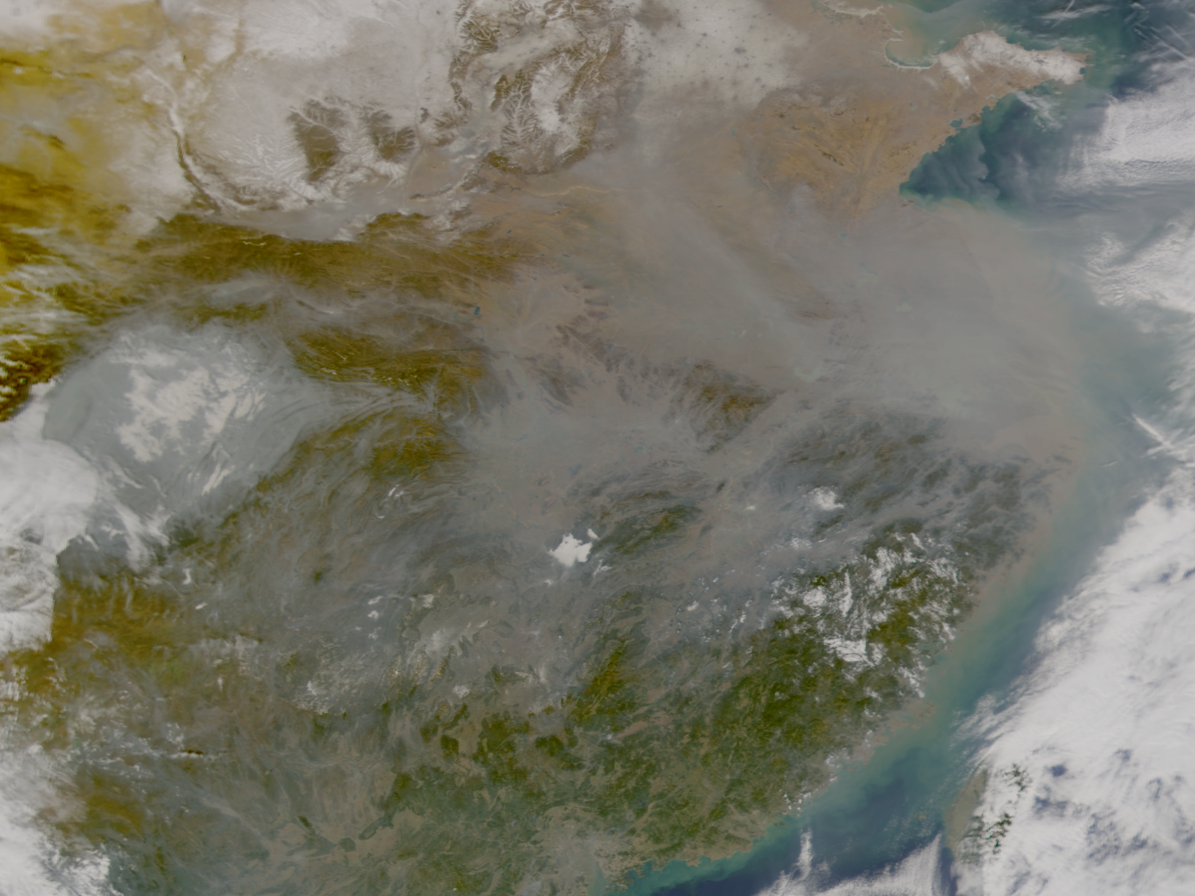
Smog Over Asia Decreasing Cloudiness
NASA/ORBIMAGE

Slide 10
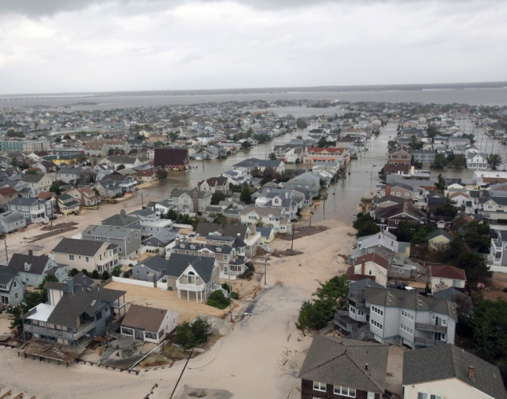
Hurricane Sandy
http://blog.wegowise.com/blog2/bid/137837/The-Environmental-Impacts-of-Hurricane-Sandy

Slide 11
Cleanest Solutions to Global Warming, Air Pollution, Energy Security
ELECTRIC POWER VEHICLES
Recommended – Wind, Water, Sun (WWS)
1. Wind 2. CSP WWS-Battery-Electric
3. Geothermal 4. Tidal WWS-Hydrogen Fuel Cell
5. PV 6. Wave
7. Hydroelectricity
Not Recommended
Nuclear Corn, cellulosic, sugarcane ethanol
Coal-CCS Soy, algae biodiesel, diesel, gasoline,
Natural gas, biomass Compressed natural gas
Energy & Env. Sci, 2, 148 (2009)

Slide 12
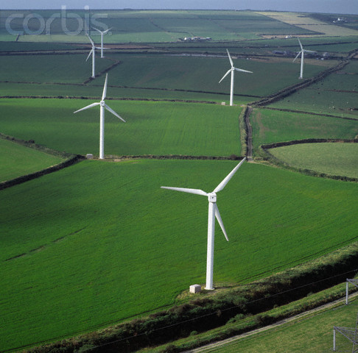
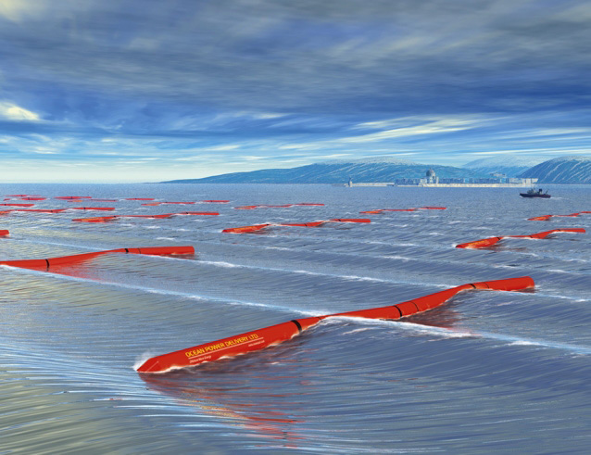
Wind Power, Wind-Driven Wave Power
www.mywindpowersystem.com

Slide 13
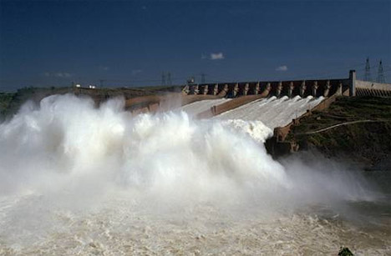
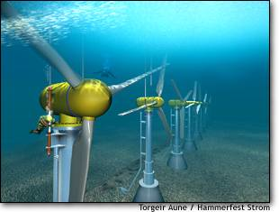
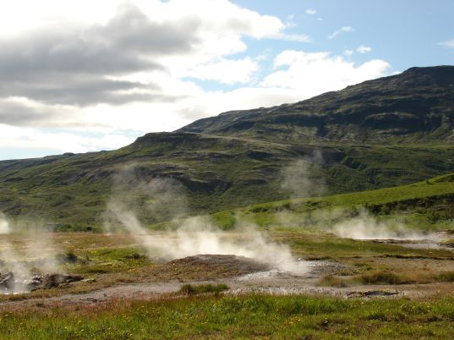
Hydroelectric, Tidal, Geothermal Power
www.gizmag.com
www.inhabitat.com
myecoproject.org
www.sir-ray.com

Slide 14
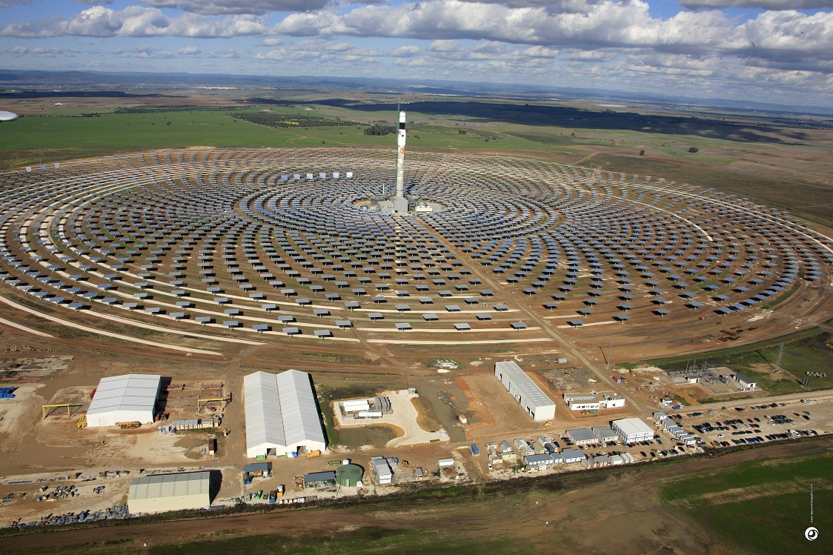
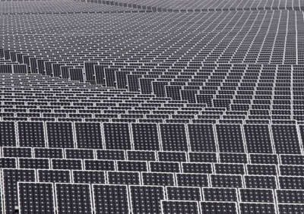
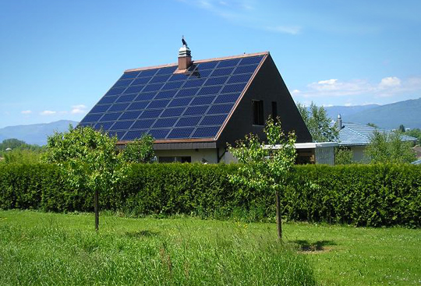
Concentrated Solar Power, PV Power
Torresol Gemasolar Spain, 15 hrs storage,
Matthew Wright, Beyond Zero
www.solarthermalmagazine.com
i.treehugger.com

Slide 15
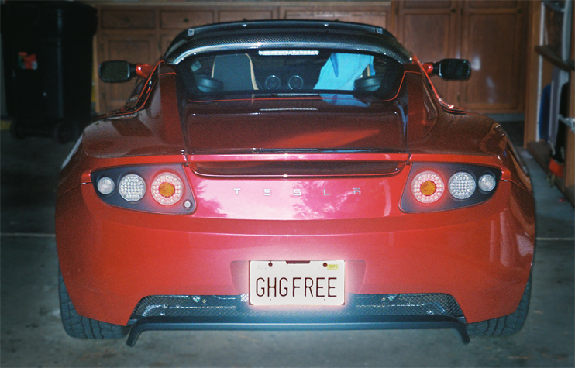
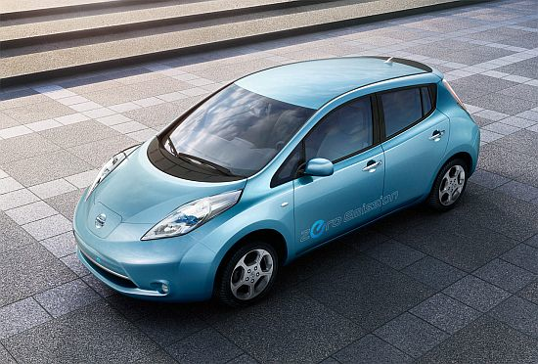
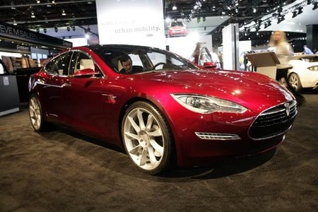

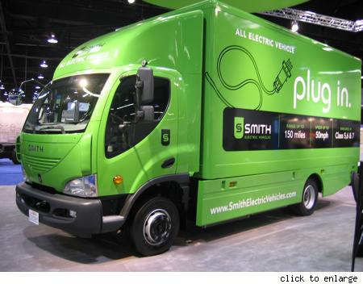
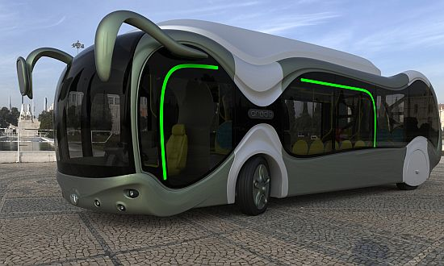
WWS Transportation
Tesla Roadster all electric
Nissan Leaf all electric
Tesla Model S all electric
weeble.net
www.blogcdn.com
www.greenlaunches.com
www.ecofriend.com
www.blogcdn.com
Electric bus
Electric truck
Hydrogen fuel cell–electric hybrid bus

Slide 16
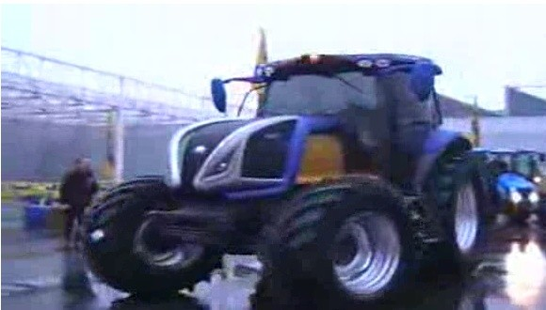
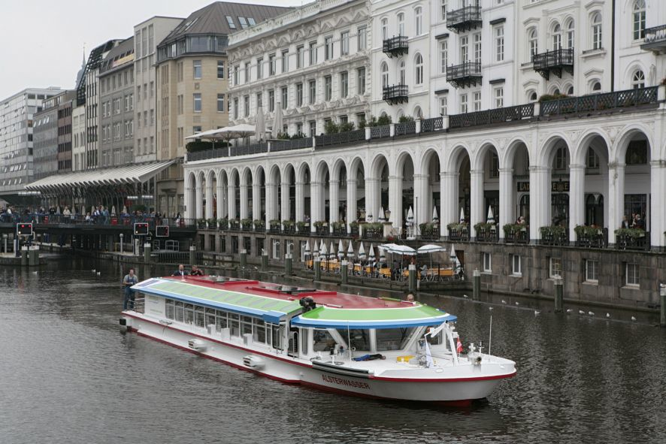
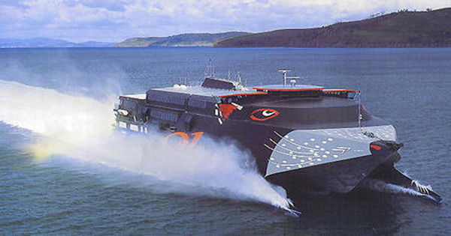

WWS Transportation
Hydrogen fuel cell ship
Hydrogen fuel cell tractor
http://green.autoblog.com
Zmships.eu
Ec.europa.eu
Electric ferry
http://technabob.com/blog/2010/01/19/rechargeable-ship/
Cryogenic hydrogen aircraft

Slide 17
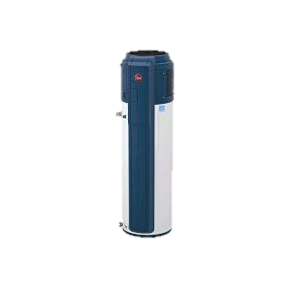
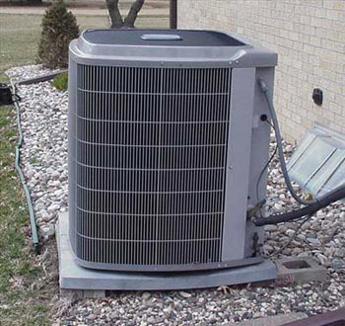
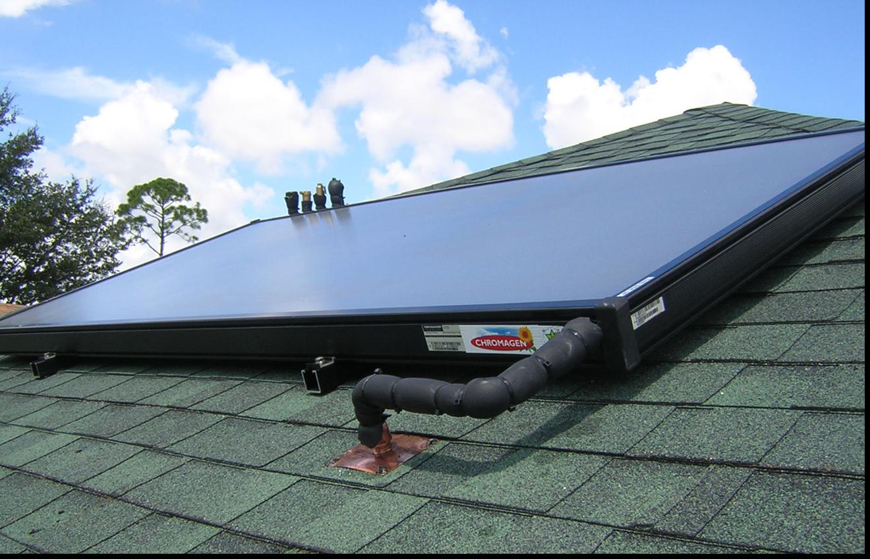
Air-Source Heat Pump, Air Source Electric
Water Heater, Solar Water Pre-Heater
Midlandpower.com
Conservpros.com
Adaptivebuilders.com
Heat pump water heater

Slide 18
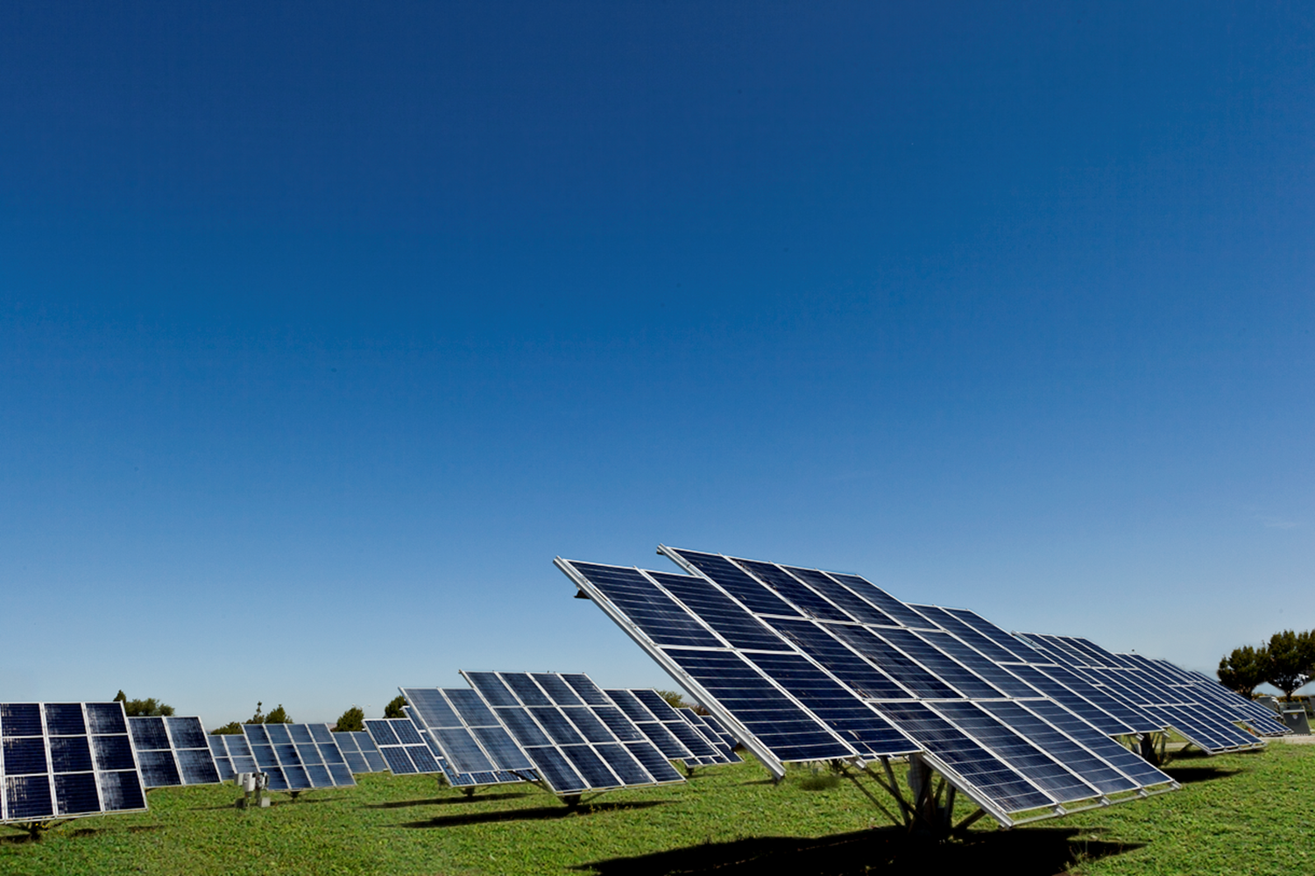
End-Use Power Demand For All Purposes
Year and Fuel Type | World | U.S. | CA | NY
2010 (TW) | 12.5 | 2.5 | .21 | .09
2030 with current fuels (TW) | 16.9 | 2.83 | .25 | .10
2030 WWS (TW) | 11.5 | 1.78 | .14 | .06
2030 Reduction w/ WWS (%) | 32 | 37 | 44 | 37
Notes:
Source?

Slide 19
Number of Plants or Devices to Power World
TECHNOLOGY PCT SUPPLY 2030 NUMBER
5-MW wind turbines 50% 3.8 mill. (0.8% in place)
0.75-MW wave devices 1 720,000
100-MW geothermal plants 4 5350 (1.7% in place)
1300-MW hydro plants 4 900 (70% in place)
1-MW tidal turbines 1 490,000
3-kW Roof PV systems 6 1.7 billion
300-MW Solar PV plants 14 40,000
300-MW CSP plants 20 49,000
100%

Slide 20
Number of Plants or Devices to Power CA
TECHNOLOGY PCT SUPPLY 2030 NUMBER
5-MW onshore wind turbines 25% 22,900
5-MW offshore wind turbines 10 7,233
5-kW Res. roof PV systems 10 16.2 million
100-kW com/gov roof PV systems 15 1.15 million
50-MW Solar PV plants 15 1820
100-MW CSP plants 15 1080
100-MW geothermal plants 5 81
1300-MW hydro plants 4 10.9 (90.2% in place)
1-MW tidal turbines 0.5 2960
0.75-MW wave devices 0.5 4360
100%

Slide 21
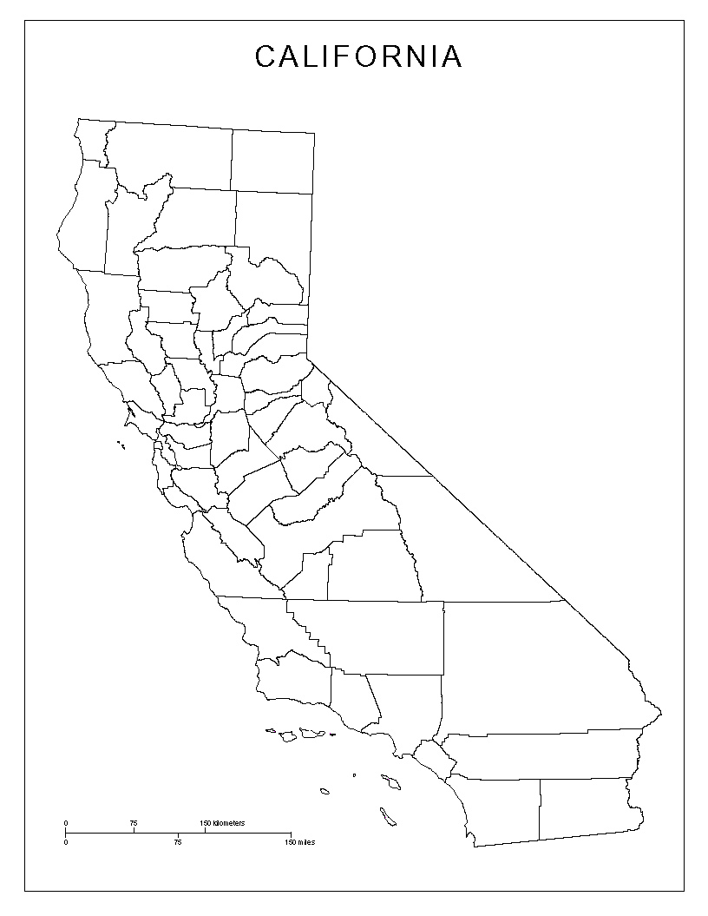
Area to power 100% of CA for all purposes
Geothermal
0.0069% of CA
Onshore wind: spacing = 2.5% of CA (green is open space)
Solar PV+CSP power plants 0.68% of CA
Offshore wind: spacing = 0.80% of CA (blue is open space)
All rooftop PV (0.36% of CA)

Slide 22
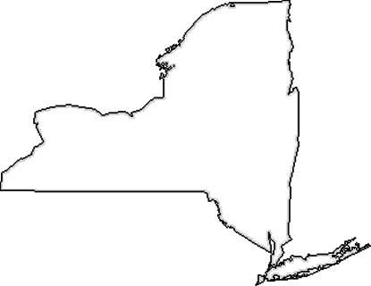
Area to power 100% of NYS for all purposes with WWS
Onshore wind:
footprint=0.05 km²
spacing=1.46% of NYS
(blue is open space)
Geothermal
0.01% of NYS
Offshore wind:
spacing= 4.62% of NYS (blue is open space)
Solar PV+CSP power plants
0.85% of NYS
All rooftop PV
(0.45% of NYS)

Slide 23
World Surface Solar
m/s
All solar over land in high-solar locations~ 340 TW
= 30 times world end-use WWS power demand 2030 of 11.5 TW

Slide 24
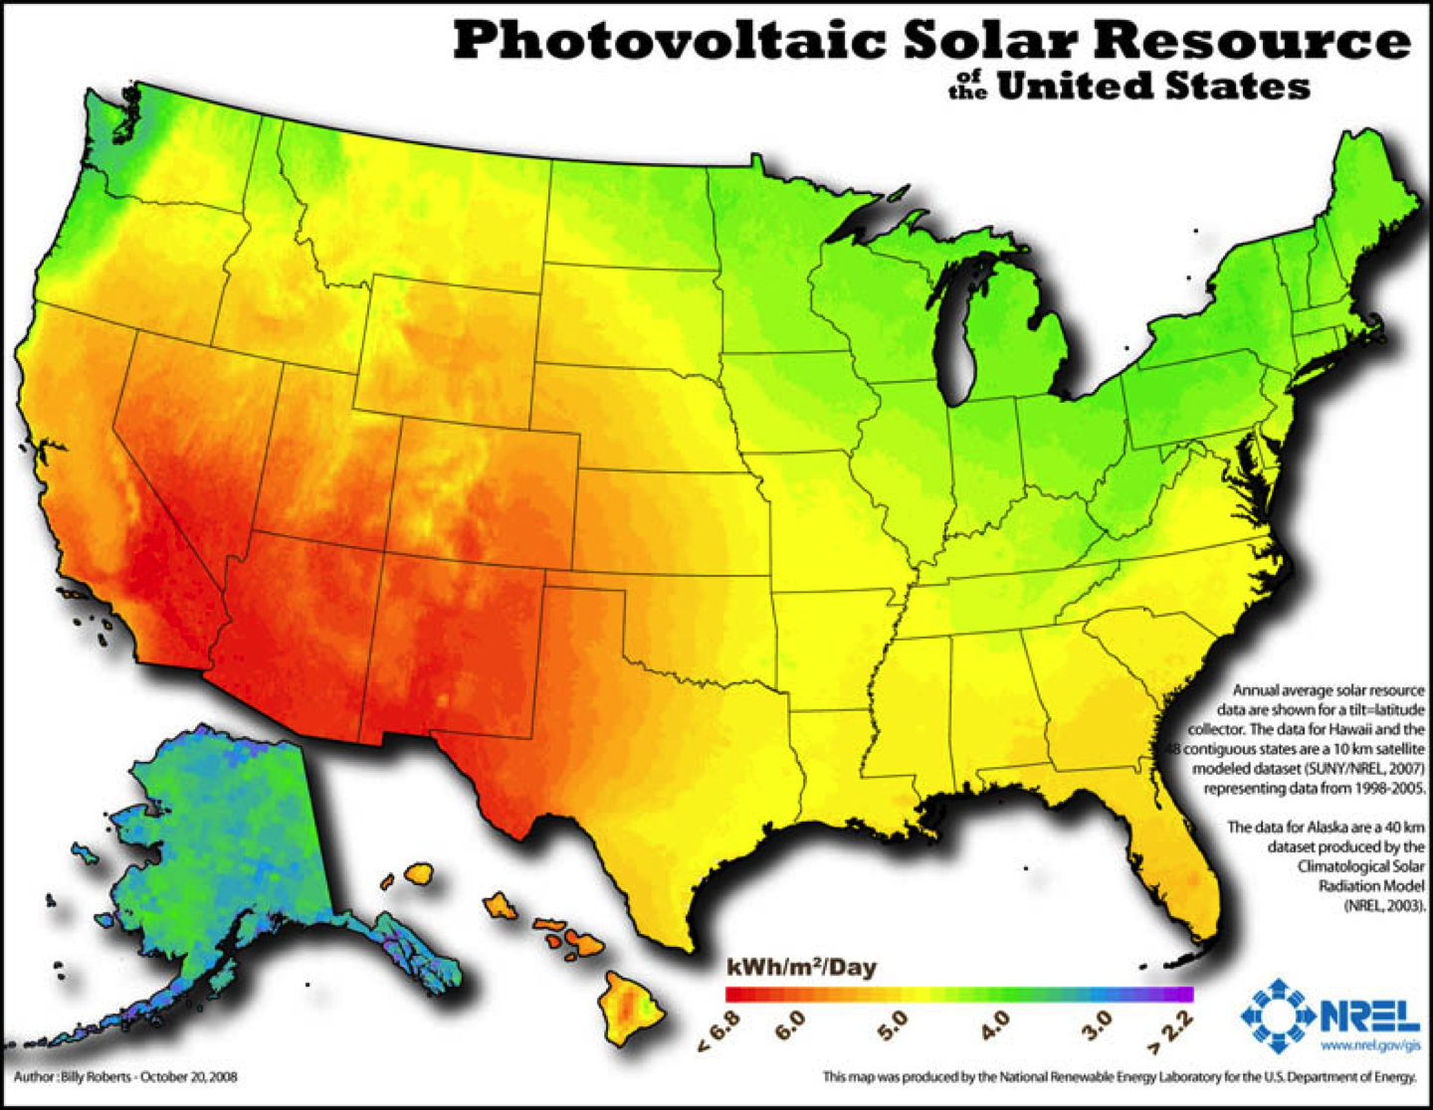
NYS: 4-4.5 kWh/m²/day)

Slide 25
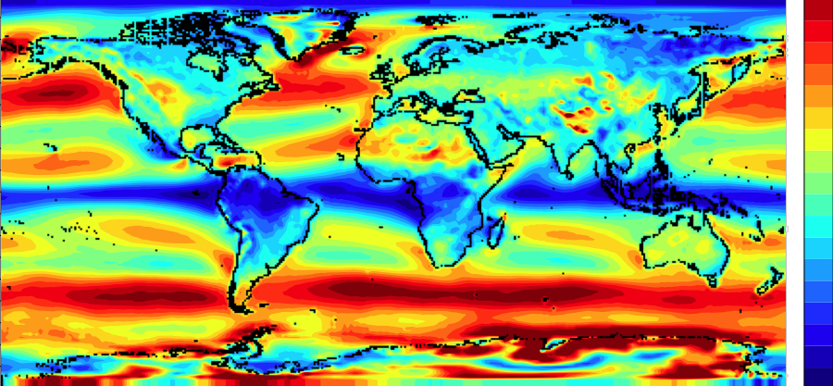
World Wind Speeds at 100m
90
m/s
10
8
0
6
4
-90
2
-180
-90
0
90
180
All wind over land in high-wind areas outside Antarctica ~ 70-80 TW
= 6-7 times world end-use WWS power demand 2030 of 11.5 TW

Slide 26
Hurricane Katrina
August 28, 22:00 GMT
No turbines
With turbines

Slide 27
Hurricane Katrina
August 29, 18:00 GMT
No turbines
With turbines

Slide 28
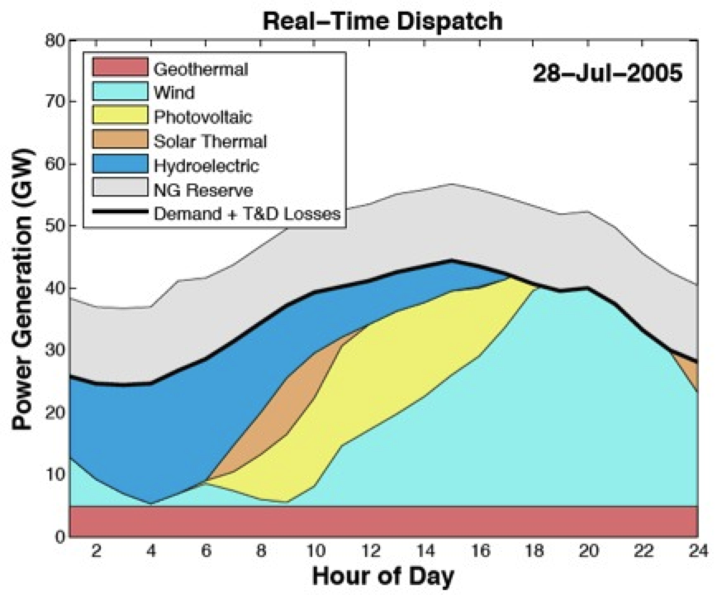
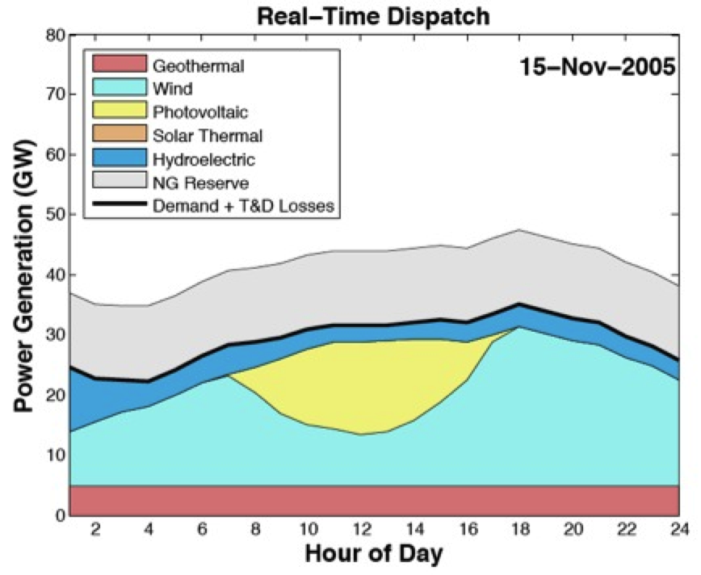
Matching Power Demand With Solar, Wind, Geothermal, Hydro
California electricity was found to be obtainable from WWS for 99.8% of all hours in 2005, 2006 without over-sizing WWS capacity, using demand-response, or using much CSP storage.
Hart and Jacobson (2011); www.stanford.edu/~ehart/

Slide 29
Costs of Energy, Including Transmission (¢/kWh)
ENERGY TECHNOLOGY 2010-2013 2020-2030
Wind onshore 4-10.5 ≤4
Wind offshore 11.3-16.5 7-10.9
Wave >11 4-11
Geothermal 9.9-15.2 5.5-8.8
Hydroelectric 4-6 4
CSP 14.1-22.6 7-8
Solar PV (utility scale) 11.1-15.9 5.5
Tidal >>11 5-7
Conventional (+Externalities) 9.2 (+5.3)=14.5 14-19 (+5.7)=20-25
Jacobson et al. (2013)

Slide 30
Costs Increase of Residential Electric Power 2003-13
10 states with highest % electric power from wind +3 ¢/kWh
Remaining 40 states +4 ¢/kWh
States with greatest increases in percent of electricity from wind experienced lowest electric power price increases.
http://www.eia.gov/electricity/sales_revenue_price/)

Slide 31
Health Cost Savings due to WWS in CA
Air pollution kills 16,000/year in CA, costing $130 billion/year, or 7% of CA GDP
CA needs ~570 GW (~$ trillion) of installed power to convert to WWS for all purposes. Health cost savings alone would pay for WWS in ~7.3 y
July 15, 2012 by DS Jacobson

Slide 32
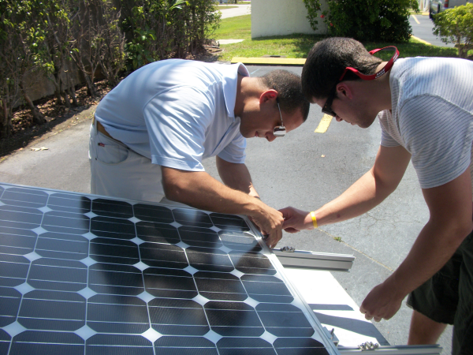
New Jobs and Price Stability From WWS in CA
WWS will generate a net of 137,000 permanent jobs/year and a total of 860,000 construction jobs over 20 years for energy facilities alone.
Info.ussolarinstitute.com

Slide 33
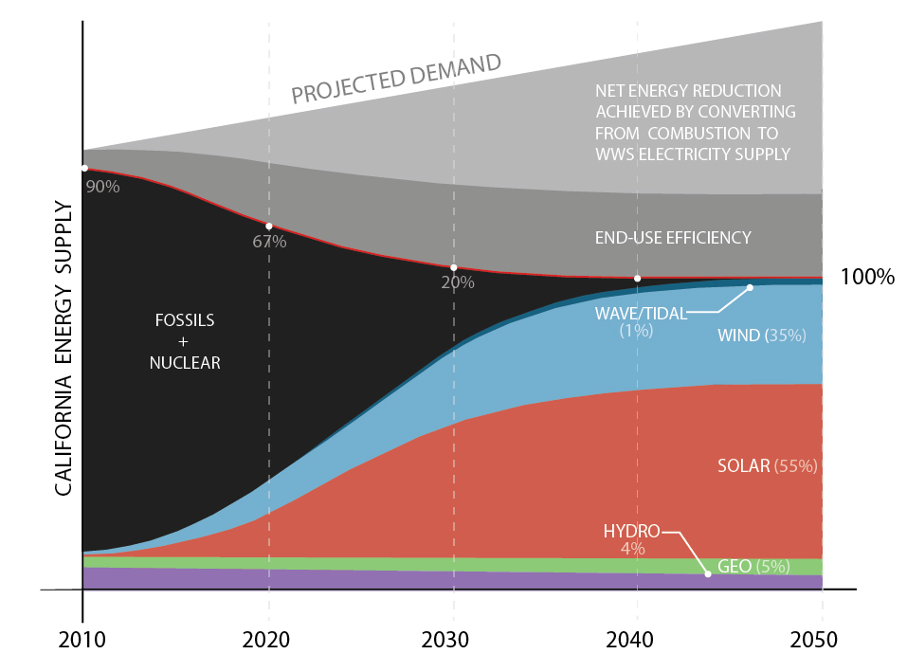
Transition to WWS (California Example)

Slide 34
Summary of Plan to Power California With WWS
Converting to WWS + electricity/H₂ reduces California power demand ~44%
Eliminates ~16,000 air pollution deaths/yr in state (~7% of GDP)
Eliminates $60 billion/year in global climate costs
Generates ~137,000 more permanent jobs than destroys
Reduces economic electricity costs compared with those of fossil fuels
Needs ~0.73% Calif’s land for footprint; 2.5% for spacing (some offshore)
Multiple methods of addressing WWS variability.
Materials are not limits although recycling may be needed.
Barriers : up-front costs, transmission needs, lobbying, politics.

Slide 35
More Info and The Solutions Project
http://www.thesolutionsproject.org/
@SolutionsWWS (Twitter)
@mzjacobson
www.stanford.edu/group/efmh/jacobson/Articles/I/susenergy2030.html

