Slide 1

Transportation-related Air Pollutants
Health Effects and Risk
Linda Tombras Smith, PhD
Chief, Health and Exposure Assessment Branch
Research Division
October 21, 2013

Slide 2
How Are Regulations Developed and Prioritized?
Law
  The authority given to Air Resources Board by legislature and US Congress
Policy
  Set by legislature and Governor
  Prioritizing regulations
Science/Public Health
  Chemical’s concentration in air
  Number of people exposed
  Chemical toxicity
2

Slide 3
Focus: Public Health and Relative Risk
Law
  The authority given to Air Resources Board by legislature and US Congress
Policy
  Set by legislature and Governor
  Prioritizing regulations
Science/Public Health
  Chemical’s concentration in air
  Number of people exposed
    At risk populations (children, elderly, poor, minority)
  Chemical toxicity
    Cancer and other health risk
    Copollutants
3

Slide 4
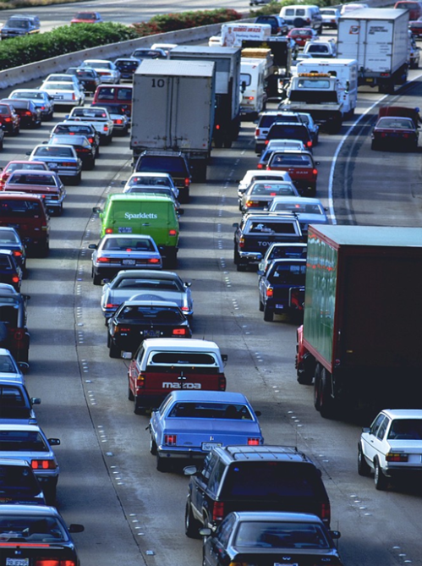
Major Transportation-related Air Pollutants of Concern
Criteria pollutant precursors
  Atmospheric processes with motor vehicle emissions leading to PM2.5, Ozone
Diesel PM
  Listed as a TAC and a component of PM2.5
Near roadway pollutants
  Black carbon, NOx, ultrafine PM
Air Toxic Contaminants (TACs)
  Benzene, 1,3-butadiene, and
  others gaseous pollutants
4

Slide 5
PM2.5, Ozone – Regional Pollutants
5

Slide 6
Ambient Air Quality Standards
3
µg/m
India
WHO
United States
California
6

Slide 7
Health Effects of PM2.5 Exposure
Premature death
  Causal for cardiopulmonary disease (US EPA)
Hospital admissions for exacerbation of pre-existing respiratory and cardiac problems
Emergency room visits for asthma
Reduced lung function in children
  Increased risk of bronchitis and chronic cough
Exposure during pregnancy - low birth weight, premature birth, and birth defects
7

Slide 8
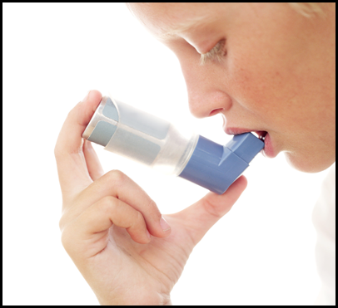
Populations Most at Risk: PM2.5
Older adults
People with chronic heart
or lung disease
Children
8

Slide 9
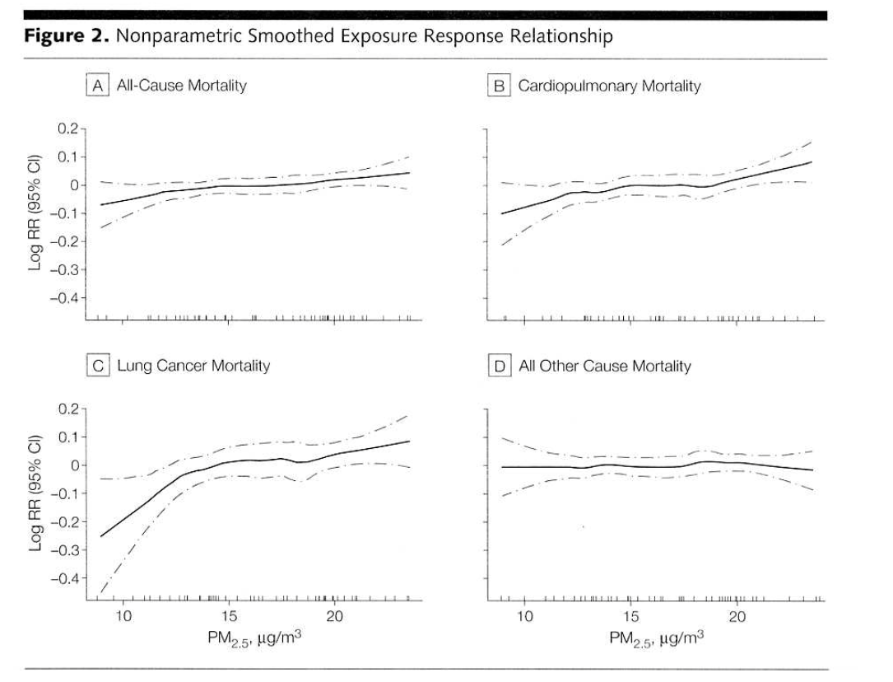
Quantifying Health Impact of PM2.5 Exposure – Premature Mortality
Air Quality Monitoring/Modeling
Concentration-Response Relationship
  Epidemiological Studies
Population Demographics
Incidence Rates
Estimated: 8,900 premature deaths per year
Smoothed
Exposure-Response Function
Cardiopulmonary Mortality
9

Slide 10
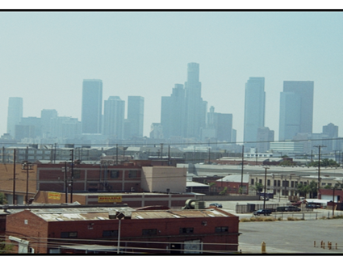
Health Effects of Ozone Exposure
Respiratory symptoms
Airway inflammation
Increased hospital and ER usage
Premature death
10

Slide 11
Effects of Ozone Exposure in Children
Reduced lung function with acute exposure
Lower attained lung function in young adults raised in high ozone areas
Increased school absenteeism
Asthma induction in active children living in high ozone communities
Emergency room visits for asthma exacerbation
11

Slide 12
Populations Most at Risk: O₃
Responses proportional to inhaled dose
  Inhaled dose is a function of
    O₃ concentration - most important factor
    Breathing rate
    Exposure duration
  Most at risk
    Children
    Workers
    Active and exercising people
  Estimated: 630 premature deaths per year
12

Slide 13
Diesel PM
A toxic air contaminant and a component of PM2.5
13

Slide 14
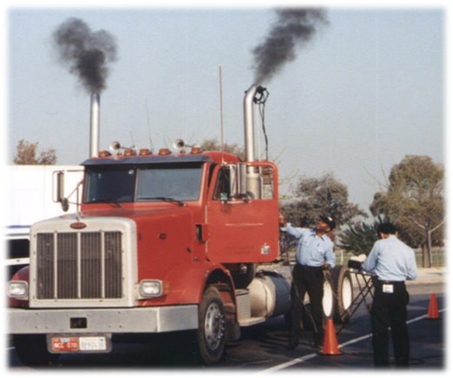
Why are Diesel PM Emissions Important?
Health effects are significant
Emissions are high
  One million diesel engines (typical day)
Risk is high
  70-80% of all air cancer risk
Adds to the exposure to PM2.5
14

Slide 15
Health Effects of Diesel PM Emissions
Diesel engine exhaust classified as carcinogenic
  Decision by IARC; part of World Health Organization
Non cancer health effects
  Short-term exposure – respiratory symptoms; irritation of the eye, nose, throat
Health effects (as a component of PM2.5)
  Long-term exposure – chronic respiratory symptoms, worsening of asthma, reduced lung function, lung cancer
  Hospitalizations, lost work days
  Premature mortality
15

Slide 16
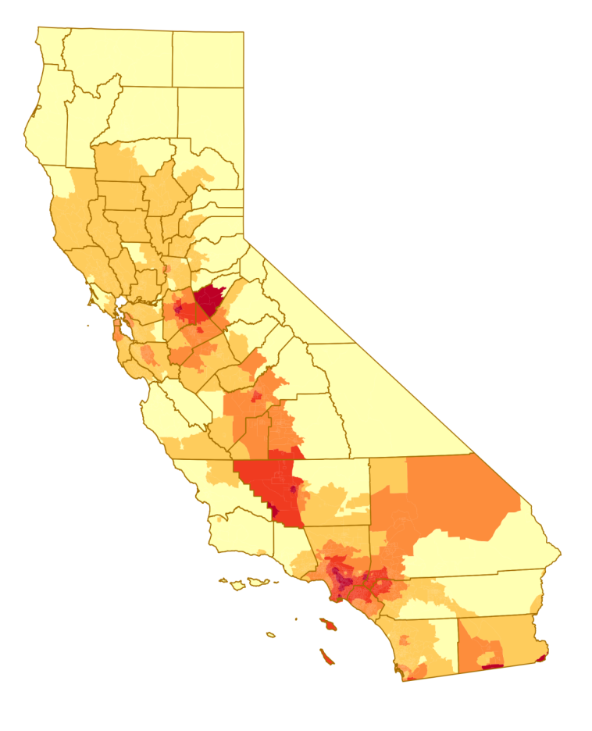
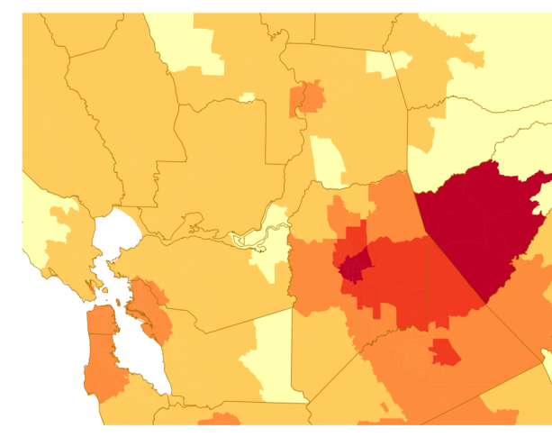
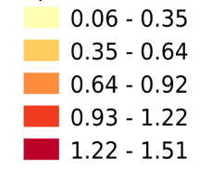
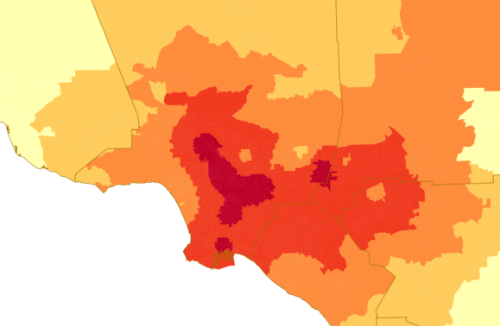
California Diesel PM Concentrations
DPM µg/m3
Bay Area
Los Angeles
Estimated: 1,200 premature deaths per year
Estimated: 214 additional cancer cases per million population per year
16

Slide 17
Near Roadway Exposures
17

Slide 18
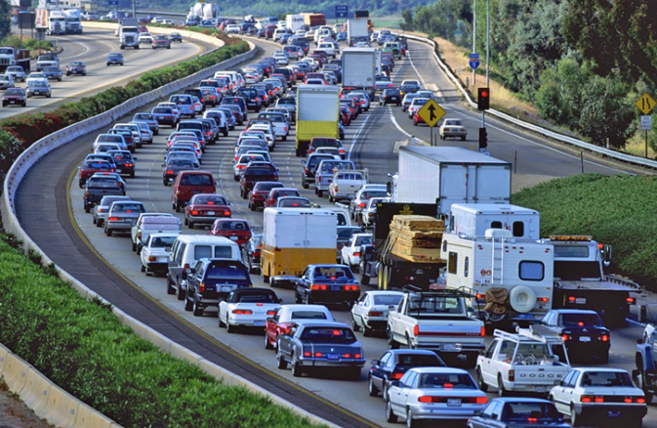
Near Roadway Exposures
Near roadway pollutants:
  Black carbon (diesel PM)
  NOx
  Ultrafine PM
Large fraction of population live near roadways
Health effects:
  Increased asthma and
  other respiratory disease
  Reduced lung function
  Increased heart disease
  Adverse birth outcomes
  Premature death
18

Slide 19
Near Roadway Exposures
Factors affecting exposure:
  Meteorology (wind speed); traffic density & composition
  Physical barriers (sound walls)
  In-vehicle and in-home filtration
19

Slide 20
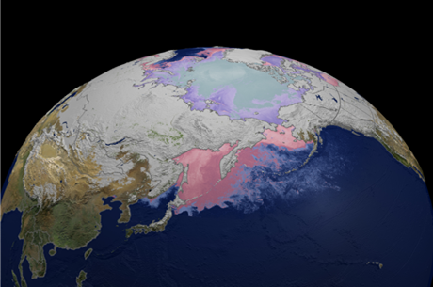
Conclusions
Outdoor air pollution is a significant public health risk
PM2.5 a leading risk factor for premature death on a global scale
Risk: PM2.5 > Ozone > Toxics
20

Slide 21

For More Information
Health Effects of Air Pollution Exposures:
http://www.arb.ca.gov/research/health/health.htm
Ambient Air Quality Standards & Health Effects Estimates:
http://www.arb.ca.gov/research/aaqs/aaqs.htm
Contact information:
  Linda Smith
  Research Division
  California Air Resources Board
  lsmith@arb.ca.gov
21

