Slide 1
Air Pollution and Global Health
Jonathan M. Samet, MD, MS
Professor and Flora L. Thornton Chair
Department of Preventive Medicine
USC Keck School of Medicine
ICAMP Working Group
Oakland, CA
October 23, 2013

Slide 2
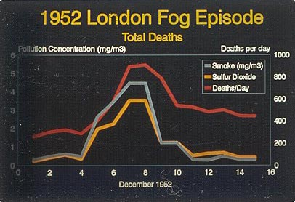
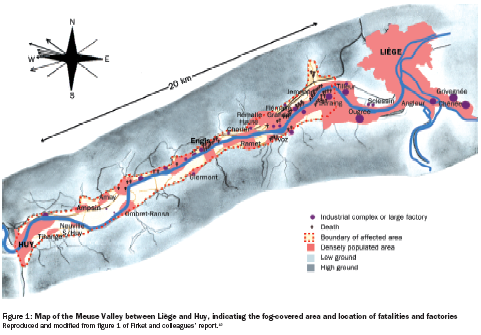
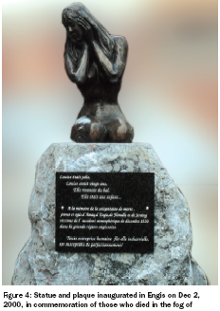
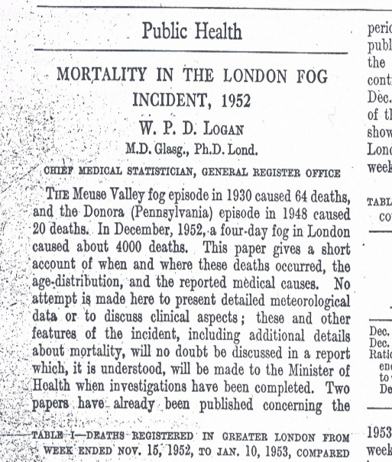
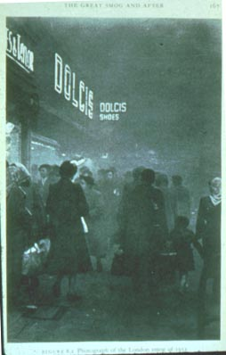
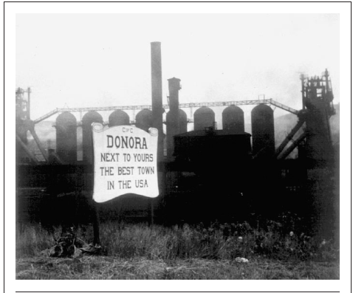
Air Pollution Disasters of the 20th Century
The Fog Disaster in the Meuse Valley, 1930…led to the first scientific proof of the potential for atmospheric pollution to cause deaths and disease, and it clearly identified the most likely causes. 60 deaths that were attributed to the fog occurred on Dec 4 and 5. Nemery et al. Lancet 2001
Beginning on October 26, 1948, sparse air movement contributed to a temperature inversion in the atmosphere over western Pennsylvania, Ohio, and areas of neighboring states. A fog laden with particulates and other industrial contaminants saturated the air of Donora, a small industrial town on the banks of the Monongahela River, some 30 miles south of Pittsburgh. Visibility was so poor that even locals lost their sense of direction. An estimated 5000 to 7000 persons in a town of 14000 residents became ill, some 400 required hospitalization, and 20 died before rain dispersed the killing smog on October 30 and 31, 1948. Helfand et al. AJPH 2001

Slide 3
1950
Research Approach
General Questions
Surveys
Ecological studies
Early time-series studies
What are the adverse effects of air pollution?
1960
1970
What are the exposure-response relationships?
Six Cities Study
Exposure
assessment
1980
ACS
1990
Modern time-series
studies
What are the key sources? What determines mixture toxicity?
CHS
Multi-site
studies
2000
2010
?

Slide 4
What are risks at current levels?
For mortality:
  Short-term increases in mortality
  Longer-term increases in mortality
For morbidity:
  Diverse adverse respiratory effects
  Adverse cardiovascular effects
  Other effects: reproductive
  Susceptible populations

Slide 5
Could the London Fog of 1952 happen again?

Slide 6
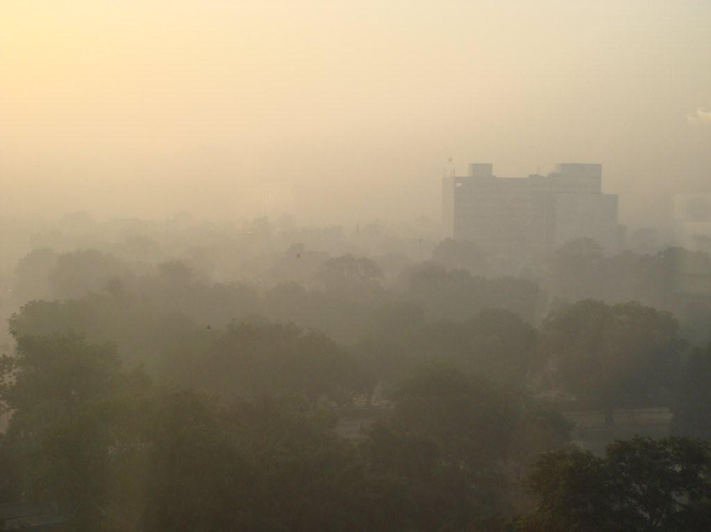
Delhi
Credit: Jonathan M. Samet
Notes:
Sunrise over Delhi

Slide 7

Hindustan Times, November 8, 2009

Slide 8
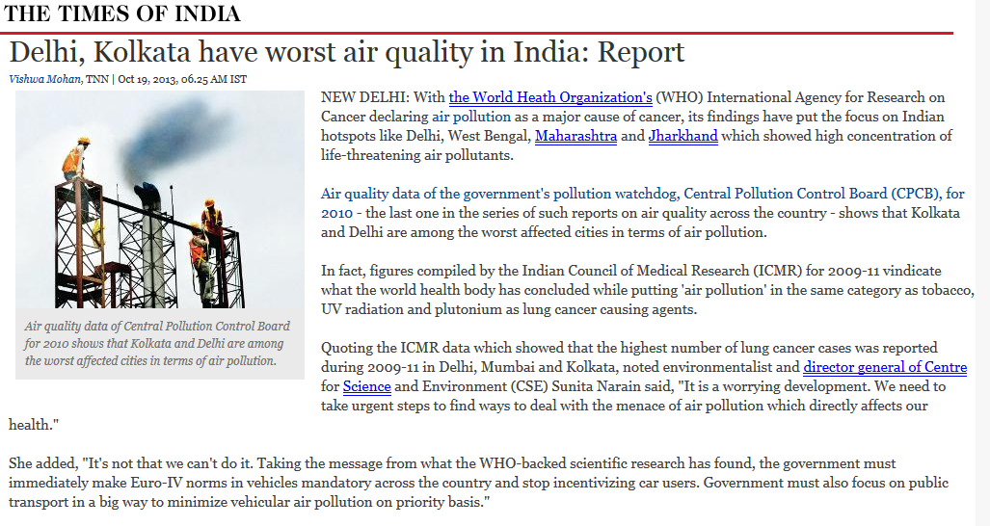
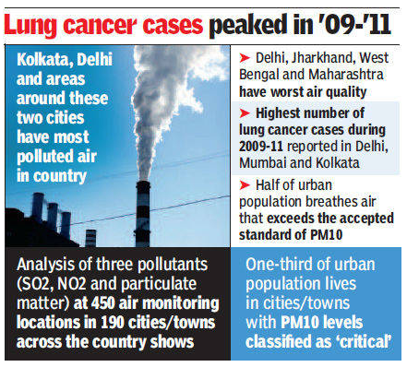
Times of India, October 19, 2013

Slide 9
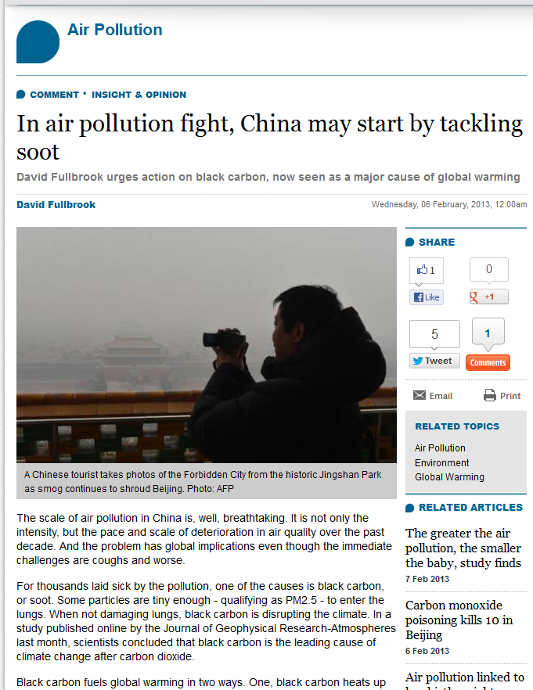
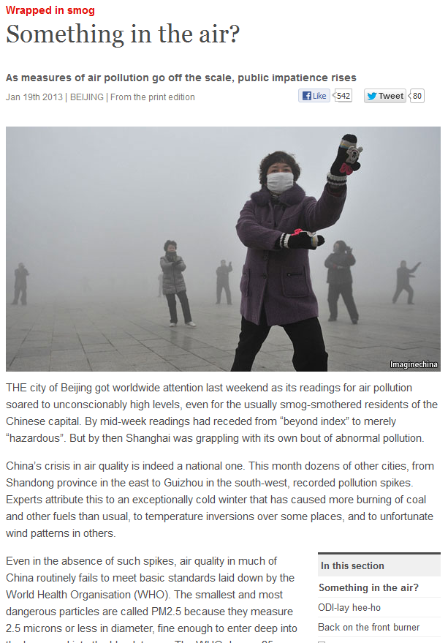


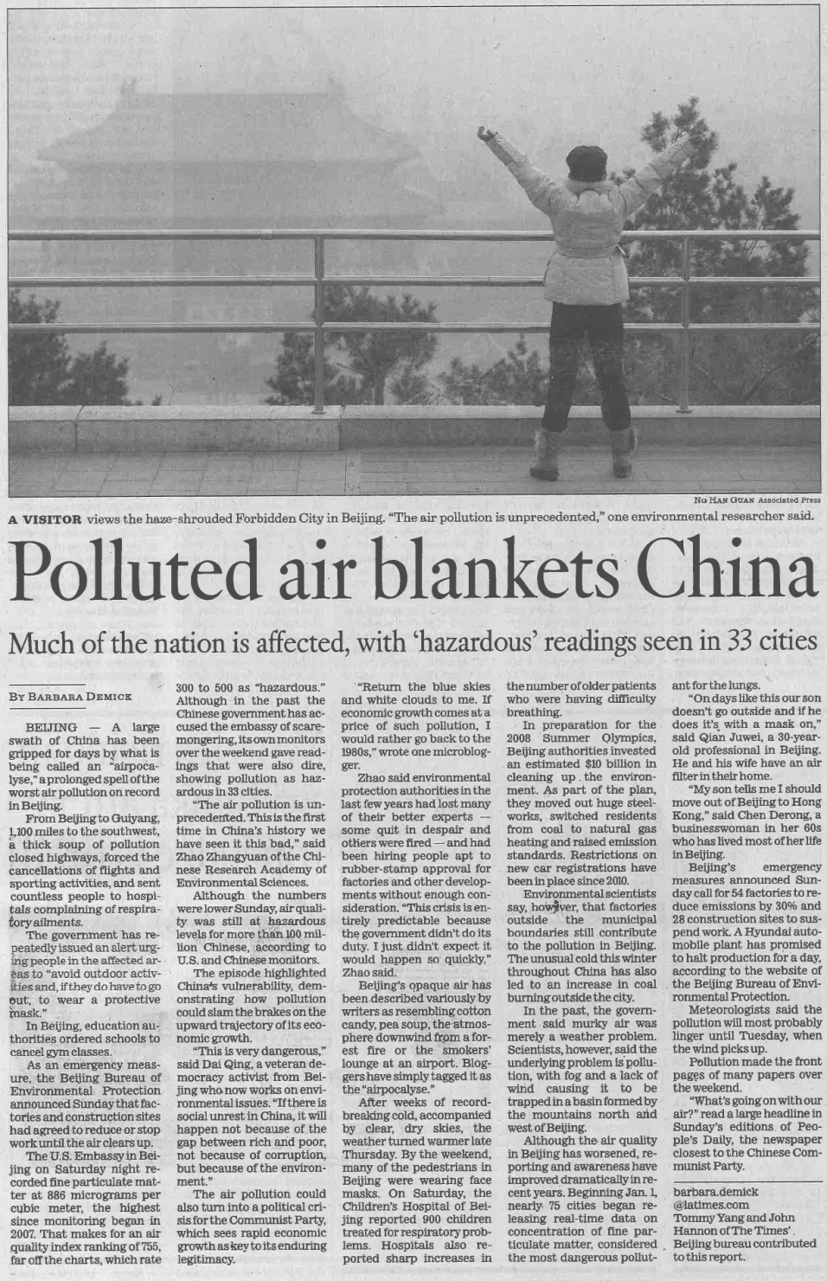
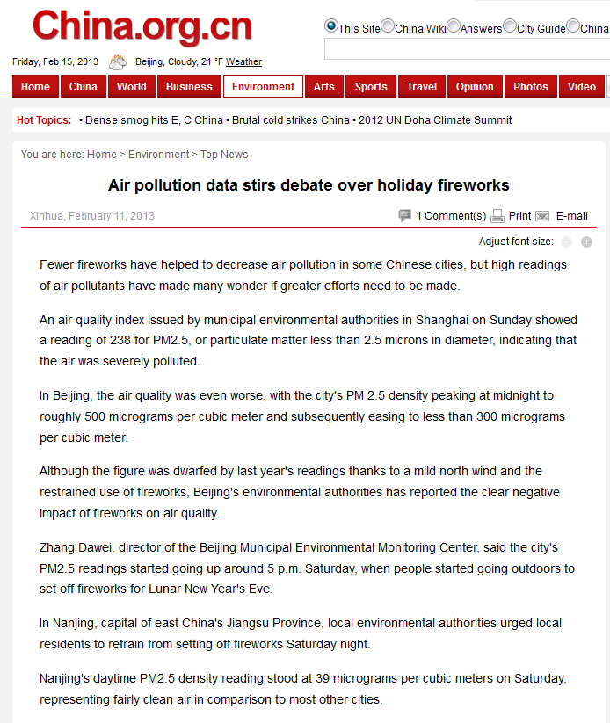
January - February, 2013
Los Angeles Times, Jan 14, 2013

Slide 10
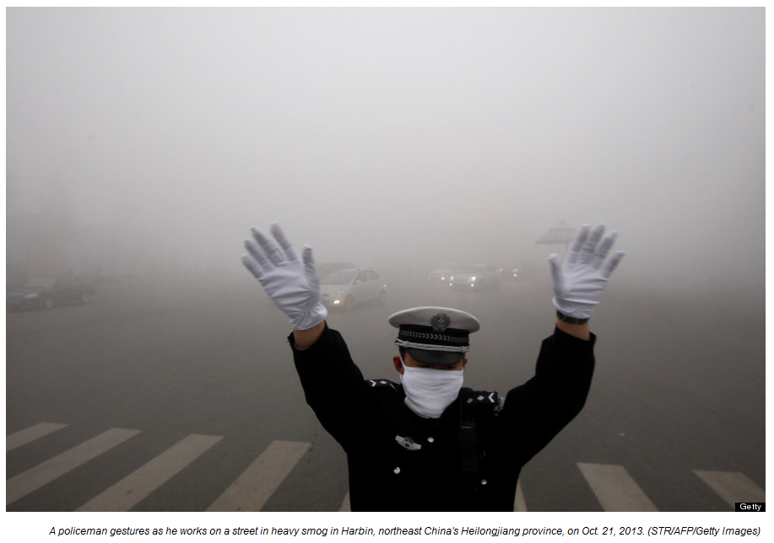
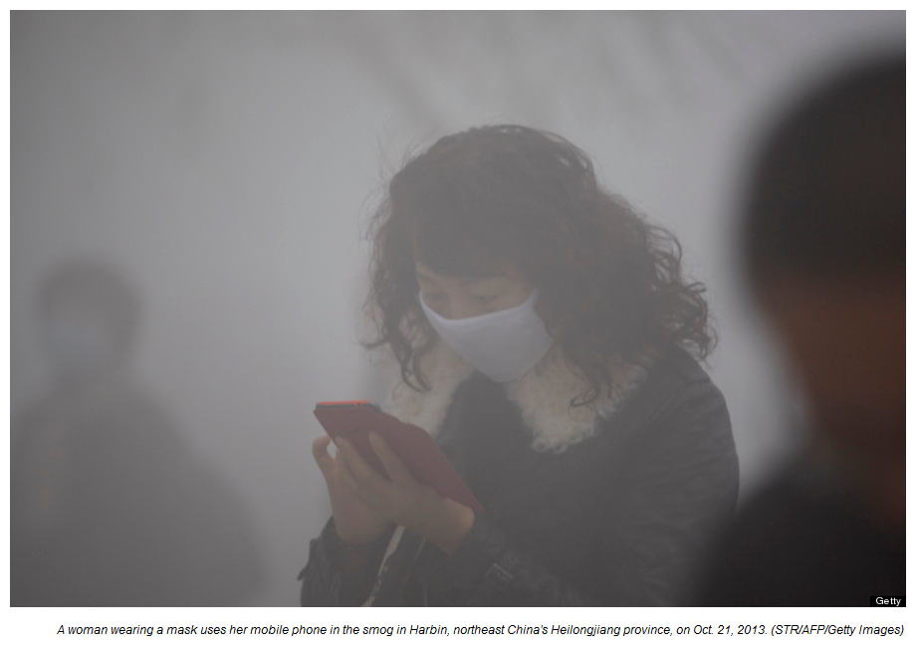
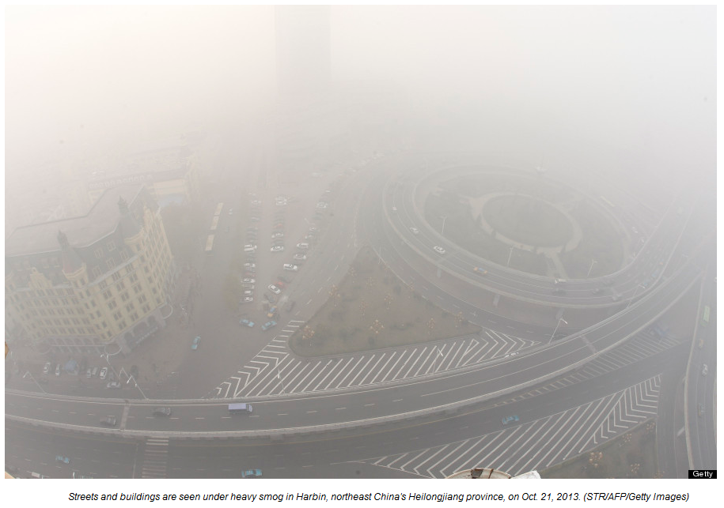
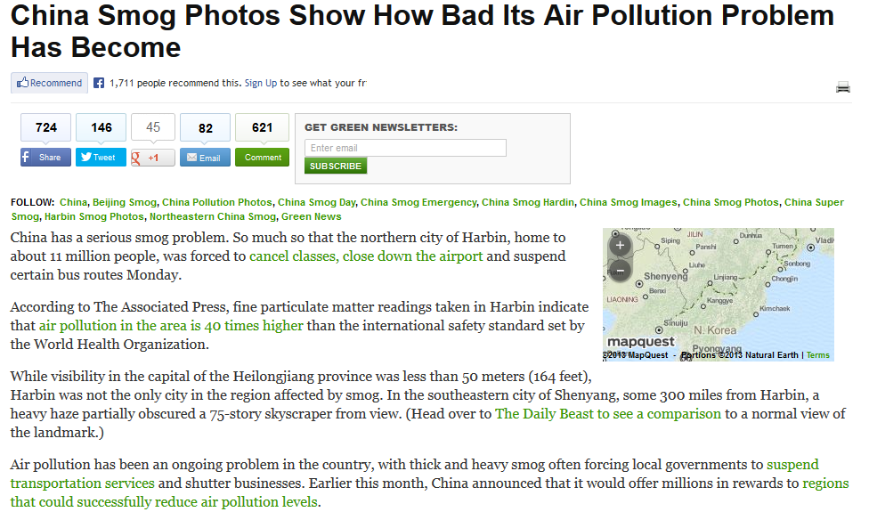
Huffington Post, October 21, 2013

Slide 11
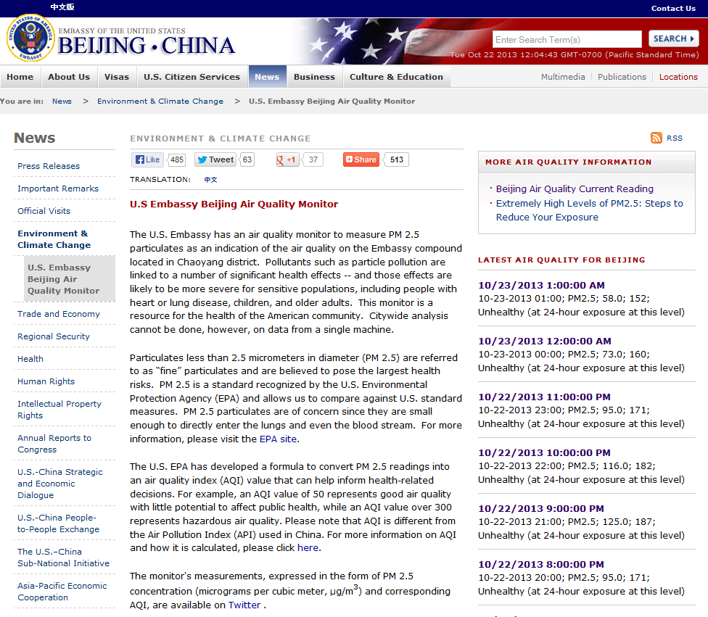
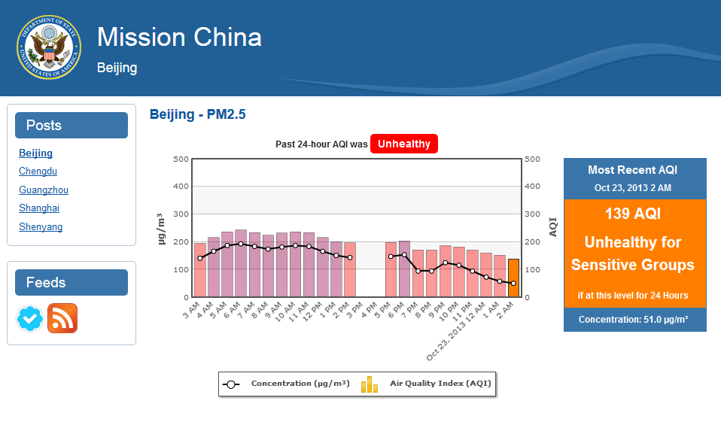
http://beijing.usembassy-china.org.cn/070109air.html

Slide 12
Global burden of disease

Slide 13
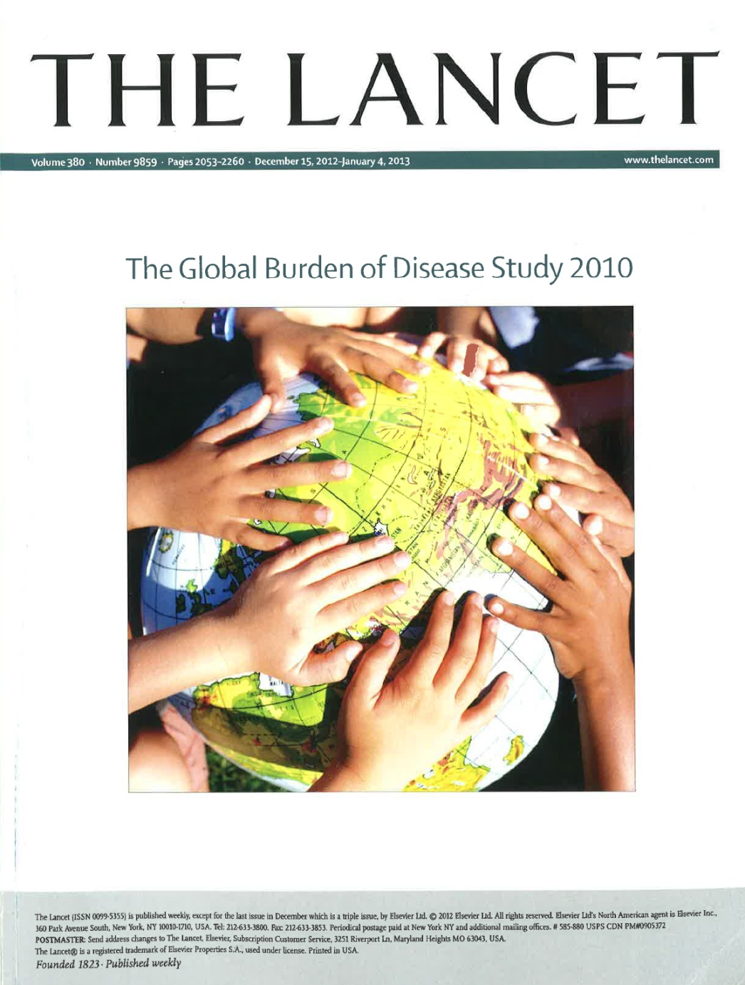
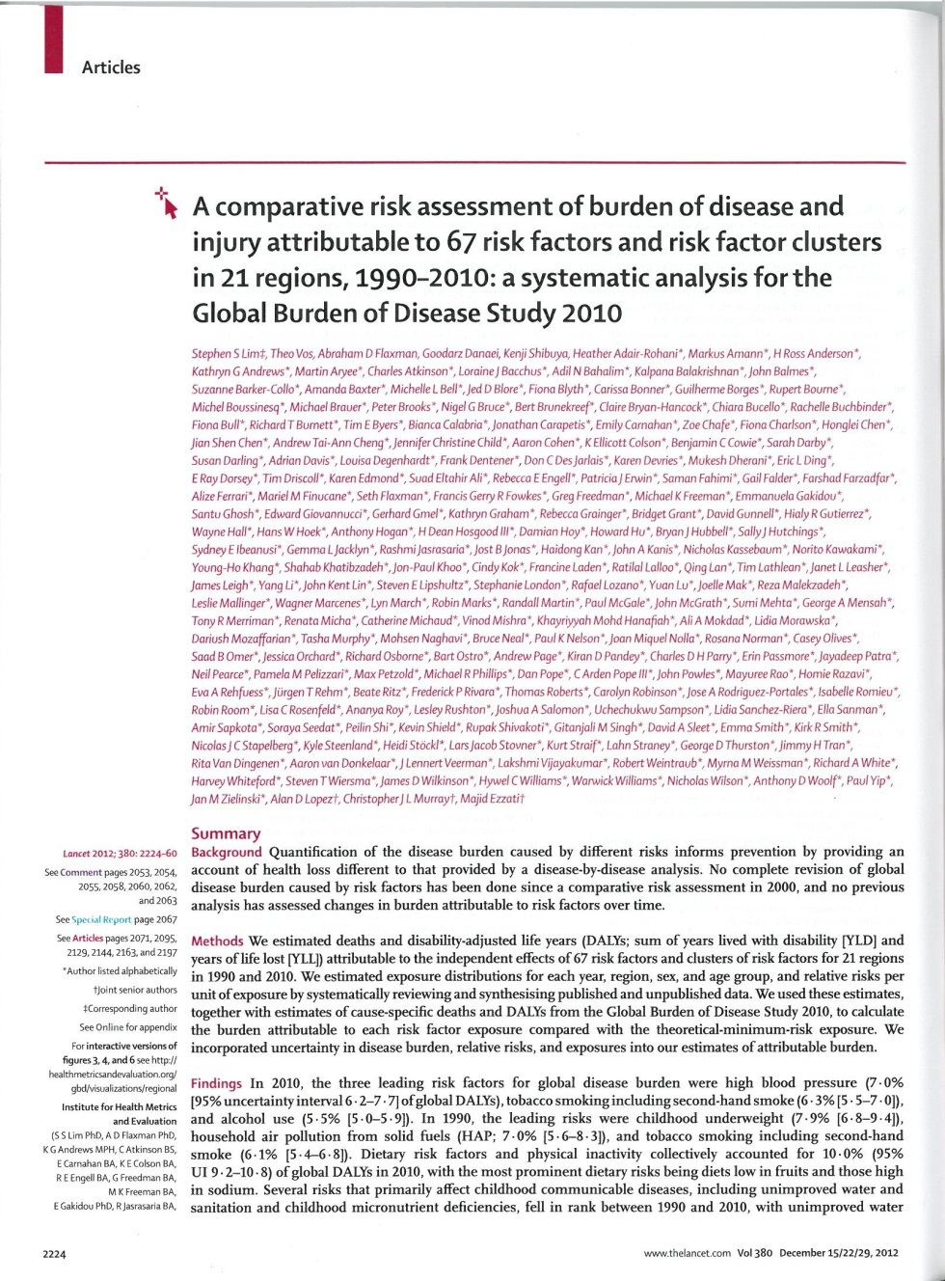

Slide 14
Estimating the Global Burden of Disease due to Ambient Air Pollution
Worldwide Health Evidence
Country- Specific Mortality, Disease
Exposure to Outdoor Air Pollution
Concentration –Response Relationships
Global Burden, DALYs, Mortality
Baseline Incidence
Slide attributed to Aaron Cohen, Health Effects Institute, Co-Chair of GBD 2010 Ambient Air Pollution Expert Group

Slide 15
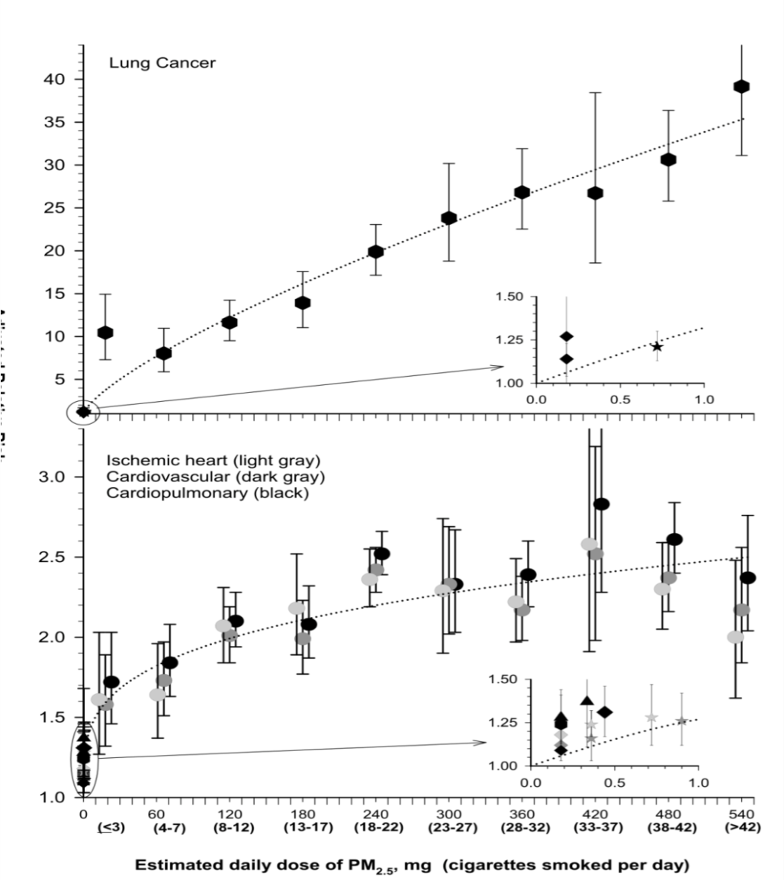
A model for estimating the global attributable burden: Integrated exposure-response function (IER)
All cohort studies of PM_{2.5} and mortality from chronic disease have been conducted in the US and Western Europe
New models needed to estimate exposure-response functions at high levels of PM in Asia, other regions
IERs estimate E-R functions using results of studies of second-hand smoke (SHS) , household air pollution (HAP), and active tobacco smoking (ATS) (Burnett R et al. 2013 Submitted)
Key model assumptions:
  Risk is a function of PM_{2.5} inhaled dose regardless of source (Pope et al. 2009; 2011)
  Consistent with risk observed in current cohort studies
  Predict risk for highest PM_{2.5} concentrations consistent with risks from SHS, HAP, active smoking
From: Pope CA et al. EHP 2011
Slide attributed to Aaron Cohen, Health Effects Institute, Co-Chair of GBD 2010 Ambient Air Pollution Expert Group

Slide 16
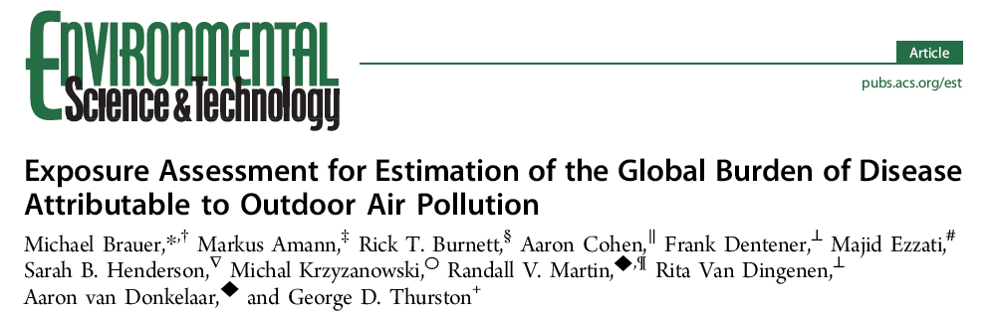
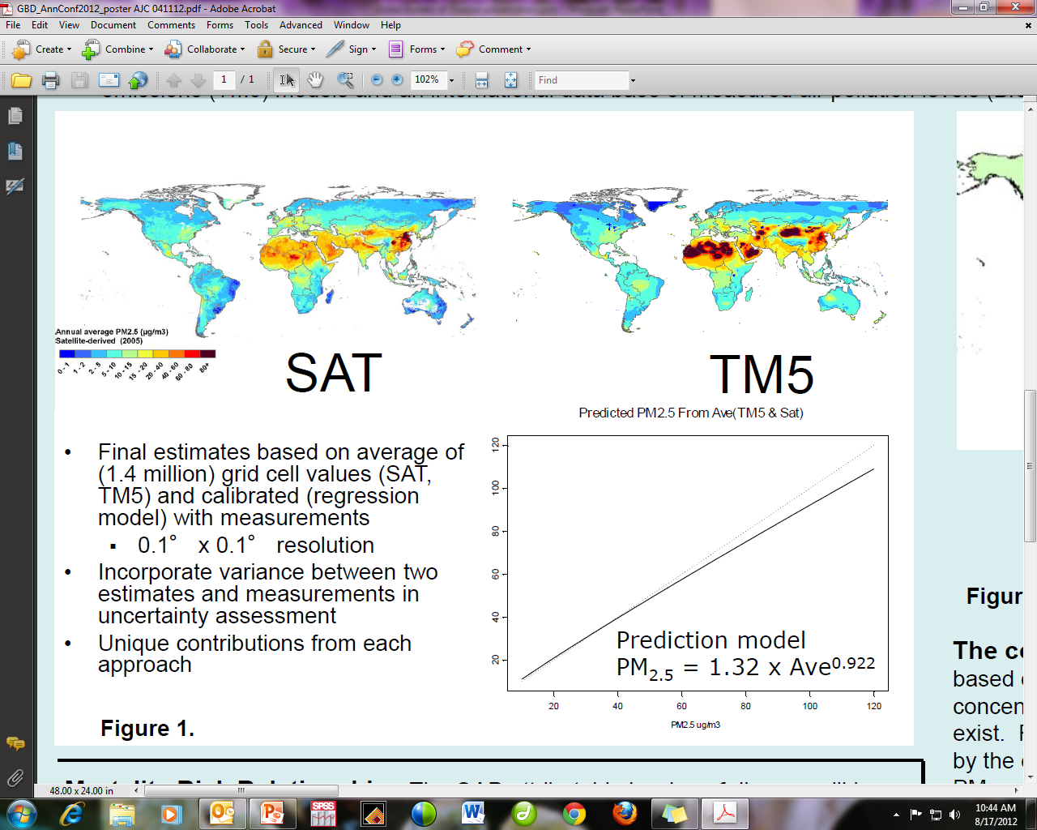
Global estimates of PM_{2.5} at 10km x 10km scale
Combined estimates from satellites (AOD), chemical transport models and ground-level measurements
Estimates include contribution of all sources of PM_{2.5}
Slide attributed to Aaron Cohen, Health Effects Institute, Co-Chair of GBD 2010 Ambient Air Pollution Expert Group

Slide 17
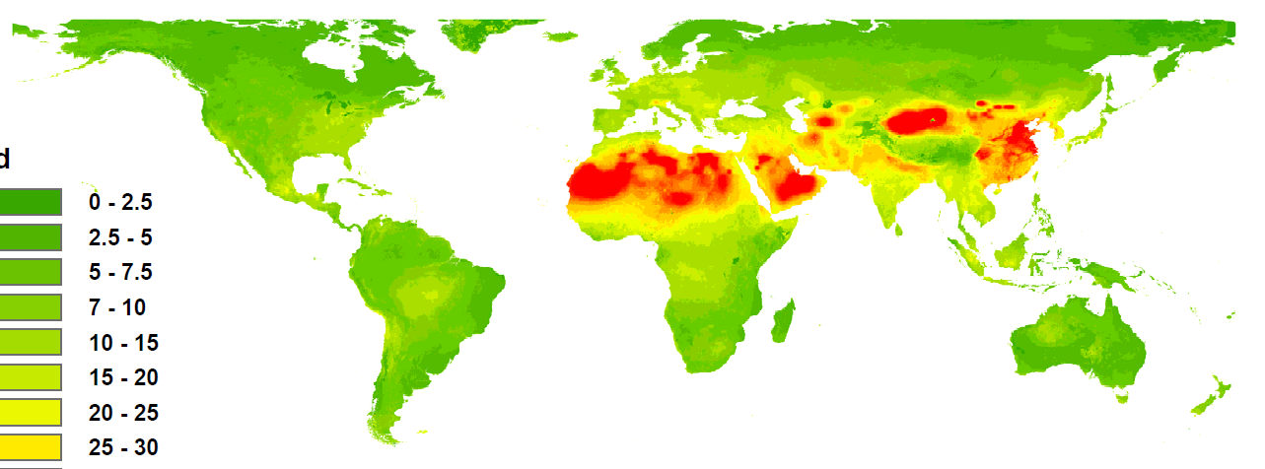
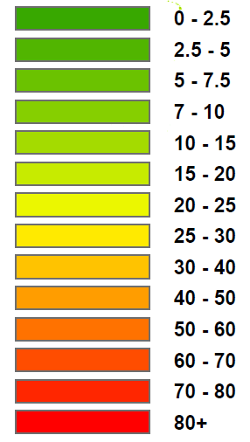
Exposure: Ambient PM Pollution
Satellite-based measures of aerosol optical depth (AOD)
TM5 chemical transport models
Calibrated against ground-based PM_{2.5} sensors
PM_{2.5} (µg per m³)
Slide attributed to Stephen Lim, Global Burden of Disease Project, Institute for Health Metrics and Evaluation, University of Washington

Slide 18
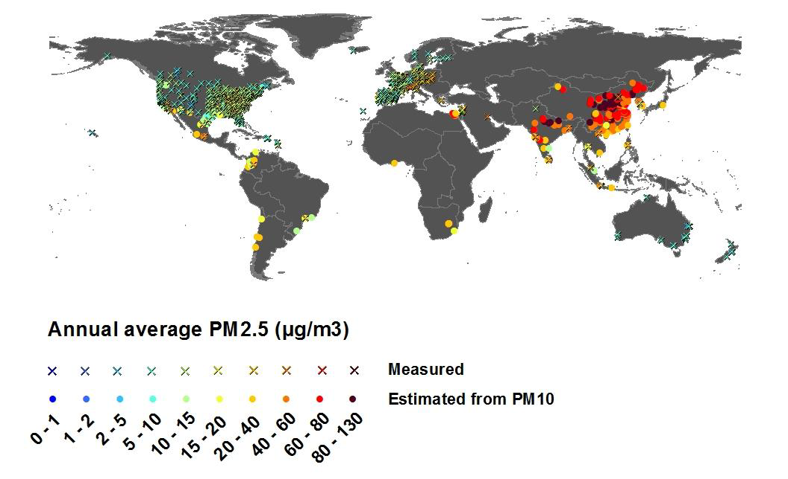
Exposure - Ambient PM Pollution
Slide attributed to Stephen Lim, Global Burden of Disease Project, Institute for Health Metrics and Evaluation, University of Washington

Slide 19
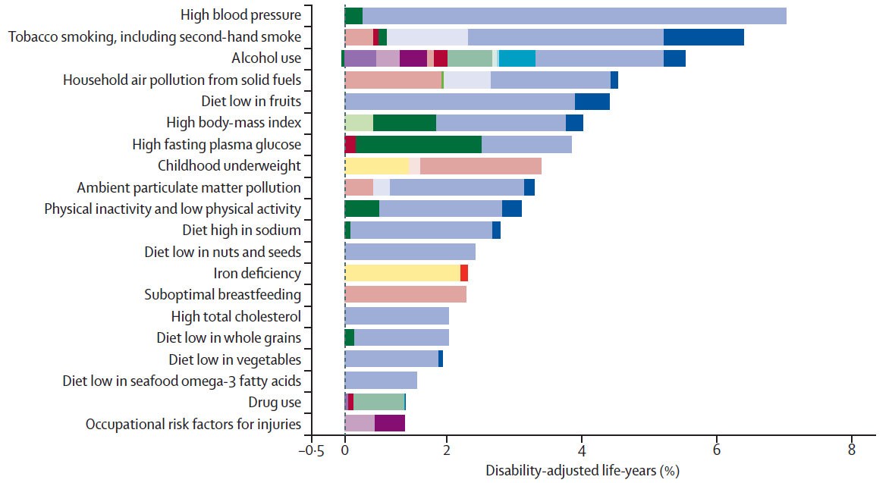
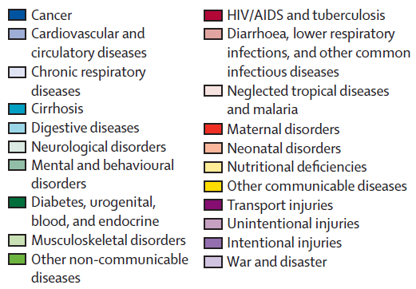
Burden of Disease Attributable to 20 Leading Risk Factors in 2010, % DALYs, both sexes
Slide attributed to Stephen Lim, Global Burden of Disease Project, Institute for Health Metrics and Evaluation, University of Washington

Slide 20
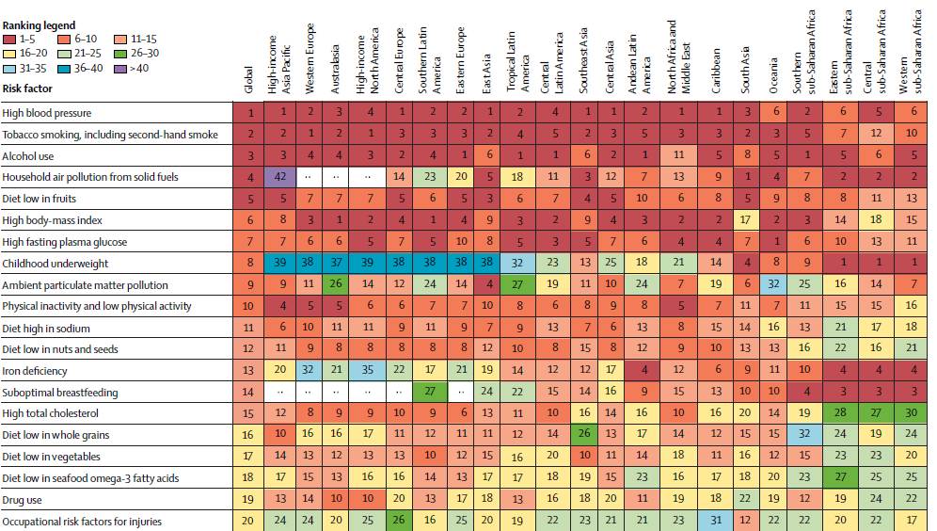
Regional variation in leading risks, 2010
Slide attributed to Stephen Lim, Global Burden of Disease Project, Institute for Health Metrics and Evaluation, University of Washington

Slide 21
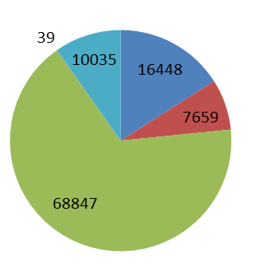
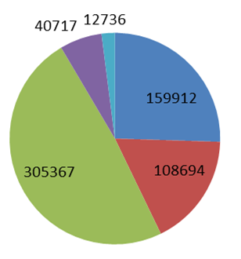
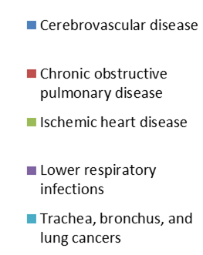
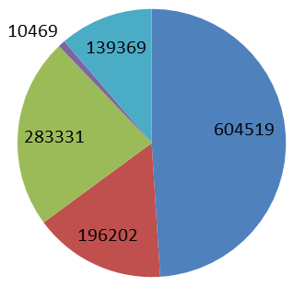
Deaths Attributable to Ambient PM_{2.5} by Cause in the US, India, and China in 2010
Deaths Attributable to Ambient Particulate Matter Pollution in 2010
US
Total attributable deaths = 103027
India
Total attributable deaths = 627426
China
Total attributable deaths = 1233891
Slide attributed to Aaron Cohen, Health Effects Institute, Co-Chair of GBD 2010 Ambient Air Pollution Expert Group

Slide 22
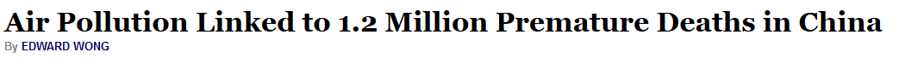
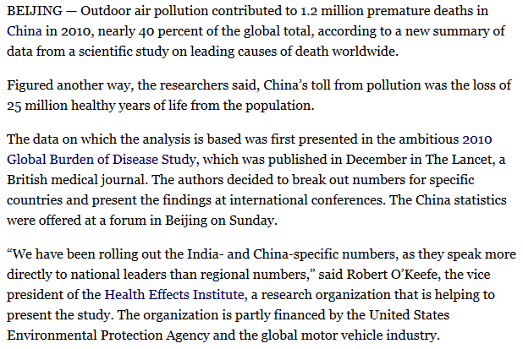
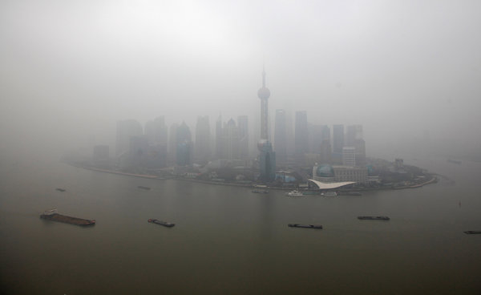
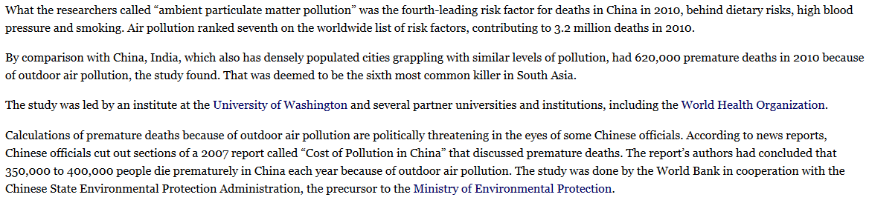
New York Times, April 1, 2013

Slide 23
Estimated population-weighted ambient air pollution levels - PM_{2.5} -increased worldwide and in China 1990-2010
1990 → 2010:
10% increase in global population-weighted PM_{2.5}
50% increase in population-weighted PM_{2.5}
Slide attributed to Aaron Cohen, Health Effects Institute, Co-Chair of GBD 2010 Ambient Air Pollution Expert Group

Slide 24
Deaths Attributable to Air Pollution, Worldwide, 1990 and 2010
 | Men |  | Women |  | Both sexes
 | 1990 | 2010 | 1990 | 2010 | 1990 | 2010
Ambient PM pollution | 1,549,448 | 1,850,428 | 1,360,712 | 1,373,113 | 2,910,161 | 3,223,540
Household air pollution from solid fuels | 2,251,932 | 1,867,043 | 2,221,558 | 1,611,730 | 4,473,490 | 3,478,773
Ambient ozone pollution | 77,087 | 86,335 | 66,274 | 66,100 | 143,362 | 152,434
Lancet 2012; 380: 2224–60

Slide 25
Air pollution and cancer: The iarc classification

Slide 26






















WORLD HEALTH ORGANIZATION
INTERNATIONAL AGENCY FOR RESEARCH ON CANCER
IARC Monographs on the Evaluation of
Carcinogenic Risks to Humans
IARC Monograph Evaluations
LYON, FRANCE

Slide 27
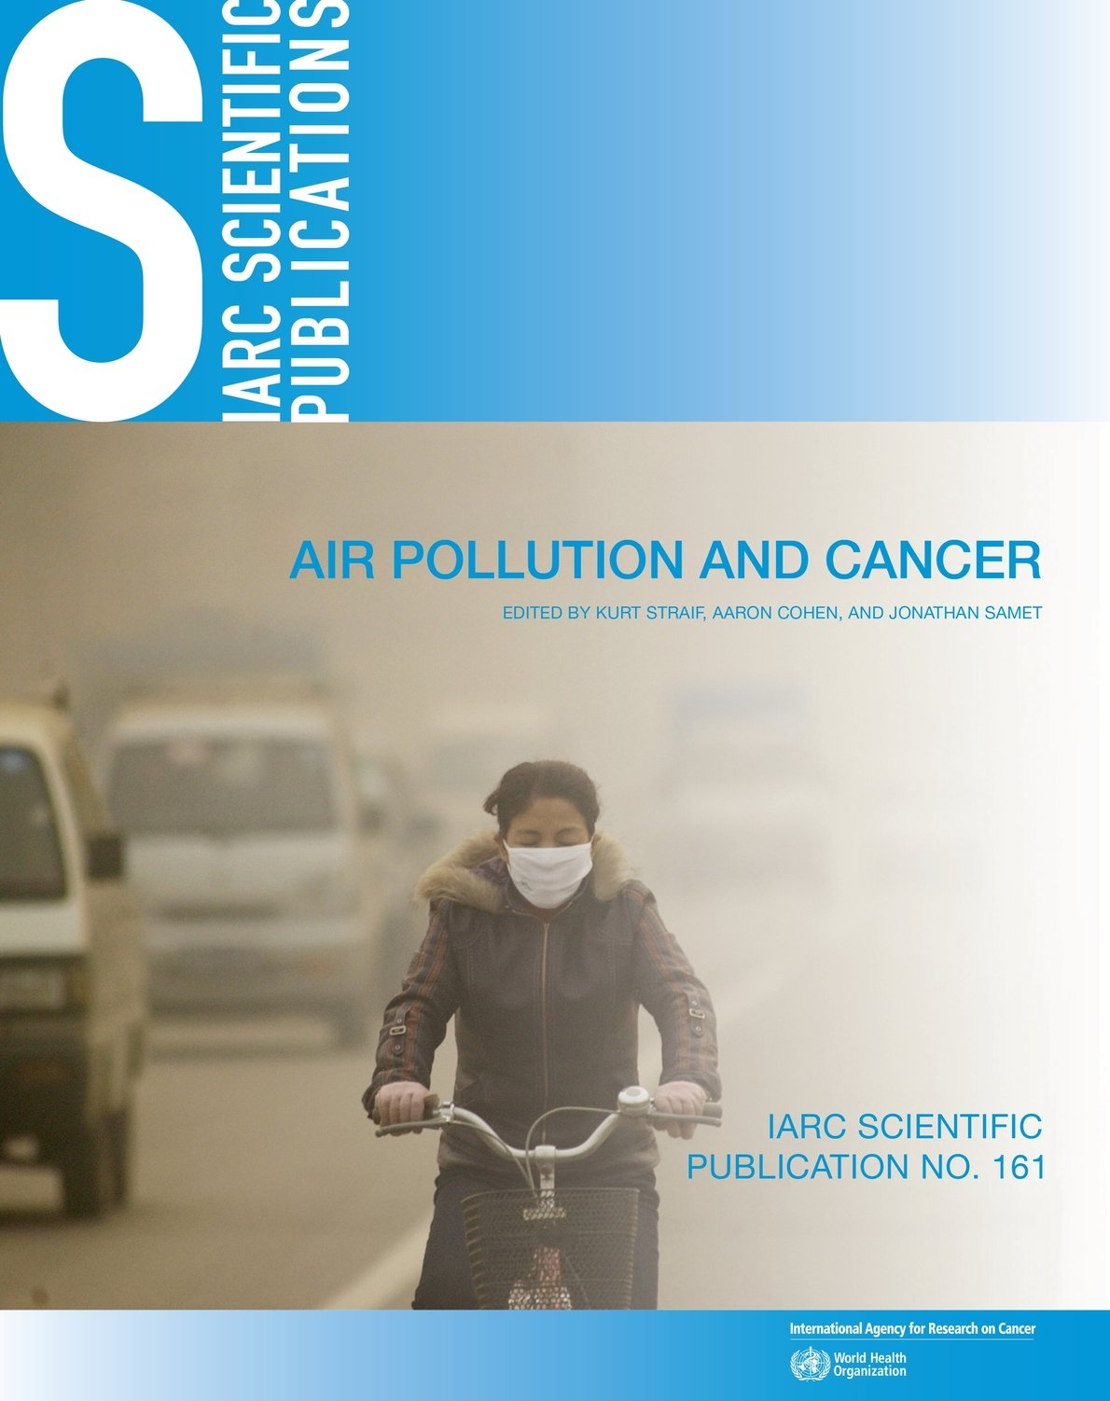
IARC Scientific Publication No. 161
Air Pollution and Cancer
Editors: Kurt Straif, Aaron Cohen, and Jonathan Samet
Available at: http://www.iarc.fr/en/publications/books/sp161/index.php

Slide 28
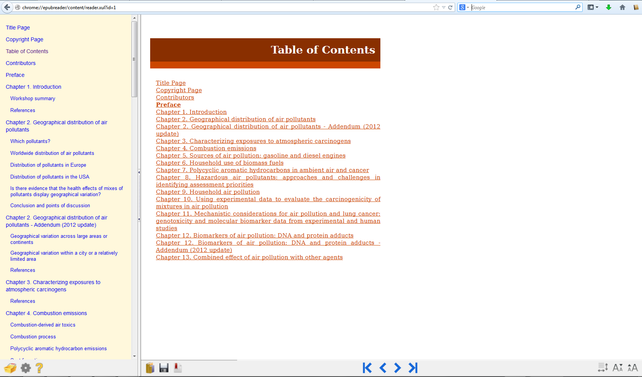
IARC Scientific Publication No. 161
Air Pollution and Cancer
Editors: Kurt Straif, Aaron Cohen, and Jonathan Samet
Available at: http://www.iarc.fr/en/publications/books/sp161/index.php

Slide 29
IARC Monograph meetings held subsequent to 2004
Volume 92 (October 2005): Some non-heterocyclic polycyclic aromatic hydrocarbons and some related exposures (IARC, 2010a).
Volume 93 (February 2006): Carbon black, titanium dioxide, and talc (IARC, 2010b).
Volume 95 (October 2006): Household use of solid fuels and high-temperature frying (IARC, 2010c).
Volume 103 (October 2011): Bitumens and bitumen emissions, and some N- and S-heterocyclic polycyclic aromatic hydrocarbons (IARC, 2013).
Volume 105 (June 2012): Diesel and gasoline engine exhausts and some nitroarenes (IARC, 2013).
Volume 109 (October 2013): Outdoor air pollution

Slide 30
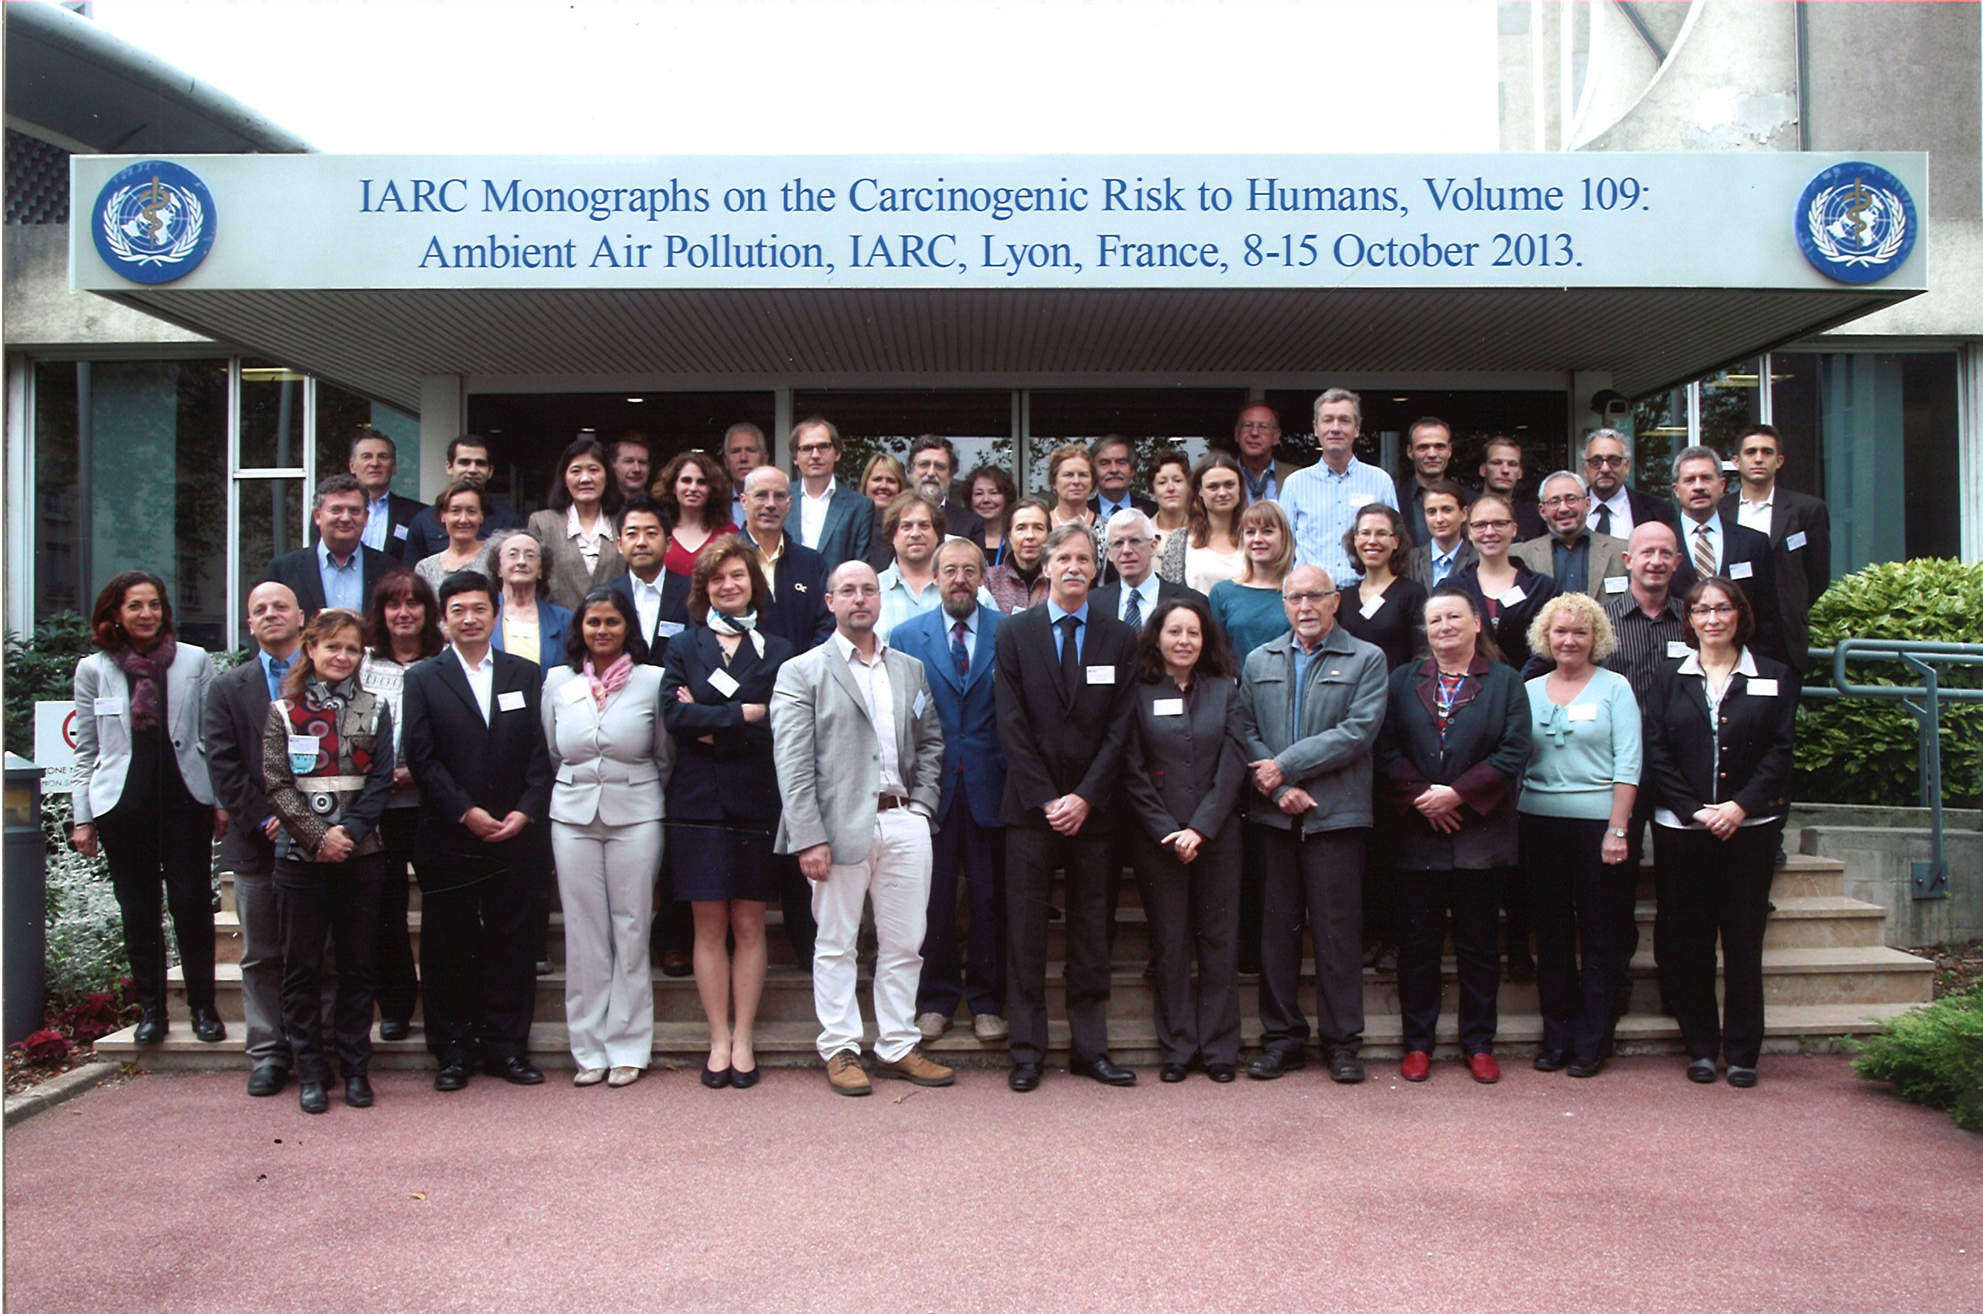

Slide 31
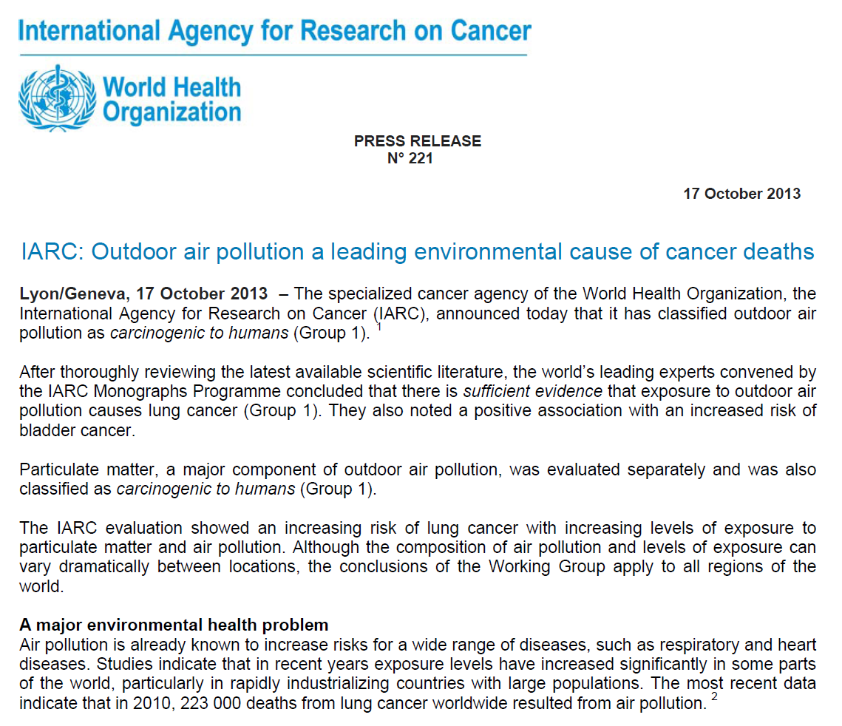

Slide 32
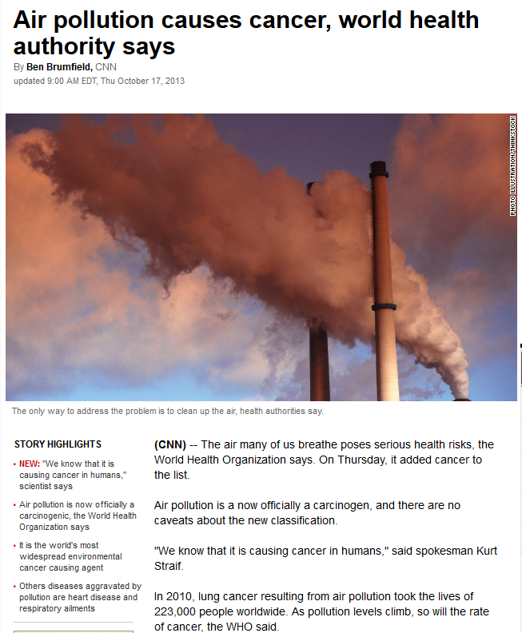

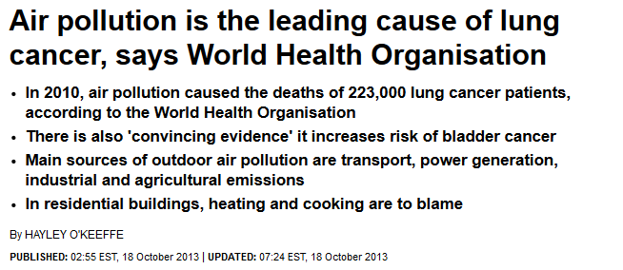
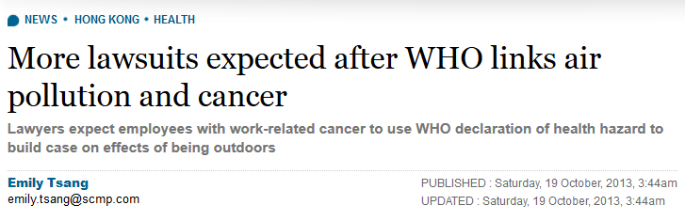
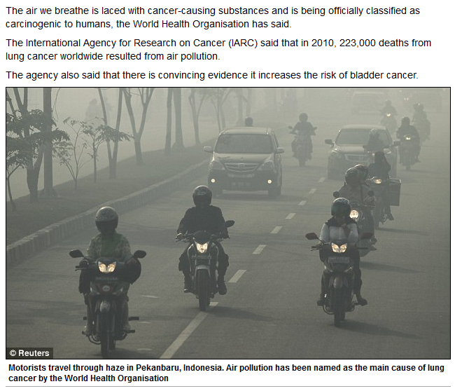
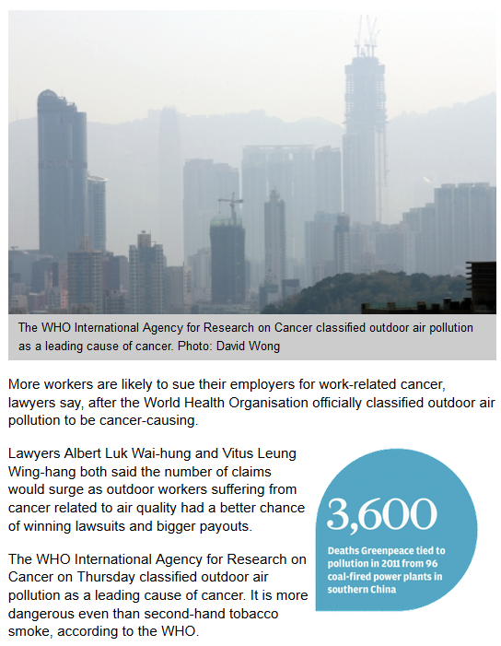

Slide 33
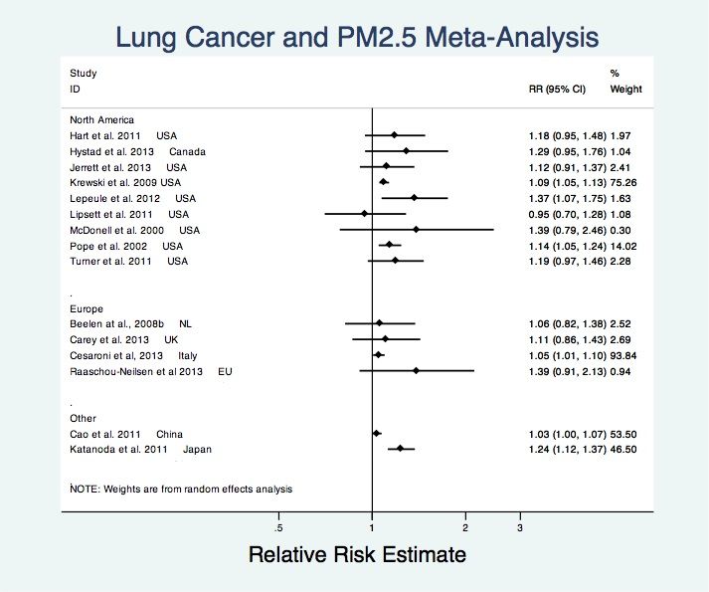
Draft IARC Monograph 109 - Ambient Air Pollution (2013)

Slide 34
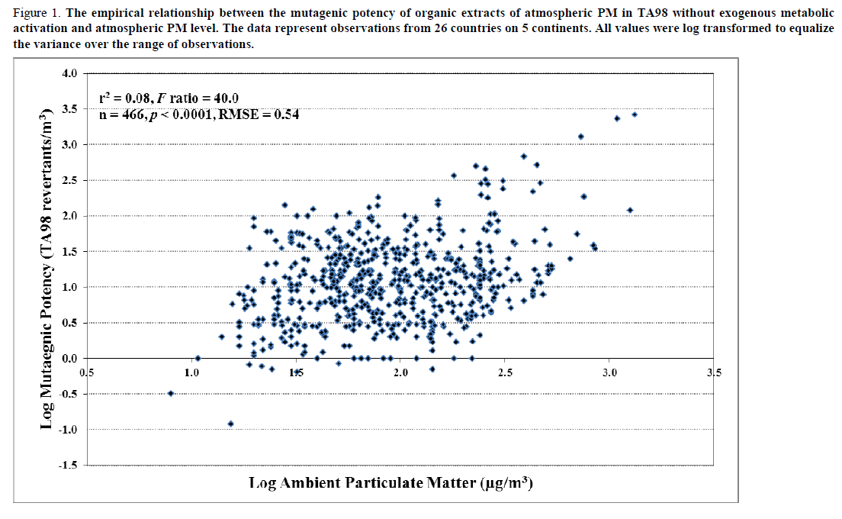
Draft IARC Monograph 109 - Ambient Air Pollution (2013)

Slide 35
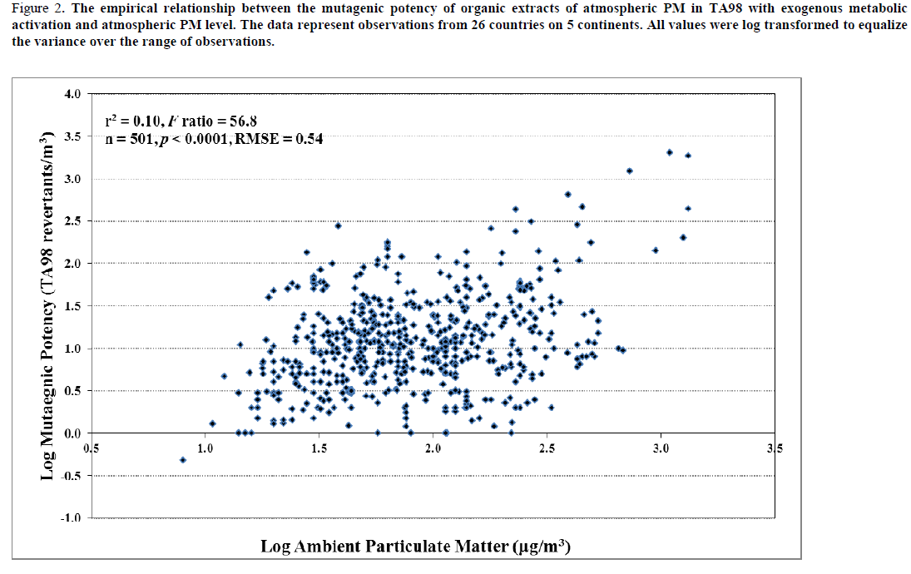
Draft IARC Monograph 109 - Ambient Air Pollution (2013)

Slide 36
The problem of traffic

Slide 37





Slide 38

Traffic-Related Air Pollution

Slide 39
China: Increasing numbers of vehicles
= Passenger vehicles
= Trucks
1978-2007
Civil vehicle fleet (per 10000）
1990-2007
Private vehicle fleet (per 10000）
National Bureau of Statistics of China. China Statistical Yearbook 2008

Slide 40
Regulating Air Quality

Slide 41
The Evidence Scale
Act
Not Act
Evidence
Politics
Costs
Activists
Advocates
Uncertainty

Slide 42
The National Ambient Air Quality Standards (NAAQS) review process
Peer-reviewed scientific studies
Integrated Science Assessment (ISA)
Concise evaluation and synthesis of most policy-relevant studies
Policy Assessment
Staff analysis of policy options based on integration and interpretation of information in the ISA and REA
Workshop on science-policy issues
Integrated Review Plan
Timeline and key policy-relevant issues and scientific questions
CASAC review and public comment
CASAC review and
public comment
Risk/Exposure Assessment (REA)
Concise qualitative assessment focused on key results, observations, and uncertainties
EPA proposed decision on standards
Interagency review
Agency decision making and draft proposal notice
Public hearings and comments on proposal
Agency decision making and draft final notice
Interagency review
EPA final decision on standards
Notes:
Figure 2. The National Ambient Air Quality Standards (NAAQS) review process

Slide 43

The NAAQS - getting better all the time
NOx SIP call
RVP phased in
Bachmann 2007;57:652-97

Slide 44
The PM Dilemma
In higher-income countries, current PM levels are still associated with adverse health effects.
And, in low- and middle-income countries, PM is present at concentrations above EPA NAAQS and WHO guidelines.

Slide 45
PM_{2.5} Ranges in Epi studies
150
Delhi, India
Beijing, China
Annual Average PM_{2.5} levels (µg/m³)
50
40
Hong Kong
30
Six Cities Study
ACS Cancer Prevention Study
ESCAPE
20
Los Angeles, US
10
0
Notes:
ESCAPE: Raaschou-Nielsen et al. Lancet Oncol 2013;14:813-22
Six Cities Study: Lepeule et al. EHP 2012;120:965-70
ACS CPS-II: Turner et al. AJRCCM 2011;184:1374-81
Delhi: Dey et al. Remote sensing of environ 2012;127:153-61
Beijing: Wong et al. PLoS ONE 2013;8(1):e53400
Hong Kong: Louie et al. Sci Total Environ 2005;338:267-81

Slide 46


Slide 47

WHO AQG: Particulate Matter
WHO Air Quality Guidelines for Particulate Matter, Ozone, Nitrogen Dioxide and Sulfur Dioxide. Global Update 2005. Summary of Risk Assessment. WHO 2005.

Slide 48


WHO indoor AQG for selected pollutants
WHO Guidelines for Indoor Air Quality: Selected Pollutants. WHO 2010.

