Slide 1
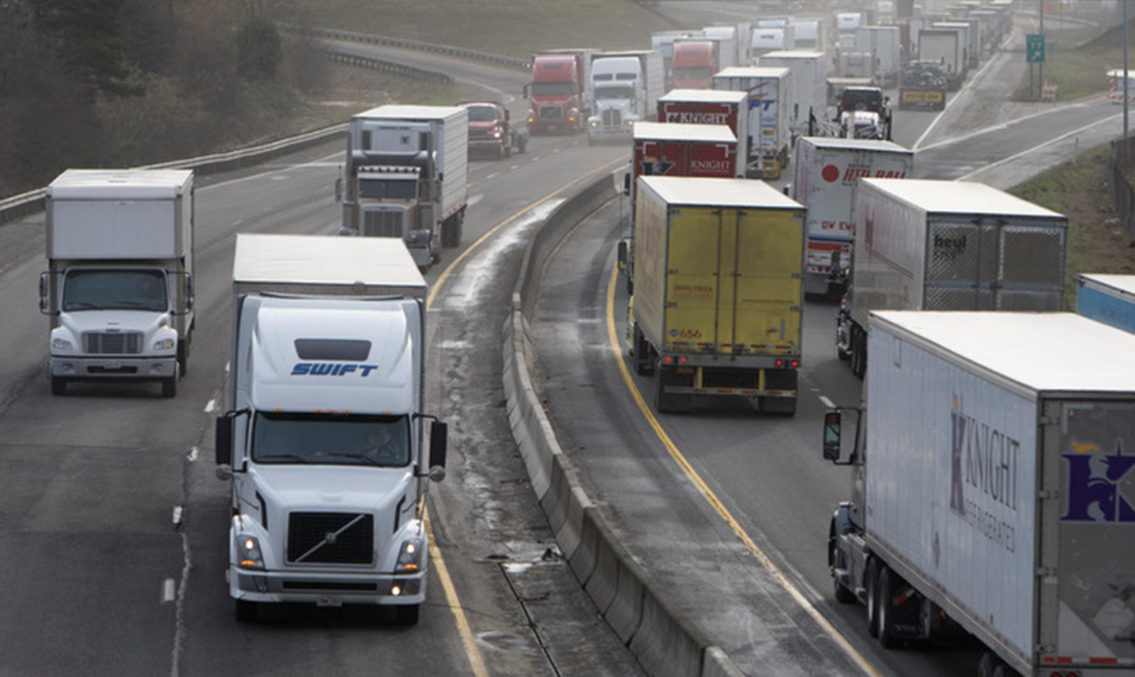

Policy and Mitigation Measures - Heavy Duty Vehicle Emissions in California
India – California Air-Pollution Mitigation Program (ICAMP)
Oakland, CA, October 21-23, 2013
Jorn Dinh Herner, Ph.D.
Chief, Research Planning and Emission Mitigation Branch, Research Division

Slide 2




Slide 3
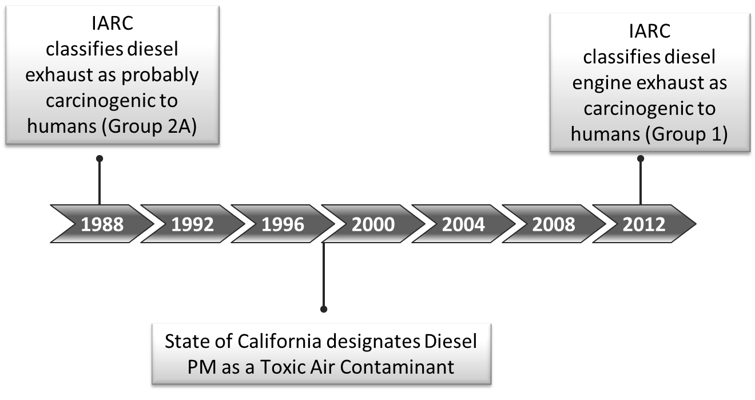
Major Drivers for Emission Reductions
Diesel Exhaust is toxic and carcinogenic
Diesel Exhaust contributes to regional and local air pollution
National Ambient Air Quality Standards for PM and Ozone
Reduce near source risk

Slide 4
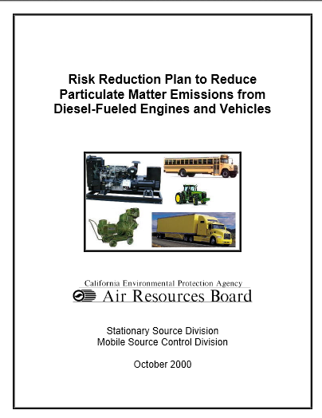
Diesel Risk Reduction Plan
Goal:
Reduce Diesel PM Emissions by 85% by 2020
How:
New Engine Emissions Standards
Ultralow Sulfur Diesel (15ppm)
In-Use Fleet Rules
•Transit agency fleet rule (2000)
•School bus idling (2002)
•Solid waste collection vehicles (2003)
•Stationary compression ignition engines (2004)
•Portable engines (2004)
•Transport refrigeration units (2004)
•Commercial vehicle idling (2004)
•Locomotives/harborcraft fuel (2004)
•Transit fleet vehicles (2005)
•Public agency/utility on-road fleets (2005)
•Port/rail cargo handling equipment (2005)
•Ship auxiliary engine fuel (2005)
•Drayage Truck Rule (2007)
•Off-Road Rule (2007)
•Truck and Bus Rule (2008)

Slide 5
Diesel Risk Reduction Plan
Keys To Success:
Flexibility in regulatory path
Outreach
Incentive funding
Enforcement
Willingness to adjust
Research
Regulation with
‘bells and whistles’

Slide 6
New Engine Standards all of United States
On-Road Engines
98+% reduction

Slide 7
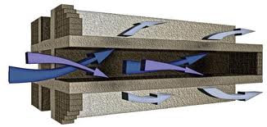
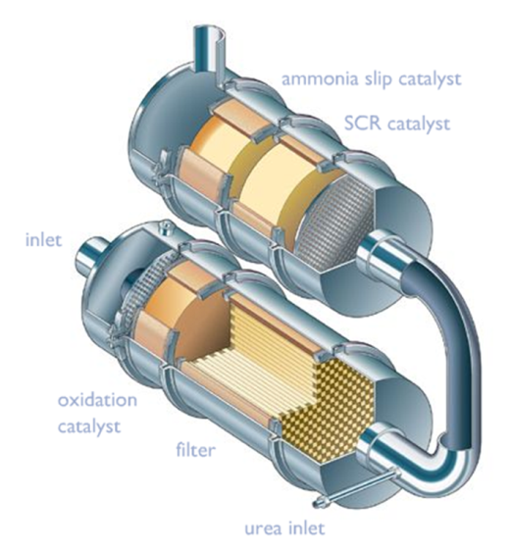
Response to Emission Standards need for aftertreatment
2007 – PM standard lowered 90%
Diesel needs DPF
2010 – NOx Standard Lowered 90%*
Diesel needs DPF and SCR
Natural Gas:
Stoichiometric with TWC
Lean Burn with SCR
* The NOx standard was lowered from 2gNOx/bhp-hr to 0.2 gNOx/bhp-hr stepwise between 2007 and 2010.

Slide 8
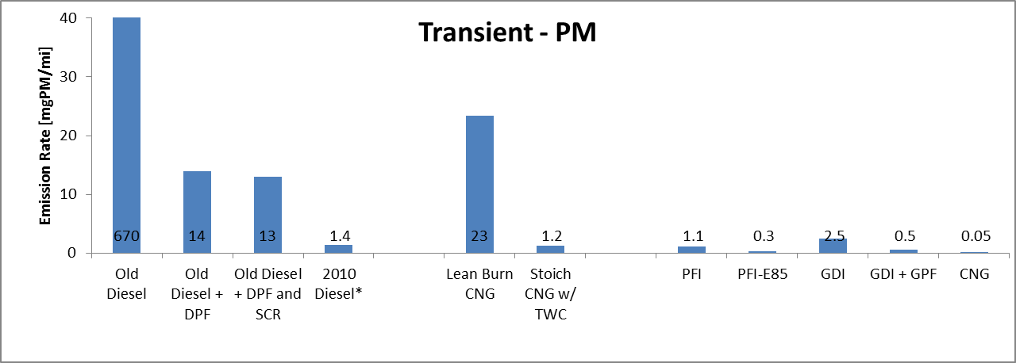
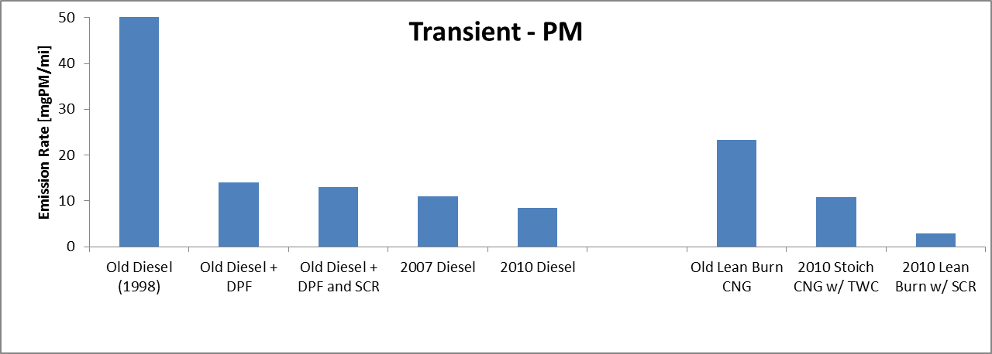
Progression of PM Emissions
670
HD Diesel HD CNG Light Duty
HD Diesel HD NG
99% and 90% PM reduction for diesel and CNG respectively
“Old” diesel and CNG number from chassis dynamometer studies, while 2007 and 2010 are average certification values in mg/mi, using 2.9 bhp-hr/mi

Slide 9
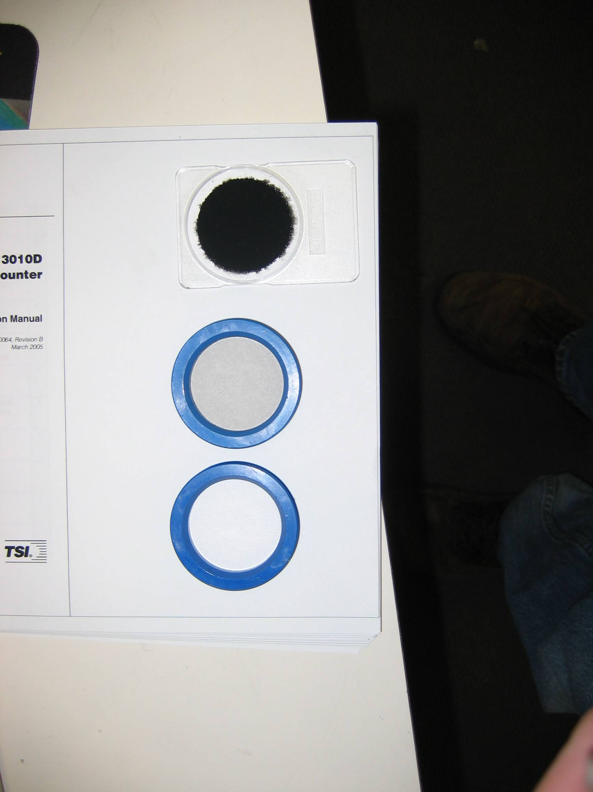
Progression of PM Emissions
670
HD Diesel HD CNG Light Duty
HD Diesel HD NG
99% and 90% PM reduction for diesel and CNG respectively
“Old” diesel and CNG number from chassis dynamometer studies, while 2007 and 2010 are average certification values in mg/mi, using 2.9 bhp-hr/mi

Slide 10
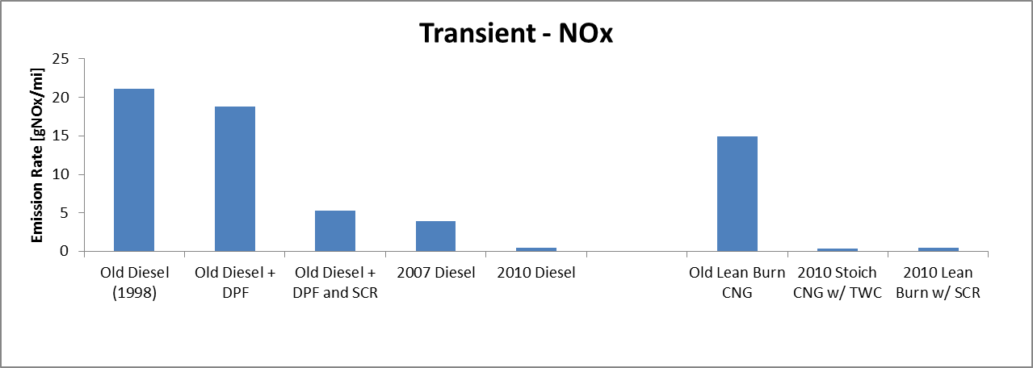
Progression of NOx Emissions
HD Diesel HD NG
Diesel -98%, CNG -97%
Need for further reductions
“Old” diesel and CNG number from chassis dynamometer studies, while 2007 and 2010 are average certification values in mg/mi, using 2.9 bhp-hr/mi

Slide 11
ARB Screening Method for Toxicity
PM Extraction
Chemical Assays
(cell free)
Cellular in vitro
Assays
Genotoxicity Assays
Type
Endpoints
Oxidative Stress
Inflammation and Oxidative Stress
DNA damage
Assay
DTT
Macrophage ROS
Inflammatory Markers mRNA
Ames assay
Comet assay

Slide 12
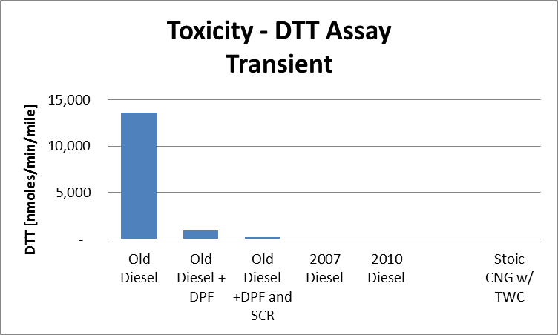
>99.7% Reduction, comparable to new NG
Oxidative Stress per Mile Driven preliminary results

Slide 13
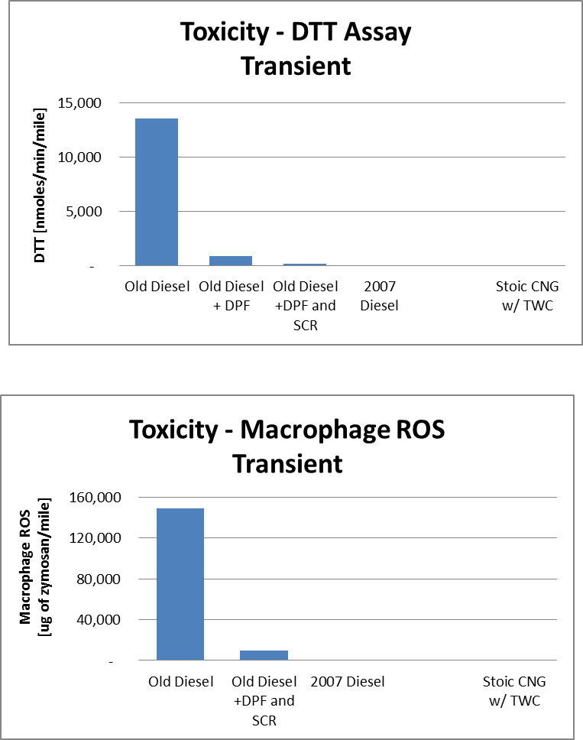
>99.8% Reduction, comparable to NG
Inflammation per Mile Driven preliminary results

Slide 14
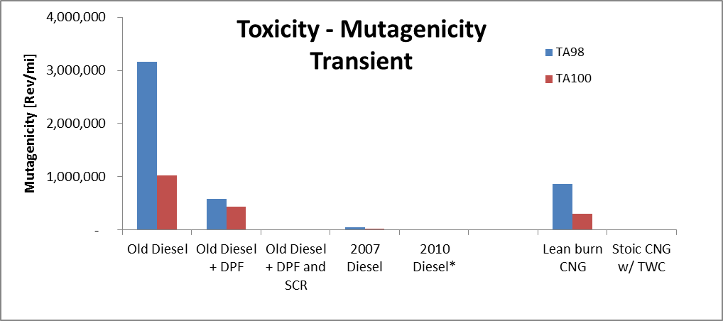
> 99.9% Reduction both NG and Diesel
DNA Damage per Mile Driven preliminary results
* Results for 2010 Diesel is from steady state cruise, not transient operation

Slide 15
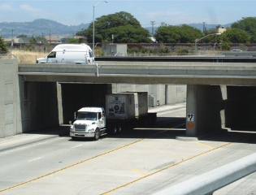
Diesel Research Program
Test effect of new technologies and fuels.
  DPF, SCR, NG, bio-diesel, renewable diesel etc. [ARB]
Understand the effect of our rules, durability of aftertreatment
  UC Berkeley, $450,000
  Denver University, $290,000
  Ports of Los Angeles [ARB]
Achieving NOx reductions
  UC Riverside, $370,000
  Southwest Research Institute $1,600,000
  SCR functionality [ARB]
Stedman, CRC 2012
Harley, ES&T, 2011 (45)

Slide 16
Conclusions
Emission control technologies drastically reduce emissions from diesel and natural gas engines.
Significant emissions reductions are possible but holistic approach is needed.
  Regulations
  Outreach
  Incentive funding
  Research
  Willingness to adjust
  Enforcement
In-use fleet rules accelerate benefit

Slide 17

Next Steps
In-fleet rules implemented through 2023
Continued need for drastic NOx reductions from Heavy Duty engines beyond what will be achieved with the 2010 standard
Zero Emissions Freight

Slide 18
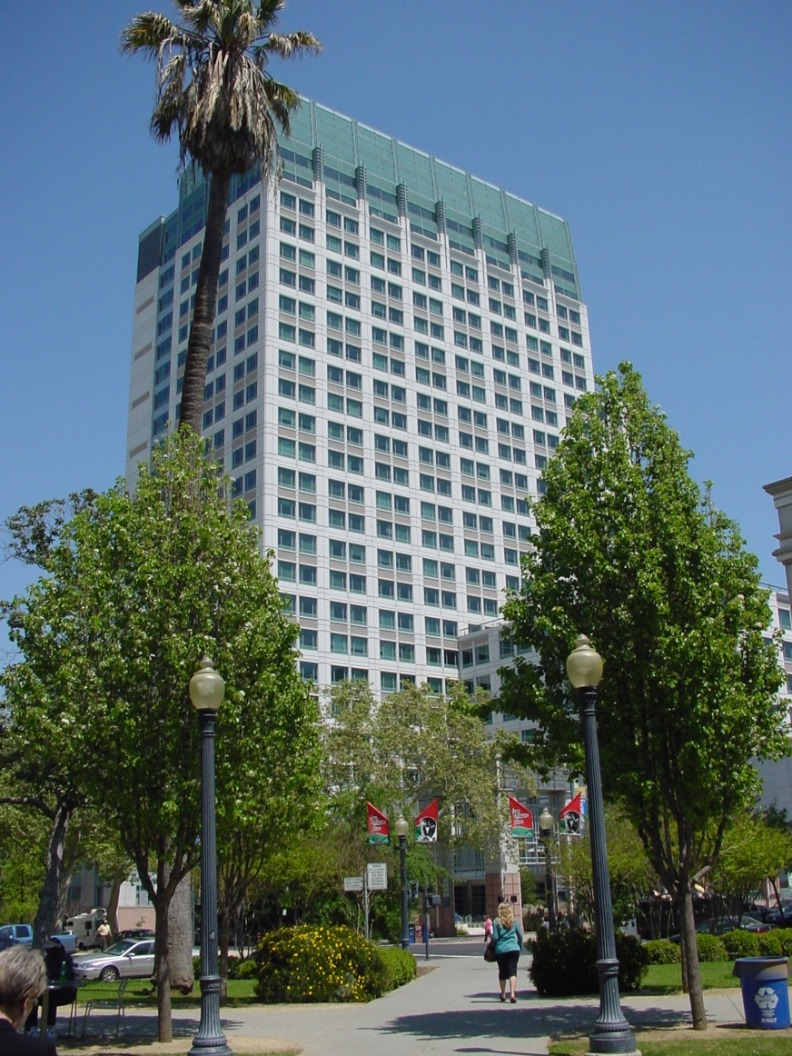
Thank you
Questions?
Contact Information:
Jorn Dinh Herner, Ph.D.
Chief, Research Planning and Emission Mitigation
Research Division, California Air Resources Board
1001 I Street, P.O. Box 2815
Sacramento, CA 95812, USA
Phone: +1 916.324.9299
Email: jherner@arb.ca.gov
Cal EPA building. Sacramento, CA, USA.

