Slide 1

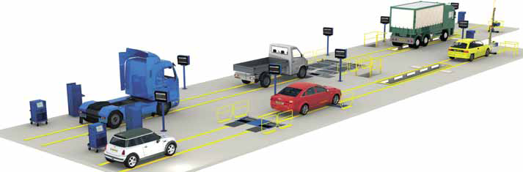
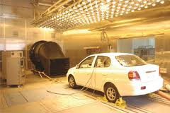
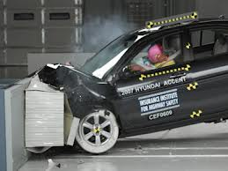
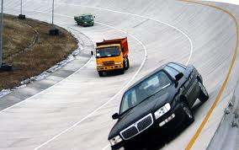
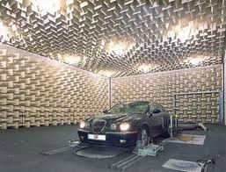
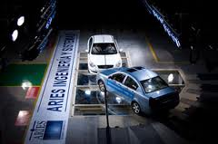
IMPROVING INSPECTION AND MAINTENANCE SYSTEM
IN INDIA

Slide 2
ABOUT NATRiP
An initiative of the Department of Heavy Industry.
Set up as an autonomous society (NATIS) with Union Cabinet Approval on 25th July 2005.
Scope:
  Upgradation of existing centers at (i) ARAI, Pune; (ii) iCAT, Manesar; (iii) VRDE, Ahmednagar.
  Green Field Centers at (i) Indore – Proving Grounds; (ii) GARC, Chennai – full facilities; (iii) Silchar – I&M, mechanic training and hill driving Center, (iv) Rae Bareli – Vehicle testing & Accident Data Research Center
Original Cost & Completion date: Rs 1718 Cr. & 30th September, 2011.
Revised Cost & Completion date: Rs 2288.06 Cr. & 31st December, 2014.

Slide 3
Need for Inspection of In-Use Vehicles
  All vehicles degrade in service with use.
  Inadequately maintained vehicles plying on roads have adverse effects on safety and environment.
Purpose of Inspection Centre
  To inspect the range of vehicles for compliance to growing roadworthiness requirements.
  Testing of in use commercial vehicles for purpose of fitness certificate under Para 62 of CMVR

Slide 4
Existing Inspection System in India
Existing system in India
Fitness Certification
(By Visual Inspection only)
Pollution Under control Certificate (PUC)
(For Commercial Vehicles only)
(For All Vehicle)

Slide 5
Current Institutional Set-up

Slide 6
Issue related to existing system
Existing system in India
Fitness Certification
Pollution Under control Certificate (PUC)
Only visual Inspection
No regulation for setting up of centre
Require only for commercial vehicle
Inadequate training to operator
No audit of testing centre

Slide 7
I&C Initiative by MoRTH
To improve the Inspection and Maintenance system in India
Pilot project of MoRTH to setup 10 Inspection & Certification centres in different states in First phase
States in the first phase:
Delhi, Haryana, Uttar Pradesh, Himachal, Andra Pradesh, Gujarat, Maharashtra, Rajasthan, Madhya Pradesh & Karnataka
MoRTH Road Map
To replicate I&C Centre to 300 numbers all over India by 2020 in other states on PPP/BOT mode

Slide 8
Types of Inspection Lanes
Types of lanes at I&C Centre
Light Duty lane
For Vehicle having GVW< 3500 Kg
Heavy Duty lane
For Vehicle having GVW> 3500 Kg
3- Wheelers
Taxi
Trucks
Buses

Slide 9
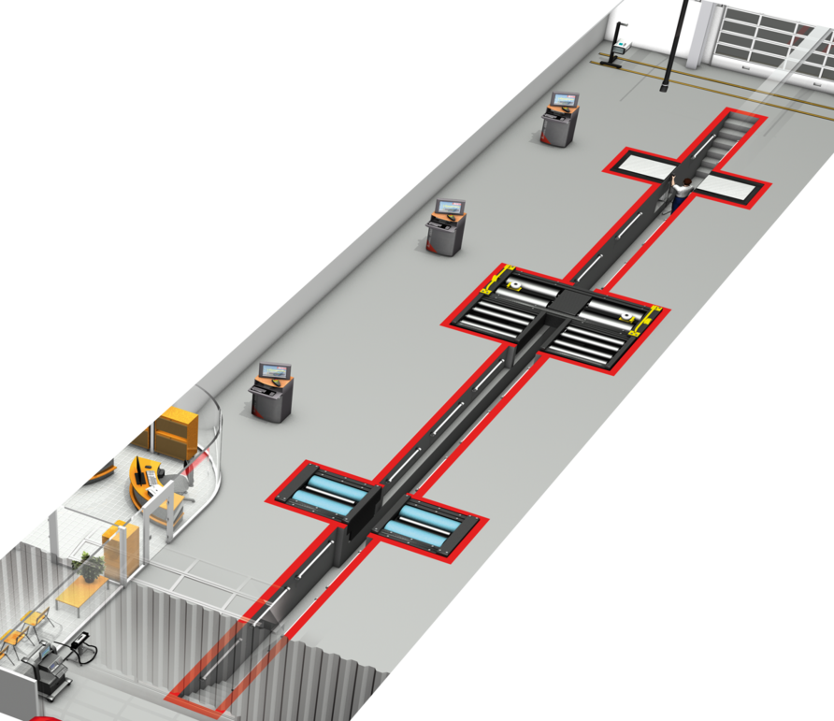
    Typical Inspection
    lane
Head Light Tester
Under Body Inspection
Free Roller
Brake Tester
Axle Play Detector
Speedometer
Gas analyzer
& Opacimeter

Slide 10
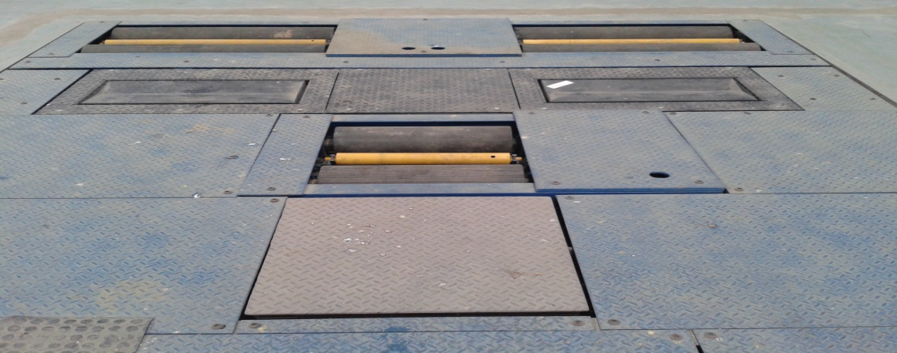
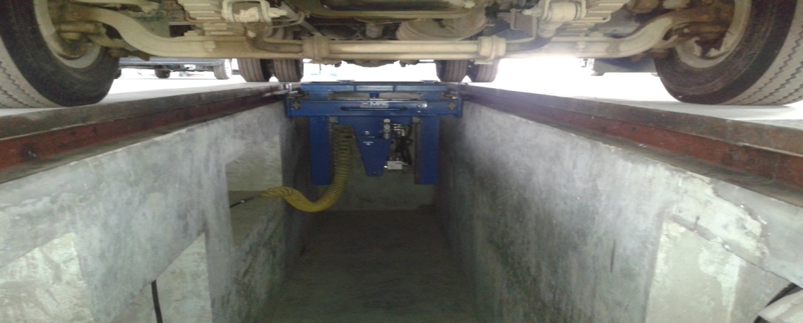
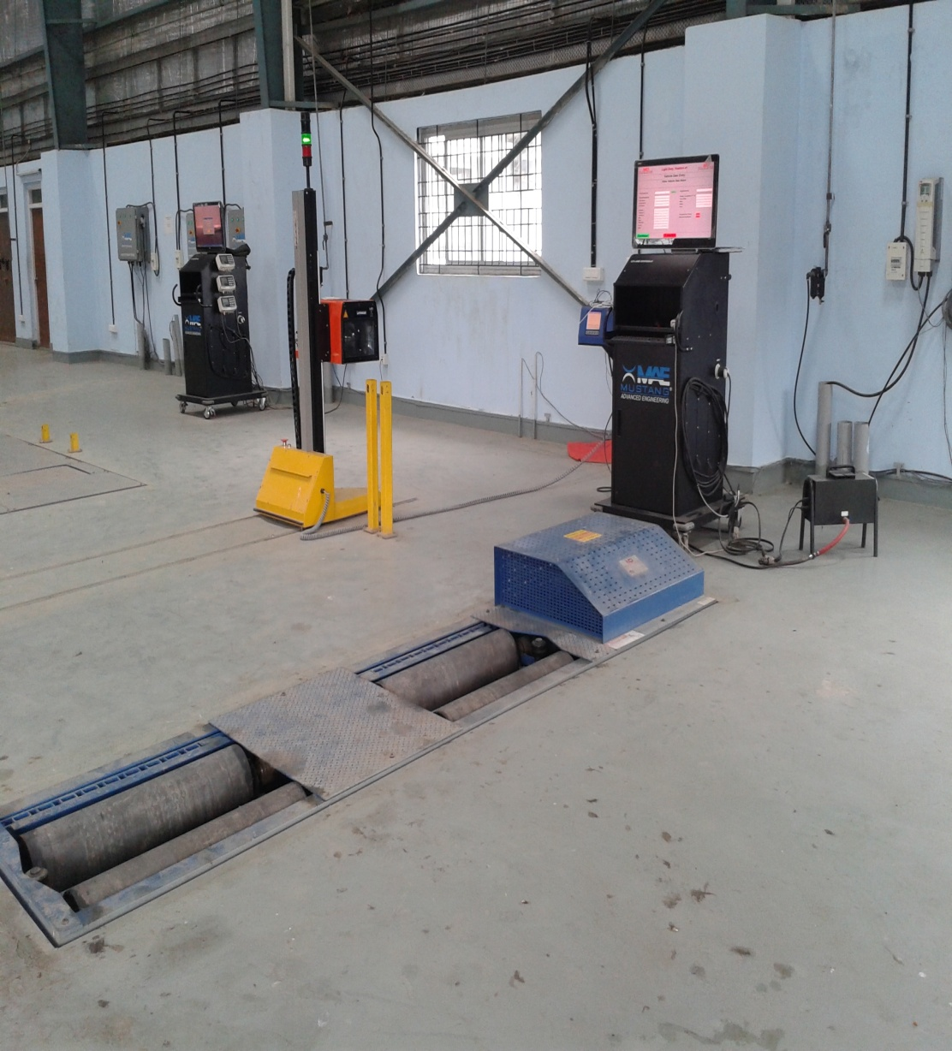
Initiative by NATRiP
Model I&M Centre at Silchar set up by NATRiP
one Heavy duty lane and one Light Duty Lane
Exhaust gas analyzer
Opacimeter
Roller Brake tester
Suspension tester
Head lamp tester
Side slip tester
Joint play tester
Visual inspection pit

Slide 11
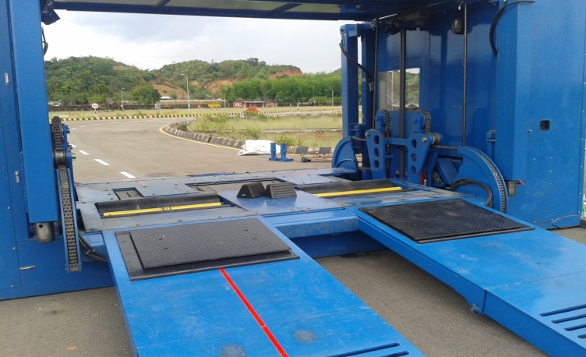
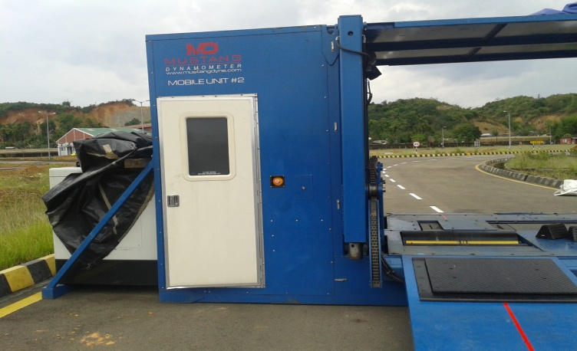
Mobile I&M Unit at Silchar
Universal Mobile lanes : 2 nos.
For road side testing at major identified crossings for enforcement purpose.
Inspection Equipment are laid out in a semi trailer.
Exhaust gas analyzer
Opacimeter
Roller Brake tester
Suspension tester
Head lamp tester
Side slip tester
Joint play tester

Slide 12
Need for the Improvement in Inspection System
To reduce CO/HC pollutants in emission
To reduce no. of accidents caused due to poor vehicle condition
To enhance the safety of passengers and pedestrians
Reduction in repair cost, Enhancement of Resale valve, Dependability, Driving pleasure.

Slide 13
Types of test at Inspection Centre
S.no | Type of Test | Equipment | Parameter
1 | Emission test for gasoline vehicle | Gas Analyzer | Emission
2 | Smoke Test for diesel vehicle | Opacimeter | Emission
3 | Brake efficiency test | Brake Tester | Safety
4 | Side Slip test | Side slip tester | Safety
5 | Speedometer test | Speedometer tester | Safety
6 | Joint play test | Joint play tester | Safety
7 | Suspension test | Suspension tester | Safety
8 | Head Lamp Test | Head Lamp tester | Safety
9 | Visual Inspection | Visual check | Safety

Slide 14
Existing Testing Fees : CMVR
Vehicle for fitness certificate
3- Wheelers
Heavy duty vehicle with GVW>3500 Kg
Rs 500
Light duty vehicles with GVW< 3500 Kg
Rs 300
Rs 200

Slide 15
Action Plan to improve I&M
Test Procedures and Pass fail limits for each test to be defined.
To revise the existing fee structure as per CMVR to attract more I&M centre on PPP/BOT mode.
Legislative amendment in the Para 62 of CMVR 1989- include parameters and pass limits in Test Table
Authorization of I&M Centre by state government under section 56 of MV act.
Roadside testing by Mobile lanes can complement a more comprehensive Motor Vehicle Inspection System.
Implementing the inspection centres through a PPP/BOT model involving Private fund Initiative(PFI)

Slide 16
Strengthening of Inspection
Test procedures need to differ for vehicles with different pollution control technologies.
Standards set should not be too stringent.
Proper coordination between the Central and state transport bodies.
Data management system that ensures that all test data are transmitted on a regular basis to a central database- linkage of I&C results and fitness with SARATHI database .
Enforcement by traffic authorities for better implementation of inspection centres.
Annual fitness regime for private vehicles and linkage with “End of Life Regulations”

Slide 17
Essential components of
an I& M programme
Awareness programmes
Human Resource development
Selection of proper equipment
Proper auditing of centres and garages
Enforcement system must be effective
Standards must not be too high resulting in excessive failures or too low resulting in being ineffective
Oversight by State/ Central Regulatory bodies

Slide 18
Awareness Program
To Conduct seminars on I&M regime.
- safer vehicles
- objective inspections
- fuel efficiency linkage
- possible linkage with insurance premiums
Campaign run on regular basis with focus on making the consumer aware of the following issues :
Advantages of Inspection and Maintenance Programme for Vehicle owners
Process followed in inspection of vehicles
Roles and duties of vehicle inspection centres and their locations.

Slide 19
Human Resource Development
Up gradation of skills of personnel to conduct the tests and capacity building through knowledge transfer
Training modules for the following categories of personnel also :
Attendants at the Inspection centers
RTOs and Vehicle Inspectors
Mechanics at the repairing centers
Refresher courses for the newer vehicle technologies

Slide 20
Proper Auditing
Auditing of the Vehicle Inspection centres is an important area to determine the effectiveness of the program in long-term.
Auditing of the nearby garages for the repair of the defects found during the inspection at Centre
Quarterly inspections to be done along with the surprise visit by the officials of transport department.
Re examination of the vehicle just checked to be done during the surprise audit.

Slide 21
Technical Improvement
Test procedures need to differ for vehicles with different pollution control technologies.
The pollutants of concern differ between diesel vehicles (PM, smoke and NOx) and gasoline vehicles (CO, HC and NOx).
Too stringent standards lead to failure of most vehicles , thus, placing a great strain on the service sector.
The test procedure shall subsequently shift to “loaded test” rather than the “idle test” for emission standards.

Slide 22
Roles and Responsibility for effective Inspection centres
Stakeholder | Responsibility
Central Government | Amendment in CMVR Rules Co ordinate I&M or I&C plan – National Regulator Issue guidelines and manuals
State Government | Incorporate relevant changes in State Rules Approve setting up of vehicle inspection Centres - State Regulator Audit performance of centres Random checking of vehicles on road
Traffic Police | On-Road enforcement
Private companies | Setting up Inspection Centres Grant Fitness Certificates
NGO’s & Media | Consumer Awareness Campaigns

Slide 23
THANK YOU

