Slide 1
Health Impact of Air Pollution India-California Air Pollution Mitigation Programme; October: 21-23, 2013
Initiative for Mitigating Air Pollution from The Transportation Sector

Slide 2
A Brief History of Air Pollution
Roman Philosopher Seneca; AD 61 “As soon as had gottten out of the heavy air of Rome, and from the stink of chimneys-”
Edward I in London banned Sea Coal
With the industrial revolution in late 18th century use of cleaner mined coal started
Meuse Valley (1930), Donora P.A (1948), and London Fog-1952
The sulfurous smoke with acidic character hung in the air longer than fluffy soot created by cheaper sea coal

Slide 3
Health Impact of London Fog
4000 excess death during the event itself
Hospital admissions increased dramatically,
Main victims were elderly and those with CV diseases,
Many sudden deaths were reported among workers commuting on bicycle or on foot with symptoms described as “choking”

Slide 4
Outdoor air pollution and emergency room visits at a hospital in Delhi.
The ambient levels of pollutants exceeded the national air quality standards on most of the days, over the two year period.
Further, emergency room visits for asthma, COAD and acute coronary events increased by 21.30%, 24.90% and 24.30% respectively on account of higher than acceptable levels of pollutants.
It is concluded that there is considerable burden of cardio respiratory diseases in Delhi due to high levels of ambient air pollution.
Indian J Chest Dis Allied Sci. 2002 Jan-Mar;44(1):13-9.

Slide 5
Cross Sectional Survey of Traffic Pollution in Delhi
Lacrimation and eye irritation was the commonest complaint,
Those with CV disease experienced significantly more episodes of breathlessness,
Those with asthma and Chronic Bronchitis had significantly more episodes of infection and breathing difficulty,
No difference was observed in urban and rural population with asthma prevalence,
Rural subjects did not show tolerance which the urban residents displayed
Pande JN, Chabra S K, Joshi TK: Harvard-MIT Workshop on ‘Urban Transport and Land use’, Pune 2001

Slide 6
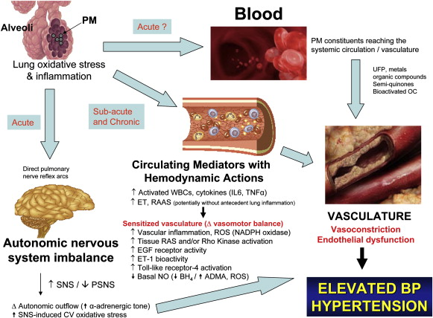
www.dna2life.com

Slide 7
Air Pollution is still a wildly underrated public health concern.
In next few decades, air pollution will kill far more people than both Malaria and access to clean drinking water,
And by 2050, (OECD) about 130 Indians out of every million are likely to die prematurely from exposure.
http://www.washingtonpost.com/blogs/wonkblog/post/whats-going-to-kill-us-in-2050-air-pollution--and-lots-of-it/2012/03/15/gIQAgiDgES_blog.html

Slide 8
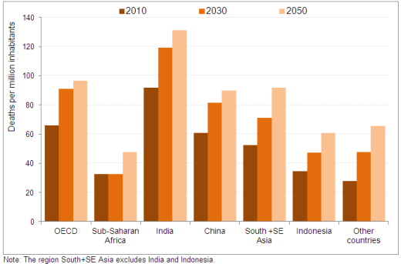
Rising Mortality due to Air Pollution

Slide 9
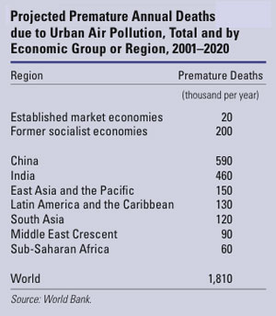

Slide 10
Health outcomes and air pollution
Increased mortality,
Increase in hospital admissions,
Decrement in lung function,
Increased air way resistance and obstruction,
Cardio-vascular disorders,
Adverse Reproductive outcomes,
Lung cancer

Slide 11
Special Concern
Little is known about the host traits making some more sensitive,
Susceptible sub populations- showing exaggerated response,
Existence of hyper-responsive individuals,
Children, elderly and those with pre-existing diseases,

Slide 12
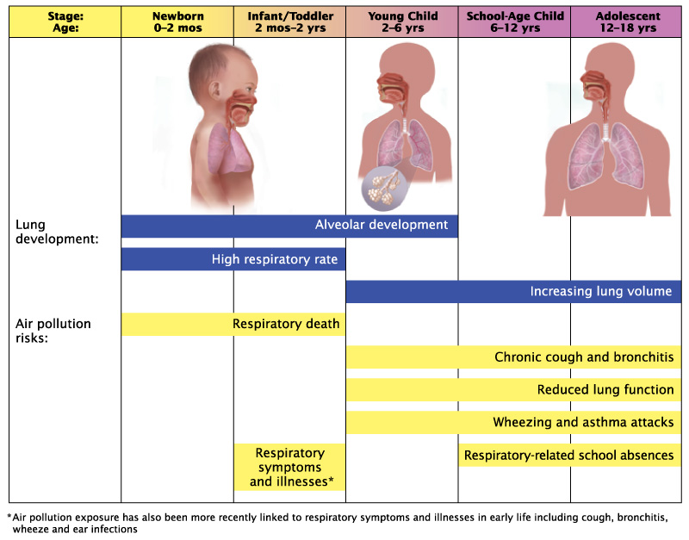
Impact During Development

Slide 13
In the recent past, air pollution has also been associated with diseases of the central nervous system (CNS), including stroke, Alzheimer’s disease, Parkinson’s disease, and neurodevelopmental disorders.
Various components of air pollution, such as nanosized particles, can easily translocate to the CNS where they can activate innate immune responses.
Journal of Toxicology, Volume 2012 (2012), Article ID 782462, 23 pages
http://dx.doi.org/10.1155/2012/782462

Slide 14
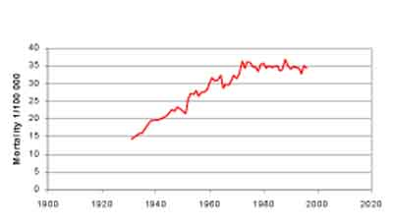
Growth of Cancer

Slide 15
Lung Cancer Trends in UK
Early 20th century Lung cancer was a rare cancer with one in 100,000 per male in U.K.
Today Lung cancer has the highest mortality rate for both males and females ,
For males the mortality rate for lung cancer (52 deaths per 100,000)

Slide 16
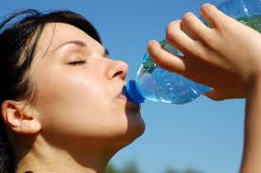
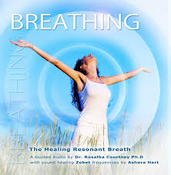

Slide 17
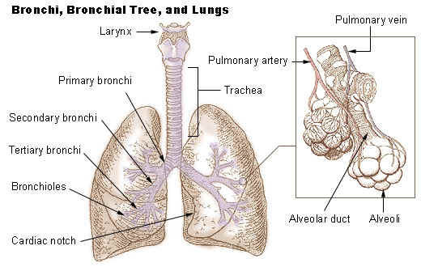

Slide 18
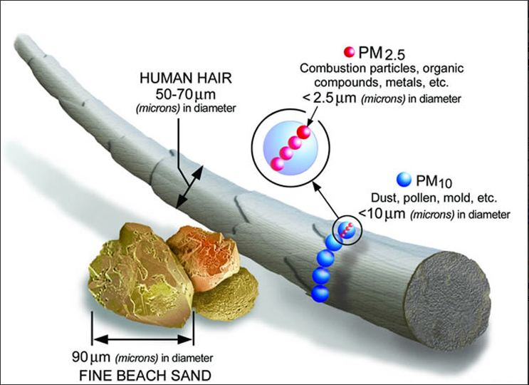

Slide 19
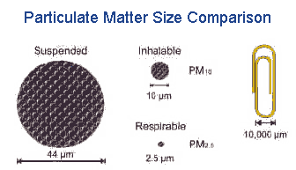

Slide 20
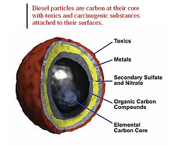
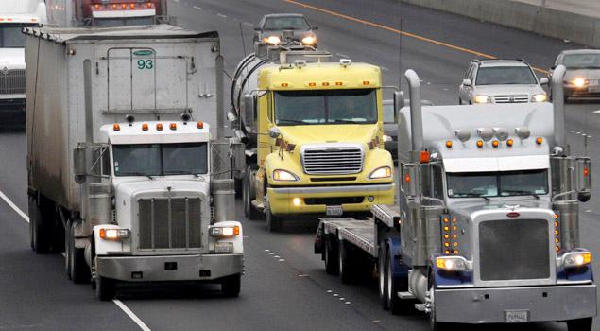

Slide 21
Particles and their Toxicity
As the PM gets smaller, it better represents anthropogenic sources of pollution,
The aerodynamic size determines the deposition in the air ways, and
The mass determines the health impact,
Increasing evidence of chemical constituents may be a reason for variability in response

Slide 22
A recently published study looking at the non accidental mortality in 72 urban communities across US:
Evidence of association between mortality and OCM, EC, silicon and sodium ion,
Some chemical constituents of PM _{2.5} were more associated with mortality than others.
Environ Health Perpect:DOI:10.1289/ehp.1206185

Slide 23
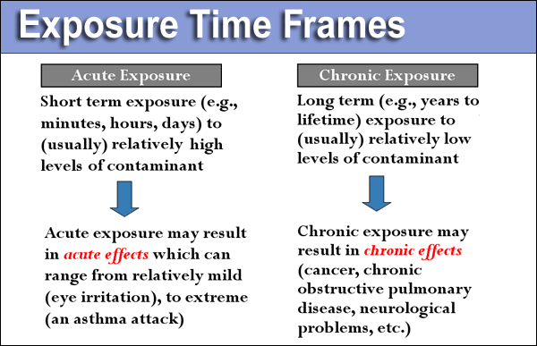

Slide 24
Exposure
Nature of the pollutants, e.g. diesel exhaust
Duration of Exposure,
Intensity of Exposure,
Time of Exposure, e.g., peak traffic hours,
Route of Exposure,
Season, e.g. winter season has inversion effect leading to trapping of air pollutants, and higher concentration of CO and Benzene

Slide 25
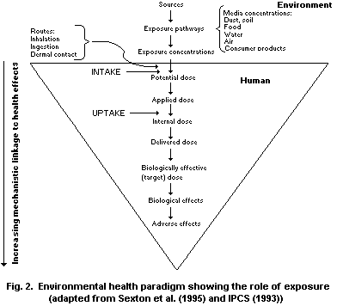

Slide 26
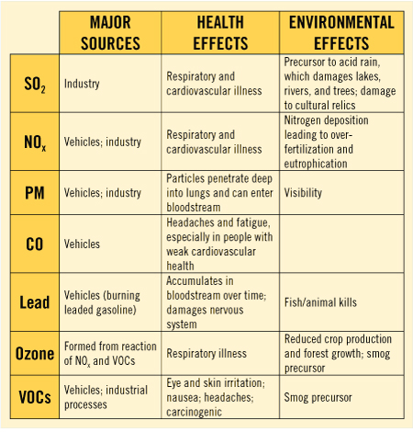
breckpollution.weebly.com

Slide 27
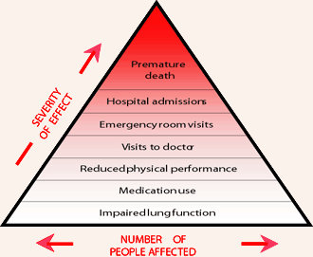
www.nrcan.gc.ca

Slide 28
Proposed Cut Points for Pollutants in Relation To National Ambient air Quality standards
Pollutants | Very Good | Acceptable | Moderately Polluted | Highly Polluted | Severly Polluted | Critical polluted
SO2 (24 Hr) | 0-40 | 41-80 | 81-120 | 121-180 | 181-270 | 270˃
NO2 (24 hr) | 0-41 | 41-81 | 81-121 | 121-240 | 240-480 | 480˃
Ozone (1Hr.) | 0-90 | 91-180 | 181-270 | 271-405 | 406-607 | 607˃
Ozone (8Hr.) | 0-50 | 51-100 | 101-150 | 151-225 | 226-338 | 338˃
CO (1Hr.) | 0-2000 | 2001-4000 | 4001-6000 | 6001-12000 | 12001-24000 | 24000˃
CO (8Hr.) | 0-1000 | 1000-2000 | 2000-3000 | 3000-6000 | 6000-12000 | 12000˃
PM10 (24 Hr) | 0-50 | 51-100 | 101-150 | 151-250 | 251-350 | 351-500˃
PM2.5 (24 Hr) | 0-25 | 26-60 | 61-90 | 91-150 | 151-240 | 241-360
All values in µg/m3

Slide 29
Proposed Advisory
Color | Description | Advisory | Recommendations
Dark green | Very good | Air quality is considered satisfactory, and air pollution poses little or no risk | No health implications
Light green | Acceptable | Air quality is acceptable; however, for some people there may be a moderate health concern who are unusually sensitive to air pollution. | Sensitive individuals should reduce outdoor exercise.
Yellow | Moderately polluted | Sensitive groups may experience health effects. The general public is not likely to be affected. Long term effects if exposed to such levels for years | Children, the elderly and individuals with breathing or heart problems should reduce long-time, high-intensity outdoor exercise.
Orange | Highly Polluted | General public may begin to experience health effects on heart and respiratory system; members of sensitive groups may experience more serious health effects. | Children, the elderly and individuals with breathing or heart problems should reduce long-time, high-intensity outdoor exercise. The general public should moderately reduce outdoor exercise.
Red | Severely Polluted | Patients with heart and lung diseases are more severely affected with weaker endurance in activities; healthy people are commonly affected. | Children, the elderly and people with breathing or heart problems should remain indoors and restrict activities. The general public should reduce outdoor exercise.
Purple | Critical | Healthy people have weaker endurance in activities and significant severe health warnings; certain diseases have early appearance | Children, the elderly and people with breathing or heart problems should remain indoors and avoid physical exersion. The general public should avoid outdoor exercise.

Slide 30
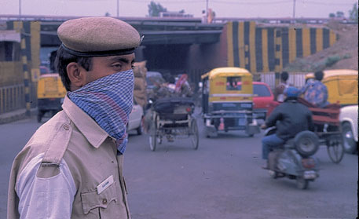

Slide 31
Conclusion
How to persuade, and educate policy makers,
More studies on health impact with exposure estimation,
Greater involvement of health sector,
Environmental health unit may be set up in health departments to sensitize and educate physicians,
Changing public perception towards air pollution.

Slide 32
Thanks
www.coeh.delhigovt.nic.in
T K Joshi
M.S. (Surgery), M.Sc., Occupational Medicine(London), Cer.OEM (UCSF), FFOM Royal College of Physicians, London)
kantjoshi@gmail.com

