Slide 1
India-California Air Pollution Mitigation Program (ICAMP)
Knowledge Action Plan
Governance
J. Seddon, A. Lloyd, B. Croes and S. Sundar

Slide 2
Policy

Slide 3
Avoid-Shift-Improve
Avoid:
Land-use planning – urban scale, SEZ, industrial policy.
Shift:
Investment in low-emission transport (e.g. address road-rail balance)
Investment in urban transport: greater accessibility and quality.
Support non-motorized transport
Improve:
Cleaner Fuels: One Nation, One Fuel, at BS IV (50ppm sulphur), followed shortly by Euro-V (10ppm sulphur) and BS-VI emission norms.
Vehicle Emissions Controls: essential for reducing PM, work best with 10ppm fuel.

Slide 4
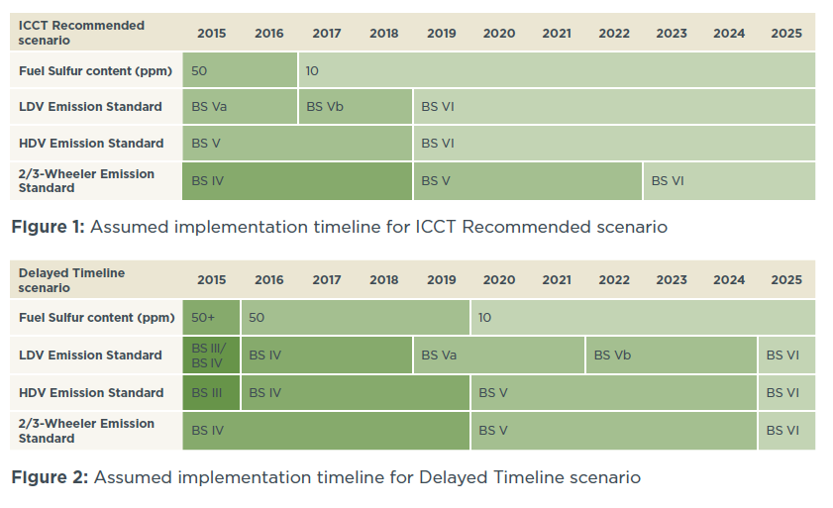
Gains from Accelerated Transition
Analysis: ICCT (2013)

Slide 5
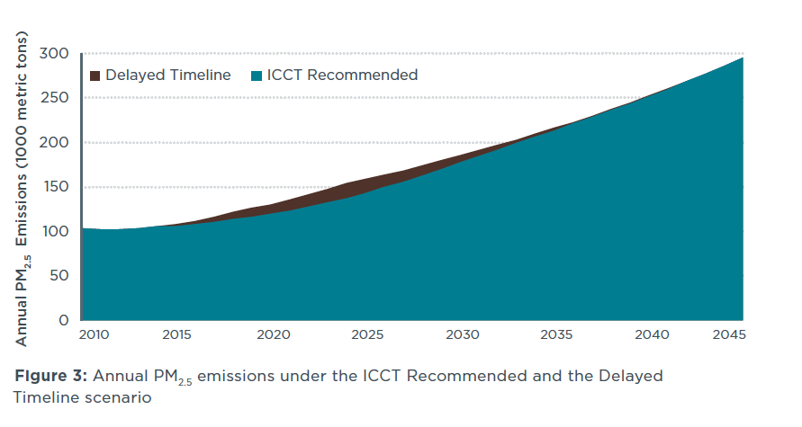
Gains from Accelerated Transition
Analysis: ICCT (2013)

Slide 6
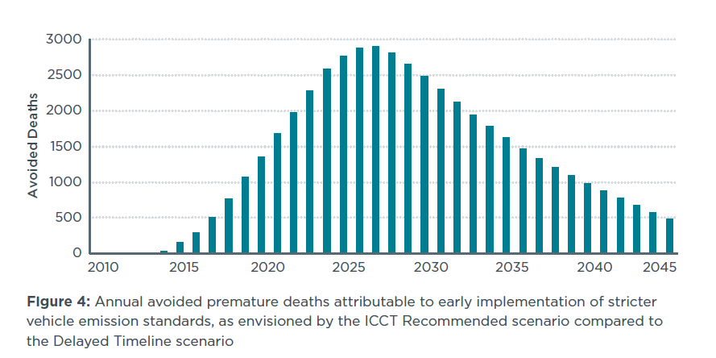
Gains from Accelerated Transition
Analysis: ICCT (2013)

Slide 7
Governance

Slide 8
Infrastructure for Policy
Information
Science and social priorities => understanding impacts of interventions.
Monitoring networks and emissions inventories => informing and tracking state and local efforts.
Public awareness of problem and solutions => allowing entrepreneurial politics.
Financing Fuel Upgrades
Capital Costs: raising ~$4-7bn
Covering recurring expenditures credibly.
Leveraging existing ULSF production capacity.

Slide 9
Enforcing vehicle controls
Enforcing vehicle emissions controls for new vehicles.
Type approval (TA) AND conformity of production (COP)
Tracking performance under real-world conditions & deterioration.
Consistent, credible regulation can drive innovation and new industries and even exports.
Registration & PUC regime.
Fleet modernisation:
Selective retrofitting for high-capital value vehicles.
Fiscal & other incentives to accelerate fleet turnover.

Slide 10
Thanks

