Slide 1
Governance: 4 Questions and Some Answers David G. Victor University of California, San Diego India-California Air Pollution Mitigation Program (ICAMP) 22 October 2013

Slide 2
Why do policies with huge benefit-cost ratios not get adopted?

Slide 3
1. What is the organization of political interest groups?

Slide 4
The public as an interest group
Highly decentralized and thus difficult to organize
Key roles for NGOs and the press

Slide 5
2. Who Owns the Enterprises that Must Change Behavior?

Slide 6
Industries that tend to be state-dominated
High value extraction (mining, oil & gas)
Visible public benefits (electricity, water and sewerage, trash collection, public transport)
Convenient locales for corruption (e.g., banking)
USA is highly unusual in extremely low level of state ownership

Slide 7
Figure 1 NOC Share of Booked Oil Reserves
7

Slide 8
Tensions in Ownership
Privately held firms
Organized around private interest, but..
Responsive to credible regulation and efficient
State-owned enterprises
Often organized for public interest, but…
Often managed incompetently.

Slide 9
3. When policy making fails, who acts?

Slide 10
Some backstops
California:
Federal Clean Air legislation
State CARB
Public petition process
Elections?
India:
Supreme Court
Elections?

Slide 11
4. Will Exogenous technological surprise “fix” governance failures?

Slide 12
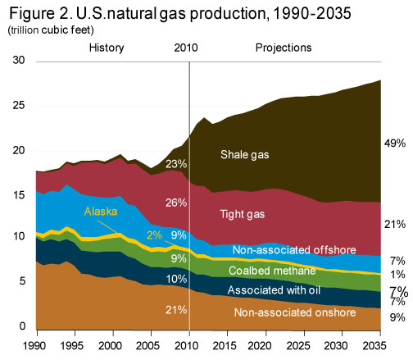

Slide 13
U.S. CO₂ emissions from Electricity

Slide 14
Oil and Natural Gas Prices: Three Markets
Sources: Heren and BP via BP Statistical Review of World Energy 2012

Slide 15
May 2012 Issue of Foreign Affairs…

