Slide 1


Overview of the California Air Resources Board
Bart Croes, Chief
Research Division
bcroes@arb.ca.gov
1-916-323-4519

Slide 2
We regulate emissions
Authorities
Motor Vehicles and Fuels
(under federal Clean Air Act exemption)
Air Toxics, Consumer Products, Greenhouse Gases
(under California law)
Oversight over Local Responsibilities
Stationary and Area Sources
Transportation Planning Targets
Rulemaking Process
Public Hearing of Governing Board
Public Workshops and Stakeholder Meetings
Public and Legislative Support
Notes:
We are responsible for coordinating the efforts of federal, state, and local authorities to meet ambient air quality standards, while minimizing the impacts on the economy.
We have the ability to set mobile source emission standards more stringent than the U.S. Environmental Protection Agency, except in the areas of shipping and construction. Other states, like many in the Northeast U.S., have taken advantage of their option to adopt our standards. We also set regulations for consumer products, paints, and solvents, and have oversight over other area and stationary sources – which are primarily a local responsibility. Californians support and want air pollution control - 65% put environmental protection over economic growth (although we think California has accomplished both), and this has created a supportive Legislature. California has 4,000 air quality professionals at the State and local levels. Since the beginning of California’s fiscal crisis, CARB’s funding dropped in half and we lost 15% of our staff. Now we are funded completely by fees on cars and industry, which is a more stable source than income tax revenue. We receive up to $166 M per year in incentive funds from fees on vehicle registration and new tire sales. This goes to diesel engine retrofits, car scrappage, and agricultural, port, and locomotive projects. The recently passed Proposition 1B goes to clean-up of California’s ports.
H&SC Part 2. Sec. 39003: The State Air Resources Board is the state agency charged with coordinating efforts to attain and maintain ambient air quality standards, to conduct research into the causes of and solution to air pollution, and to systematically attack the serious problem caused by motor vehicles, which is the major source of air pollution in many areas of the state.
AB32 and Governor’s Executive Orders directed CARB to address the role of, and impacts on, California regarding climate change:
Executive Order # S-03-05, 06/01/05, establishing greenhouse gas emission reduction targets.
Executive Order # S-06-06, 01/25/06, biofuels and bioenergy from renewable resources.
Executive Order # S-20-06, 10/18/06, on responsibilities and roles of state agencies in climate change.
Executive Order # S-01-07, 01/18/07, Low Carbon Fuel Standard.
Executive Order # S-13-08, 11/14/08, Directing State Agencies to Plan for Sea Level Rise and Climate Impacts.
In PPIC’s 13th annual survey on the environment (July 2013), 65 percent of Californians say the government should act right away to cut GHG emissions—up 9 points since 2012. Less than a third (30%) say the state should wait for the economy to improve. Among likely voters, 59 percent say the state should act now, up 13 points since last year
A majority of Californians say air pollution is a big problem (28%) or somewhat of a problem (34%) in the region where they live. Adults living in the Inland Empire (44%), Los Angeles (40%), and Central Valley (31%) are much more likely to say it is a big problem than those living in the San Francisco Bay Area (16%) and Orange/San Diego (14%). Latinos (41%) and blacks (40%) are much more likely to express this view than Asians (23%) and whites (20%). About half of Californians say air pollution in their region is a very serious (22%) or somewhat serious (30%) threat to their health or the health of their immediate families. Residents are divided when asked if they think air pollution is a more serious health threat in lower-income areas of their region (48% yes, 46% no).

Slide 3
Our national impact
Federal Clean Air Act Exemption
for California vehicle emission standards
To meet “compelling and extraordinary” conditions
Must meet or exceed federal regulations
Can be adopted by other states
(15 including Northeast States, Oregon, Washington)
California Firsts
Lead-free gasoline
Low-sulfur fuels
Three-way catalytic convertor
Stringent NO_{X} control
Notes:
We are responsible for coordinating the efforts of federal, state, and local authorities to meet ambient air quality standards, while minimizing the impacts on the economy.
We have the ability to set mobile source emission standards more stringent than the U.S. Environmental Protection Agency, except in the areas of shipping and construction. Other states, like many in the Northeast U.S., have taken advantage of their option to adopt our standards. We also set regulations for consumer products, paints, and solvents, and have oversight over other area and stationary sources – which are primarily a local responsibility. Californians support and want air pollution control - 65% put environmental protection over economic growth (although we think California has accomplished both), and this has created a supportive Legislature. California has 4,000 air quality professionals at the State and local levels. Since the beginning of California’s fiscal crisis, CARB’s funding dropped in half and we lost 15% of our staff. Now we are funded completely by fees on cars and industry, which is a more stable source than income tax revenue. We receive up to $166 M per year in incentive funds from fees on vehicle registration and new tire sales. This goes to diesel engine retrofits, car scrappage, and agricultural, port, and locomotive projects. The recently passed Proposition 1B goes to clean-up of California’s ports.
H&SC Part 2. Sec. 39003: The State Air Resources Board is the state agency charged with coordinating efforts to attain and maintain ambient air quality standards, to conduct research into the causes of and solution to air pollution, and to systematically attack the serious problem caused by motor vehicles, which is the major source of air pollution in many areas of the state.
AB32 and Governor’s Executive Orders directed CARB to address the role of, and impacts on, California regarding climate change:
Executive Order # S-03-05, 06/01/05, establishing greenhouse gas emission reduction targets.
Executive Order # S-06-06, 01/25/06, biofuels and bioenergy from renewable resources.
Executive Order # S-20-06, 10/18/06, on responsibilities and roles of state agencies in climate change.
Executive Order # S-01-07, 01/18/07, Low Carbon Fuel Standard.
Executive Order # S-13-08, 11/14/08, Directing State Agencies to Plan for Sea Level Rise and Climate Impacts.
In PPIC’s 13th annual survey on the environment (July 2013), 65 percent of Californians say the government should act right away to cut GHG emissions—up 9 points since 2012. Less than a third (30%) say the state should wait for the economy to improve. Among likely voters, 59 percent say the state should act now, up 13 points since last year
A majority of Californians say air pollution is a big problem (28%) or somewhat of a problem (34%) in the region where they live. Adults living in the Inland Empire (44%), Los Angeles (40%), and Central Valley (31%) are much more likely to say it is a big problem than those living in the San Francisco Bay Area (16%) and Orange/San Diego (14%). Latinos (41%) and blacks (40%) are much more likely to express this view than Asians (23%) and whites (20%). About half of Californians say air pollution in their region is a very serious (22%) or somewhat serious (30%) threat to their health or the health of their immediate families. Residents are divided when asked if they think air pollution is a more serious health threat in lower-income areas of their region (48% yes, 46% no).

Slide 4
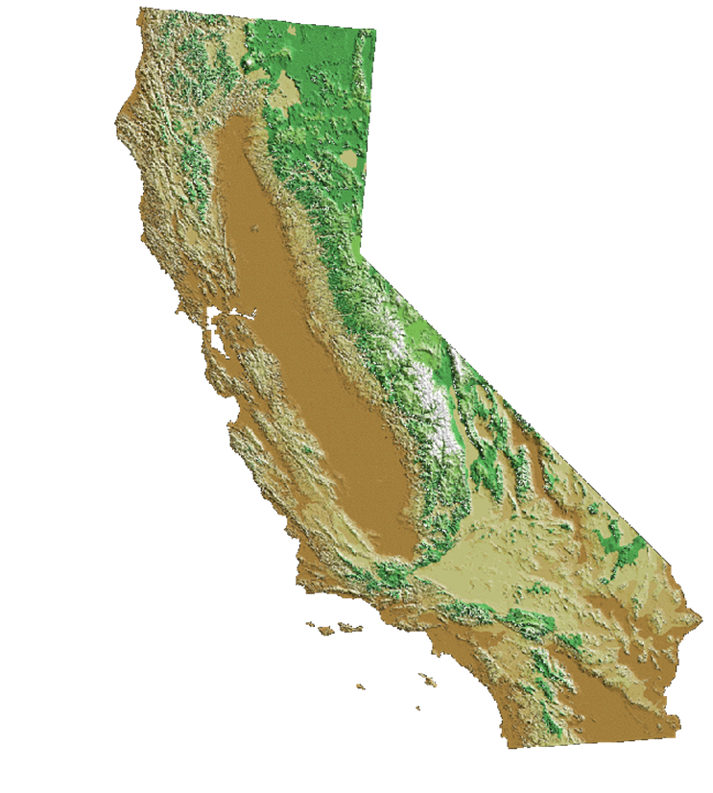
California’s air pollution problem
Unique geography and meteorology confine air pollutants
Over 90% of Californians breathe unhealthy air
38 M people
90 people per km²
24 M gasoline cars
1.3 M diesel vehicles
1.4 B km per day
18 M off-road engines
3 large container ports
Notes:
As you can see from these numbers, transportation plays a major role in California’s air quality problems and greenhouse gas emissions. Although we’ve attained air quality standards for lead, SO₂, sulfates, and NO₂, and cut peak ozone and particle levels by at least 75%, there are still many days of unacceptable ozone and PM across most of the State. In fact, over 90% of Californians continue to breathe unhealthy air at times.

Slide 5
Traffic on world’s first freeway (1950s)
Notes:
Photograph of the Pasadena Freeway, 1950s.
SOURCE: EPA

Slide 6
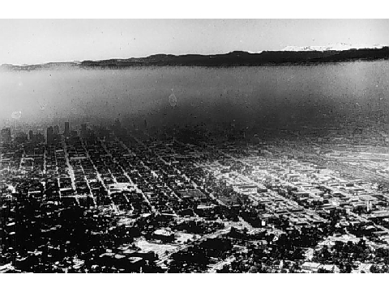

Air quality after World War II
Unhealthy levels of lead, NO₂, SO₂, CO, ozone, particulate matter, and air toxics
Poor visibility
Difficulty breathing
Extreme eye irritation
In Los Angeles
  Over 100 smog alerts annually
  Over 300 days with unhealthy air annually
Notes:
6
[CLICK TO START VIDEO]
In 1968, the air quality in California was filthy by today’s standards.
The most visible aspect of air pollution was the brownish haze of smog that cloaked California cities, particularly in the South Coast, throughout much of the year. The smog was thick with irritating substances like ozone, formaldehyde and peroxyacetyl nitrate or PAN, which made breathing difficult and made eyes water.
Most Californians breathed high levels of lead, nitrogen dioxide, sulfur dioxide, carbon monoxide, particulate matter and air toxics – pollutants that are harmful to human health.
Toxic emissions from industry, incinerators and consumer products poured into the air with few restrictions.
The air is much cleaner than when it was at it’s worst in the post-World War II period. In the mid-1960s, total oxidant (ozone plus NO₂) levels approached 800 ppb in Los Angeles. 24-hour-average PM10 concentrations exceeded 1800 μg/m³ in desert areas and 600 μg/m³ in Los Angeles.
In 1980, most Californians breathed unhealthy levels of lead, nitrogen dioxide, sulfur dioxide, carbon monoxide, ozone, particulate matter, and/or air toxics.
In the South Coast, there were over 100 days of Stage 1 health alerts when all residents were urged to restrict their activity outdoors. Peak ozone levels reached 49 parts per hundred million -- our air quality standard is 9 pphm.

Slide 7
Our policy instruments
Performance-based Emission Standards
Aftertreatment effective but turnover slow
Retrofits and repowering also beneficial
Fuel improvements provide immediate benefits
Incentive Funding
$150M per year for diesel engines
$1B for port trucks and equipment
Market-based Programs
Carbon emission trading for large sources
Enforcement and Monitoring Programs
Notes:
Our technology research and development demonstrates that reduced emissions are feasible, but the use of performance-based standards allows industry to come up with more cost-effective approaches.
Enforcement and monitoring programs are also an important key.

Slide 8
Science informs our policies
Legislative Requirements
Automotive Engineer and M.D. on Governing Board
Health-based ambient air quality standards
Extramural research program with external oversight
Peer review of scientific basis for regulations
Workforce
70% engineers and scientists
In-house research
Field/Modeling Studies
Los Angeles and San Joaquin Valley Air Basins
Notes:
Our Governing Board is required to have an MD and engineer as members, and our first and last two chairmen were respected atmospheric scientists. Except for the chairman, our Board only works once per month and relies on us for technical input. Most of our dedicated work force are engineers and scientists, and about 20% of our employees have Ph.D.’s and Master’s degrees. We also have several partnerships with universities (UCLA, UCD) on mobile source research. We conduct our own vehicle testing programs and fund extramural research at a level of $10 million in a good year, about $5 million currently, and take advantage of the strong academic community in California and other states. We also fund a technology demonstration and commercialization program. CARB has funded the development of state-of-the-art emission, air quality, and macroeconomic models. Our technology research demonstrates that reduced emissions are feasible, but the use of performance-based standards allows industry to come up with more cost-effective approaches. Our world-class enforcement and monitoring programs ensure that the emission standards are met. We have a requirement that the scientific underpinnings of all our regulations undergo scientific peer review. This is normally done by the University of California. Underlying this science-based approach is the willingness to move ahead in the face of some uncertainties.
The H&SC directs ARB’s major activities toward protecting public health and welfare from the adverse impacts of air pollution. Of particular note is the mandate to conduct research to promote a fuller understanding of the nature and causes of adverse air quality impacts and through a science-based approach to assure that subsequent emission controls will accomplish their objectives in a timely and cost-effective manner. We have a long tradition of air pollution research to ensure that environmental decision-makers have the best possible scientific information for making their decisions regarding the specific regulations and actions needed to protect public health and welfare from the effects of air pollution.

Slide 9
Performance-based regulations
Mobile Sources (>99% gasoline, 98% diesel reduction)
  Cleaner engines
  Aftertreatment
  Cleaner gasoline and diesel fuel
  Alternative fuels
Stationary Sources (80-90% reduction)
  Low-NO_{X} burners
  Selective catalytic reduction
  Cleaner fuels
Area Sources (>75% reduction)
  Vapor recovery
  Low-volatility solvents, paints, consumer products
Notes:
9
9
To reduce emissions, the Air Resources Board and local air districts adopted an aggressive strategy of air pollution controls. The Air Resources Board has led the way in pursuing controls which push the technological envelope and encourage innovation.
Key mobile source controls include cleaner engines; after treatment systems such as 3-way catalysts for automobiles and diesel particulate traps for large trucks; cleaner gasoline and diesel fuel; and alternative fuels.
Adopted mobile source emissions standards represent a reduction of over 99 percent for new gasoline vehicles, and 98 percent for new diesel vehicles, relative to their pre-control levels.
Industrial source control measures include low NO_{X} burners, selective catalytic reduction, and cleaner fuels such as compressed natural gas. These have resulted in an 80 to 90 percent reduction in oxides of nitrogen.
Other control measures on smaller sources include vapor recovery systems in cars and gas pumps, and low-VOC consumer products. Together these controls have achieved around a 75 percent reduction in reactive organic gases.

Slide 10
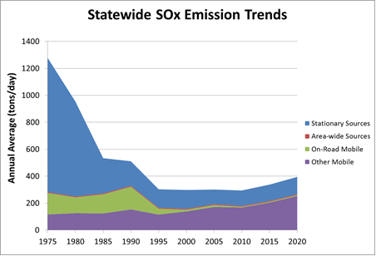
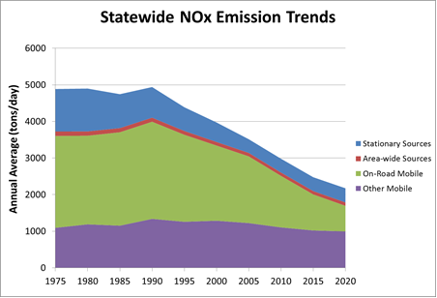
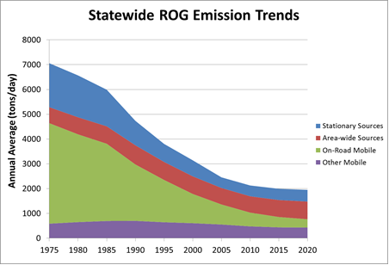
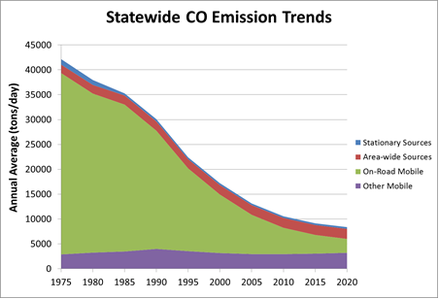
California emission trends

Slide 11
Air pollution reduced 75-90% despite growth
Carbon
Monoxide
Nitrogen
Dioxide
Sulfur
Dioxide
Population
Number
of Vehicles
Vehicle
Miles
Ozone – Los Angeles peak reduced 70%, hours of exposure by 90%
PM10 – annual-average levels reduced 75%
Air toxics – lead eliminated, cancer risk reduced 80% (since 1989)
Black carbon – reduced 90% (95% by 2020)
Notes:
11
Levels of other pollutants have diminished considerably as well. Since 1968, the peak level of carbon monoxide has shrunk by 87 percent, nitrogen dioxide by 83 percent, and sulfur dioxide by 90 percent.
Pollutant levels have fallen in spite of California’s rapid growth. In the same time period, California’s population almost doubled, the number of vehicles on the road increased by 170 percent, and the number of vehicle miles traveled almost tripled.
Today, lead, as a regional pollutant from gasoline, is a problem of the past. The entire state meets the health-based standards for lead, as well as nitrogen and sulfur dioxides. Fifty-six of the state’s fifty-eight counties meet the carbon monoxide standards. The South Coast has not seen a Stage 1 smog alert in over three years and ozone peaks are down over 50 percent. Annual average PM10 concentrations have declined over 20 percent and the statewide cancer risk from air toxics is down by 50 percent. Let’s look more closely at trends for several of the pollutants that still pose a challenge.

Slide 13
Notes:
NO2 concentrations have declined but the State AAQS has not been attained and concerns persist due to its participation in a variety of air quality concerns (O3, HNO3, NO3, PM2.5), its direct emission rate increasing with some control methods, and new near roadway standards.
With respect to O3, the rate of air quality improvement in the Central Valley has always been slow and recently the rate of improvement in the South Coast AB has slowed. The ozone weekend effect remains a concern has the peak concentrations in greater number of locations occur more frequently on weekends.
Direct emissions of PM2.5 have been relatively constant as increasing population and activities have counterbalanced controls. However, the bulk of the ambient PM2.5 concentrations are due to secondary formation in the atmosphere and the control of NOx, SOx, and VOC emissions has effectively reduced ambient concentrations. However, PM2.5 concentrations still exceed AAQs in much of CA.
13

Slide 14
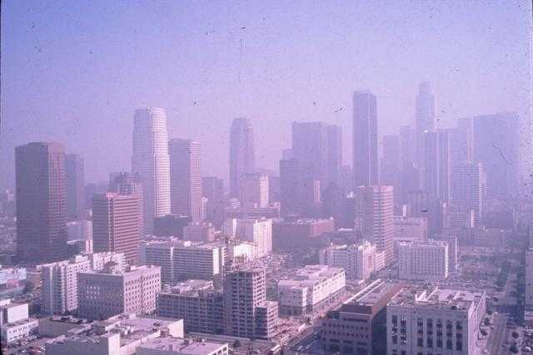
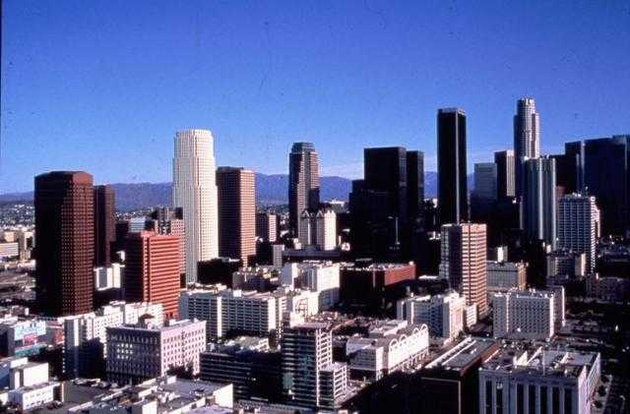
Costs of Control
0.5% GDP (US 1990-2020)
  Benefits of Control
  $10-95 in health benefits for each $1 of control (US 1970-1990)
  $30 in health benefits for each $1 of control (US 1990-2020)*
  Air pollution control industry – 32,000 jobs and $6.2B (CA 2001)
  Clean energy industry – 123,000 jobs and $27B (CA 2009)
U.S. EPA Reports to Congress on The Benefits and Costs of the Clean Air Act (www.epa.gov/air/sect812/index.html)
* 1990-2020 uncertainty analysis under development
Notes:
14
The improvements in California's air quality over the last four decades have come at a modest cost to society.
The total cost of air pollution controls is estimated to be 10 billion dollars, a small share of California’s 2 trillion dollar economy. At the same time, the air pollution control industry in California generates around 6.2 billion dollars and employs 32,000 people, so much of the money spent on control stays in the state. A recent study by EBI concluded that the air pollution control industry in California generated $6.2 billion in revenues and employed 32,000 people in 2001. The U.S. figures are $27 billion in revenues and employment of 178,000 people.
The benefits of controls include thousands fewer premature deaths and hospitalizations each year, and millions fewer lost school and work days.
The value of these benefits is approximately four dollars for every dollar spent on control. California’s air pollution control strategies are cost-effective.

Slide 15
Our current targets
Air Quality
By 2020, attain annual PM2.5 of 12 µg/m³
By 2023, attain 8-hour ozone of 80 ppb
By 2025, attain 24-hour PM2.5 of 35 µg/m³
By 2032, attain 8-hour ozone of 75 ppb
Diesel and Freight Transport
By 2020, diesel PM risk 85% below 2000 levels
Greenhouse Gases
By 2020, reduce to 1990 levels
By 2050, 80% below 1990 levels
Notes:
Since he first came into office in 2003, Governor Schwarzenegger has set ambitious goals for us. We expect to reduce diesel PM by 85% from 2000 and 2020, with similar goals for goods movement. Because of the tripling in freight traffic expected to occur over this time period, this equates to 95% control which we’re accomplishing through a combination of new engine standards by USEPA, cleaner fuels, retrofits, and hundreds of millions of dollars each year for incentive programs.
The Governor issued an Executive Order in 2005 calling for an 80% reduction in greenhouse gas emissions below 1990 levels by 2050. This is the most ambitious target in the world, and is needed to limit global warming to 2ºC (if adopted by the rest of the developed countries), and prevent catastrophic sea level rise. There is an initial step is to reduce California’s emission to 2000 levels by 2010. And by 2020, the goal is to reduce to 1990 emission levels, about 30% below our current trends.
Science tells us the time to act is now to avoid the more severe consequences of climate change.
Governor Schwarzenegger’s Executive Order, released in June 2005, calls for an 80% reduction in GHG emissions below 1990 levels by 2050. This is the most ambitious target in the world, and is needed to limit global warming to 2ºC (if adopted by the rest of the developed and developing countries).
An initial step is to reduce California’s emission to 2000 levels by 2010.
By 2020, the goal is to reduce to 1990 emission levels, about 30% below our current trends.

Slide 16
Summary
California had the worst air quality in the world
Emissions reduced 75-99% by
  Emission standards, primarily transportation sources
  Low-sulfur and other cleaner fuels
  Diesel retrofits
  Transportation planning
Air quality improved 75-90% despite growth
Control costs outweighed by large public health benefits, improved crop yields, and job creation

