Slide 1
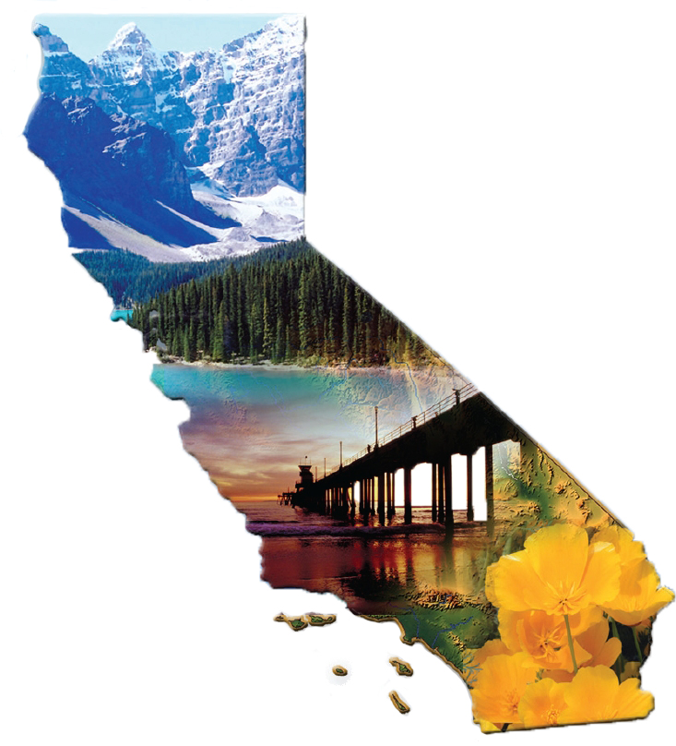
California Air Quality Governance
Bart Croes, Chief
Research Division
bcroes@arb.ca.gov
1-916-323-4519

Slide 2
Growth Stages of a Culture of Environmental Management
Recognizing the Need
Controls in the developed world came only after major environmental disasters
Donora, Pennsylvania
London
Los Angeles
Controls depend on social consensus
Notes:
The history of pollution control in the “developed” world is characterized by three steps:
Recognizing the need
Finding the political will, and
Developing institutions to facilitate compliance and provide enforcement.
Recognizing the need – polluters have always contended that cleaning up will threaten their livelihood. In the developed world we have always needed to show a compelling need for pollution controls, usually in the form of negative health effects, to gain public and political support for controls. In managed economies such as the old USSR, environmental protection was generally seen as a bourgeois luxury and a drag on production. So it is important that the society realize that the costs of pollution are borne by the society at large, through loss of worker productivity, increased health costs, material damage, and degradation of resources.

Slide 3
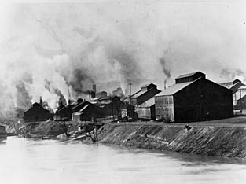
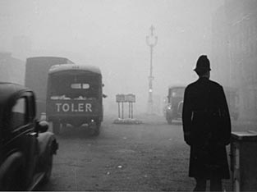
Recognizing the Need
Donora, Pennsylvania
October 26-31, 1948
20 people asphyxiated
>7,000 sickened by air pollution trapped in the Monongahela Valley
London
1661 - John Evelyn: "Hellish and dismall cloud of sea-coale"
1800s - Smokey fog known as a "London particular”
1899 - London Smoke Abatement Society founded.
December 1952 - Dense smoke-fog shrouds London for four days, Ministry of Health reports 4,075 more people died than expected under “normal” conditions
Notes:
In the “western” world air pollution has been a recognized problem for centuries. In the 1600s London was described as having a "Hellish and dismall cloud of sea-coale." London’s air continued to get worse due to increases in population and increased use of coal. Finally in December 1952 dense smoke-filled fog shrouds London for four days. Cattle die at a livestock show. The smokey-fog could be seen indoors, interferring with patrons views in movie theaters. A subsequent Ministry of Health report estimated 4,075 more people died than would have been expected to under normal conditions.
The United States had its own wake-up call in Donora, PA. In October of 1948, a strong inversion trapped pollutants in the valley of the Monongahela River. 20 people asphyxiated and over 7,000 were sickened by the air pollution

Slide 4
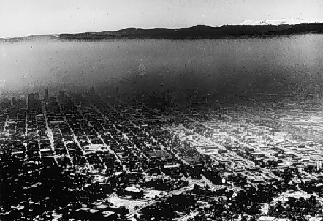
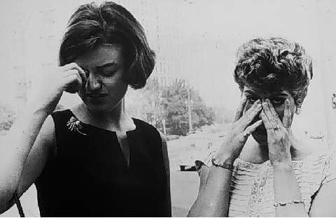
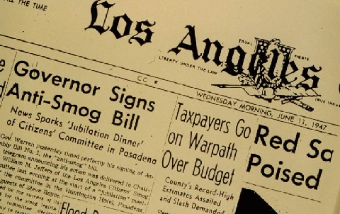
Los Angeles in 1940s
County air pollution
control districts established
2.8 million vehicles

Slide 5
Growth Stages of a Culture of Environmental Management
Recognizing the Need
Finding the Will
Government, business community and public must share commitment to be effective
Notes:
Finding the political will. In the first half of the last century, pollution was not unrecognized, but the polluting industries had great political clout and the public at large was largely indifferent. It took calamities such as those in Donora, Pa. and London to galvanize public support.
In China, the economic reforms of the 1980s led economists to study what factors were slowing growth, and they found that pollution-caused illness and absenteeism were a drag on industrial production and that resource damage due to ozone, acid rain, and water pollution, were reducing the value of forest and farm products. It was then clear to China’s leaders that environmental controls were necessary. Unfortunately, this pathway – economists and technocrats deciding on policy – leads to serious problems in implementation. This is true whether in a capitalist or socialist economy – public consensus and broad commitment to environmental goals are essential if national policy is to be successfully implemented.

Slide 6
History of Air Pollution Law
1947 – California Air Pollution Control Act signed, established 35 local air pollution control districts
1959 – California begins developing ambient air standards and controls for motor vehicles
1961 – California establishes automotive emission control technology requirements
1963 – First Federal Clean Air Act
1967 – California Air Resources Board established to coordinate all state’s air pollution activities
Notes:
This is fairly typical of the evolution of environmental law. First there is a problem or catastrophe, then California asses law then the federal government passes a similar law.

Slide 7
U.S. Clean Air Acts
1963: air quality criteria
1965: emission standards for motor vehicles
1967: air quality standards
1967: federal pre-emption of motor vehicles standards, EXCEPT California
1970: Clean Air Act
enforceable air quality standards
State Implementation Plans (SIPs)
motor vehicle emission standards
air toxics program
citizen right to sue

Slide 8
Growth Stages of a Culture of Environmental Management
Recognizing the Need
Finding the Will
Developing Institutions to Facilitate and Enforce
Infrastructure must make compliance practical and evasion painful
Planning tools must tailor the program to local situations
Ongoing legal, public education and research efforts necessary to sustain a justifiable control program
Notes:
Developing institutions to facilitate compliance and provide enforcement. This is the realm of “technology transfer” where California and the rest of the developed world’s pollution control community can assist developing economies.

Slide 9
Developing Institutions to Facilitate and Enforce Air Pollution Control
Control technologies are the least of the problem
Technical Assistance
Permitting and compliance tracking
Certifying complying products (new vehicles, diesel filters, aftermarket parts, consumer products)
Planning Assistance
Tools to track changing emissions, population, land use and economic activity
Technical and economic analysis skills
Appropriate technologies
Cost effectiveness
Technology penetration
Benefits estimation
Notes:
Technical help should include all aspects of a control program, from the hardwired tasks such as design and implementation of motoring networks to the “soft” technologies such as permitting and compliance tracking.
Planning assistance is needed to develop tools to track changing factors controlling emissions, such as population, land use, and economic activity. Economic analysis skills are needed to gauge appropriate rates of technology penetration. New technologies must be implemented within the structure of the local economy –after all, if a cleaner car is prohibitively expensive to the average buyer, fleet penetration will be so slow that the air quality benefits will never be realized.

Slide 10
Developing Institutions to Facilitate and Enforce Air Pollution Control
Maintain Authorities
Defend against legal challenges
Legislative expertise
Public education
Research Program
Health and economic impacts of pollution
Benefits of controls
Technology feasibility demonstrations
Notes:
We can assist in establishing health research programs to track the impacts of air pollution on public health, both to measure the economic impacts of pollution and to track the benefits of improved air quality – essential to guide controls where they are most needed and to energize public and political support for the programs.
Finally, programs need to be explained to the public and political leaders through public education and publication of regular progress reports, research findings, and air quality statistics.

Slide 11
Regulatory structure
U.S. EPA
Sets National Ambient Air Quality Standards
Reviews, approves, enforces State Implementation Plans (SIPs)
California Air Resources Board
Sets State Ambient Air Quality Standards
Regulates mobile sources (except ships, aircraft, trains)
Sets consumer products emission limits
Establishes air toxics risk reduction
Regulates greenhouse gases
Sets regional transportation planning targets
Bureau of Automotive Repair
Runs passenger car inspection and maintenance program
Air quality management districts
Control stationary point sources
Control stationary area sources

Slide 12
California Air Resources Board
The Board
11 part-time members
Full-time chair
Service “at the pleasure of the Governor”
Appointment by Governor, approval by Senate
CARB
Staff of 1100, mostly engineers but also health researchers and economists
Annual budget of about $300 million
Headquarters in Sacramento (California capitol)
Motor vehicle programs in Los Angeles

Slide 13
Extra slides

Slide 14
California Clean Air Act
First laws were enacted in 1947
With exceptions, all who discharge air pollutants must first get a permit
All vehicles must adhere to California emission control requirements
Vehicular fuel must meet state requirements.
ARB has specific research mandates such as identifying toxic air contaminates and toxic hot spots
Notes:
California Clean Air Act of 1988
Statute: Health and Safety Code Section 39607-39612, 40001, 40400, 40510, 40522.5, 40716-40717.5, 40910-40930, 41503-40503.5, 41600, 41712, 42301, 42301.1, 42302.1, 42311-42311.2, 42352, 42402.5, 43000.5, 43013, 43018, 43019
The lack of post-1987 federal requirements and Congressional inaction to re-authorize the Federal Clean Air Act (FCAA) served as the impetus for the California legislature to address the state’s continuing air quality problems. As a result, the California Clean Air Act (CCAA), for the first time spelled out in state statute California’s air quality goals, planning mechanisms, certain regulatory strategies, and standards of progress. State ambient Air Quality Standards (State standards) were to be attained by all areas of California by the earliest practicable date. No deadlines were set to attain the standards; instead, it is performance based with requirements reflecting on the severity of a region’s air quality problems. To measure progress and to assure the control strategy is being implemented as planned, the CCAA requires: annual regulatory schedules; annual progress reports on adoption and implementation of rules; a triennial assessment of air quality program effectiveness; a triennial revision of the plan; and comprehensive plan updates under certain circumstances. In 1990, amendments to the FCCA were enacted by Congress. Since then, the CCAA was amended (1992, 1996) along with administrative actions to aline the implementation of the two Acts. In most cases, air districts subject to both the CCAA and FCAA requirements have developed a single plan, which addresses both requirements in order to eliminate duplicative staff work and public process.

Slide 15
Federal Clean Air Act (1963)
Regulates air emissions from area, stationary, and mobile sources
Sets National Ambient Air Quality Standards (NAAQS) to protect public health and the environment
Directs the states to develop state implementation plans (SIPs)
Notes:
So lets jump in a specific area. We are going to review environmental laws on a media by media basis starting with air.
Clean Air Act
Statute: 42 U.S.C. 7401 et seq. (1970)
Regulation: 40 CFR Parts 50-80
The Clean Air Act is the comprehensive Federal law that regulates air emissions from area, stationary, and mobile sources. This law authorizes the U.S. Environmental Protection Agency to establish National Ambient Air Quality Standards (NAAQS) to protect public health and the environment. The goal of the Act was to set and achieve NAAQS in every state by 1975. The setting of maximum pollutant standards was coupled with directing the states to develop state implementation plans (SIP's) applicable to appropriate industrial sources in the state. The Act was amended in 1977 primarily to set new goals (dates) for achieving attainment of NAAQS since many areas of the country had failed to meet the deadlines. The 1990 amendments to the Clean Air Act in large part were intended to meet undressed or insufficiently addressed problems such as acid rain, ground-level ozone, stratospheric ozone depletion, and air toxics.
The original Federal Clean Air Act and its subsequent amendments were based on legislation from California.

Slide 16
Summary
California per capita emissions must be lowest in U.S.
Current air pollution health risk
PM2.5 >> ozone > air toxics
Emissions control focus
1950s and 1960s: smoke
1970s and 1980s: lead, SO_{X}, hydrocarbons and NO_{X}
1990s to present: diesel PM and NO_{X}, air toxics, GHG
Air quality improved 75-90% despite growth
On-road controls have greatest benefits
Benefits much greater than control costs

