Slide 1


Nature of Air Pollution in California
Bart Croes, Chief
Research Division
bcroes@arb.ca.gov
1-916-323-4519

Slide 2
Unique, Adverse Meteorology
Lowest Per Capita Emission Targets
Onshore circulation pattern, high temperatures, stagnant air masses, and mountain ranges that trap pollutants lead to ...
Population Carrying Capacity (VOC+NO_{X})
(million) (tpd) (lb/person/yr)
Los Angeles 16.9 840 36
San Joaquin Valley 4.1 630 69
Houston 5.5 1360 181
Notes:
Because of California’s proximity to the Pacific Ocean and the mountains that surround our air basins, our meteorology is particularly conductive to generating poor air quality. Carrying capacity is an estimate of the maximum emissions a region can have and still attain the national ozone standard. As you can see from the column to the far right, the average resident in Los Angeles can only emit 1/5th the VOC and NO_{X} as someone in Houston, which has similar ozone peaks.

Slide 3
Air pollution causes premature death
California estimates
Pollutant | Annual Deaths*
PM2.5 | 7,300 to 11,000
Ozone | 300 to 1000
Toxic Air Contaminants | <400
*2006-2008 for PM2.5; 2005 for ozone and TAC
Note: 233,00 total deaths in 2010
Notes:
Using HEI and USEPA-sponsored research, we estimated a range for the number of premature deaths associated with PM and ozone, as shown in the far right column. Because of its much higher concentration-response relationship, long-term exposure to PM2.5 appears to be responsible for up to 90% of these deaths, and has become the focus of our control efforts.
Factor of two uncertainty
==============
And these are not people dying a few days earlier – the USEPA has calculated an average of 14 lost life years.
Ozone numbers are mortality associated with difference between 2004-2006 ambient levels and state standard of 70 ppb. These estimates are unpublished, but they’re the latest we have.
we roll back to 70 ppb for ozone and 5.8 µg/m3 or PM2.5. The CR functions are central estimates.
You list a TAC number of 400. I am sending you a chart with TAC trends that include DPM and other TACS. When you present the data, you may want to consider that the DPM is a subset of PM2.5 so they cannot be added together.
I would take out the sentence on EPA’s estimate of 14 years of life lost. I am not sure I believe it.

Slide 4
Cancer risks from airborne toxics*
(90% of risk from traffic pollutants)
Diesel PM
1,3-Butadiene
Hexavalent Chromium
Carbon Tetrachloride
Benzene
para-Dichlorobenzene
Formaldehyde
Perchloroethylene
Acetaldehyde
All Others
* Estimated 400 cases/year in 2005 (dioxins not included).
Notes:
This slide shows the relative contribution of known air toxics to overall cancer risk.
The diesel PM estimate is based on distributions of time-activity patterns to estimate population-weighted personal exposure, while the other pollutants are based strictly on measured outdoor levels. If we included indoor sources, formaldehyde and perchloroethylene would increase relative to the others.
We measure another 30 air toxics, but the risk levels are much lower. Dioxins are not included, but appear to be similar to 1,3-butadiene and benzene in terms of cancer cases.
90% of the risk appears to be due to mobile sources, and we have focused our control program this decade on diesel PM.
Of the known cancer-causing air pollutants in California, the mobile source-related air toxics of diesel PM, 1,3-butadiene and benzene account for 90% of the total risk.
NOTES:
California has a network of 20 monitoring stations for air toxics that represent average population exposures. We don’t have a routine diesel PM measurement, but rather infer from a peer-reviewed methodology based on a strong correlation with total NOx measurements.

Slide 5
Major California control programs
Smoke controls began in 1945
  Backyard burning, open burning at garbage dumps, industrial smoke
Hydrocarbon controls begin in 1956
  Gasoline storage tanks and trucks
1970s
  Industrial SO_{X} controls
  Lead and RVP limits for gasoline
  Three-way catalysts for passenger cars
1980s
  On-board diagnostics
  Low-sulfur gasoline and diesel
1990s
  Air toxics
2000s and beyond
  Light trucks meet same standards as cars
  Diesel PM and NO_{X}
  Greenhouse gases

Slide 6
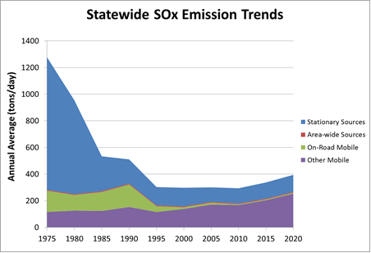
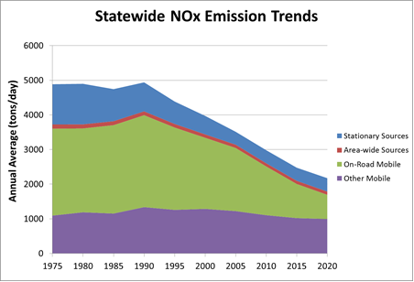
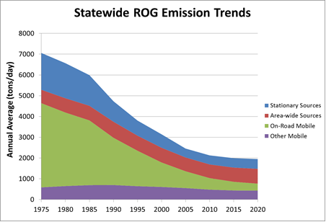
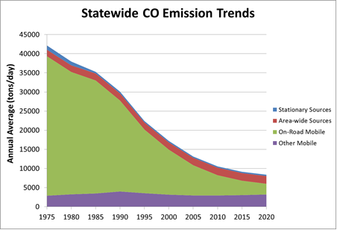
California emission trends

Slide 7
Ozone trends in Los Angeles
Peak 1 Hr Ozone
State Standard Exceedances
Stage 1 Alerts (0.20 ppm)
Stage 2 Alerts (0.35 ppm)
Notes:
7
This graph shows the trend in peak ozone concentration for the South Coast, which historically has had California’s worst smog.
In the late 1960’s peak ozone concentrations in the range of 0.50 to 0.60 parts per million were common. Today we’re used to thinking of smog as a summertime phenomenon, but in those days, ozone reached unhealthy levels almost every day of the year. Stage 1 alerts, where the ozone concentration exceeded 0.2 parts per million, were declared on over half of all days.
The ozone levels recorded in Los Angeles in the 1960’s are the highest levels ever recorded, anywhere in the world. Today, the peak concentrations are roughly a quarter of their 1960’s levels.

Slide 8
Ozone trends in California
San Diego
San Joaquin Valley
San Francisco Bay Area
California Standard
Notes:
8
Other areas of the state have also seen a dramatic reduction in ozone levels. This chart shows peak ozone levels for the San Francisco Bay Area, San Diego, and the San Joaquin Valley. Ozone levels have decreased in all the state’s major urban areas.

Slide 9
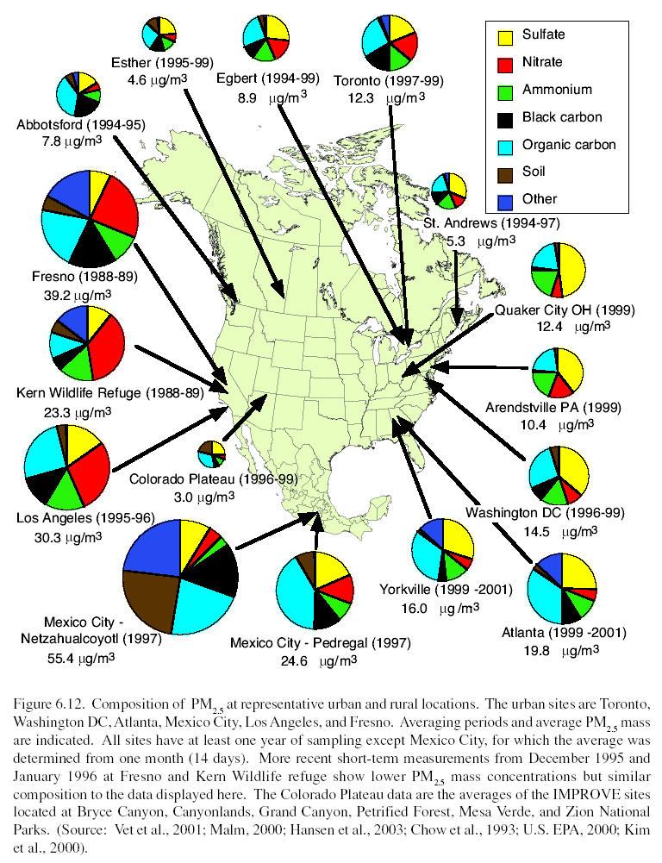
Nitrates and organics dominate California PM2.5
(because of low sulfur emissions)
Notes:
As an example of NARSTO’s products, this synthesis of PM2.5 speciation data collected in the three countries demonstrates that the causes, and consequently the path to PM2.5 attainment are very different. The East Coast of the U.S. and Eastern Canada have very high sulfate (in yellow) due to coal burning. In California, we have removed sulfur from diesel fuel and gasoline, and we use natural gas for electrical generation, so our high PM2.5 areas are dominated by ammonium nitrate (in red). Carbonaceous species (black and teal), derived primarily from mobile sources are high throughout. In Mexico City, many sources contribute to it’s high PM2.5 levels.

Slide 10
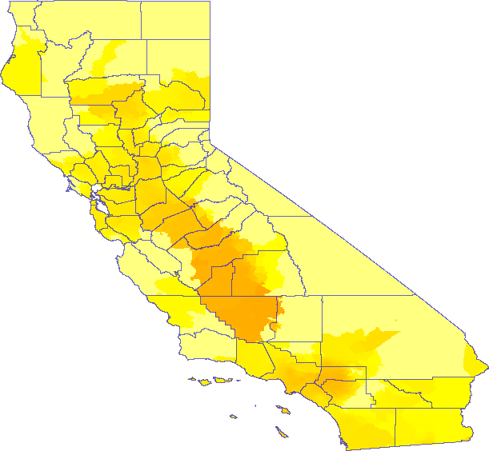
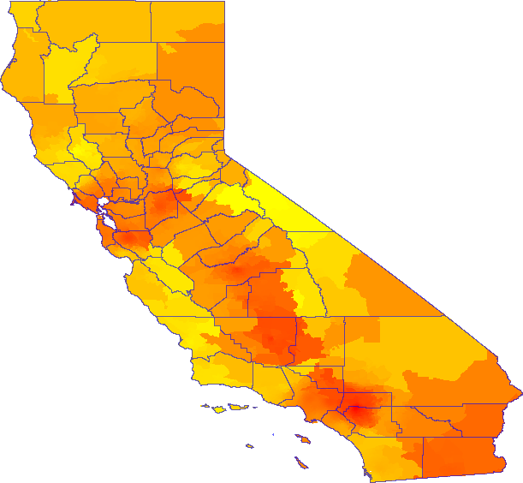
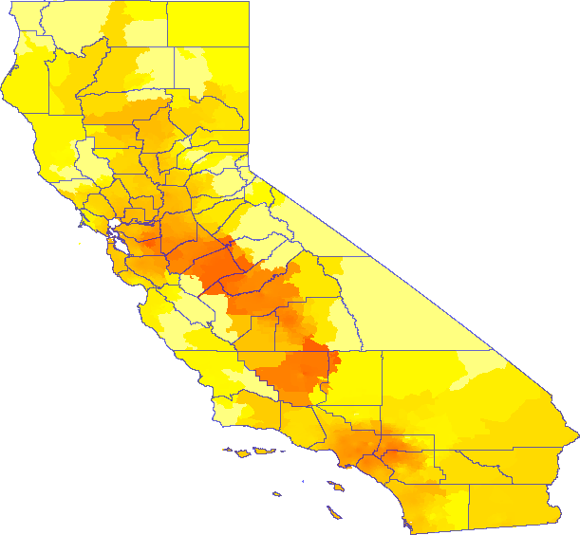
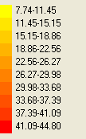
PM2.5 exposures across California
1987
1999
2006
Notes:
This slide shows maps of PM2.5 concentration in 1987, 1999, and 2006. As shown in the key on the right, the darker the color, the higher the PM2.5 concentration.
Throughout California, we see significant reductions in PM2.5 exposures, especially in major air basins. In fact, the rates of PM2.5 reductions in California are among the most striking in the nation.

Slide 11
As PM2.5 declined, has life expectancy increased?
Overall change in U.S. (1980 to 2000)
  2.7 years improvement (health care, lifestyle, diet)
For every decrease of 10 µg/m³ PM2.5
  0.61 (± 0.20) years improvement
Reductions in PM2.5 accounted for 15% of U.S. life expectancy improvement
Pope et al. (2009) Fine particulate air pollution and life expectancy in the United States, New England Journal of Medicine, 360: 376-386.
Notes:
From 1980 to 2000 the general life expectancy in the United States increased by 2.7 years. This was mostly due to improved healthcare, lifestyles, and diet.
The results of the study presented today found a decrease in fine particulate matter of 10 micrograms per cubic meter was associated with an increase in life expectancy of 0.61 years or 7 months.
The association between reductions in fine particulates and life expectancy remained significant even after the authors made statistical adjustments for changes in socioeconomic conditions, demographics, and smoking patterns.
During the last two decades life expectancy has increased by 2.7 years. The researchers calculate that more than 15% of that improved life expectancy was associated with reduced fine PM.

Slide 12
In-vehicle exposures can dominate
In-Vehicle = Centerline > Roadside >> Ambient
Examples of in-vehicle-to-ambient ratios
  Benzene: 4-8 times higher, 15-20% of total exposure (LA)¹
  Diesel: 5-15 times higher, 30 -55% of total exposure (CA)²
  1,3-Butadiene: 50 to 100 times higher³
Location of emissions matter
  Exhaust high and at front of leading vehicle produces 5 times less in-vehicle impacts than exhaust low and at rear of vehicle
¹Rodes, et al. (1998) ²Fruin, et al. (2004) ³Duffy and Nelson (1997)
Notes:
Vehicles are not built to be air tight. The pressure changes around a moving vehicle can lead to dozens of air exchanges per hour, even if windows are closed. By comparison, a home typically has only one or two air exchanges per hour.
Another major aspect of in-vehicle exposures is that roadway concentrations of vehicle-related pollutants are typically several times higher than ambient concentrations. Furthermore, concentrations at the centerline of the road are highest, and can be several times higher again than concentrations on the side of the road. It is these centerline concentrations that reflect the air getting into your vehicle.
For example, using results from an ARB-sponsored study in Sacramento and Los Angeles in late 1997, aromatic compounds like benzene were 4 to 8 times higher inside vehicles than in ambient urban air.
For vehicle-related pollutants that have no evaporative component, the in-vehicle-to-ambient ratio is often higher. For example, diesel PM concentrations inside vehicles are 5 to 15 times higher than ambient, based on black carbon measurements.
Compounds with short atmospheric lifetimes, such as 1,3 butadiene, appear to have the highest concentration ratios.
Finally, the locations where emissions occur does matter. On-road emissions produce greater exposures than off-road, and low exhaust locations have higher impacts than high exhaust. Therefore, when you consider the contributions of in-vehicle exposures to total exposure, reductions in on-road diesel emissions are by far the most effective way to reduce peoples exposures to vehicle-related pollutants.
These high in-vehicle concentrations contribute a lot to a person’s overall exposure. On average, Californians spend about 90 minutes per day in vehicles. This is about 6% of our 24-hour day.
- For a compound with multiple sources like benzene, the in-vehicle fraction of total exposure is 15 to 20%.
- For pollutants like diesel PM the fraction is 30 to 55%.
- Finally, the fraction for shorter-lived pollutants such as 1,3-butadiene or ultrafine particles may be even higher.

Slide 13
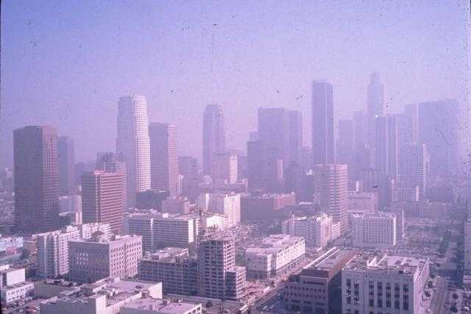
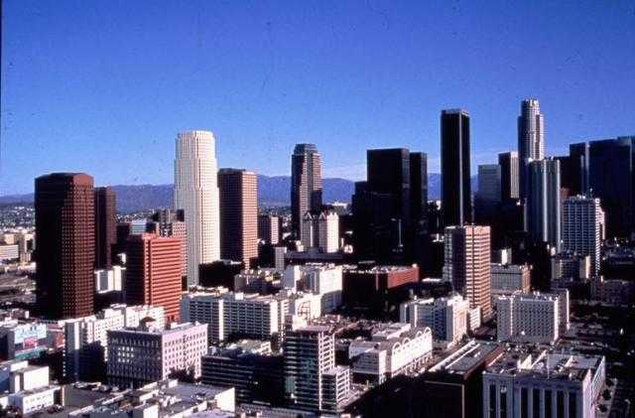
Costs of Control
0.5% GDP (US 1990-2020)
  Benefits of Control
  $10-95 in health benefits for each $1 of control (US 1970-1990)
  $30 in health benefits for each $1 of control (US 1990-2020)*
  Air pollution control industry – 32,000 jobs and $6.2B (CA 2001)
  Clean energy industry – 123,000 jobs and $27B (CA 2009)
U.S. EPA Reports to Congress on The Benefits and Costs of the Clean Air Act (www.epa.gov/air/sect812/index.html)
* 1990-2020 uncertainty analysis under development
Notes:
13
The improvements in California's air quality over the last four decades have come at a modest cost to society.
The total cost of air pollution controls is estimated to be 10 billion dollars, a small share of California’s 2 trillion dollar economy. At the same time, the air pollution control industry in California generates around 6.2 billion dollars and employs 32,000 people, so much of the money spent on control stays in the state. A recent study by EBI concluded that the air pollution control industry in California generated $6.2 billion in revenues and employed 32,000 people in 2001. The U.S. figures are $27 billion in revenues and employment of 178,000 people.
The benefits of controls include thousands fewer premature deaths and hospitalizations each year, and millions fewer lost school and work days.
The value of these benefits is approximately four dollars for every dollar spent on control. California’s air pollution control strategies are cost-effective.

Slide 14
Summary
California per capita emissions must be lowest in U.S.
Current air pollution health risk
  PM2.5 >> ozone > air toxics
Emissions control focus
  1950s and 1960s: smoke
  1970s and 1980s: lead, SO_{X}, hydrocarbons and NO_{X}
  1990s to present: diesel PM and NO_{X}, air toxics, GHG
Air quality improved 75-90% despite growth
On-road controls have greatest benefits
Benefits much greater than control costs

Slide 15
Extra slides

Slide 16
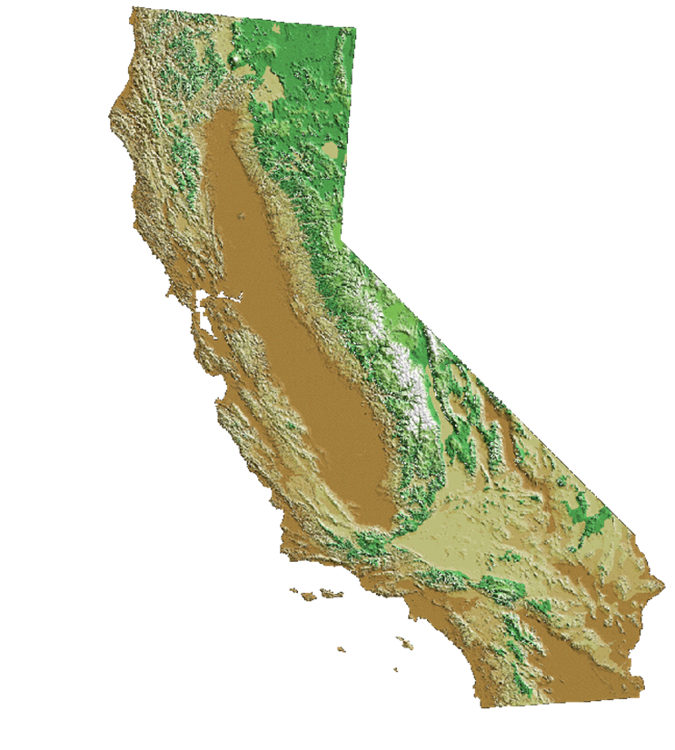
California’s air pollution problem
Unique geography and meteorology confine air pollutants
Over 90% of Californians breathe unhealthy air
38 M people
90 people per km²
24 M gasoline cars
1.3 M diesel vehicles
1.4 B km per day
18 M off-road engines
3 large container ports
Notes:
As you can see from these numbers, transportation plays a major role in California’s air quality problems and greenhouse gas emissions. Although we’ve attained air quality standards for lead, SO₂, sulfates, and NO₂, and cut peak ozone and particle levels by at least 75%, there are still many days of unacceptable ozone and PM across most of the State. In fact, over 90% of Californians continue to breathe unhealthy air at times.

Slide 17
Air pollution reduced 75-90% despite growth
Carbon
Monoxide
Nitrogen
Dioxide
Sulfur
Dioxide
Population
Number
of Vehicles
Vehicle
Miles
Ozone – Los Angeles peak reduced 70%, hours of exposure by 90%
PM10 – annual-average levels reduced 75%
Air toxics – lead eliminated, cancer risk reduced 80% (since 1989)
Black carbon – reduced 90% (95% by 2020)
Notes:
17
Levels of other pollutants have diminished considerably as well. Since 1968, the peak level of carbon monoxide has shrunk by 87 percent, nitrogen dioxide by 83 percent, and sulfur dioxide by 90 percent.
Pollutant levels have fallen in spite of California’s rapid growth. In the same time period, California’s population almost doubled, the number of vehicles on the road increased by 170 percent, and the number of vehicle miles traveled almost tripled.
Today, lead, as a regional pollutant from gasoline, is a problem of the past. The entire state meets the health-based standards for lead, as well as nitrogen and sulfur dioxides. Fifty-six of the state’s fifty-eight counties meet the carbon monoxide standards. The South Coast has not seen a Stage 1 smog alert in over three years and ozone peaks are down over 50 percent. Annual average PM10 concentrations have declined over 20 percent and the statewide cancer risk from air toxics is down by 50 percent. Let’s look more closely at trends for several of the pollutants that still pose a challenge.

Slide 18
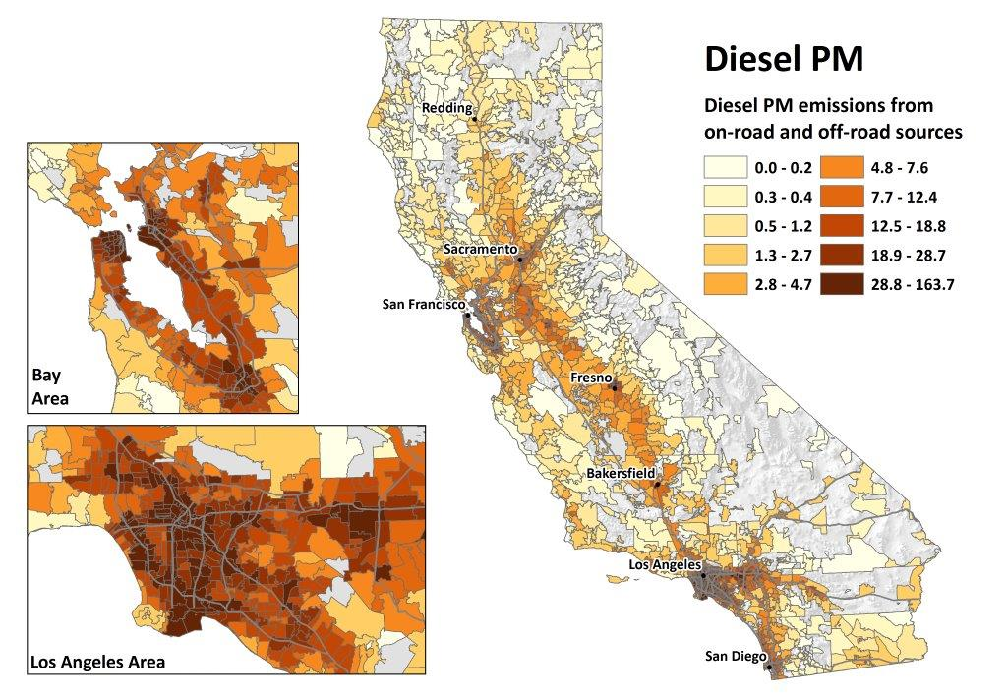

Slide 19
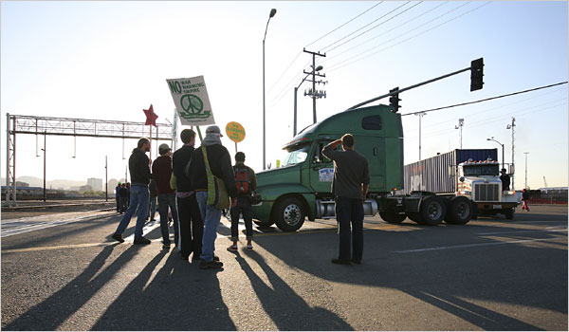

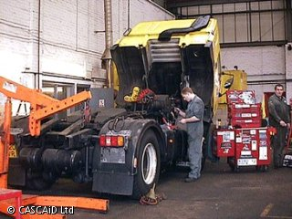
Study of U.S. trucking industry
Compared with U.S. population:
  All-cause death rate:
    28% lower
However:
  Heart disease death rate:
    Drivers 49% higher
    Dockworkers 32% higher
  Lung cancer death rate:
    Drivers 10% higher
    Dockworkers 10% higher
Laden, et al. (2007) Cause-specific mortality in the unionized U.S. trucking industry, Environmental Health Perspectives, 115:1192-1196.
Notes:
This study found that the employees had a lower overall death rate than the general population, as would be expected in a working population. However, when deaths due to heart disease and lung cancer were compared to the general U.S. population, the death rate observed was elevated, especially for drivers and dockworkers. The death rates for heart disease were elevated among drivers by 49% and dockworkers by 32%; and lung cancer death rate was also elevated among drivers and dockworkers by 10%. Note that this study did not have information on the participants' individual exposure or, life style, including factors that could impact their health such as dietary preference and amount of exercise. Current research by the investigators are measuring the actual diesel exposures by job categories.
The study that I am presenting today is a national study led by Harvard University that involves the participation of about 54,000 members of the Teamsters Union from four companies. The investigators examined the medical history of Teamsters employed from 1985 to the year 2000 by job category. Each job category in this population has distinct exposure patterns. For example, long-haul and pickup and delivery drivers are exposed directly to traffic; dockworkers are exposed to trucks in the yard and exhaust from forklifts. A questionnaire was mailed to current workers to assess the distribution of smoking habits by job title and terminal characteristics. The smoking rates were similar to the general U.S. population for both drivers and non-drivers. To provide insight into death patterns associated with these exposures, the investigators examined death rates for specific causes by the different job categories in the trucking industry compared to the general U.S. population of the same age group.

