Slide 1

Voluntary Energy Efficiency Improvement in Road Freight
from International Experience to Local Practice:
Guangdong Green Freight Program
Ke Fang
World Bank
Delhi, January 2014

Slide 2
Road Freight: Why Do We Care?
2
Competitiveness
  Major cost component of delivered goods
  “Regressive” access to logistics in inefficient systems
Poverty Reduction
  Rural agricultural productivity
  Access to markets and services
  Prices of food and essentials
Environmental Concerns
    Major local air pollution source
    Fast growing source of GHG emissions
National Energy Safety
  Major oil consumer
  Increasing demand for energy

Slide 3
Freight is Key Contributor to
Air Pollution & GHG Emission in China
Emission Contribution by Vehicle Type, China 2011
Source: 2012 China Vehicle Emission Control Annual Report
3
Trucks (22% of total fleet in number) account for 54% of total transport sector fuel consumption in China.
Heavy- and medium- duty freight vehicles only account for 7.7% of the total automobile fleet in 2011. However, together they account for 62.8% of NOx and 69.6% of PM2.5 emissions.
Notes:
Taking c for example, in 2011 there were 4,605,771 and 2,678,008 vehicles respectively, which only account for 4.9% and 2.8% of the total automobile fleet. However, together they account for 62.8% of NOx and 69.6% of PM2.5 emissions.

Slide 4
Tightening Vehicle Emission Standards and Fuel Standards
China Emission Standards for Heavy-Duty Diesel Engines, g/kWh (smoke in m-1)
Tier | Date | Test | CO | HC | NOx | PM | Smoke
China III | Planned Jan 1, 2007/Actual July 1, 2008 | ESC & ELR | 2.1 | 0.66 | 5 | 0.10 0.13 | 0.8
China IV | Planned Jan 1, 2010/Updated planned July 1, 2013 |  | 1.5 | 0.46 | 3.5 | 0.02 | 0.5
China V | Planned Jan 1, 2012/Will be postponed for sure, expected in 2015 |  | 1.5 | 0.46 | 2 | 0.02 | 0.5
China VI | Under discussion | WHSC
Over the past decade, fuel standards in China have been tightened as well but consistently lagged behind the fuel requirements corresponding to the vehicle emission standards.
4
Notes:
China follows the European vehicle emission standards, which are specified both by fuel type (gasoline/diesel)[1] and by vehicle type (light-duty vehicles/heavy-duty vehicles).
[1] Compression Ignition (Diesel) Positive Ignition (Gasoline)

Slide 5
Managing In-use Vehicles is Critical
China’s Automobile Fleet by Emission Standards
Source: 2012 China Vehicle Emission Control Annual Report
5
Notes:
“Yellow Label” vehicles refer to the pre China I gasoline vehicles and diesel vehicles not meeting the China III standards. Due to their high environmental impacts, they are marked with yellow labels.

Slide 6
Efficient Freight Operations are Also Critical
China’s logistics cost accounts for 18.4% of total GDP in 2007 (8.99% in developed countries)
Deadhead rate is as high as 40% (10% in developed countries)
6
Notes:
2007年我国物流总成本占GDP的比重约为18.4%，而欧美发达国家仅占8.99%；我国公路货车空载率高达40%，而欧美发达国家只有10%左右；在许多领域，我国企业的物流成本约比欧美发达国家高出40%至50%

Slide 7
Market Failure
Cost-effective freight/logistics technology and management practices are already available.
But they are not widely deployed in developing countries, despite potential economic benefits from fuel saving.
According to China experience, the key problem is:
  Lack of information and confidence on the performance, cost and reliability of fuel efficiency technologies/practices
  Lack of comprehensive policy support
7

Slide 8
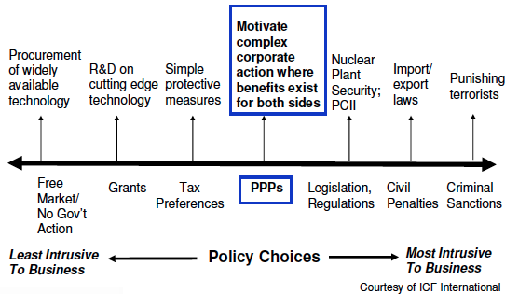
How to Address This Market Failure?
Lessons from US EPA SmartWay
8
Notes:
PPPs fit in a range of policy tools

Slide 9
How to Address This Market Failure?
Lessons from US EPA SmartWay
Environmental & energy concerns
Start from vehicle technology
4. Multi-Modal Integration
3. Improved Logistics
2. Behavior & Maintenance
1. Technologies

Slide 10
SmartWay Transport Partnership:
Key Program Components
1. Partnership
Assess, benchmark and track
emissions of carriers, shippers, and logistics companies
National idle reduction program
New carbon assessment tools
Partner support (PAM, helpline)
GHG and fuel savings
2. Technology Programs:
– Test program
– SmartWay Tractor/Trailer
– SmartWay-verified technologies
– Test methods
Finance Programs
  – Innovative finance programs
  (grant programs, banks, retailers)
  – SmartWay Finance web site
Outreach and Education
    Partner recognition - SmartWay web site, logo, and awards
    Partner education – webinars, fact sheets, e-update, web site, workshops, events
    Innovative pilot programs
    Brand marketing – PSAs, media campaigns, events

Slide 11
Guangdong Green Freight Demonstration Project (2011-2015)
11
First demonstration project in China’s road freight sector
Project objectives:
  Improve energy efficiency through retrofitting truck fleets with new technologies and innovative financing methods
  Utilize information technologies to facilitate freight operations lowering the deadhead rate of trucks

Slide 12
Key Features of the Project
12
Partnership
Technology programs
Finance programs
Capacity building programs
Outreach and Education programs

Slide 13
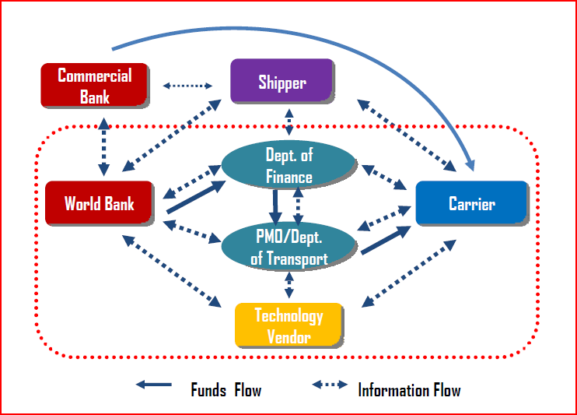
Partnership Framework
13

Slide 14














Partnership Development
The World Bank
The Energy Sector Management Assurance Program
Guangzhou Transport Committee
14

Slide 15
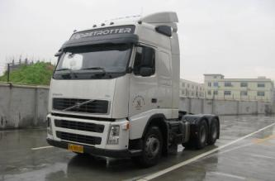
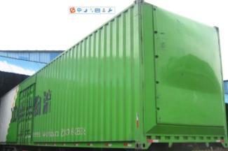
Technology Demonstration
Energy Efficiency truck technologies demonstration
  Pilot testing on 14 trucks, 1st phase 145 trucks, 2nd phase about 1000 trucks,
Pilot testing of logistics operation technologies:
  Pilot Advanced Brokerage Information System
  Pilot “Drop-and-Hook” freight operations
15
15

Slide 16
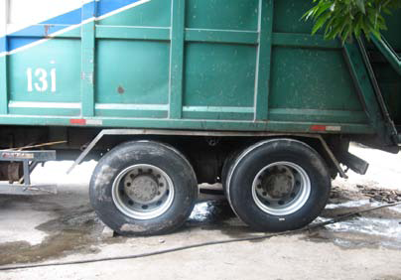
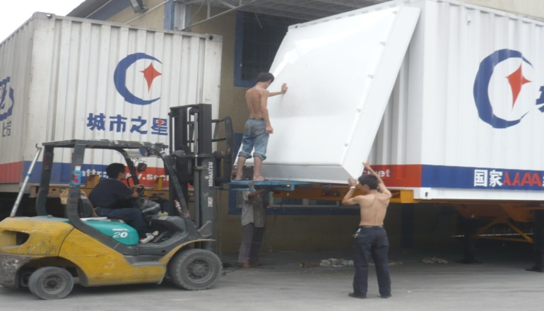
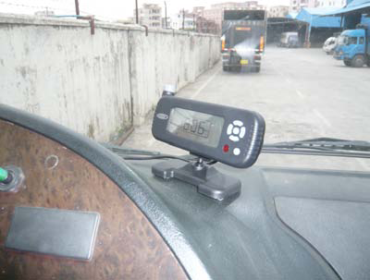
Technology: Testing
Carried out on 14 trucks in three truck fleets in Guangzhou
    Tire systems, Aerodynamics
  EPA technical guidance, SmartWayTM contacts
Test provided impetus for larger program
  Best case 18% improvement and investment by fleet
  Interest from the government in a broader program
16

Slide 17
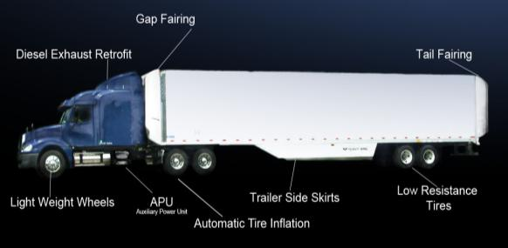
Technology: Truck Retrofitting
17

Slide 18
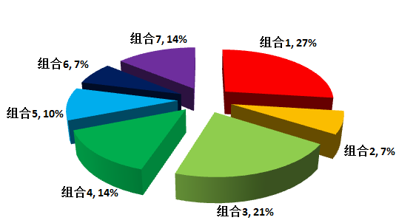
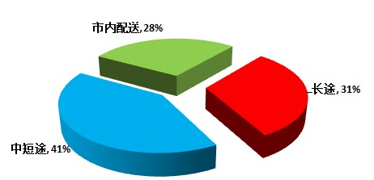
Technology: Phase I Update
10 participating trucking companies
145 participating trucks
7 technology combinations
Intra-urban distribution, 28%
Long-distance, 31%
Short/medium-distance, 41%
18

Slide 19
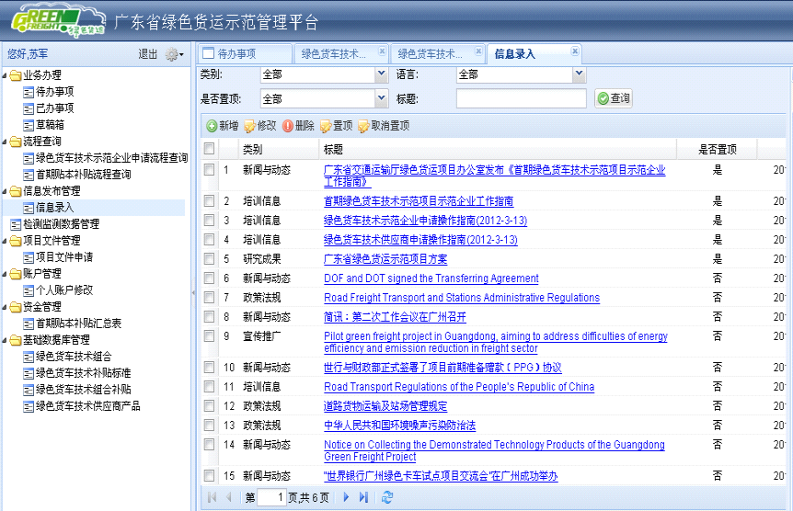
Technology: Online Monitoring and Reporting System
Record and archive travel speed, loading, fuel consumption, and travel distances
  Scientifically
  Objectively
  Real-time
  Automatically

Slide 20
Innovative Financing Programs
Green Freight technology rebate
  Based on the prevailing down payment rate for a truck loan
Performance-based payments
  Based on the prevailing interest rate of a truck loan
Better access for SMEs to commercial finance
  Utilize ESCO as intermediary to connect commercial banks and SMEs
20
Notes:
ESCO: Energy Service Company

Slide 21

Proposed Innovative Financing Pilot
Government
World Bank
Commercial Banks
Upfront guarantee
Dedicated funding pool
ESCO Financing
ESCO
Potential candidates
Technology providers
Equipment vendors
Qualified ESCOs
Post-purchase subsidies
Truck Retrofitting
Returns Sharing
Trucking Companies
21
Notes:
21

Slide 22
Cash Flows for Trucking Companies
(in Pink) Before and After
Before
Returns from fuel savings
Commercial Banks
80%
Loans
Upfront investment from trucking companies
ESCO
Subsidies and Payments
20%
WB Grants
WB Grants
ESCO Returns Sharing
ESCO
Investment
After
22
Notes:
22

Slide 23
A Multi-Win Scenario
Trucking Company
  More balanced cash flow
ESCO
  Earn profits from fuel saving
Commercial
Banks
  Lower risks, lower operational costs
Technology Providers
  Increased competitiveness
Government
  Leverage social capital for wider goods
23
Notes:
23

Slide 24
Large-scale Capacity Building
24
24
Research on key policy and regulatory issues
Training for government officials and enterprise managers and overseas tours
Training for installation and operation of technologies
Training for drivers on energy efficient driving skills

Slide 25
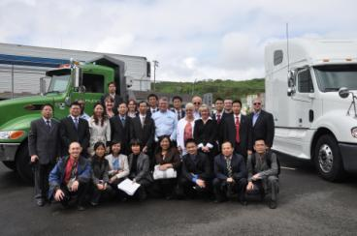
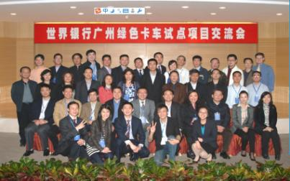
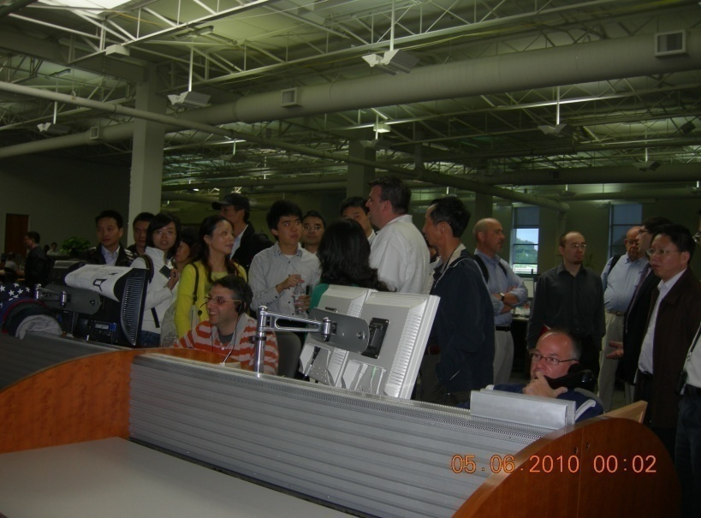
Overseas Study Tours and Seminars
25

Slide 26
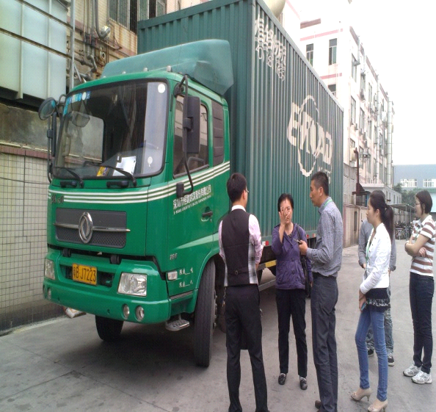
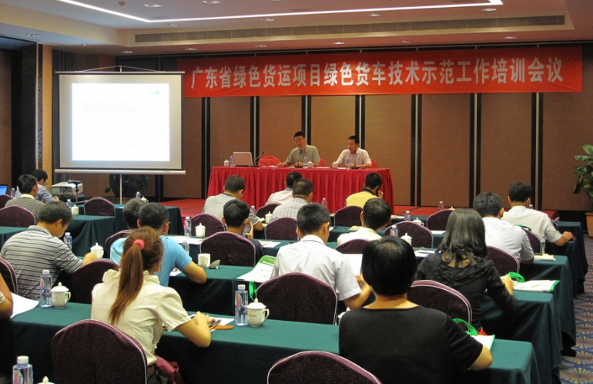
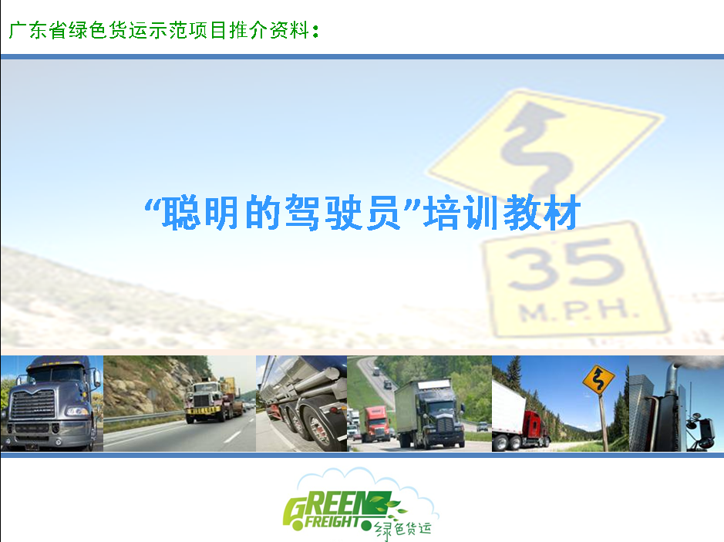
Driver Training
26

Slide 27
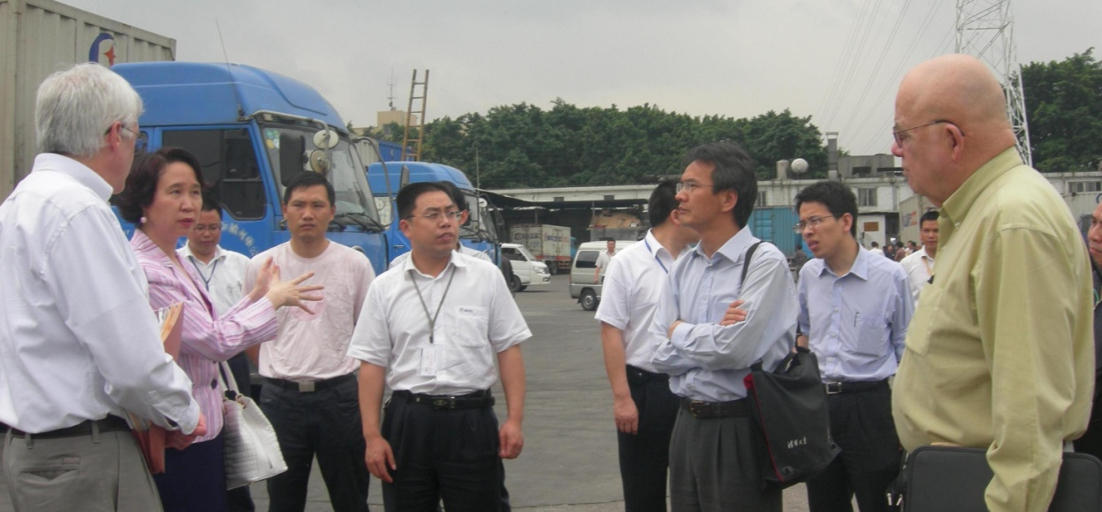
Marketing and branding
27
27
“Green Freight” logo
“Green Freight” website
Public awareness raising and promotion
Documentation and information dissemination
“Green Freight Trade Fairs” and “Green Freight Submits”

Slide 28
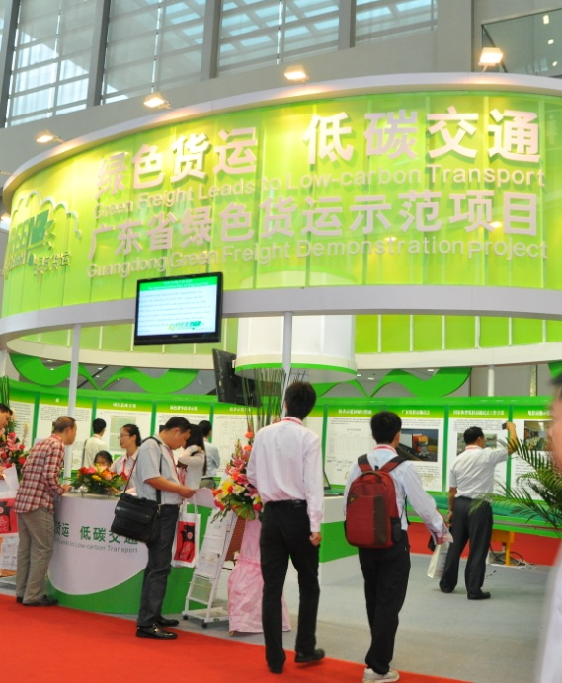
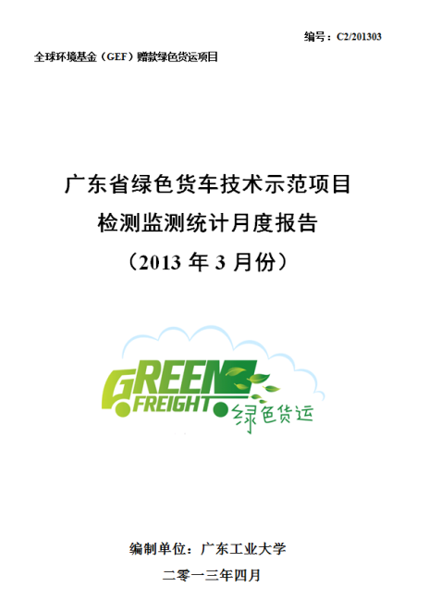
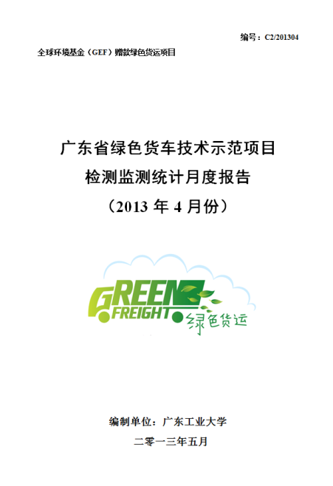
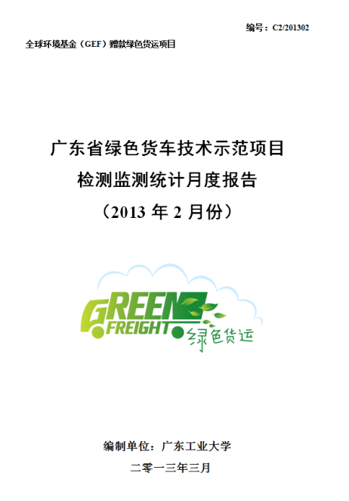
Project Branding
28

Slide 29
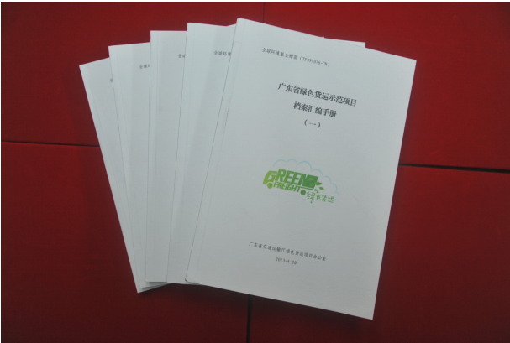
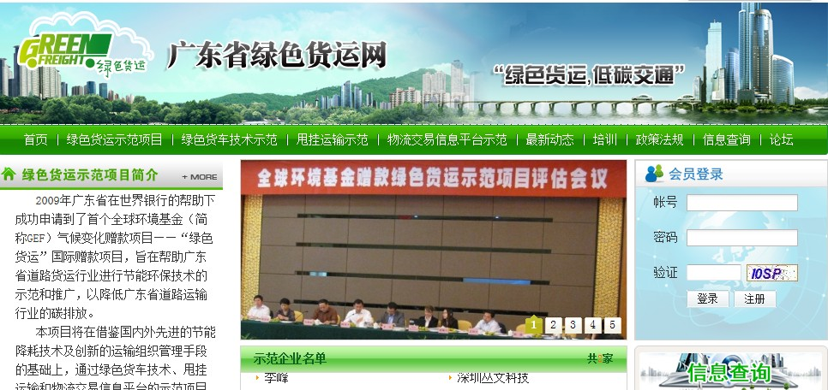
Monthly Reports and Project Website
29

Slide 30
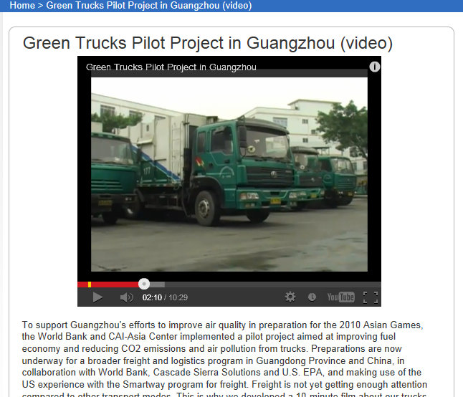
Broad Dissemination

Slide 31
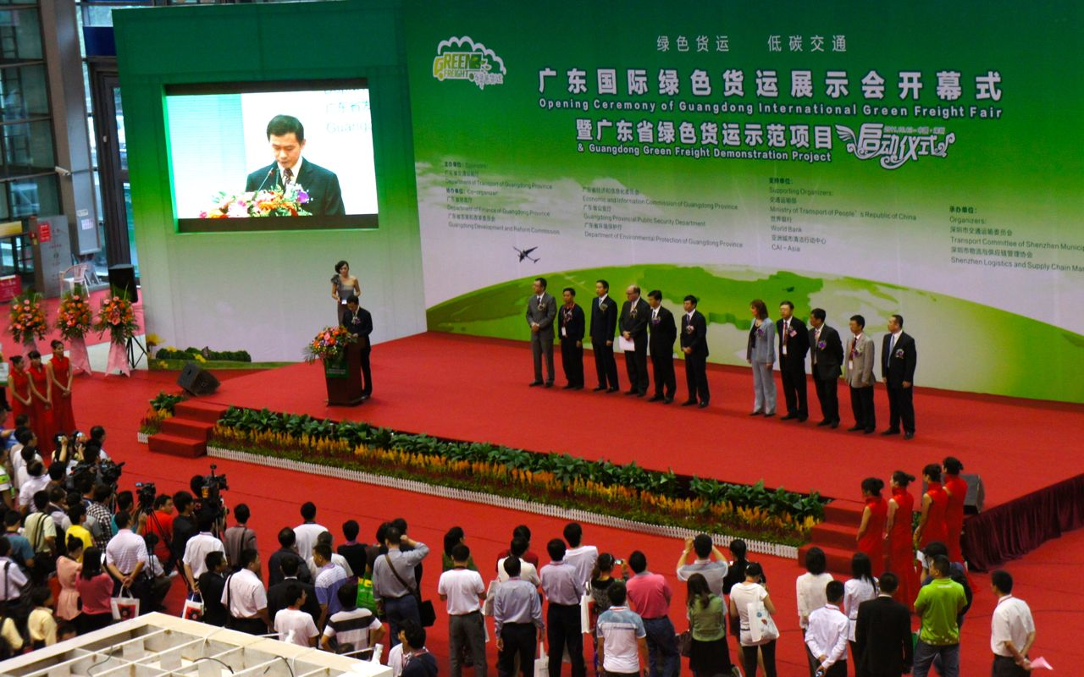
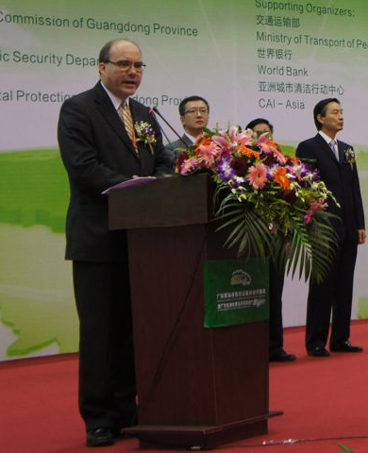
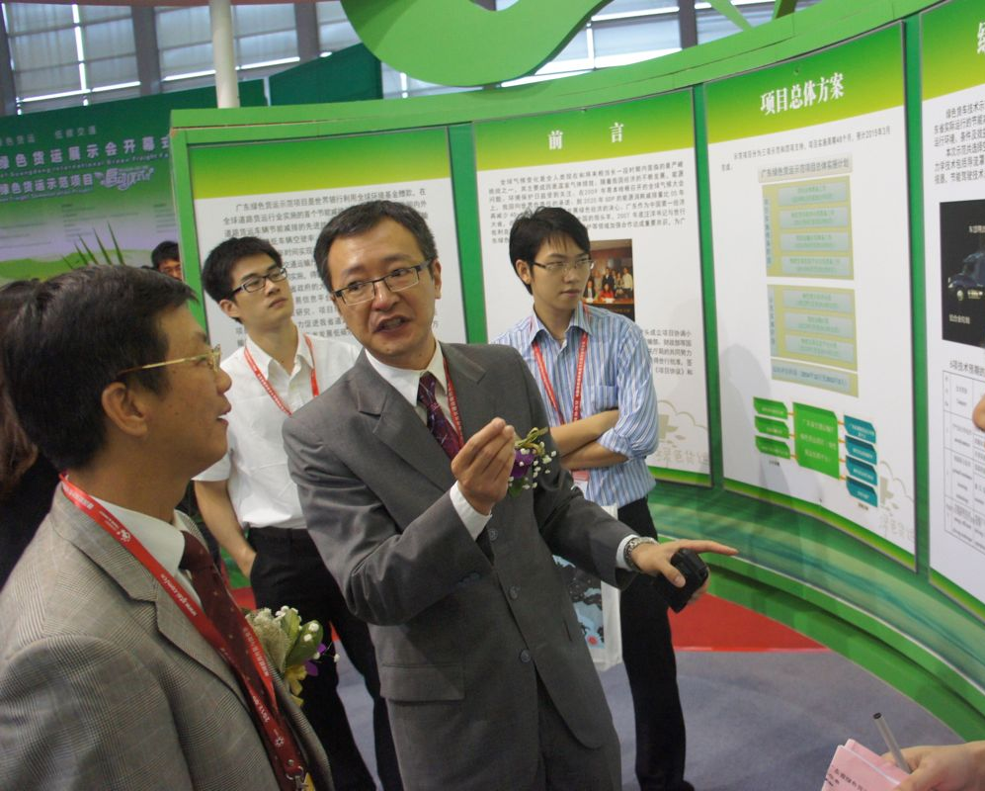
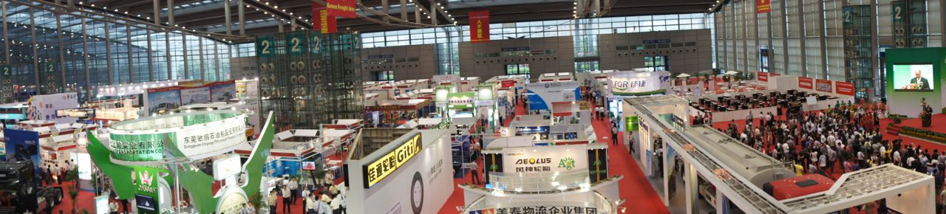
Green Freight Trade Fair
31

Slide 32
Lessons Learnt
Huge potential for energy efficiency and emission reduction in road freight sector
Inspiration from the US SmartWay approach
  Overall programming, Technical guidance, contacts from SmartWay partners
Importance of locally generated knowledge
  Pilots and M&E for actual performance, cost and reliability of fuel efficiency technologies/practices
Partnership with other stakeholders incl. both the public and the private sector incl. local banks - key for scale-up
Strong promotional and branding efforts help
What is the World Bank’s role?
  facilitator, information, knowledge, or financing provider?
32

Slide 33
Challenges Ahead
33
33
Keep the “Snowball” rolling and keep it “Cool”…
  Convincing data of fuel saving effects for green technologies
  Replication in other places in China
  Attracting participating companies, particularly shippers
  Dialogue with national agencies on technology certification and other policy and regulatory issues
  Development of local suppliers and local R&D capacity
  Materializing the ESCO-oriented financing option and development of green finance market

Slide 34
Latin America
Asia
China
Expert Group
Govt Steering Committee
Green Freight China Seminars
Green Freight at governmental Env. Sustainable Transport Forum
Green Transport Financing Market Review
Logistics Institutions and Policy Study
Brazil Green Freight Initiatives
Green Freight Corridor in GMS region & Green Trucks Toolkit
Mexio Transporte Limpio
Low Carbon Logistics Wuhan
Study Tours to US and Europe
Guangdong International Green Freight Fair
Green Freight in India (planned)
Guangdong GEF Green Trucks Project
Green Freight China Program
design
Other…
Green Freight Asia Network (Private Sector)
Green: World Bank and partners, e.g., CAI Asia,
Yellow: CAI-Asia and other partners
Grey: other initiatives.
Guangzhou Green Trucks Pilot Project
Other…
Other…
Green Freight on the Move!

Slide 35
Thank You!
Contact: Kfang@Worldbank.org
On-line story about Guangdong Green Freight Project：
http://www.worldbank.org/en/news/feature/2013/09/13/improving-fuel-efficiency-and-reducing-emissions-of-trucks-in-china
Three Video Stories:
1. http://www.worldbank.org/en/news/video/2013/09/13/china-making-trucks-greener
2. http://www.worldbank.org/en/news/video/2013/09/13/a-faster-and-cleaner-way-of-transporting-goods
3. http://www.worldbank.org/en/news/video/2013/09/13/moving-china-freight-more-efficiently-than-ever

