Slide 1

Ways to mitigate Transport Pollution
A S Bhal
Economic Advisor,
Ministry of Urban Development, government of India

Slide 2
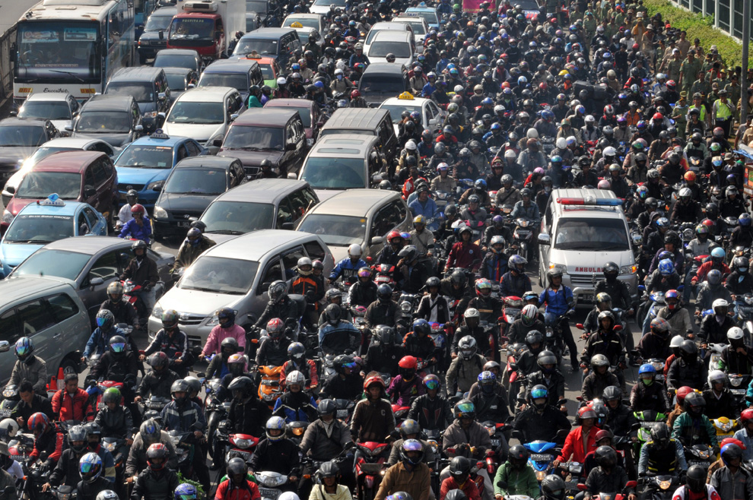
Traffic in Our Cities - Jakarta

Slide 3
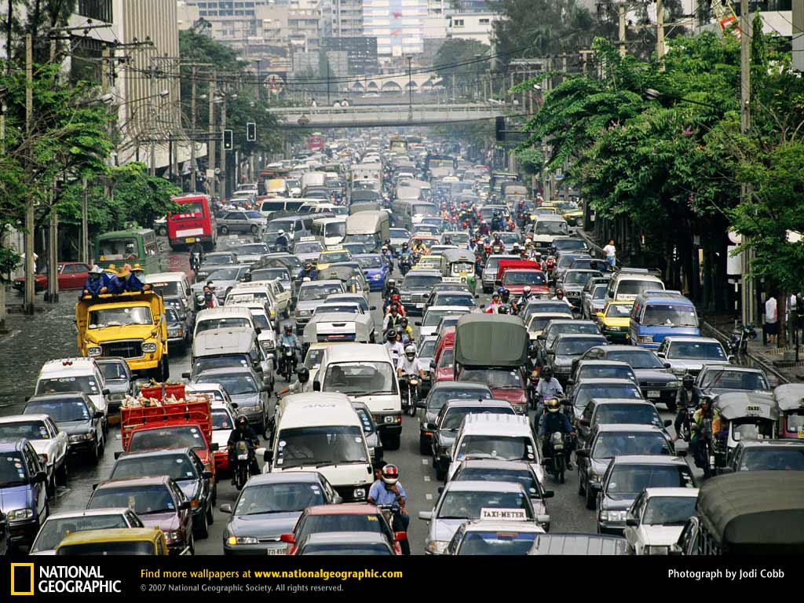
Traffic in Our Cities - Bangkok

Slide 4
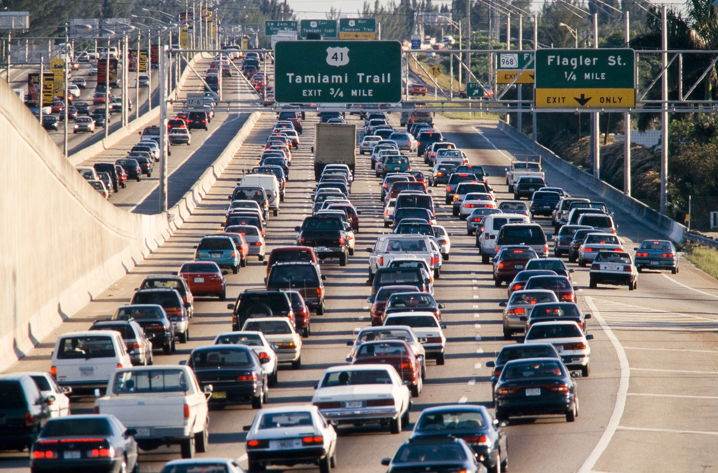
Traffic in Our Cities – New York

Slide 5
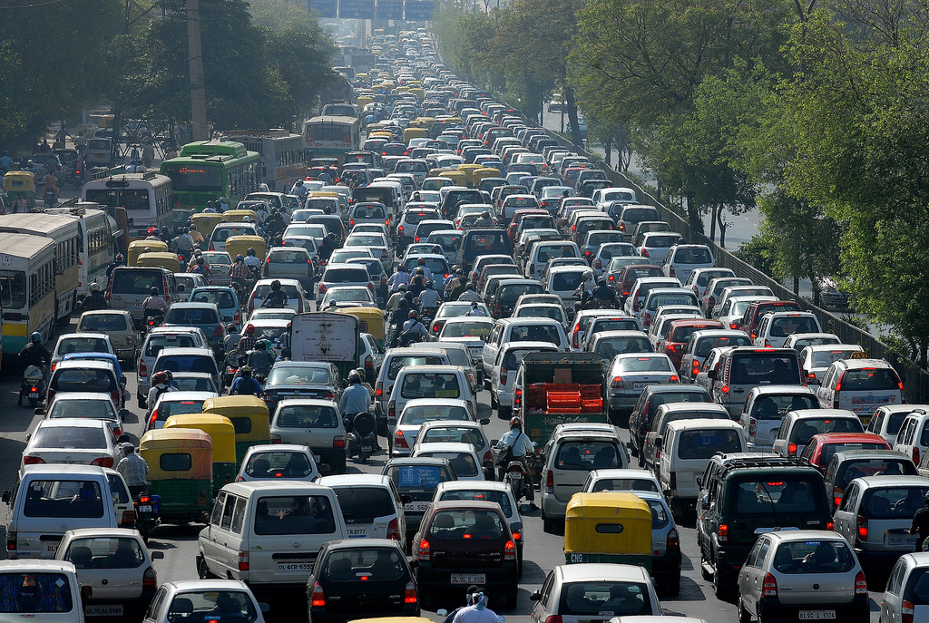
Traffic in Our Cities – New Delhi

Slide 6
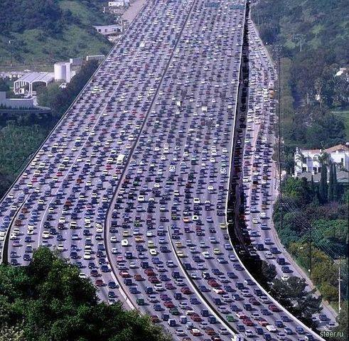
Traffic in Our Cities - China

Slide 7
Key Challenges
Growing Congestion
Declining Road Safety
Rising Energy consumption
Increasing Urban Population
Increasing Air Pollution & CO2 emissions
Adverse Health Effect

Slide 8
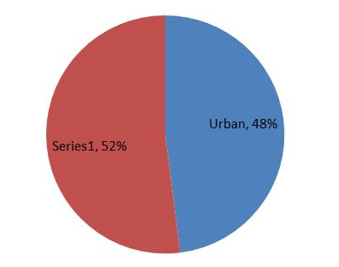
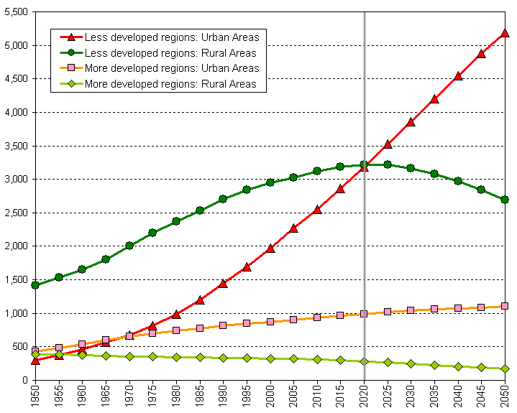
Increasing Urban Population
World Statistics
Total Global population 7.09 billion
Urban Population – 3.4 billion
The population has been growing at an average 1.1%
Highest population in Asian Cities – 60%
India & China together account for 37% of the total population
India Statistics
In 2011 - the population of India is 1.2 billion
31% of population lives in urban areas
53 cities have over a million population and eight metropolis cities (over 5 million population)
Increasing city populations: Urban and rural population by development regions (in millions)
Source: United Nations Population Division, World Urbanization Prospects, The 2009 Revision

Slide 9
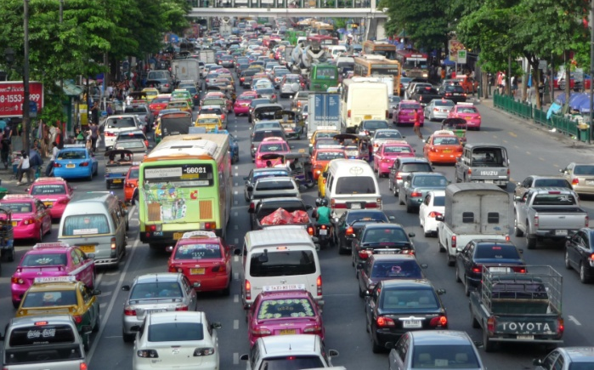
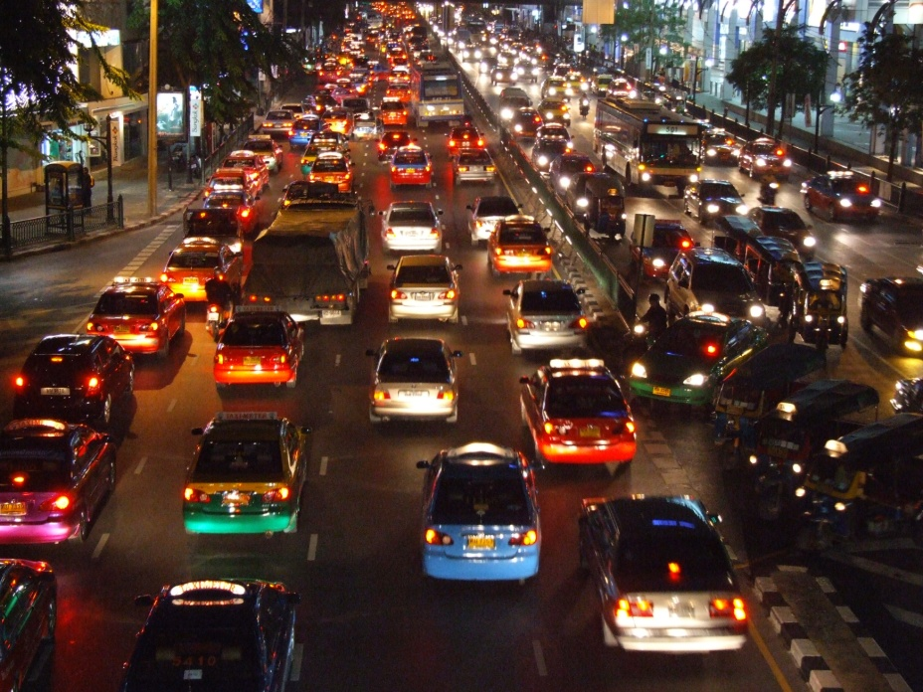
Growing Congestion
In most cities, mobility is dominated by personal motorized transport.
Many people choose cars to move around…
Already 1.2 billion cars on road
Some forecast see 4 billion cars by 2050
Average vehicle speed during peak hour is as low as 10 kmph
With growing GDP, modal share of motorized modes increasing

Slide 10
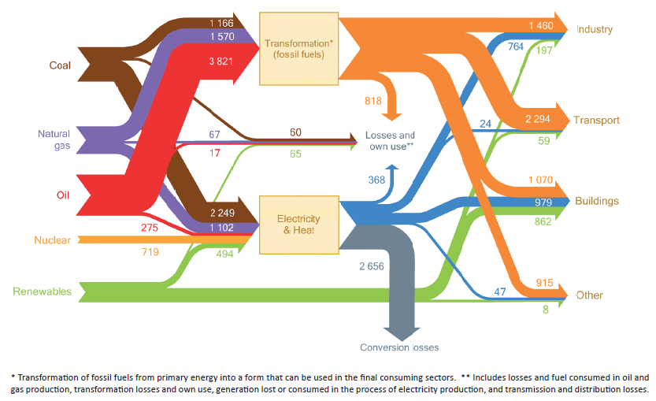
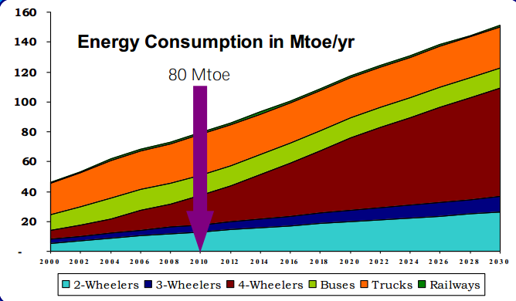
Rising Energy Consumption
Global Scenario
High Consumption of energy by the Transport Sector – 2377 Mtoe/ year (27.4%) only after building industry.
Source – 97% from non renewable sources
India
Energy Consumption by transport sector – 80 Million Tons of Oil Equivalent (Mtoe)/ year
Growth in transport energy consumption of 38% between 2010-2035 (especially due to larger car and truck fleets)
The global energy system 2010, (mtoe)
Source: IEA 2012
Indian energy system 2010, (mtoe)

Slide 11
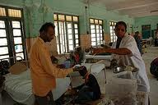
Adverse Health Effects
It has been estimated that 20 lakh Indians die annually due to air pollution. India is spending Rs 4,550 crore per year to treat health problems caused by air pollution
Concentrations of health-harming air pollutants in developing cities far exceed those in developed cities

Slide 12
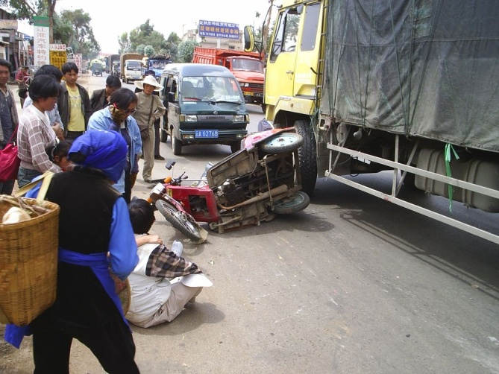
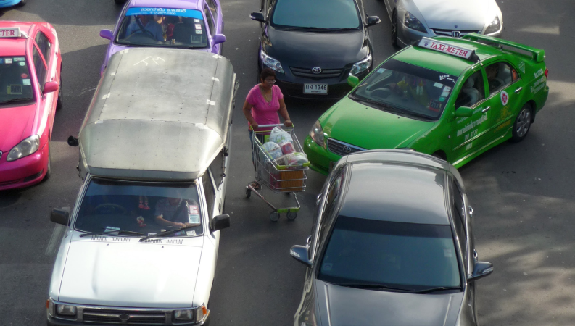
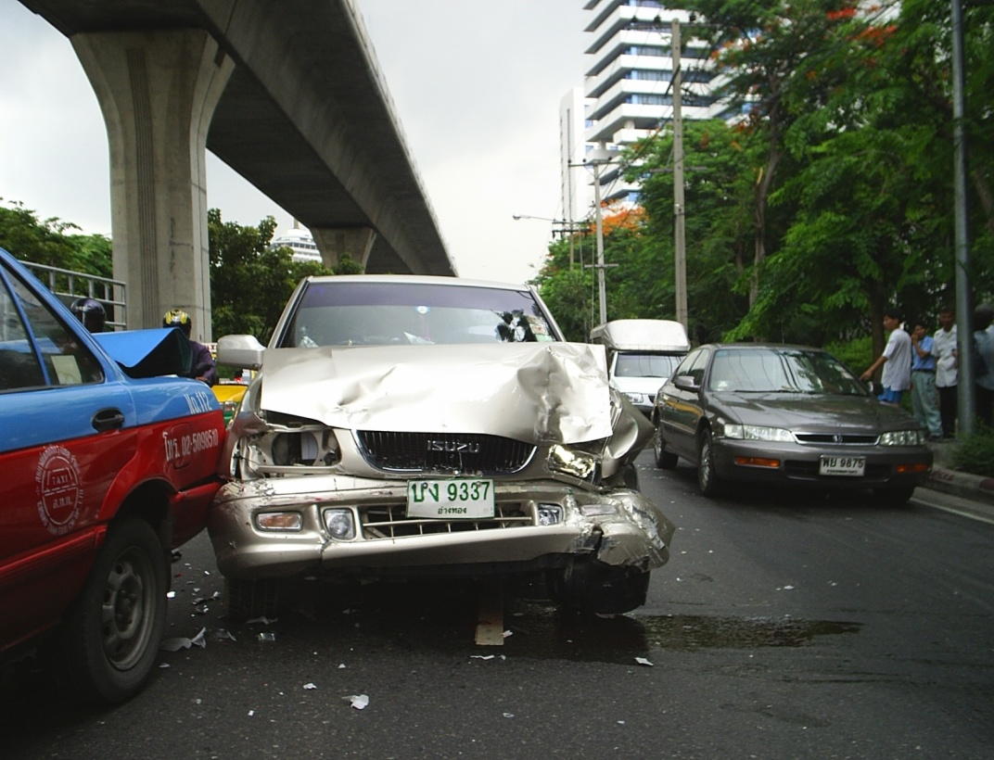
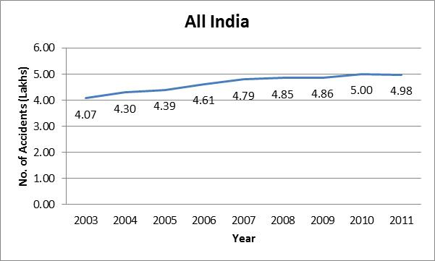
Declining Road Safety
Worldwide, 13 Lakhs road deaths per year
Costs of road crashes and injuries estimated to be US$ 518 billion/year.
India, 5 Lakhs road deaths in 2011, growing at about 2.6% annually
MoRTH estimates 50% increase in accidents in 10 years in BAU scenario

Slide 13
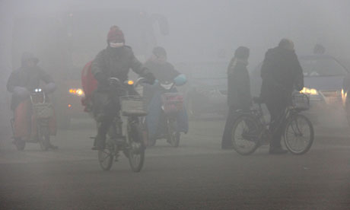
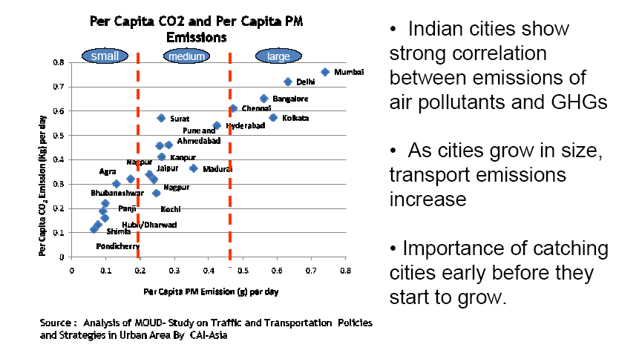
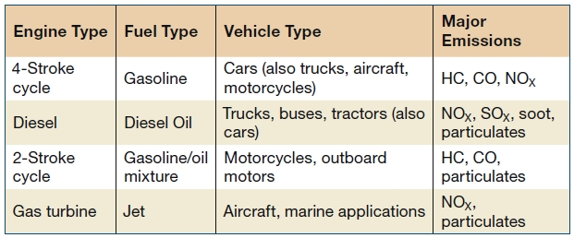
Air Polution & Carbon Emmision
Road transport is a major contributor to air pollution
Transport is responsible for 13 % of GHG emissions and for 23% of energy related emissions
As cities grow in size, transport emissions increase
Major types of air pollutants - Particulate matter, CO2, NOX etc
  In developing cities, the most critical air pollutants are usually particulate matter and ozone
Photo: HAP/Quirky China News / Rex Feat
Notes:
Is that jeep in the background of the first picture burning??? Anyway, nice slide.

Slide 14
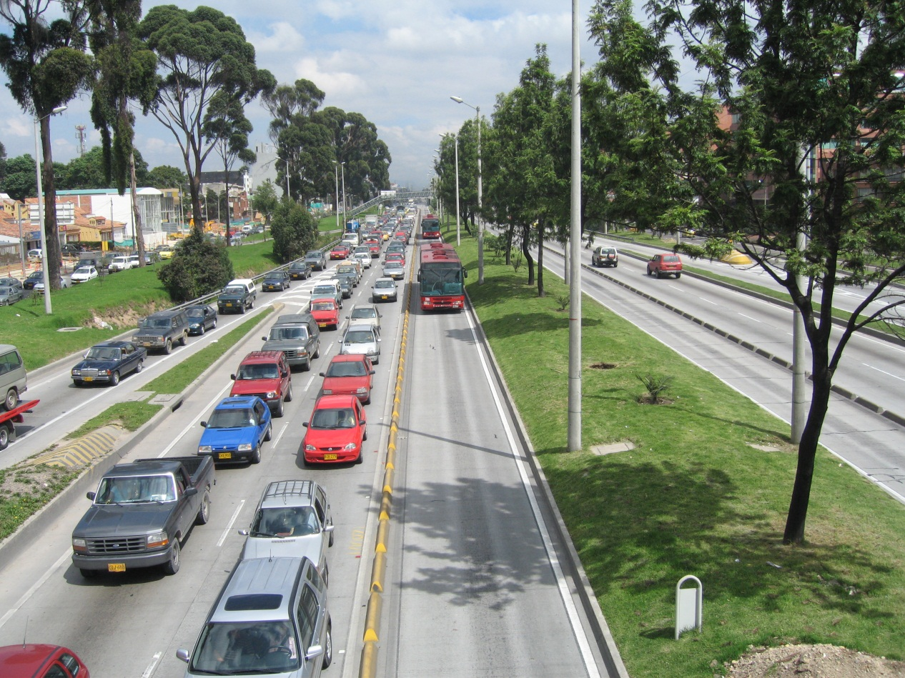
Answer – Sustainable Urban Transport!

Slide 15
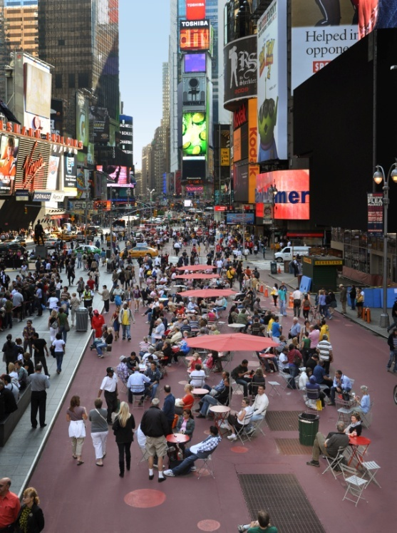
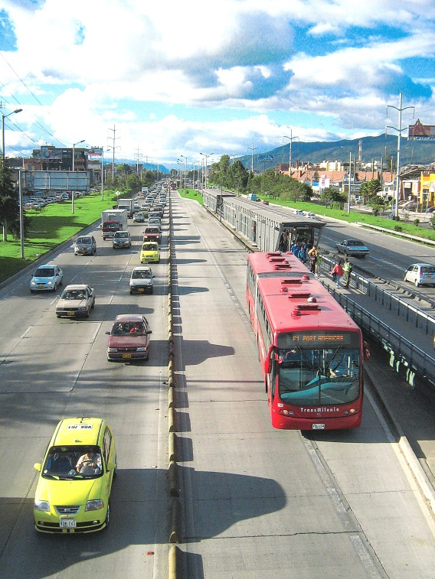
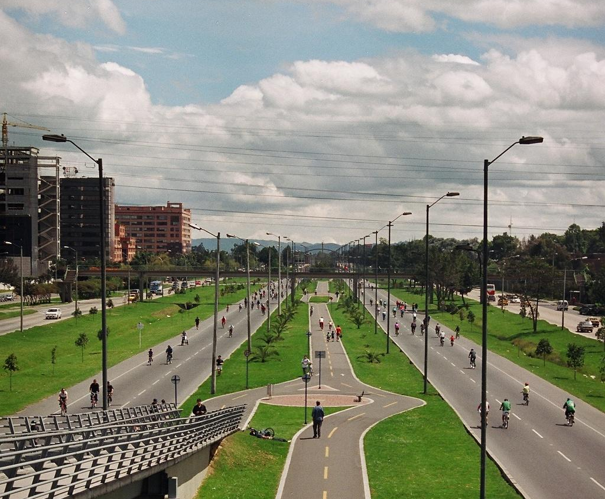
Goals of Sustainability
Social: access for all sections of society to all activities necessary to participate in social life has to be guaranteed as far as possible
Economic: mobility of persons and of goods has to be provided without over-burdening the financial limitations of the public and private budgets
Environmental: rate of use of non-renewable resources should not exceed the rate at which renewable substitutes are developed

Slide 16
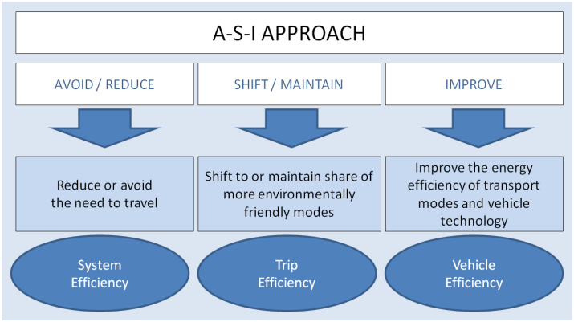
Sustainable Approach
Social Sustainability
Economic Sustainability
Environment Sustainability

Slide 17
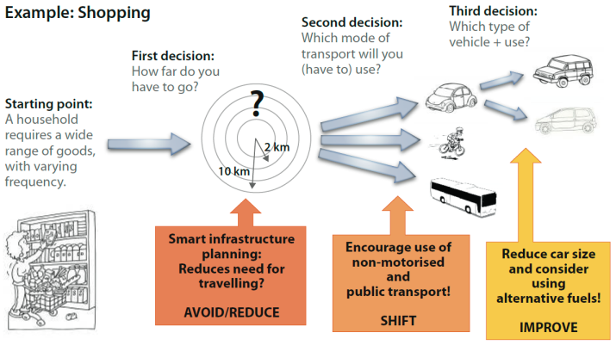
Mitigation Options
A practical example: The A-S-I approach applied to shopping

Slide 18
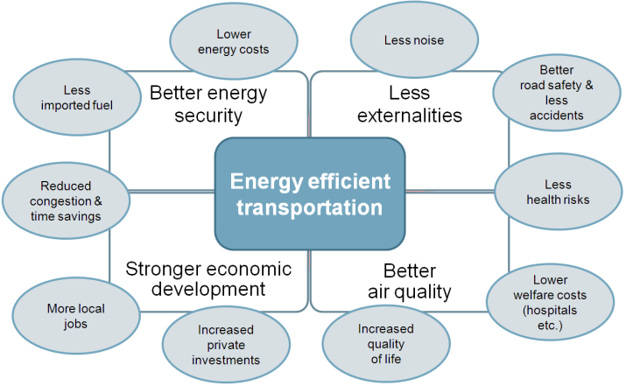
Basic Principles for Sustainable
Urban Transport
The ASI approach does not only reduce emissions on a local and global level and improve energy efficiency
It also supports the vitalization of public spaces, social cohesion and economic attractiveness of a city

Slide 19
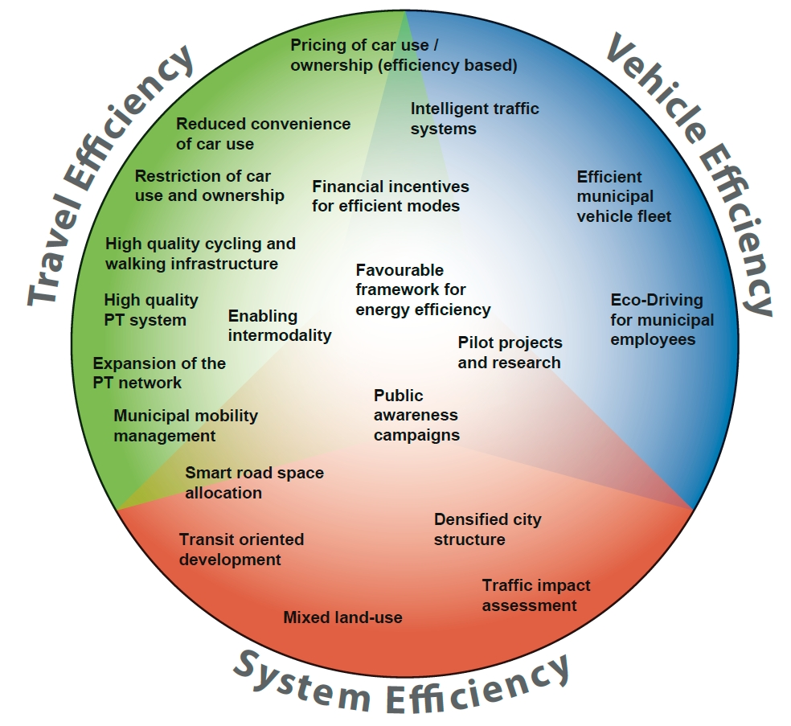
Implementing A-S-I policies

Slide 20
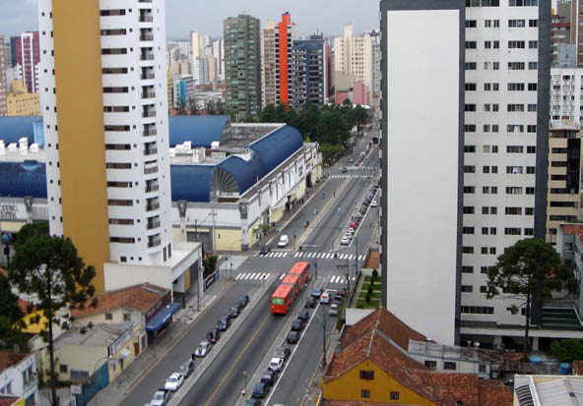
Travel Efficiency

Slide 21
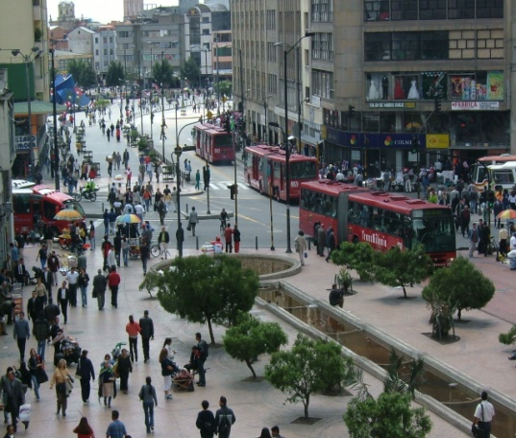

Travel efficiency
Issues
Walk and Cycle facilities are generally missing
Public Transport is inadequate in quality and quantity
No effort to control transport demand
No Parking Policy
Accidents are increasing
Freight movement is not a part of urban transport planning
Mitigation Measures
Priority to Non Motorized Transport
Support Public Transport
Land use Transport Integration
Travel Demand Management Measures
?

Slide 22
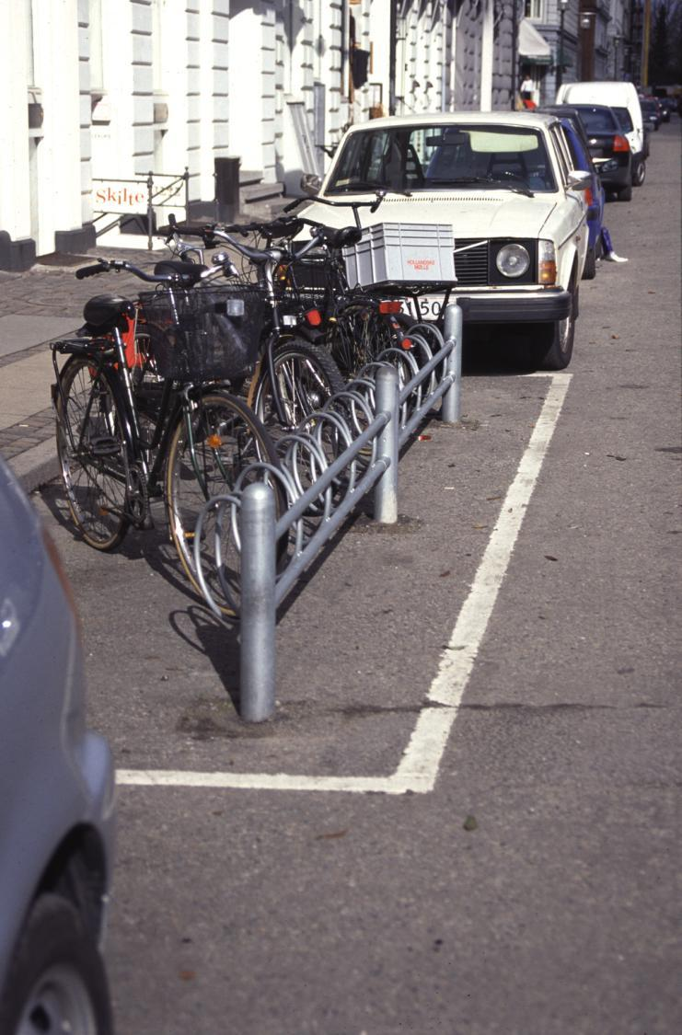
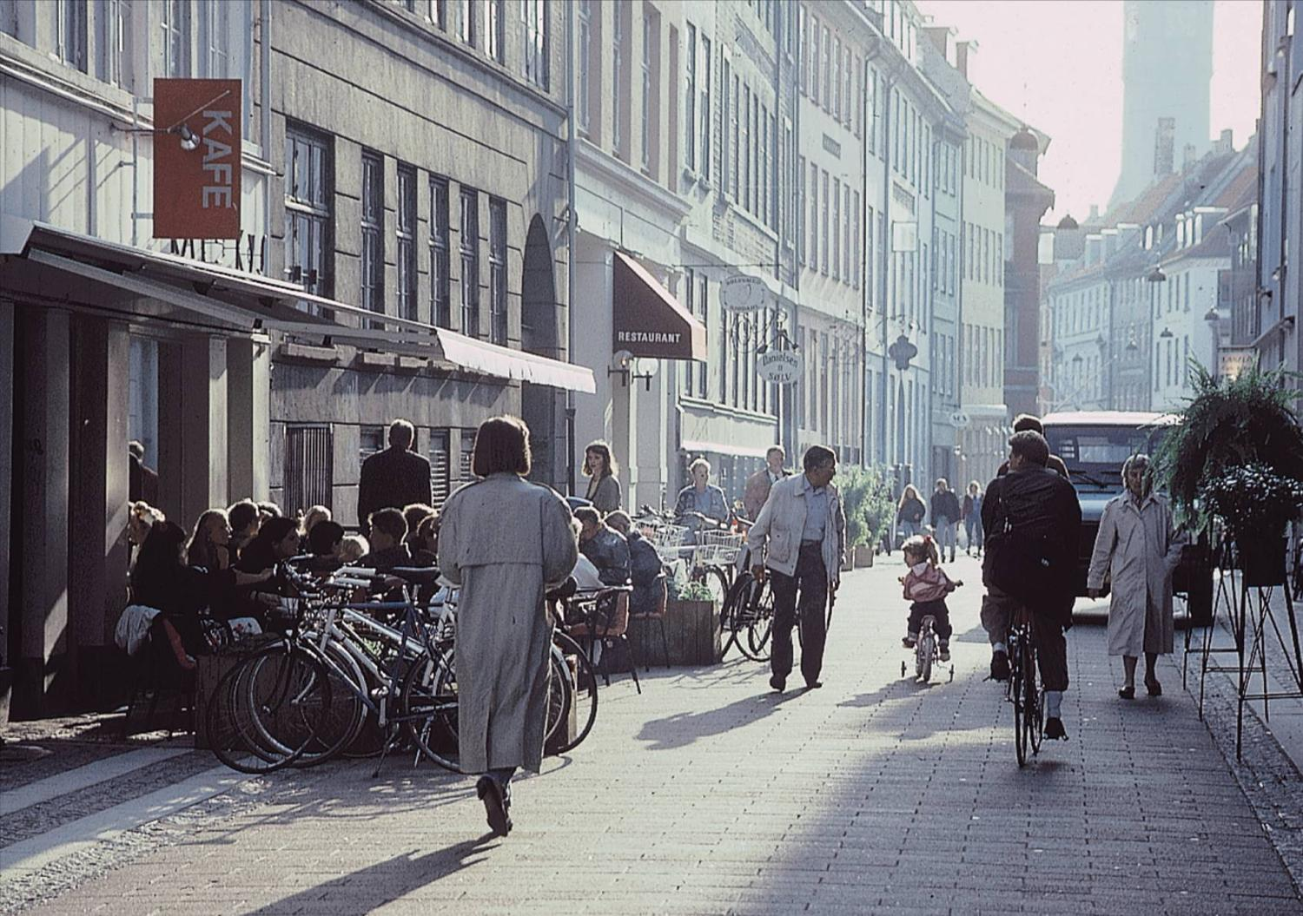
Non Motorized Transport
10 bicycles = 1 car parking space
Bicycle tracks are very efficient - 5 times more people can move per hour on a bicycle track compared with a traffic lane

Slide 23
Priority to Public Transport
System | Numbers across the world
Metro | 188
LRT | More than 250
Monorail | 112
BRT | 156
To transport 10,000 people for one – kilometer (case of full occupancy)
Parameters | Car | Minibus | Regular Bus | Heavy Bus | Articulated Bus | Bi- articulated Bus
Persons per vehicle | 5 | 25 | 80 | 105 | 180 | 270
Vehicles needed | 2000 | 400 | 125 | 95 | 55 | 37
Area occupied (sq. mt) | 48,000 | 8,800 | 3,000 | 3,260 | 2,600 | 2,370
Fuel Consumption (liters) | 400 | 120 | 40 | 30 | 31 | 34
(Source: Transport and Environment Report, Department of Ecology and Environment, Govt. of Karnataka)

Slide 24
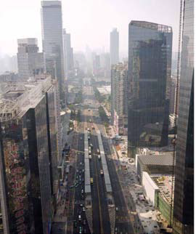
Land Use Transport Integration
Need to integrate transportation investments with development plans; and how transport can further the vision of future of our cities.
Transit Orient Development (TOD)
compact, mixed use development near new or existing public transportation infrastructure.
Align density to availability of public transport
Ensure availability of affordable housing in close proximity to mass rapid transit nodes
“Integrate land use and transport to create high density, mixed-use”

Slide 25
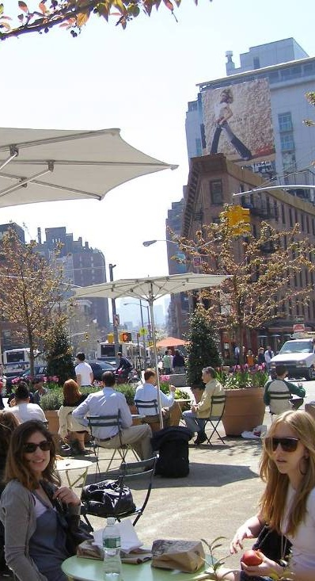
TDM Measures
Parking Management
Congestion Management
Speed reductions
Road Pricing
Priority for buses
Park & ride facilities
Pedestrian only areas
Public awareness

Slide 26
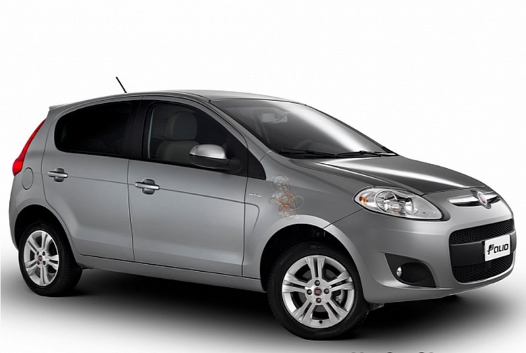
Vehicle Efficiency

Slide 27
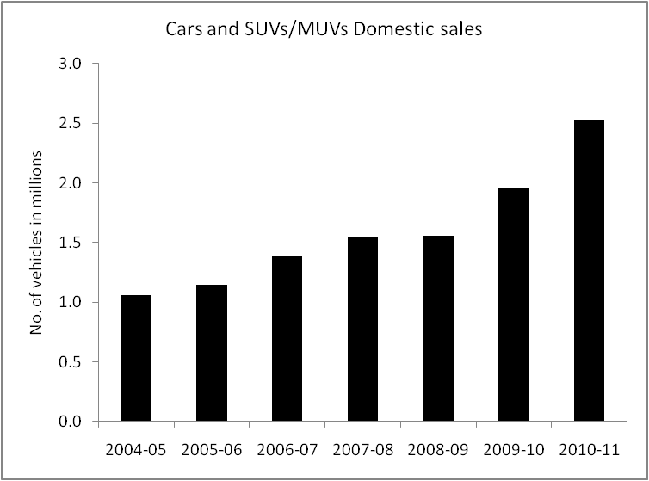
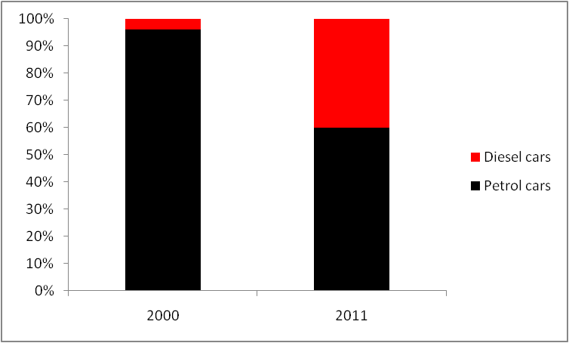
Vehicle Efficiency
Major Issues
Increasing Sales of Cars
Rapidly growing use of diesel (in 2000: 4 % of car sales, now 50%)
Quality of diesel in India does not meet the international standard
Mitigation Measures
BS (III) norms for fuels and vehicles implemented all over India
BS(IV) norms for vehicles and fuels implemented in 12 cities
Pollution under control certificate (PUC) for in-use vehicles
Independent fuel testing laboratories for checking fuel adulteration
Thrust on use of clean transportation fuel (CNG) in few cities
Source: Based on SIAM data
Source: Based on market data

Slide 28
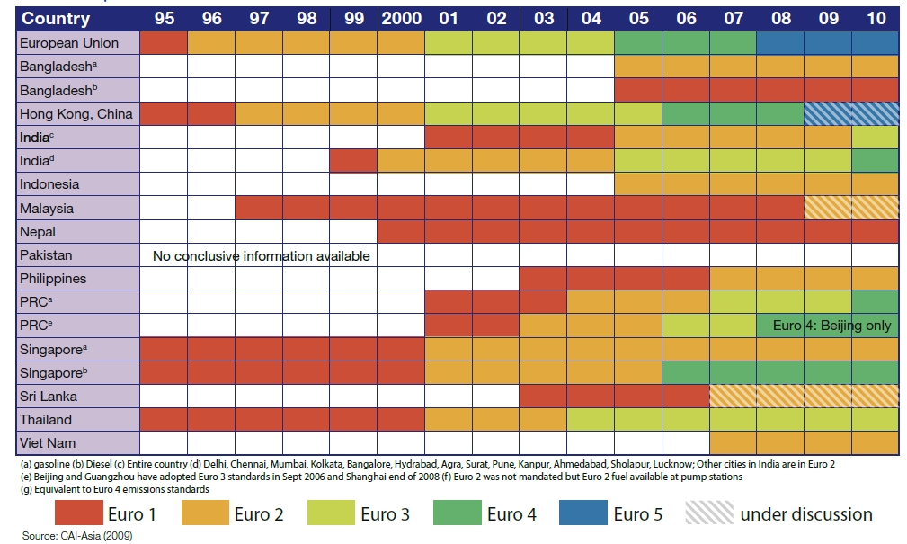
Action Plan for Clean Air in Cities
  Emission standards worldwide

Slide 29
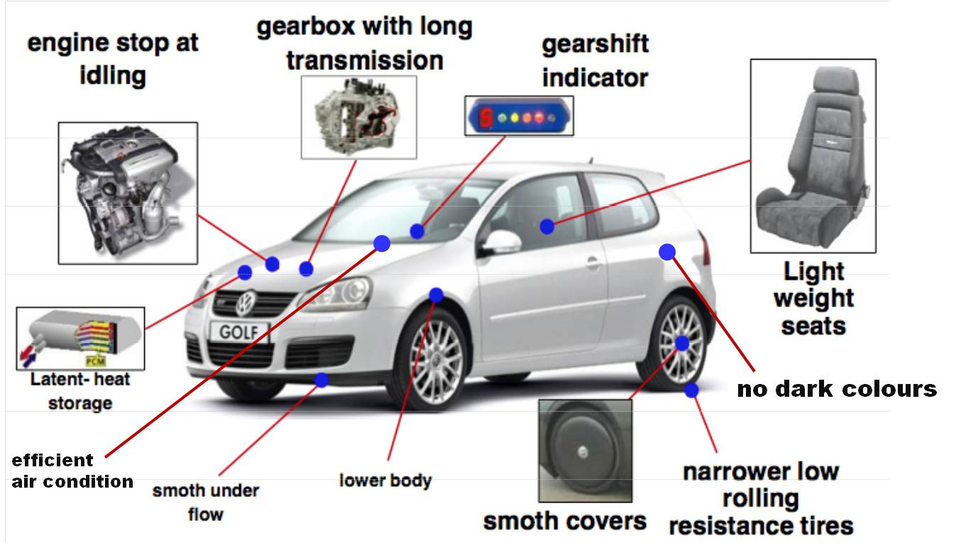
Mitigation options for Indian cities
Improve Vehicle Technologies: Measures can be clustered into three categories
Improvement of existing vehicles
New fuel concepts
Development of new car concepts
Technical options for improving the energy efficiency of LDVs

Slide 30
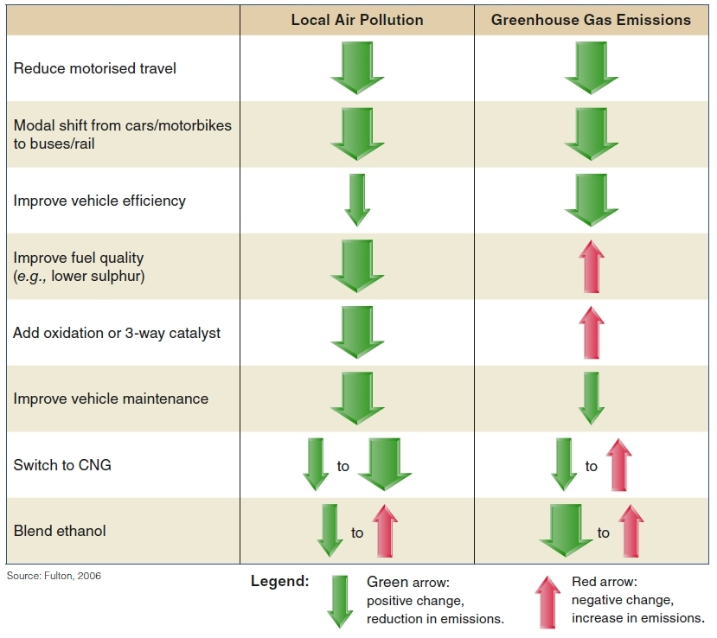
Link between local & global Issues
  Sustainable transport instruments: Synergies between local air quality improvements and GHG mitigation

Slide 31
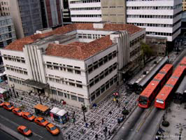
System Efficiency

Slide 32
Options in Development of Cities
Compact City
Urban Sprawl
60% of the population of Barcelona is within 600m of a subway line (99kms of subway lines and 136 metro stations)
To provide the same accessibility as Barcelona, Atlanta would have to build 3,400 km of metro line (compared to the current 74 km) and build 2,800 new railway stations.

Slide 33
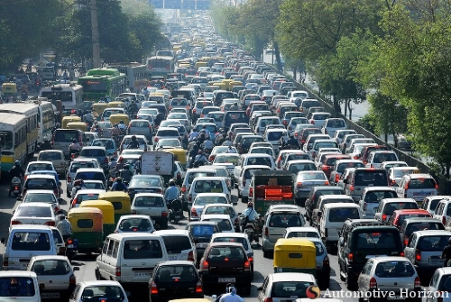
Results of Urban Sprawl
Rampant increase in automobile ownership and usage
Incessant traffic jams
Situation only getting worse
Road in New Delhi – Source: http://carimg.sulekha.com/automotive-albums/default/original/delhi_traffic_congestion.jpg

Slide 34








Effect of Shift
`
Mixed Traffic
Regular Bus
BRT
single lane
Pedestrians
BRT
double lane
Suburban Rail
(e.g. Mumbai)
Cyclists
Light Rail
Heavy Rail
(e.g. Hong Kong)














14 000
18 000
19 000

100 000
2 000
9 000
20 000
43 000
80 000
Pphpd on 3.5m wide lane= pax / hour / direction
Source: Botma & Papendrecht, TU Delft 1991 and own figures

Slide 35
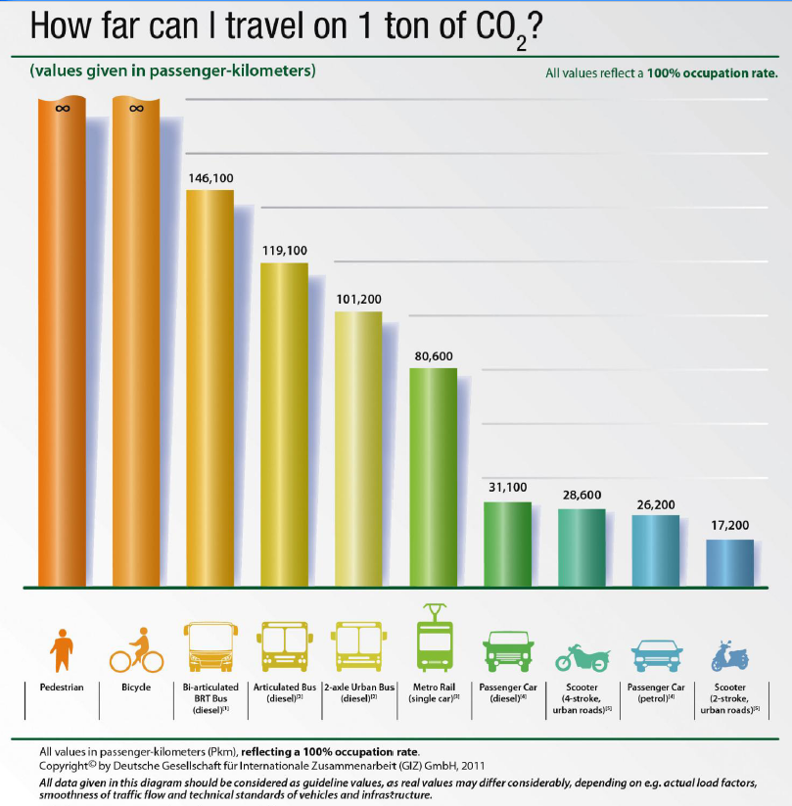
Improve Energy & Environment
`
`
`

Slide 36
Transport & Environment
CO₂ emissions from passenger transport vs. modal split: Selected cities, different lifestyles
 | Share (%) of public transport, walking and cycling | CO2 emissions (kg per capita per year)
Houston | 5% | 5690 kg
Montreal | 26% | 1930 kg
Madrid | 49% | 1050 kg
London | 50% | 1050 kg
Paris | 54% | 950 kg
Berlin | 61% | 774 kg
Tokyo | 68% | 818 kg
Hongkong | 89% | 378 kg
`
Source: UITP

Slide 37
Energy consumption and transport
Breaking the Trend
By using the ASI approach cities increased the modal share of walking, cycling and PT and saw a decrease in the consumption of energy for passenger transport per capita.
Source: UITP
Notes:
It shows that cities with a high and increasing modal share of public transport, walking and cycling, saw a decrease in the consumption of energy for passenger transport per capita.

Slide 38
Thank You!

