Slide 1
Issues and Concerns in California
Dr. Alan Lloyd, President Emeritus
International Council on Clean Transportation
alloyd@theicct.org
Former Chair, California Air Resources Board
Former Secretary, California Environmental Protection Agency

Slide 2
Our current targets
Air Quality
By 2020, attain annual PM2.5 of 12 µg/m³
By 2023, attain 8-hour ozone of 80 ppb
By 2025, attain 24-hour PM2.5 of 35 µg/m³
By 2032, attain 8-hour ozone of 75 ppb
Diesel and Freight Transport
By 2020, diesel PM risk 85% below 2000 levels
Greenhouse Gases
By 2020, reduce to 1990 levels (AB 32)
By 2050, 80% below 1990 levels
Notes:
Since he first came into office in 2003, Governor Schwarzenegger has set ambitious goals for us. We expect to reduce diesel PM by 85% from 2000 and 2020, with similar goals for goods movement. Because of the tripling in freight traffic expected to occur over this time period, this equates to 95% control which we’re accomplishing through a combination of new engine standards by USEPA, cleaner fuels, retrofits, and hundreds of millions of dollars each year for incentive programs.
The Governor issued an Executive Order in 2005 calling for an 80% reduction in greenhouse gas emissions below 1990 levels by 2050. This is the most ambitious target in the world, and is needed to limit global warming to 2ºC (if adopted by the rest of the developed countries), and prevent catastrophic sea level rise. There is an initial step is to reduce California’s emission to 2000 levels by 2010. And by 2020, the goal is to reduce to 1990 emission levels, about 30% below our current trends.
Science tells us the time to act is now to avoid the more severe consequences of climate change.
Governor Schwarzenegger’s Executive Order, released in June 2005, calls for an 80% reduction in GHG emissions below 1990 levels by 2050. This is the most ambitious target in the world, and is needed to limit global warming to 2ºC (if adopted by the rest of the developed and developing countries).
An initial step is to reduce California’s emission to 2000 levels by 2010.
By 2020, the goal is to reduce to 1990 emission levels, about 30% below our current trends.

Slide 3
Issues and concerns
Meeting Air Quality Standards
Los Angeles and San Joaquin Valley
Role of PM transport from East Asia
Role and source of high ozone aloft
Meeting Greenhouse Gas Targets
Transforming California to clean energy
Controlling CH₄ and N₂O emissions
Role of brown carbon
Integrating AQ/GHG Control Programs
Impact of climate change on air quality
Identify co-benefits and trade-offs
3
Notes:
For criteria pollutants as local emissions decrease, concentrations aloft and at the model boundaries are increasingly important in accurately predicting ground-level concentrations for the correct reasons.
Climate change will affect local meteorology, which is the primary factor determining daily pollutant concentrations. Because some pollutant emissions or resultant ambient concentrations impact both air quality and radiative processes (climate), it is important to understand the linkages between air quality, climate change, and meteorology so that emission control strategies are integrated, balanced, and effective.

Slide 4
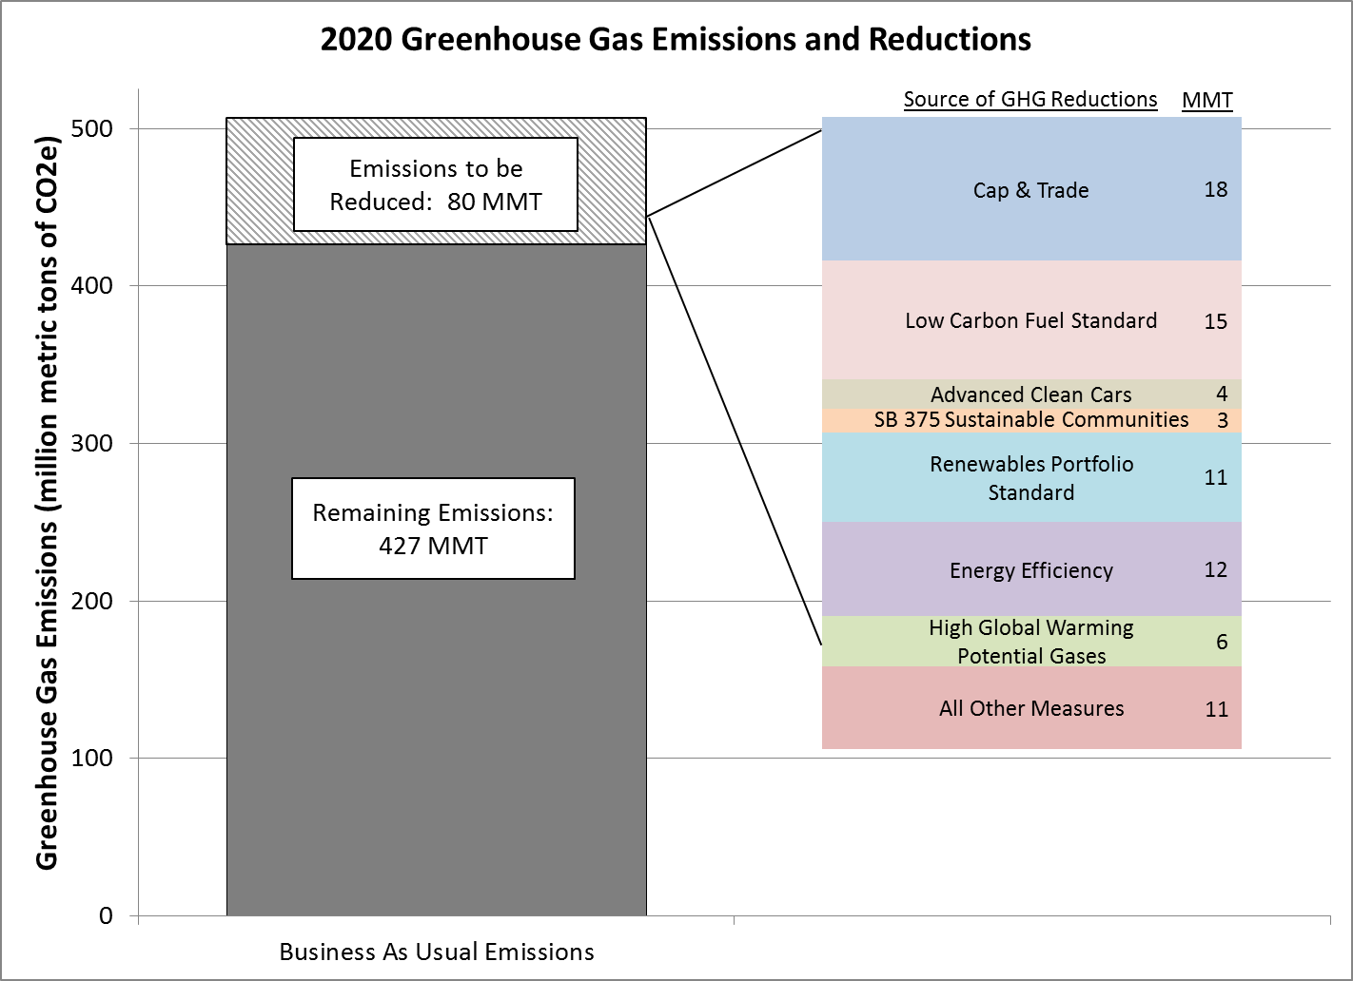
Assembly Bill 32 actions
4
Notes:
Note: the 427 MMT of remaining emissions has already been reduced to account for the benefits of baseline GHG reduction programs, like the first phase of GHG standards for cars, adopted by ARB prior to passage of AB 32.

