Slide 1
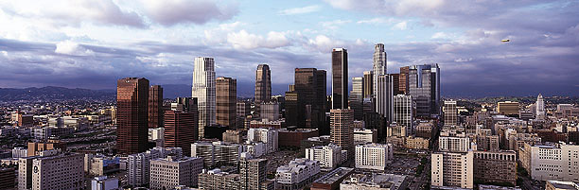
What Was Done in California and How?
Dr. Alan Lloyd, President Emeritus
International Council on Clean Transportation
alloyd@theicct.org
Former Chair, California Air Resources Board
Former Secretary, California Environmental Protection Agency

Slide 2
We regulate emissions
Authorities
Motor vehicles and fuels
(under federal Clean Air Act exemption)
Air toxics, consumer products, greenhouse gases
(under California law)
Oversight over Local Responsibilities
Stationary and area sources
Transportation planning targets
Rulemaking Process
Public hearing of Governing Board
Public workshops and stakeholder meetings
Public and legislative support
Notes:
We are responsible for coordinating the efforts of federal, state, and local authorities to meet ambient air quality standards, while minimizing the impacts on the economy.
We have the ability to set mobile source emission standards more stringent than the U.S. Environmental Protection Agency, except in the areas of shipping and construction. Other states, like many in the Northeast U.S., have taken advantage of their option to adopt our standards. We also set regulations for consumer products, paints, and solvents, and have oversight over other area and stationary sources – which are primarily a local responsibility. Californians support and want air pollution control - 65% put environmental protection over economic growth (although we think California has accomplished both), and this has created a supportive Legislature. California has 4,000 air quality professionals at the State and local levels. Since the beginning of California’s fiscal crisis, CARB’s funding dropped in half and we lost 15% of our staff. Now we are funded completely by fees on cars and industry, which is a more stable source than income tax revenue. We receive up to $166 M per year in incentive funds from fees on vehicle registration and new tire sales. This goes to diesel engine retrofits, car scrappage, and agricultural, port, and locomotive projects. The recently passed Proposition 1B goes to clean-up of California’s ports.
H&SC Part 2. Sec. 39003: The State Air Resources Board is the state agency charged with coordinating efforts to attain and maintain ambient air quality standards, to conduct research into the causes of and solution to air pollution, and to systematically attack the serious problem caused by motor vehicles, which is the major source of air pollution in many areas of the state.
AB32 and Governor’s Executive Orders directed CARB to address the role of, and impacts on, California regarding climate change:
Executive Order # S-03-05, 06/01/05, establishing greenhouse gas emission reduction targets.
Executive Order # S-06-06, 01/25/06, biofuels and bioenergy from renewable resources.
Executive Order # S-20-06, 10/18/06, on responsibilities and roles of state agencies in climate change.
Executive Order # S-01-07, 01/18/07, Low Carbon Fuel Standard.
Executive Order # S-13-08, 11/14/08, Directing State Agencies to Plan for Sea Level Rise and Climate Impacts.
In PPIC’s 13th annual survey on the environment (July 2013), 65 percent of Californians say the government should act right away to cut GHG emissions—up 9 points since 2012. Less than a third (30%) say the state should wait for the economy to improve. Among likely voters, 59 percent say the state should act now, up 13 points since last year
A majority of Californians say air pollution is a big problem (28%) or somewhat of a problem (34%) in the region where they live. Adults living in the Inland Empire (44%), Los Angeles (40%), and Central Valley (31%) are much more likely to say it is a big problem than those living in the San Francisco Bay Area (16%) and Orange/San Diego (14%). Latinos (41%) and blacks (40%) are much more likely to express this view than Asians (23%) and whites (20%). About half of Californians say air pollution in their region is a very serious (22%) or somewhat serious (30%) threat to their health or the health of their immediate families. Residents are divided when asked if they think air pollution is a more serious health threat in lower-income areas of their region (48% yes, 46% no).

Slide 3
Our national impact
Federal Clean Air Act Exemption
for California vehicle emission standards
To meet “compelling and extraordinary” conditions
Must meet or exceed federal regulations
Can be adopted by other states
(15 including Northeast States, Oregon, Washington)
California Firsts
Lead-free gasoline
Low-sulfur fuels
Three-way catalytic converter
Stringent NO_{X} control
Notes:
We are responsible for coordinating the efforts of federal, state, and local authorities to meet ambient air quality standards, while minimizing the impacts on the economy.
We have the ability to set mobile source emission standards more stringent than the U.S. Environmental Protection Agency, except in the areas of shipping and construction. Other states, like many in the Northeast U.S., have taken advantage of their option to adopt our standards. We also set regulations for consumer products, paints, and solvents, and have oversight over other area and stationary sources – which are primarily a local responsibility. Californians support and want air pollution control - 65% put environmental protection over economic growth (although we think California has accomplished both), and this has created a supportive Legislature. California has 4,000 air quality professionals at the State and local levels. Since the beginning of California’s fiscal crisis, CARB’s funding dropped in half and we lost 15% of our staff. Now we are funded completely by fees on cars and industry, which is a more stable source than income tax revenue. We receive up to $166 M per year in incentive funds from fees on vehicle registration and new tire sales. This goes to diesel engine retrofits, car scrappage, and agricultural, port, and locomotive projects. The recently passed Proposition 1B goes to clean-up of California’s ports.
H&SC Part 2. Sec. 39003: The State Air Resources Board is the state agency charged with coordinating efforts to attain and maintain ambient air quality standards, to conduct research into the causes of and solution to air pollution, and to systematically attack the serious problem caused by motor vehicles, which is the major source of air pollution in many areas of the state.
AB32 and Governor’s Executive Orders directed CARB to address the role of, and impacts on, California regarding climate change:
Executive Order # S-03-05, 06/01/05, establishing greenhouse gas emission reduction targets.
Executive Order # S-06-06, 01/25/06, biofuels and bioenergy from renewable resources.
Executive Order # S-20-06, 10/18/06, on responsibilities and roles of state agencies in climate change.
Executive Order # S-01-07, 01/18/07, Low Carbon Fuel Standard.
Executive Order # S-13-08, 11/14/08, Directing State Agencies to Plan for Sea Level Rise and Climate Impacts.
In PPIC’s 13th annual survey on the environment (July 2013), 65 percent of Californians say the government should act right away to cut GHG emissions—up 9 points since 2012. Less than a third (30%) say the state should wait for the economy to improve. Among likely voters, 59 percent say the state should act now, up 13 points since last year
A majority of Californians say air pollution is a big problem (28%) or somewhat of a problem (34%) in the region where they live. Adults living in the Inland Empire (44%), Los Angeles (40%), and Central Valley (31%) are much more likely to say it is a big problem than those living in the San Francisco Bay Area (16%) and Orange/San Diego (14%). Latinos (41%) and blacks (40%) are much more likely to express this view than Asians (23%) and whites (20%). About half of Californians say air pollution in their region is a very serious (22%) or somewhat serious (30%) threat to their health or the health of their immediate families. Residents are divided when asked if they think air pollution is a more serious health threat in lower-income areas of their region (48% yes, 46% no).

Slide 4
Our policy instruments
Performance-based Emission Standards
Aftertreatment effective but turnover slow
Retrofits and repowering also beneficial
Fuel improvements provide immediate benefits
Incentive Funding
$150M per year for diesel engines
$1B for port trucks and equipment
Market-based Programs
Carbon emission trading for large sources
Enforcement and Monitoring Programs
Notes:
Our technology research and development demonstrates that reduced emissions are feasible, but the use of performance-based standards allows industry to come up with more cost-effective approaches.
Enforcement and monitoring programs are also an important key.

Slide 5
Science informs our policies
Legislative Requirements
Automotive Engineer and M.D. on Governing Board
Health-based ambient air quality standards
Extramural research program with external oversight
Peer review of scientific basis for regulations
Workforce
70% engineers and scientists
In-house research
Field/Modeling Studies
Los Angeles and San Joaquin Valley Air Basins
Notes:
Our Governing Board is required to have an MD and engineer as members, and our first and last two chairmen were respected atmospheric scientists. Except for the chairman, our Board only works once per month and relies on us for technical input. Most of our dedicated work force are engineers and scientists, and about 20% of our employees have Ph.D.’s and Master’s degrees. We also have several partnerships with universities (UCLA, UCD) on mobile source research. We conduct our own vehicle testing programs and fund extramural research at a level of $10 million in a good year, about $5 million currently, and take advantage of the strong academic community in California and other states. We also fund a technology demonstration and commercialization program. CARB has funded the development of state-of-the-art emission, air quality, and macroeconomic models. Our technology research demonstrates that reduced emissions are feasible, but the use of performance-based standards allows industry to come up with more cost-effective approaches. Our world-class enforcement and monitoring programs ensure that the emission standards are met. We have a requirement that the scientific underpinnings of all our regulations undergo scientific peer review. This is normally done by the University of California. Underlying this science-based approach is the willingness to move ahead in the face of some uncertainties.
The H&SC directs ARB’s major activities toward protecting public health and welfare from the adverse impacts of air pollution. Of particular note is the mandate to conduct research to promote a fuller understanding of the nature and causes of adverse air quality impacts and through a science-based approach to assure that subsequent emission controls will accomplish their objectives in a timely and cost-effective manner. We have a long tradition of air pollution research to ensure that environmental decision-makers have the best possible scientific information for making their decisions regarding the specific regulations and actions needed to protect public health and welfare from the effects of air pollution.

Slide 6
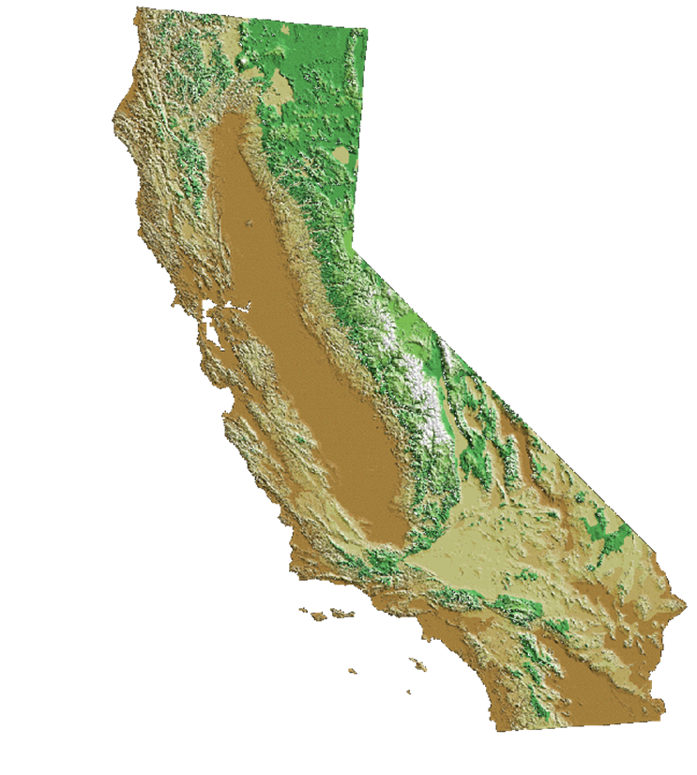
California’s air pollution problem
Unique geography and meteorology confine air pollutants
Over 90% of Californians breathe unhealthy air
38 M people
90 people per km²
24 M gasoline cars
1.3 M diesel vehicles
1.4 B km per day
18 M off-road engines
3 large container ports
Notes:
As you can see from these numbers, transportation plays a major role in California’s air quality problems and greenhouse gas emissions. Although we’ve attained air quality standards for lead, SO₂, sulfates, and NO₂, and cut peak ozone and particle levels by at least 75%, there are still many days of unacceptable ozone and PM across most of the State. In fact, over 90% of Californians continue to breathe unhealthy air at times.

Slide 7
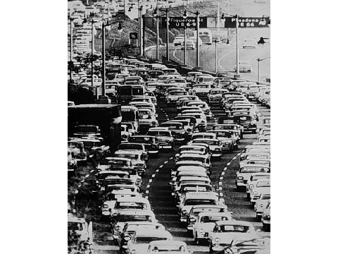
Notes:
Photograph of the Pasadena Freeway, 1950s.
SOURCE: EPA

Slide 8
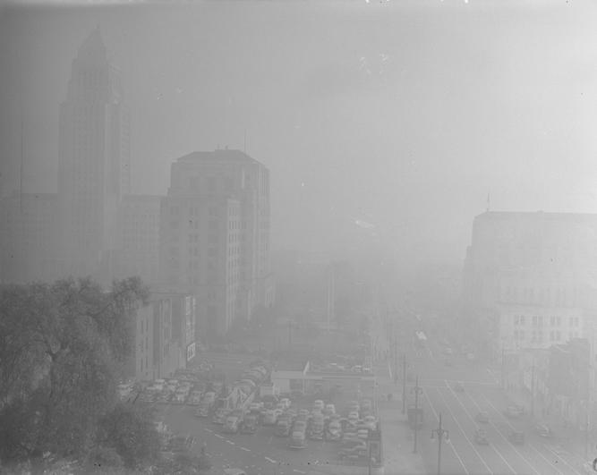
Los Angeles Smog in 1948
Notes:
The air is much cleaner than when it was at it’s worst in the post-World War II period. In the mid-1960s, total oxidant (ozone plus NO₂) levels approached 800 ppb in Los Angeles. 24-hour-average PM10 concentrations exceeded 1800 μg/m³ in desert areas and 600 μg/m³ in Los Angeles.

Slide 9
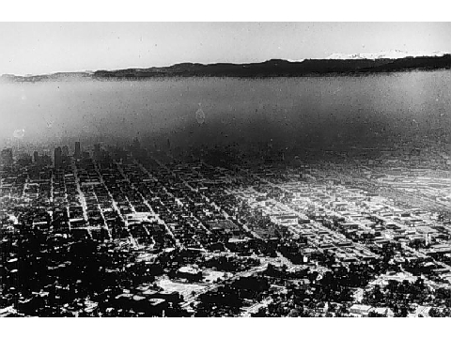

Air quality after World War II
Unhealthy levels of lead, NO₂, SO₂, CO, ozone, particulate matter, and air toxics
Poor visibility
Difficulty breathing
Extreme eye irritation
In Los Angeles
  Over 100 smog alerts annually
  Over 300 days with unhealthy air annually
Notes:
9
[CLICK TO START VIDEO]
In 1968, the air quality in California was filthy by today’s standards.
The most visible aspect of air pollution was the brownish haze of smog that cloaked California cities, particularly in the South Coast, throughout much of the year. The smog was thick with irritating substances like ozone, formaldehyde and peroxyacetyl nitrate or PAN, which made breathing difficult and made eyes water.
Most Californians breathed high levels of lead, nitrogen dioxide, sulfur dioxide, carbon monoxide, particulate matter and air toxics – pollutants that are harmful to human health.
Toxic emissions from industry, incinerators and consumer products poured into the air with few restrictions.
The air is much cleaner than when it was at it’s worst in the post-World War II period. In the mid-1960s, total oxidant (ozone plus NO₂) levels approached 800 ppb in Los Angeles. 24-hour-average PM10 concentrations exceeded 1800 μg/m³ in desert areas and 600 μg/m³ in Los Angeles.
In 1980, most Californians breathed unhealthy levels of lead, nitrogen dioxide, sulfur dioxide, carbon monoxide, ozone, particulate matter, and/or air toxics.
In the South Coast, there were over 100 days of Stage 1 health alerts when all residents were urged to restrict their activity outdoors. Peak ozone levels reached 49 parts per hundred million -- our air quality standard is 9 pphm.

Slide 10
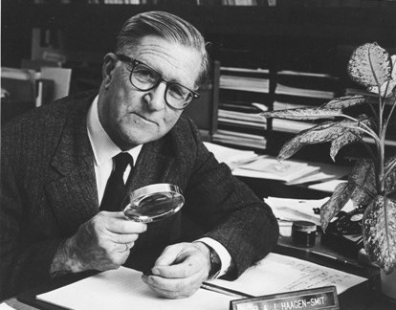
Notes:
Arie Haagen-Smit

Slide 11
Cancer risks from airborne toxics*
(90% of risk from traffic pollutants)
Diesel PM
1,3-Butadiene
Hexavalent Chromium
Carbon Tetrachloride
Benzene
para-Dichlorobenzene
Formaldehyde
Perchloroethylene
Acetaldehyde
All Others
* Estimated 400 cases/year in 2005 (dioxins not included).
Notes:
This slide shows the relative contribution of known air toxics to overall cancer risk.
The diesel PM estimate is based on distributions of time-activity patterns to estimate population-weighted personal exposure, while the other pollutants are based strictly on measured outdoor levels. If we included indoor sources, formaldehyde and perchloroethylene would increase relative to the others.
We measure another 30 air toxics, but the risk levels are much lower. Dioxins are not included, but appear to be similar to 1,3-butadiene and benzene in terms of cancer cases.
90% of the risk appears to be due to mobile sources, and we have focused our control program this decade on diesel PM.
Of the known cancer-causing air pollutants in California, the mobile source-related air toxics of diesel PM, 1,3-butadiene and benzene account for 90% of the total risk.
NOTES:
California has a network of 20 monitoring stations for air toxics that represent average population exposures. We don’t have a routine diesel PM measurement, but rather infer from a peer-reviewed methodology based on a strong correlation with total NOx measurements.

Slide 12
Air pollution causes premature death
California estimates
Pollutant | Annual Deaths*
PM2.5 | 5,800 to 8,900
Ozone | 300 to 1000
Toxic Air Contaminants | <400
*2009-2011 for PM2.5; 2005 for ozone and TAC
Note: 233,00 total deaths in 2010
Notes:
Using HEI and USEPA-sponsored research, we estimated a range for the number of premature deaths associated with PM and ozone, as shown in the far right column. Because of its much higher concentration-response relationship, long-term exposure to PM2.5 appears to be responsible for up to 90% of these deaths, and has become the focus of our control efforts.
Factor of two uncertainty
===============
PM2.5 – 7,300 to 11,000 using 2006-08 data
And these are not people dying a few days earlier – the USEPA has calculated an average of 14 lost life years.
Ozone numbers are mortality associated with difference between 2004-2006 ambient levels and state standard of 70 ppb. These estimates are unpublished, but they’re the latest we have.
we roll back to 70 ppb for ozone and 5.8 µg/m3 or PM2.5. The CR functions are central estimates.
You list a TAC number of 400. I am sending you a chart with TAC trends that include DPM and other TACS. When you present the data, you may want to consider that the DPM is a subset of PM2.5 so they cannot be added together.
I would take out the sentence on EPA’s estimate of 14 years of life lost. I am not sure I believe it.

Slide 13
Our current targets
Air Quality
By 2020, attain annual PM2.5 of 12 µg/m³
By 2023, attain 8-hour ozone of 80 ppb
By 2025, attain 24-hour PM2.5 of 35 µg/m³
By 2032, attain 8-hour ozone of 75 ppb
Diesel and Freight Transport
By 2020, diesel PM risk 85% below 2000 levels
Greenhouse Gases
By 2020, reduce to 1990 levels (AB 32)
By 2050, 80% below 1990 levels
Notes:
Since he first came into office in 2003, Governor Schwarzenegger has set ambitious goals for us. We expect to reduce diesel PM by 85% from 2000 and 2020, with similar goals for goods movement. Because of the tripling in freight traffic expected to occur over this time period, this equates to 95% control which we’re accomplishing through a combination of new engine standards by USEPA, cleaner fuels, retrofits, and hundreds of millions of dollars each year for incentive programs.
The Governor issued an Executive Order in 2005 calling for an 80% reduction in greenhouse gas emissions below 1990 levels by 2050. This is the most ambitious target in the world, and is needed to limit global warming to 2ºC (if adopted by the rest of the developed countries), and prevent catastrophic sea level rise. There is an initial step is to reduce California’s emission to 2000 levels by 2010. And by 2020, the goal is to reduce to 1990 emission levels, about 30% below our current trends.
Science tells us the time to act is now to avoid the more severe consequences of climate change.
Governor Schwarzenegger’s Executive Order, released in June 2005, calls for an 80% reduction in GHG emissions below 1990 levels by 2050. This is the most ambitious target in the world, and is needed to limit global warming to 2ºC (if adopted by the rest of the developed and developing countries).
An initial step is to reduce California’s emission to 2000 levels by 2010.
By 2020, the goal is to reduce to 1990 emission levels, about 30% below our current trends.

Slide 14
Major California control programs
Smoke controls began in 1945
  Backyard burning, open burning at garbage dumps, industrial smoke
Hydrocarbon controls begin in 1956
  Gasoline storage tanks and trucks
1970s
  Industrial SO_{X} controls
  Lead and RVP limits for gasoline
  Three-way catalysts for passenger cars
1980s
  On-board diagnostics
  Low-sulfur gasoline and diesel
1990s
  Air toxics
2000s and beyond
  Light trucks meet same standards as cars
  Diesel PM and NO_{X}
  Greenhouse gases

Slide 15
Performance-based regulations
Mobile Sources (>99% gasoline, 98% diesel reduction)
  Cleaner engines
  Aftertreatment
  Cleaner gasoline and diesel fuel
  Alternative fuels
Stationary Sources (80-90% reduction)
  Low-NO_{X} burners
  Selective catalytic reduction
  Cleaner fuels
Area Sources (>75% reduction)
  Vapor recovery
  Low-volatility solvents, paints, consumer products
Notes:
15
15
To reduce emissions, the Air Resources Board and local air districts adopted an aggressive strategy of air pollution controls. The Air Resources Board has led the way in pursuing controls which push the technological envelope and encourage innovation.
Key mobile source controls include cleaner engines; after treatment systems such as 3-way catalysts for automobiles and diesel particulate traps for large trucks; cleaner gasoline and diesel fuel; and alternative fuels.
Adopted mobile source emissions standards represent a reduction of over 99 percent for new gasoline vehicles, and 98 percent for new diesel vehicles, relative to their pre-control levels.
Industrial source control measures include low NO_{X} burners, selective catalytic reduction, and cleaner fuels such as compressed natural gas. These have resulted in an 80 to 90 percent reduction in oxides of nitrogen.
Other control measures on smaller sources include vapor recovery systems in cars and gas pumps, and low-VOC consumer products. Together these controls have achieved around a 75 percent reduction in reactive organic gases.

Slide 16
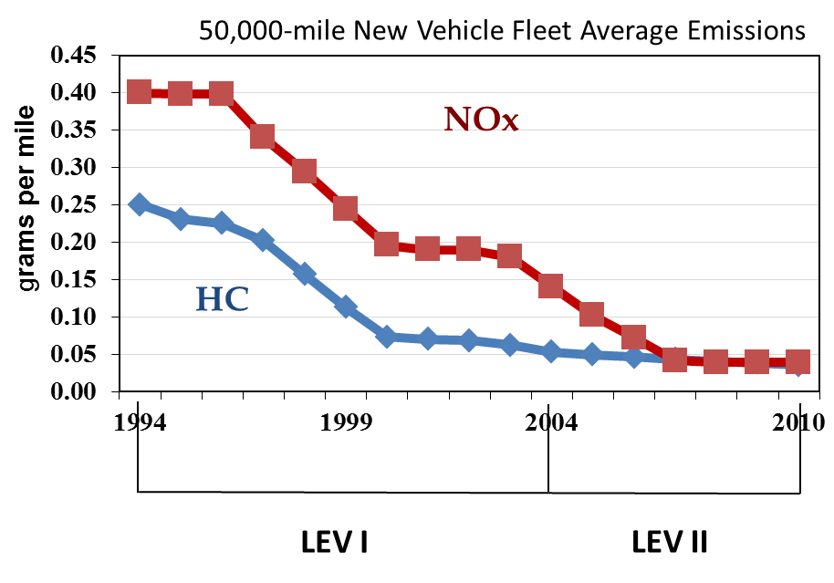
Light-duty emission standards
EGR
TWC
On-Board Computer
NOx
Advanced Computer
Fuel Injection
O2 Sensor
Oxidation
Catalyst
HC
1966
1975
Unleaded Gasoline
1993

Slide 17
Heavy-duty emissions standards
Computer Control
EGR
DPF
SCR
Notes:
1991 and 1994 standards met by: Injection Timing Retard, Increased Inj. Pressure, Reduced Intake Manifold Temperature
1998 standard met by: Adv. in Combustion Chamber Design, Electronic Controls, Charge Air Cooling
2004 standard met by: cooled EGR, VGT, common rail fuel injection
2007 standard met by DPF
2010 standard met by SCR

Slide 18
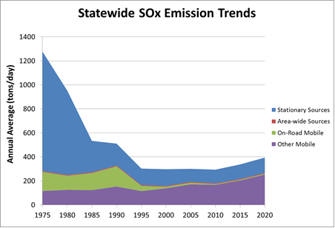
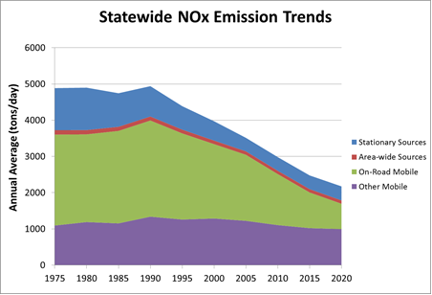
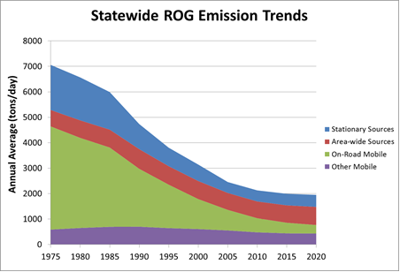
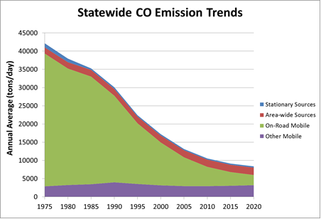
California emission trends

Slide 19
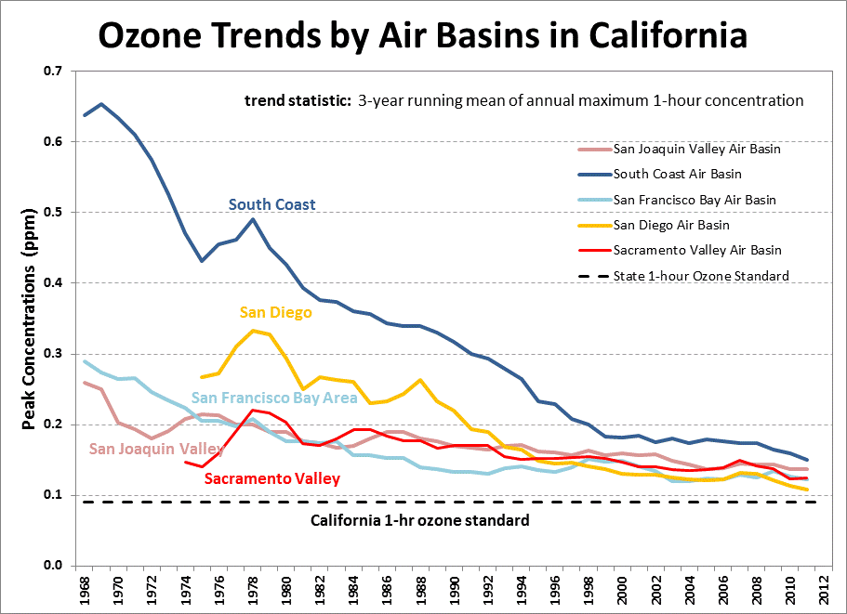

Slide 20
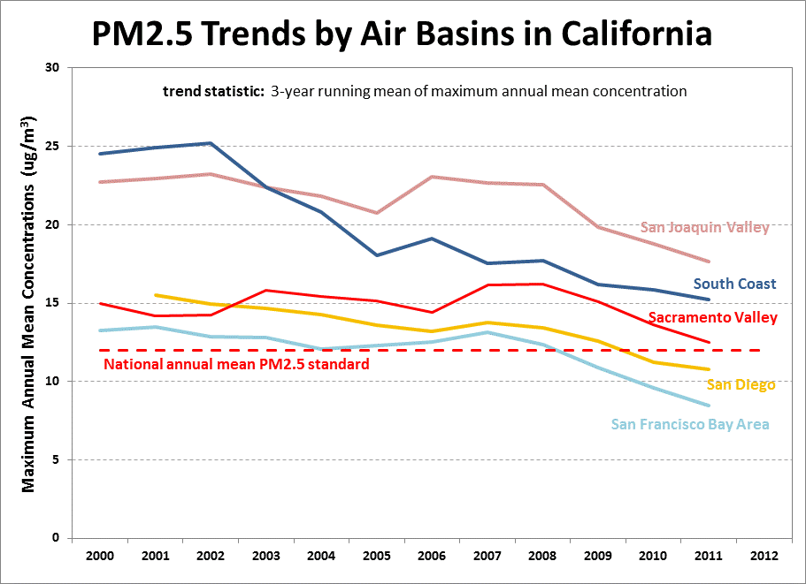

Slide 21
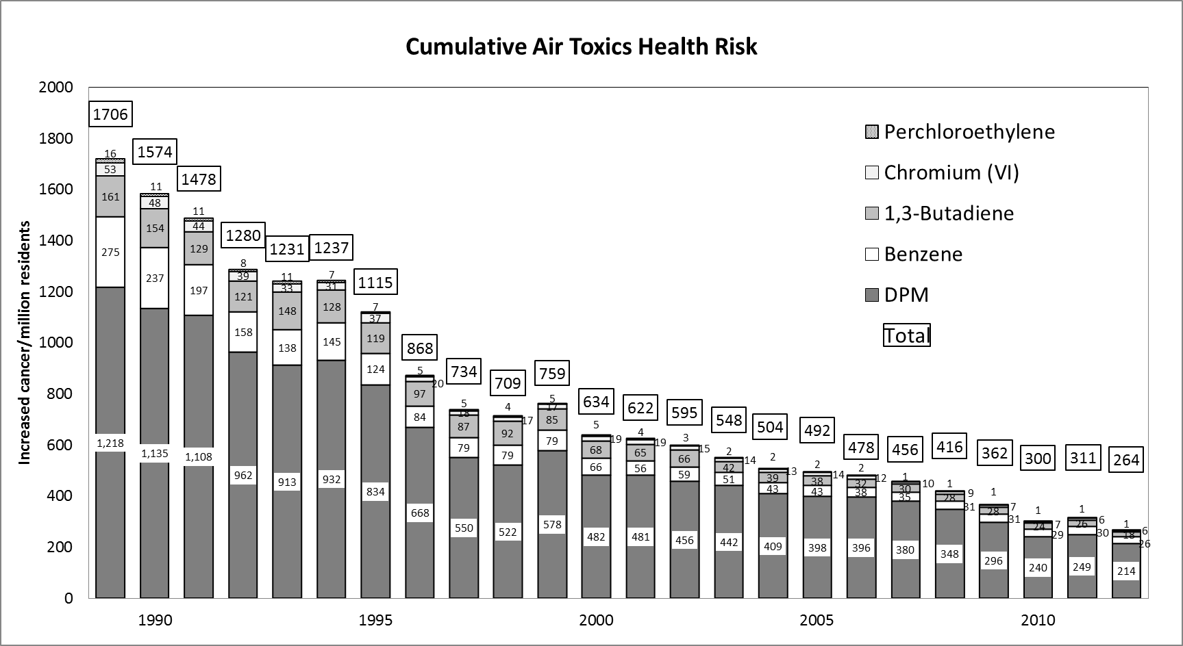
Cumulative lifetime cancer risk
(per million)

Slide 22
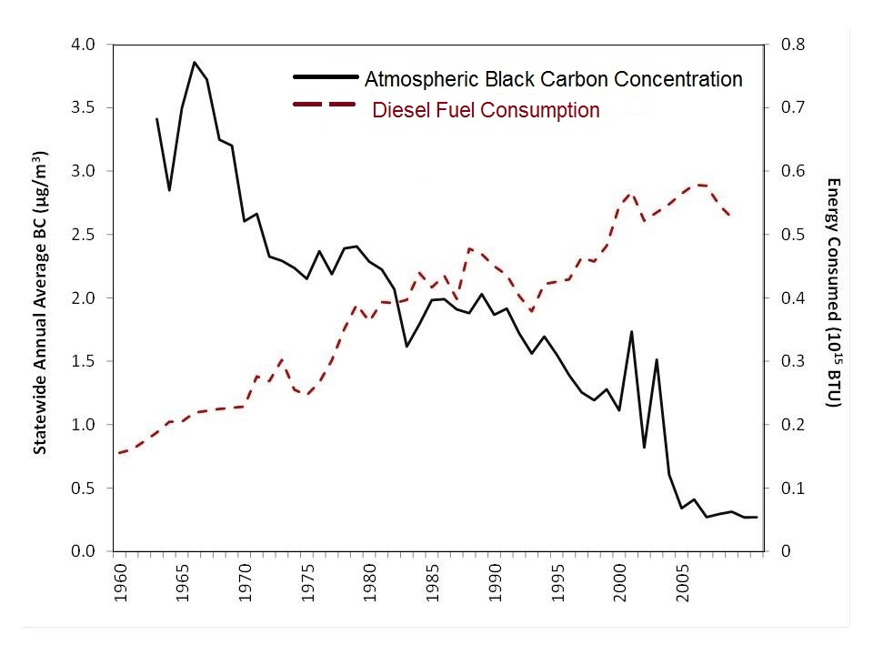
California Progress on Black Carbon
Ramanathan et al. (2013) Black Carbon and the Regional Climate of California, CARB Contract No. 08-323
22
Notes:
Over the last 40 years, as shown in this graph from Tom Kirchstetter of Lawrence Berkeley National Laboratory, there has been a large decrease in observed black carbon levels in California, even though distillate fuel oil consumption went up by a factor of four. Diesel fuel consumption went up even more, by a factor of six. This reduction is due to CARB and USEPA regulations and enforcement programs.

Slide 23
Air pollution reduced 75-90% despite growth
Carbon
Monoxide
Nitrogen
Dioxide
Sulfur
Dioxide
Population
Number
of Vehicles
Vehicle
Miles
Ozone – Los Angeles peak reduced 70%, hours of exposure by 90%
PM10 – annual-average levels reduced 75%
Air toxics – lead eliminated, cancer risk reduced 80% (since 1989)
Black carbon – reduced 90% (95% by 2020)
Notes:
23
Levels of other pollutants have diminished considerably as well. Since 1968, the peak level of carbon monoxide has shrunk by 87 percent, nitrogen dioxide by 83 percent, and sulfur dioxide by 90 percent.
Pollutant levels have fallen in spite of California’s rapid growth. In the same time period, California’s population almost doubled, the number of vehicles on the road increased by 170 percent, and the number of vehicle miles traveled almost tripled.
Today, lead, as a regional pollutant from gasoline, is a problem of the past. The entire state meets the health-based standards for lead, as well as nitrogen and sulfur dioxides. Fifty-six of the state’s fifty-eight counties meet the carbon monoxide standards. The South Coast has not seen a Stage 1 smog alert in over three years and ozone peaks are down over 50 percent. Annual average PM10 concentrations have declined over 20 percent and the statewide cancer risk from air toxics is down by 50 percent. Let’s look more closely at trends for several of the pollutants that still pose a challenge.

Slide 24










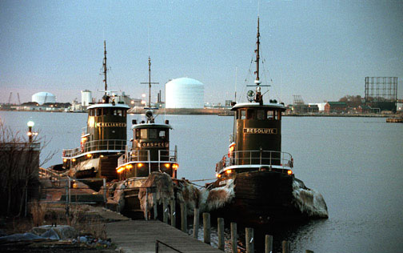
In-Use Diesel Regulations
Urban Buses (2000) Garbage Trucks (2003) Stationary Engines (2004) Transport Refrigeration Units (2004) Portable Engines (2004) Transit Fleet Vehicles (2005) Public Fleets & Utilities (2005) Cargo Handling Equipment (2005) | Drayage Trucks (2007) Off-Road Vehicles (2007) Trucks and Buses (2008) Tractor-Trailer GHG (2008) Agricultural Tractors and Equipment (under development)
24

Slide 25
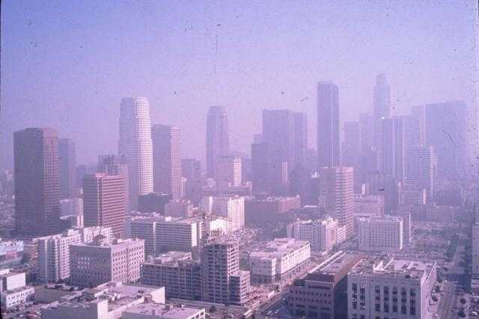
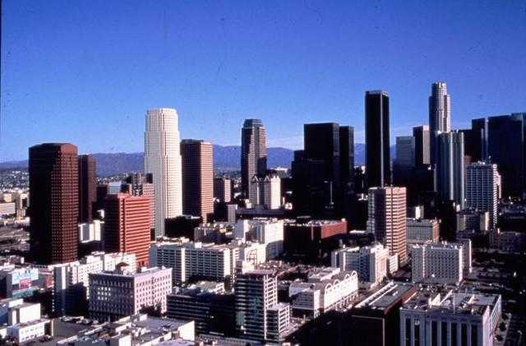
Costs of Control
0.5% GDP (US 1990-2020)
  Benefits of Control
  $10-95 in health benefits for each $1 of control (US 1970-1990)
  $30 in health benefits for each $1 of control (US 1990-2020)*
  Air pollution control industry – 32,000 jobs and $6.2B (CA 2001)
  Clean energy industry – 123,000 jobs and $27B (CA 2009)
U.S. EPA Reports to Congress on The Benefits and Costs of the Clean Air Act (www.epa.gov/air/sect812/index.html)
* 1990-2020 uncertainty analysis under development
Notes:
25
The improvements in California's air quality over the last four decades have come at a modest cost to society.
The total cost of air pollution controls is estimated to be 10 billion dollars, a small share of California’s 2 trillion dollar economy. At the same time, the air pollution control industry in California generates around 6.2 billion dollars and employs 32,000 people, so much of the money spent on control stays in the state. A recent study by EBI concluded that the air pollution control industry in California generated $6.2 billion in revenues and employed 32,000 people in 2001. The U.S. figures are $27 billion in revenues and employment of 178,000 people.
The benefits of controls include thousands fewer premature deaths and hospitalizations each year, and millions fewer lost school and work days.
The value of these benefits is approximately four dollars for every dollar spent on control. California’s air pollution control strategies are cost-effective.

Slide 26
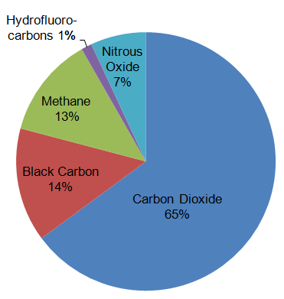
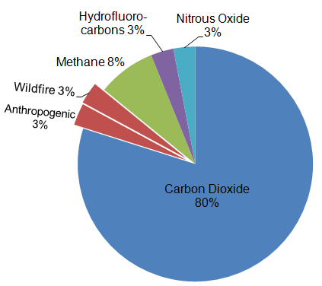
Climate Pollutant Emissions
(2010)
Global
California
26
Notes:
Globally, short-lived climate pollutants (SLCPs) represent nearly 28 percent of the total climate pollutant emissions. In California, their contribution is about 17 percent. SLCPs have atmospheric lifetimes ranging from a few days to a few decades, but during these shorter lifetimes they are very potent. Because they are more quickly cleared from the atmosphere, reducing their emissions results in immediate climate and air quality benefits.
Note: 100-year GWPs with global GHG data from World Research Institute (WRI) web site. 100-year GWP year for black carbon is from Bond et al study that is also cited in the recent IPCC-AR5 report.

Slide 27
California leader in energy efficiency
14,000
United States
12,000
California
New York
10,000
8,000
kWh/person
6,000
4,000
2,000
0
1960
1965
1970
1975
1980
1985
1990
1995
2000
year
27
www.eia.doe.gov/emeu/states/sep_use/total/csv/use_csv
Notes:
Despite larger house and more appliance, California and New york have been able to hold household energy use constant at pre-OPEC oil embargo levels. This equate to $110 savings per capita (ASK DANA TO CHECK)
-------------
PROGRAMS
Cool roofs
Standby losses
Pigments that reflect invisible near-infrared radiation
“Fleet” Average for Lighting Efficiency
Air conditioning system standards for U.S. split into regions based on type of weather
White roofs on existing buildings
Benchmarking of Commercial Buildings – fine tuning of energy management systems

Slide 28
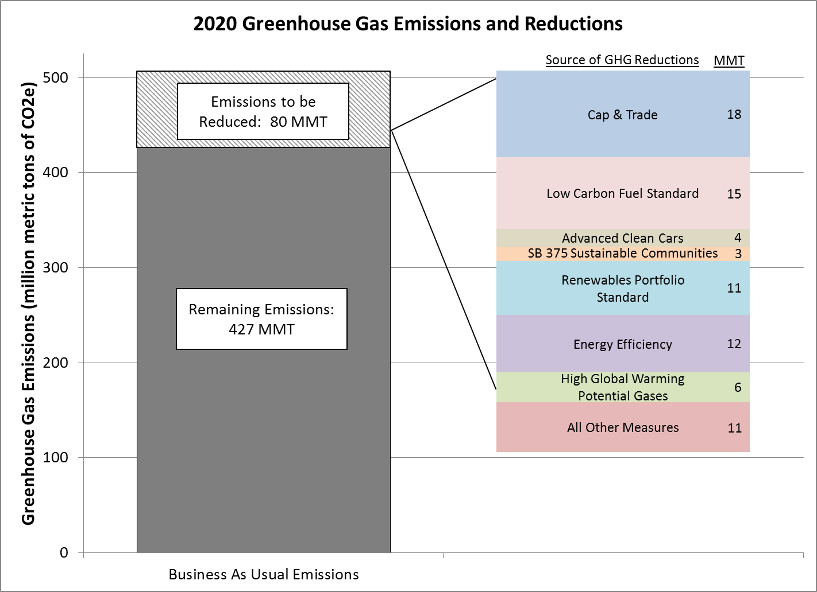
Assembly Bill 32 actions
28
Notes:
Note: the 427 MMT of remaining emissions has already been reduced to account for the benefits of baseline GHG reduction programs, like the first phase of GHG standards for cars, adopted by ARB prior to passage of AB 32.

Slide 29
Major California GHG policies
Transportation
  54.5 mpg fleet average by 2025
  1.5 million zero emission vehicles by 2025
  10% lower carbon intensity by 2020
  ~7.6% per capita VMT reduction by 2020, ~12% by 2035 (SB 375)
Electricity generation
  33% renewable by 2020
  No coal after 2025 (SB 1368)
  12,000 MW renewable self generation by 2025
Energy efficiency
  Appliance standards
  $2.5B for school retrofits (Prop 39), retrofit existing building (AB 758)
  Zero energy new residential buildings by 2020, commercial by 2030
Water
  20% per capita water consumption reduction by 2020
Waste
  75% diversion by 2020 (AB 341)

Slide 30
Summary
California had worst air quality in world
Current air pollution health risk
  PM2.5 >> ozone > air toxics
Emissions control focus
  1950s and 1960s: smoke
  1970s and 1980s: lead, SO_{X}, hydrocarbons and NO_{X}
  1990s to present: diesel PM and NO_{X}, air toxics, GHG
Air quality improved 75-90% over past 45 years
Benefits much greater than control costs
Need to achieve 80-90% GHG control
Notes:
Others:
On-road controls have greatest benefits

