Slide 1
Mitigating Air Pollution: Overview
Dr. Alan Lloyd
India-California Air Pollution Mitigation Program
Oakland, CA
22 October 2013

Slide 2
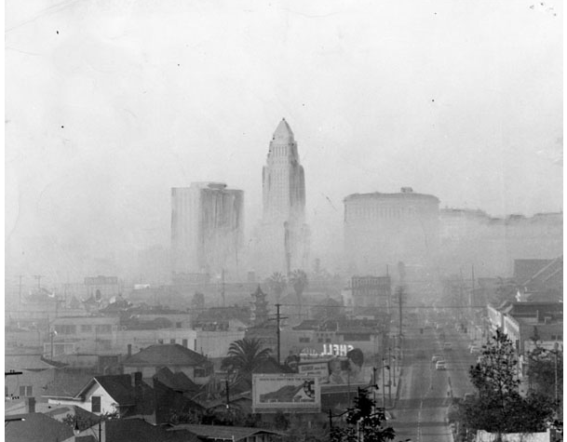
Los Angeles: October 1968
Examiner Collection photo courtesy of The Los Angeles Public Library

Slide 3
Overview: What has worked in California
Strong public health interest
Strong research base
Strong civil society interest
Technology-forcing standards

Slide 4
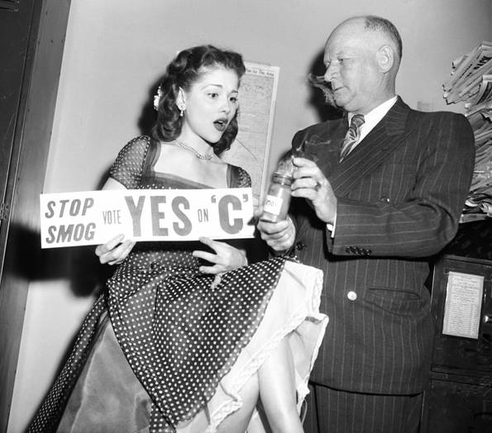
Strong Public Push for Clean Air
Health Effects
  Children’s Health Study
  Los Angeles Field Studies
Crop damage
Visibility
Property damage

Slide 5
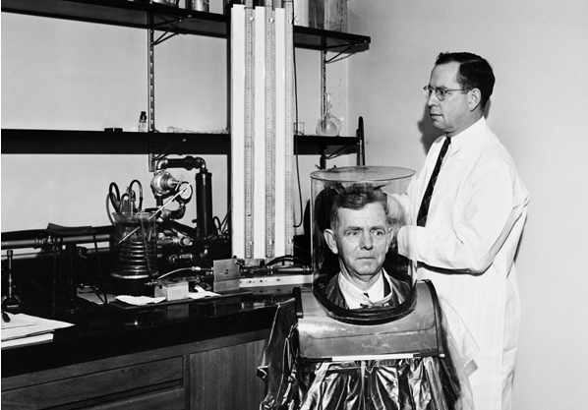
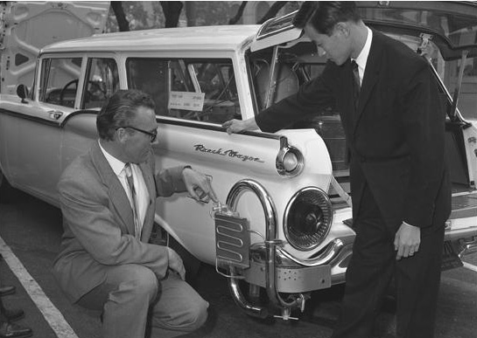
Strong Public Research Interest
Key Institutions
  CalTech
  Stanford University
  University of California
  USC
  Cal State Universities
  National labs
Strong Government Research Programs
  ARB Research Division
  OEHHA

Slide 6
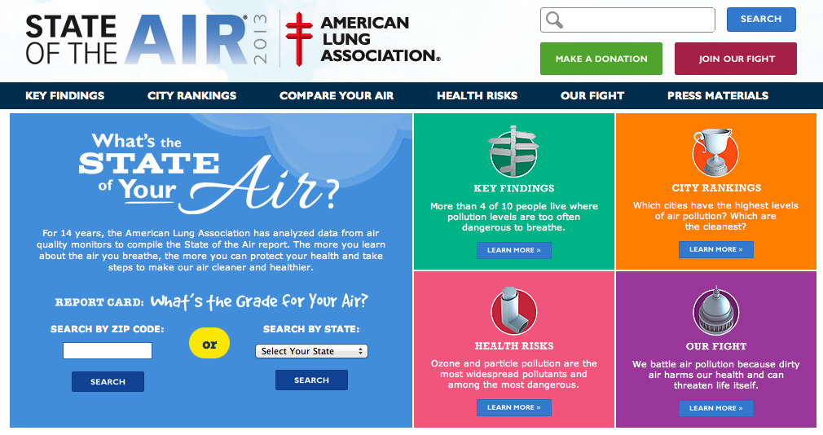
Strong Civil Society Interest
American Lung Association: Annual State of the Air Report

Slide 7
Diesel Toxicity Finding
OEHHA Risk Assessment
  1998: California Air Resources Board classified diesel particulate matter as a toxic air contaminant
ARB Risk Management
  2000: Diesel Risk Reduction Plan
California Air Resources Board: Particulate Emissions from Diesel-Fueled Engines as a Toxic Air Contaminant.
http://www.arb.ca.gov/toxics/dieseltac/dieseltac.htm

Slide 8
Major Shifts in Technologies
Technological Strategies for BC Control

Slide 9
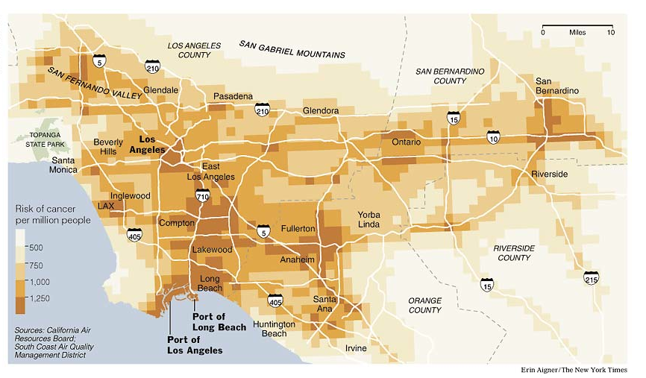
Risk of Cancer in Los Angeles from Diesels (2005)
http://www.nytimes.com/imagepages/2005/08/02/national/20050803_angeles.html

Slide 10
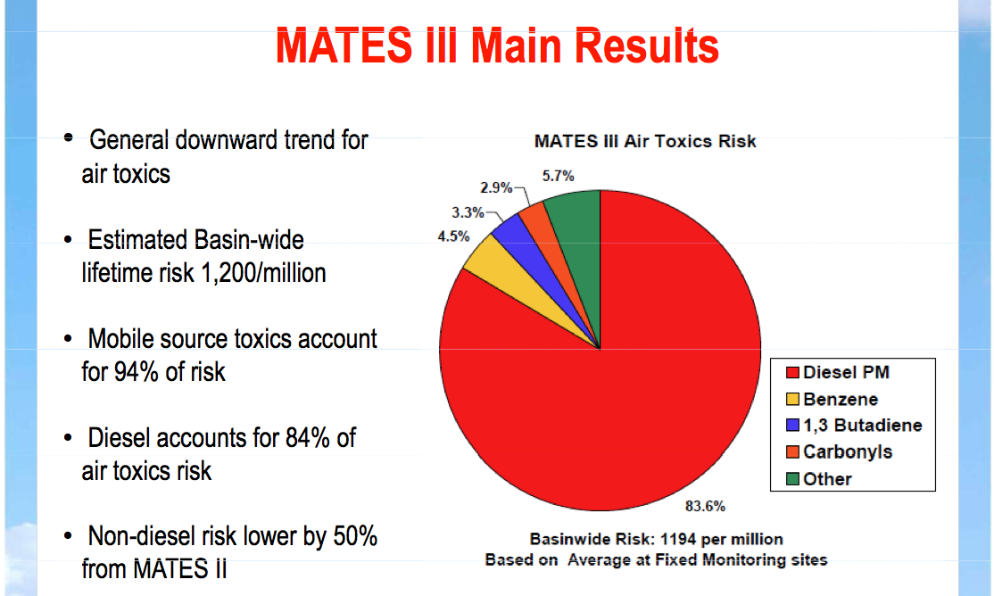
Diesel Particulate Matter in Los Angeles

Slide 11
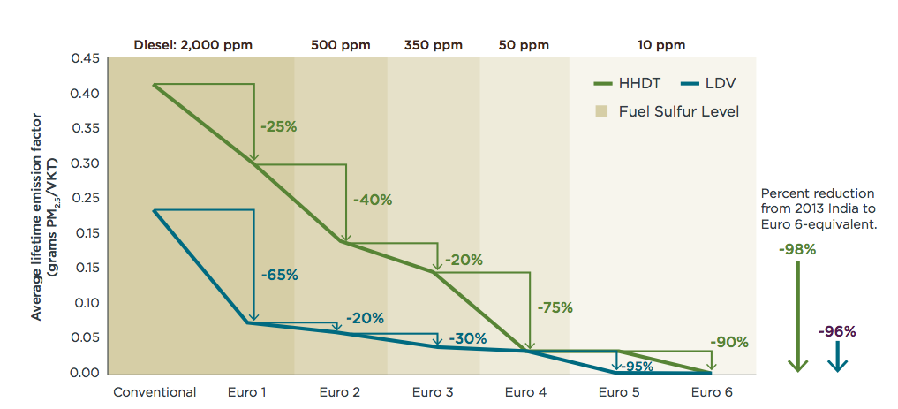
Performance-Based Standards
Standards forced fuel-neutral changes in technologies

Slide 12

Improvements in Nitrogen Oxides

Slide 13
What still needs improvement in California
Links between land use planning and vehicle emissions
Strategies that shift human behavior toward efficient travel
Investments in non-motorized transport
Investments in public transport
Etc.

Slide 14
Comparison of passenger vehicle fuel economy standards
India
http://www.theicct.org/passenger-vehicles/global-pv-standards-update/

Slide 15
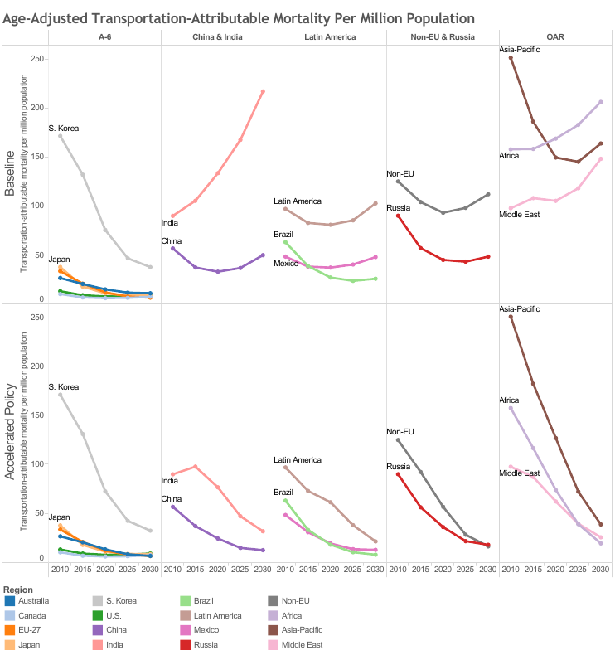
Developing Regions will Experience Large Growth in Health Risk From Vehicle Emissions
International Council on Clean Transportation (2013). The Impact of Stringent Fuel and Vehicle Standards on Premature Mortality and Emissions. In Press.

Slide 16
Accelerated adoption of fuel/vehicle standards will Protect Future Health Gains
International Council on Clean Transportation (2013). The Impact of Stringent Fuel and Vehicle Standards on Premature Mortality and Emissions. In Press.

Slide 17
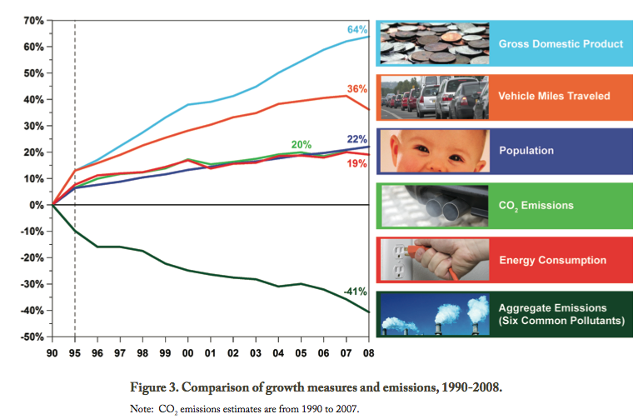
Cleaner Air and Economic Growth

Slide 18
Suggestions for India Going Forward
Policies based on sound science
Systems approach works
Monitor ambient air
Ability to recall vehicles and enforce fuel quality standards
Legal framework should exist for implementing regulations
Judicial framework should exist for citizen lawsuits
See ICCT India Retrospective Report
http://www.theicct.org

Slide 19
Thank You

