Slide 1

Policy Conclave on reducing vehicular emissions to improve air quality
Improving quality of public transportation and support for non-motorized transport
Dinesh Mohan
INDIAN INSTITUTE OF TECHNOLOGY DELHI

Slide 2

Woodcock etc al, Lancet
IITDELHI 2/4/2014
Notes:
These are the per capita carbon dioxide emissions from transport from the different futures. BAU is business as usual with no mitigation measures.
1.3, 1.2, 0.7, 0.7, 0.45
Similar reductions with lower emission motor vehicles and more active travel but only achieve targets (60% reduction) with combined mitigation approach

Slide 3
Notes:
These are the per capita carbon dioxide emissions from transport from the different futures. BAU is business as usual with no mitigation measures.
.47, .75, .66, .40, .36
Under the combined approach emission reduction scenario we would see emissions per capita slightly lower than London but this could be part of a contraction and convergence approach.

Slide 4
Delhi: Health impacts by cause
 | Change in disease burden | Change in premature deaths
Ischaemic heart disease | 11-25% | 2490-7140
Cerebrovascular disease | 11-25% | 1270-3650
Road traffic crashes | 27-69% | 1170-2990
Diabetes | 6-17% | 180-460
Depression | 2-7% | NA
IIT Delhi 4 February 2014
Notes:
Here again now looking at combined impact, ranked in terms of population health impact, with % reduction in condition specific disease burden and the corresponding reduction in premature deaths.
In Delhi as in London we found the biggest benefit from less heart disease (affected by both air pollution and physical activity) and stroke.
But we also found fewer road traffic fatalities and important benefits from less diabetes and depression.

Slide 5
Petrol pump survey
Delhi
Cars - 1.28 million (59% of registered)
Two-wheelers - 1.95 million (45% of registered)
IIT Delhi 2/4/2014

Slide 6
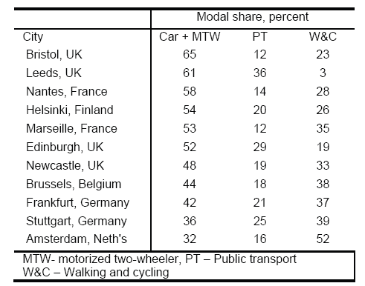
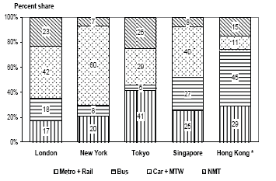
ISSUES
Even cities in high income countries have not been able to solve the problems that all of us have to deal with in the near future
NO INDIAN CITY HAS CAR USE MORE THAN 15% CAR USE
IIT Delhi
IITDELHI 2/4/2014

Slide 7
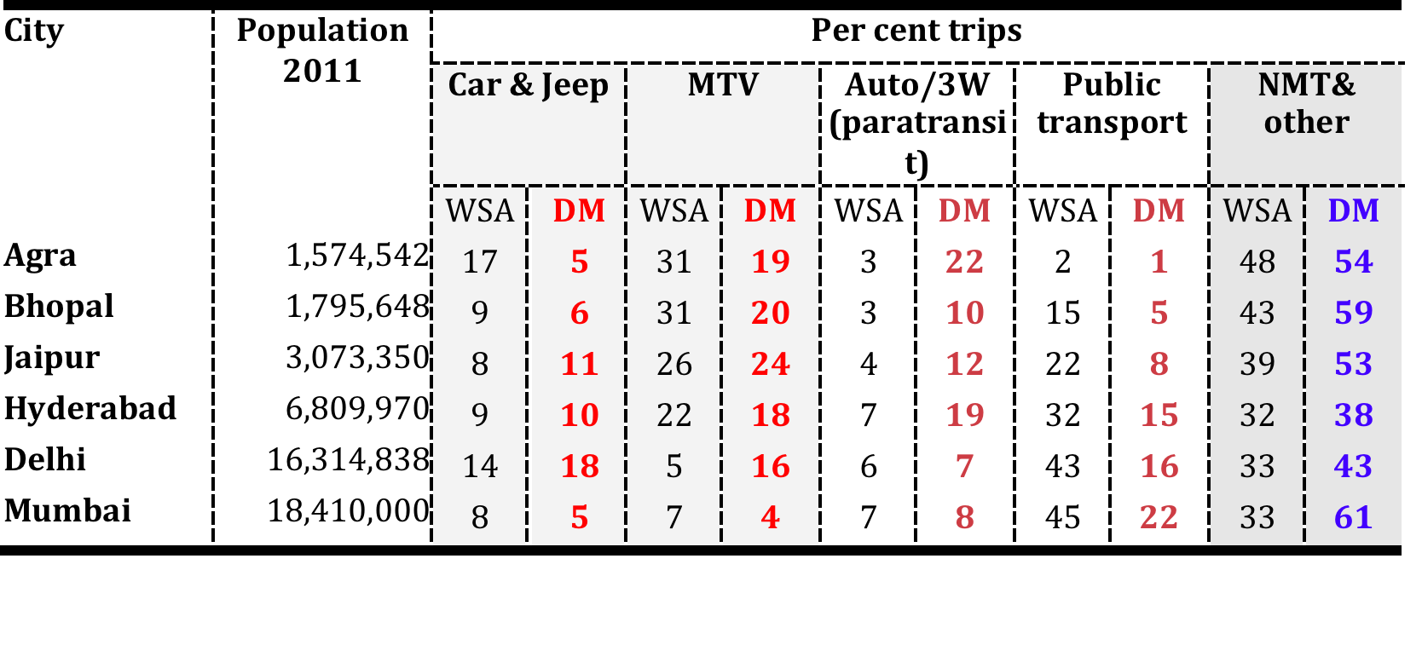
Estimated trip rates
+
+
WSA – Wilbur Smith Associates
Underestimates:
Bus trips not included: contract buses + company buses
Auto/3W: overloading, real number not available
IIT Delhi 4 February 2014

Slide 8
Understanding public transportation and non-motorized transport in Indian cities
There is a pent up demand for non motorised transport, but middle classes perceive roads to be unsafe – hence forced motorised transport
Each public transport trip trip includes 4 walking trips
Even subsidised public transport too expensive for low income families (~30% in Delhi). Forced use harms family welfare
Most trips < 6 km even in metro cities
IIT Delhi 4 February 2014

Slide 9
Understanding public transportation and non-motorized transport in Indian cities
Cities within mega cities – not sprawl
Efficient and affordable “taxi” systems a necessary condition for public transport preference
Public transport fares < marginal cost of motorcycle
Public transport does not save time unless there is congestion for trips less than ~ 15 km
IIT Delhi 4 February 2014

Slide 10
DOOR TO DOOR TRIP TIMES
ELEVATED/
UNDERGRND
PT
SURFACE
PT
CAR
BICYCLE
WALK
ELEVATED
UNDERGRND
PT
SURFACE
PT
CAR
BICYCLE
3 KM
6 KM
ELEVATED
UNDERGRND
PT
SURFACE
PT
CAR
ELEVATED
UNDERGRND/
PT
SURFACE
PT
CAR
12 KM
24 KM
IIT Delhi 2013

Slide 11
LIFE CYCLE COSTS
Source: TERI, 2013
IIT Delhi 2/4/2014

Slide 12
Evidence from 4 continents
At the design level, design of road infrastructure (road cross section, carriageway width, intersection design), facilities for pedestrians, bicycles and public transport users influence the behaviour of road users……………………………………………………….(Tiwari, G. 2012, India)
We can best improve global health by making sure that walking, bicycling and use of public transport are the dominant modes of travel for people in urban areas. This will only be possible if we strive to make our towns and cities safe and pleasant environments and that people perceive walking and cycling and their urban environment more generally to be safe…………………..…………………(Roberts, I. 2012, UK)
There is an urgent need for the linking-up of transport planning and urban design, public health and transport safety, well-being and the built environment…………………………………. (Risom, J. 2012, Denmark)
From that viewpoint, pedestrian flow spaces should be designed first according to human environmental needs such as safety perception; later, vehicles should be incorporated, as well as other means of transportation, but subordinated to the environmental experience of pedestrians……………………………………………...(Vargas, M. 2012, Chile)
IIT Delhi 2/4/2014

Slide 13
Evidence from 4 continents
Evidence from India, South Africa, South America, North America and Europe indicates that both children and adults are concerned about traffic safety and crime on the streets and in public transport facilities. This influences their decision whether to walk, bicycle or use public transport…………………………..........................…(Appleyard, B. 2012, USA)
Integrated urban planning is needed to better address crime and violence, and to create communities that support active transportation and therefore reduce driving and climate change….(Cohen, L. 2012, USA)
Studies performed in various European and North American countries clearly show that personal safety is a determinant factor in a person’s decision whether or not to use public transport…….(Cardia, C. 2012, Italy)
Many transportation policies aimed at motorised vehicles fail to pay attention to their impacts on poverty and social exclusion. They neglect the access and transportation demands of the more economically disadvantaged groups of society, who rely mostly on public transportation, walking, and cycling…….....(Villaveces, A. 2012, Colombia)
it is clear from the child independent and scholar travel data that if walking is to be promoted amongst children, safer environments are required. There is no reason to believe that the same would not apply to encouraging adult pedestrians as well…(Behrens, R. 2012, South Africa)
IIT Delhi 2/4/2014

Slide 14
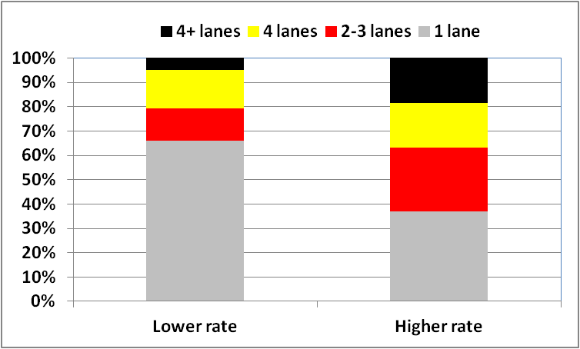
Location of fatal crashes on different road widths in US cities selected randomly for low and high crash rates
IIT Delhi 2/4/2014

Slide 15

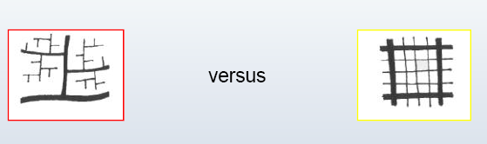

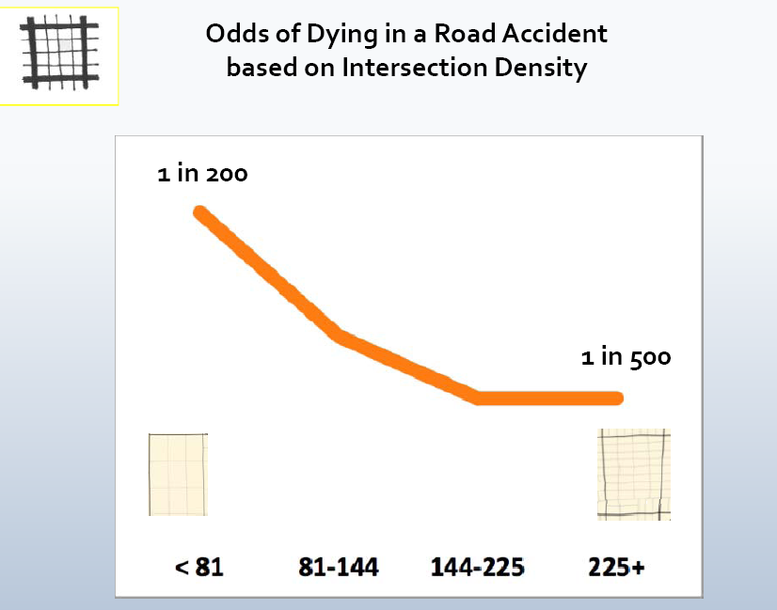
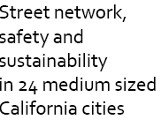
IIT Delhi 2/4/2014

Slide 16
City layout, design of buildings, and zonal regulations have to ensure that all parts of the city experience human activity and increased interaction at all times
All neighborhoods integrate the
presence of homes, work places, shopping, leisure
activity and entertainment
Buildings should not be hidden behind boundary walls, fences, and hedges
Separated car traffic creates a barrier and a no-mans land, empty pedestrian and bicycle routes and empty public transit stops at night, as well as large parking facilities, tunnels and overpasses with even more fear of crime.
IIT Delhi 4 February 2014

Slide 17
There is an urgent need for the linking-up of transport planning and urban design, public health and transport safety, well-being and the built environment
Natural surveillance is defined as the ability to see and be seen within the urban space and it refers to designing strategies that seek to increase visibility of a space by using appropriate location, window design, lighting, and landscaping, among other actions.
Urban vehicle speeds have to be controlled by appropriate road design. The design approaches include: pro- vision of wide pedestrian paths and segregated bicycle lanes on all arterial roads
IIT Delhi 4 February 2014

Slide 18
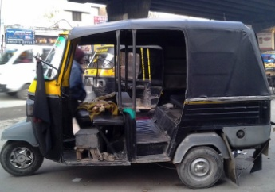
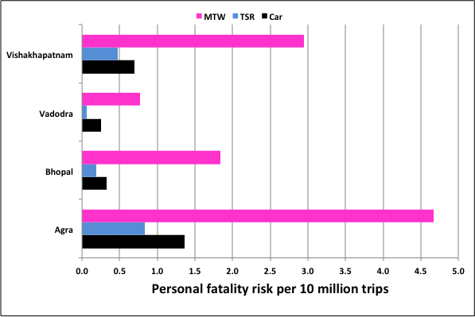
Personal risk estimate
Assumption - occupants per vehicle per day
MTW-4 TSR-60 Car-7
Mohan, D, Tiwari, G, Mukherjee, S 2013
IIT Delhi 4 February 2014

Slide 19
Vehicle role - societal level, adjusted for exposure
Mohan, D, Tiwari, G, Mukherjee, S 2013
IIT Delhi 4 February 2014

Slide 20
Safe roads a precondition for the future low CO2 city
Children, elderly, walking speed ~ 0.8 m/s
Pedestrian green phase < 30 s
Therefore, motorised lanes < (30 X 0.8) = < 24 m
Shops and/or street vendors by design
City blocks ~ 800 m square
Maintain urban average speeds at 15 km/h
Public transit on surface

Slide 21
Safe roads a precondition for the future low CO2 city
Fatality rate not solely determined by road & vehicle design, enforcement, income levels or city size
RTI fatality rates can vary by a factor of 3-5 among cities of similar size and income
City street structure and urban form - significant effect on RTI fatality rates
Cities with a higher proportion of wide streets and low density road networks appear to have a much higher RTI fatality rate
Urban safety a necessary condition for control of global warming
IIT Delhi 2/4/2014

Slide 22
IIT Delhi 4 February 2014

Slide 23
IIT Delhi 4 February 2014

Slide 24
IIT Delhi 4 February 2014

Slide 25
IIT Delhi 4 February 2014

